Slide 1
Proposed MAC Motions
September 17, 2014

Slide 2
Motions in July Meeting

Slide 3
Motion 1: Frame
Frame: the structure is defined as the following periods in order
  Synchronization period, Discovery period, Peering period, Contention Access period, and Contention Free period.
  The duration of a frame is also the synchronization interval which is fixed with a value of TBD.
  The duration of each period is fixed and the values are TBD.

Slide 4
Motion2: Working Assumptions for a Superframe
Superframe: contains multiple frames which will be considered as an optional feature on the condition that the following are proved
  Creating and maintaining Superframe can be performed with reasonable overhead.
  Creating and maintaining Superframe over a large area is possible especially with multi-hop.
  Not having the knowledge about the Superframe structure does not affect a PD’s capability of discovery and peering.
  Having Superframe structure provides substantial benefit that outweighs the overhead required to create and maintain Superframe.

Slide 5
Motion 3:
Synchronization Procedure
Synchronization Procedure includes the following sub-procedures:
  Initial Synchronization procedure
  Maintaining Synchronization procedure
  Re-Synchronization procedure
A PD starts Initial Synchronization procedure if the PD does not have its own reference timing.
  e.g. when the PD powers on, etc.
After successful Initial Synchronization procedure, a PD makes a transition to Maintaining Synchronization procedure.
A PD may make a transition to Re-synchronization procedure from Maintaining Synchronization procedure according to a triggering condition.
  TBD: a triggering condition

Slide 6
Motion 4:
Initial Synchronization
To acquire a reference timing, a PD scans for the existing synchronization signals during a TBD time.
If it detects the synchronized condition, it derives its own timing from the detected synchronization signal.
  The synchronized condition is determined from a synchronization signal or multiple synchronization signals with the same timing detected during the scanning period.
If it detects multiple synchronization signals with different timing during the scanning period, it performs a synchronization procedure based on the timings derived from the detected synchronization signals.
  The synchronization procedure includes at least adjusting its own timing based on the derived timings.
If it fails to detect any synchronization signal, it starts to send synchronization signal with its own timing.

Slide 7
Motion 5:
Maintaining Synchronization
A PD maintains its own timing reference based on measurement of synchronization signals.
Maintaining Synchronization procedure includes at least fine adjustment of timing reference and triggering of Re-Synchronization procedure.
  If unsynchronized condition for fine adjustment is met, it adjusts its own timing based on the detected synchronization signal during Synchronization period.
  If unsynchronized condition for Re-Synchronization is met, it makes a transition to Re-Synchronization procedure.
  TBD: details of unsynchronized conditions

Slide 8
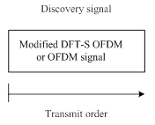
Motion6: PHY Discovery Signal
Discovery signal is transmitted via UWB, OFDM, or DFT-S OFDM .
DFT-S OFDM or OFDM
  Discovery information bits are mapped onto one or more discovery resource blocks (DRBs). The preambles are included (not shown).
  A Discovery Resource Block comprises one or multiple of time resources or time and frequency resources.
UWB (TBD)
Fairness
  PDs

Slide 9
Motion7: Information for Discovery
For the purpose of discovery of PDs, the discovery information represents one or more of the following IDs
  Device ID, Device Group ID, Application type ID, Application-specific ID, Application-specific user ID, Application-specific group ID.
The discovery information is not limited to IDs mentioned above.

Slide 10
Motion8: Discovery Type
The Discovery type is defined by a higher layer.
The MAC messages should support at least the following discovery types:
Advertisement: In Advertisement type discovery, a PD broadcasts its own discovery information and does not expect responses.
Publish/Subscribe: In Publish/Subscribe type discovery, a PD broadcasts its own discovery information and expects responses from PDs that have discovered the broadcast message(s).
Query/Reply: In Query/Reply type discovery, a PD broadcasts the discovery information of the PD or PDs being queried and expects a response or responses from the PD or PDs, accordingly.

Slide 11
Motion9: MAC Discovery Messages
MAC shall support at least the following discovery messages:
Discovery Request message
Discovery Response message

Slide 12
Motion10: Re-Synchronization
It performs a synchronization procedure based on the timings derived from the detected synchronization signals.
  The synchronization procedure includes at least adjusting its own timing based on the derived timings.

Slide 13
Motion11:
Peering /Re-peering/De-peering
MAC shall support the following procedures:
Peering
Re-peering
De-peering
Peering is the procedure to establish a link between a pair of PDs or links among multiple PDs discovered during the discovery procedure.
Re-peering is the procedure to re-establish a link between a pair of PDs or links among multiple PDs which peered previously. In the re-peering procedure, peering may be simplified.
De-peering is the procedure to disconnect the link established by peering.

Slide 14
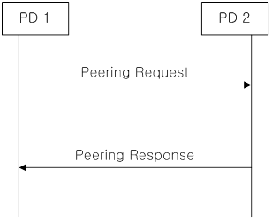
Motion12: Peering Messages
MAC shall support the following peering messages:
Peering Request message
Peering Response message

Slide 15
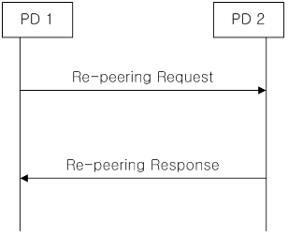
Motion13: Re-peering Messages
MAC shall support the following re-peering messages:
Re-peering Request message
Re-peering Response message

Slide 16
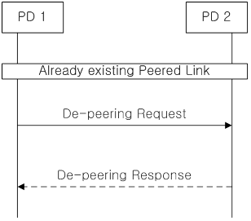
Motion14: De-peering Messages
MAC shall support the following De-peering messages:
De-peering Request message
De-peering Response message

Slide 17
Motion15: Peering Procedure
The peering procedure is initiated by sending a peering request message including peering information.
Responder shall send a peering response message to requestor to indicate whether the peering request is accepted or rejected.
The response message may include peering information if the request is accepted.

Slide 18
Motion16: Re-peering Procedure
Re-peering procedure is similar to peering procedure. The main differences are:
  1) some of the previous peering information may not be included in request and response messages;
  2) the PD receiving the re-peering request validates re-peering information with the corresponding peering information before it accepts the re-peering request.
  TBD: parameters for validation may be Peering IDs, or Link IDS, etc.

Slide 19
Motion17: De-peering Procedure
De-peering procedure starts with a de-peering request. De-peering response is optional.

Slide 20
Motion18: Working Assumption
PHY Peering Procedure
The following proposals are working assumptions and the final procedure is TBD.
ETRI: PPDU Format for Peering Request in PSDU
NICT: the peering request is implemented as Random Access Preamble illustrated

Slide 21
Motion19:
Communication Period
Communication period comprises Contention Access period (CAP) and Contention-free period (CFP).
  CAP is located prior to CFP in a Frame.
  The durations of CAP and CFP are fixed.
Unicast, multicast, or broadcast data packets are transmitted during Communication period.
Control packets may be transmitted during Communication period.
  E.g. Control packets for scheduling, group management, etc.

Slide 22
Motion20: CAP
A PD transmits control/data packets during CAP period using the following access scheme:
  LBT (Listen-before-Talk)
  CSMA-CA
  The conditions to increase Contention Window (CW) are TBD:
    For example:
      when it does not receive an ACK after transmitting a unicast packet and
      when it detects a collision after transmitting a multicast/broadcast packet.
  The conditions to decrease Contention Window (CW) are TBD.
    For example:
      when detecting no collision for TBD time.
  Any further enhancement is not limited.

Slide 23
Motion21: CFP
CFP comprises Scheduling Request period, Scheduling Response period, Resource slots (RSs).
Only a PD with Link ID shall exchange Scheduling Request and Scheduling Response messages.
The scheduled PD transmits one or more data packets in scheduled RS(s).
Any further enhancement is not limited.
TBD: Other possibilities to reuse RS by non-scheduled PDs.

Slide 24
Motions in September Meeting

Slide 25
Motion 22: Discovery Request Message
    Discovery Request Message shall include source address. Source address type and length are TBD.
    Moved: Huan-Bang Li
    Second: Marco Hernandez
    Yes: 6
    No: 0
    Abstain: 0

Slide 26
Motion 23:
Multi-hop Support
Background
  For the sake of progress and to avoid layer-violation,
Proposed Motion
  Any identification, context or etc. to represent multi-hop link is not specified.
  Any procedure to establish and manage multi-hop link is not specified.
  Other possibilities to support multi-hop protocol in higher layer is not limited and needs further discussion.

