Slide 1
Proposed MAC Synchronization
Ad Hoc PM1 (7/16)
AM1 (7/17)
Doc: 15-14-0458-00-0008
July 17, 2014

Slide 2
Discussion (ad hoc on 7/15)
Synchronization (stated on 7/15)
  If PD detects the existing synchronization signal, it refers the timing of the sync-signal,
  Otherwise, it starts to send synchronization signal with the own timing
Synchronization (updated on 7/16)
  To acquire a synchronization, a PD scans for the existing synchronization signal.
    If it detects the synchronization signal, it performs the synchronization procedure to be synchronized with the detected synchronization signal.
    If it fails to detect any synchronization signal, it starts to send synchronization signal with the own timing

Slide 3
ETRI & Samsung

Slide 4
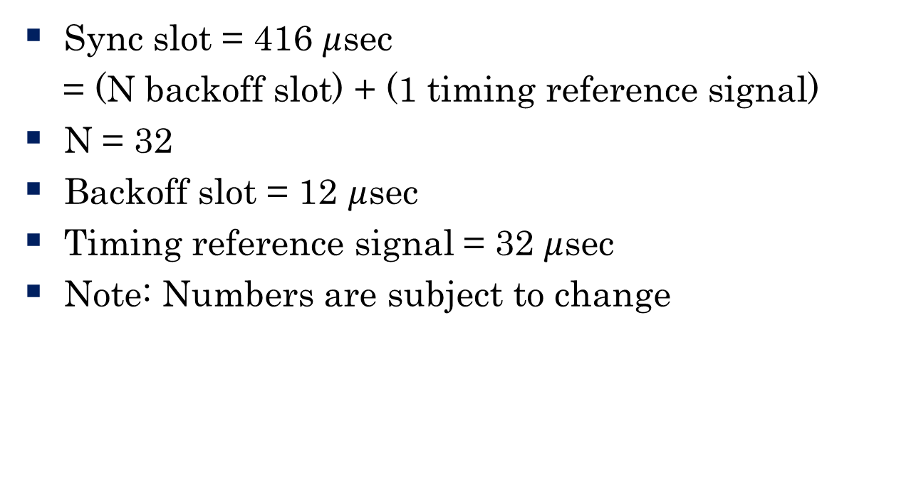
ETRI (doc 15-14-0249r2): Structure of Sync Slot
Sync slot = 416 $μ$sec
= (N backoff slot) + (1 timing reference signal)
N = 32
Backoff slot = 12 $μ$sec
Timing reference signal = 32 $μ$sec
Note: Numbers are subject to change

Slide 5
ETRI: Design Strategy of Random Access Based on CSMA/CA for Sync
Adaptive
  If # PDs large → large CW
  If # PDs small → small CW
Update strategy of CW
  Collision indicates CW is too small
  Missing timing reference signal indicates CW is too large
  CW update follows EIED mechanism
Fairness
  PDs broadcast their own CW sizes
  PDs update their CW size to minimize the variance of CW sizes among PDs

Slide 6
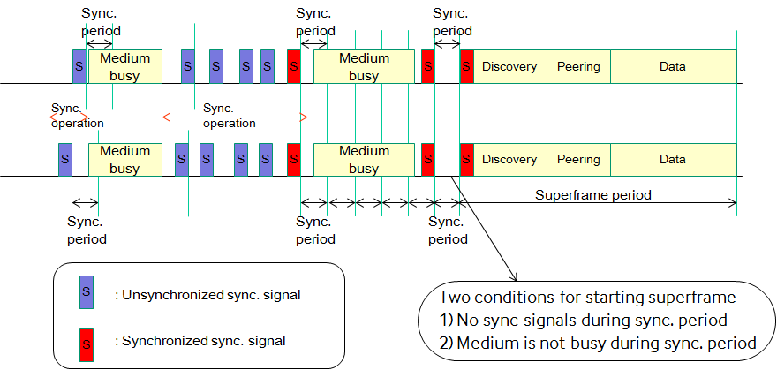
Samsung:
Three modes of synchronization
Initial Synchronization Mode
  Based on measurement of all synchronization signals, it starts initial synchronization mode if a PD detects multiple synchronization signals with different timing reference in a sync. interval.
    Otherwise it refers the timing from a synchronization signal.
  It performs distributed synchronization procedure if channel is idle, otherwise it keeps the internal cycle without sending synchronization signal.
  It transits to maintaining synchronization mode when it determines that the synchronization condition is met.
Maintaining Synchronization Mode
  It maintains the timing reference based on measurement of synchronization signals in Synchronization period
  Maintaining includes fine adjustment of timing reference.
  Asynchronous condition is periodically checked, and it transits to re-synchronization mode when multiple synchronization signals with different timing reference in a sync interval are detected.

Slide 7
Samsung:
Re- Synchronization Mode
  It performs distributed synchronization procedure if channel is idle, otherwise it keeps the internal cycle without sending synchronization signal.
  It transits to maintaining synchronization mode when it determines that the synchronization condition is met.

Slide 8
Issues
TBD
  Whether different PDs which have different synchronization algorithms can be converged.
  If this is not proven, temporarily the following procedures on how to synchronize are assumed.
    Condition: All or some PDs are transmitting synchronization signals.
    When a PD listens a synchronization signal from another PD, it adjusts the own timing based on the certain function.
      TBD: the function is same across all PDs or not.
    Requirement: PDs in the certain area should have a common timing in the required duration.

Slide 9
Motion 3:
Synchronization Procedure
Synchronization Procedure includes the following sub-procedures:
  Initial Synchronization procedure
  Maintaining Synchronization procedure
  Re-Synchronization procedure
A PD starts Initial Synchronization procedure if the PD does not have its own reference timing.
  e.g. when the PD powers on, etc.
After successful Initial Synchronization procedure, a PD makes a transition to Maintaining Synchronization procedure.
A PD may transit to Re-synchronization procedure from Maintaining Synchronization procedure according to a triggering condition.
  TBD: a triggering condition

Slide 10
Motion 4:
Initial Synchronization
To acquire a reference timing, a PD scans for the existing synchronization signals during a TBD time.
If it detects the synchronized condition, it derives its own timing from the detected synchronization signal.
  The synchronized condition is determined from that a synchronization signal or multiple synchronization signals with the same timing during the scanning period is/are detected.
If it detects multiple synchronization signals with different timing during the scanning period,
it performs a synchronization procedure based on the timings derived from the detected synchronization signals.
  The synchronization procedure includes at least adjusting its own timing based on the derived timings.
If it fails to detect any synchronization signal, it starts to send synchronization signal with its own timing.

Slide 11
Motion 5:
Maintaining Synchronization
A PD maintains its own timing reference based on measurement of synchronization signals in Synchronization period.
Maintaining Synchronization procedure includes at least fine adjustment of timing reference.
If unsynchronized condition is met, it makes a transition to Re-Synchronization procedure.
  Unsynchronized condition are TBD:
    One possible case: means that the PD determines that multiple synchronization signals with different timing reference in a Synchronization interval are detected.
    Second possible case: means that the PD determines that

Slide 12
Motion 5:
Maintaining Synchronization
A PD maintains its own timing reference based on measurement of synchronization signals in Synchronization period.
Maintaining Synchronization procedure includes at least fine adjustment of timing reference and triggering of Re-Synchronization procedure.
  If unsynchronized condition for fine adjustment is met, it adjust its own timing based on the detected synchronization signal during Synchronization period.
  If unsynchronized condition for Re-Synchronization is met, it makes a transition to Re-Synchronization procedure.
  TBD: details of unsynchronized conditions

Slide 13
Motion 6:
Re- Synchronization

