Slide 1
Project: IEEE 802.15 Working Group for Wireless Personal Area Networks (WPANs)
Submission Title: Summary of Support for Ranging in 802.15.4
Date Submitted: 16 July 2014
Source: [Benjamin Rolfe] Company [BCA]
Address [PO Box 798 Los Gatos CA 95031]
Voice:[+1 408 395 7207], FAX: [Deprecated ], E-Mail:[ben @ blindcreek.com]
Re: [Development of proposals for TG4r]
Abstract: [Summary of RF-ranging as it exists in 802.15.4 as of 2014 [802.15.4-2011 + Sum(802.15.4efgjkmp)], where we are and where we can go]
Purpose: Support TGr4 in proposal development
Notice: This document has been prepared to assist the IEEE 802.15. It is offered as a basis for discussion and is not binding on the contributing individual(s) or organization(s). The material in this document is subject to change in form and content after further study. The contributor(s) reserve(s) the right to add, amend or withdraw material contained herein.
Release: The contributor acknowledges and accepts that this contribution becomes the property of IEEE and may be made publicly available by 802.15.
Ben Rolfe (BCA)
Notes:
doc.: IEEE 802.15-11/0204r0
March 2011
John Barr, JRBarr, Ltd.

Slide 2
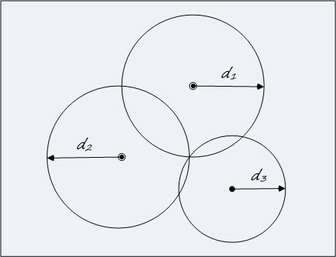
Ranging in 802.15.4 2014
Summary of Current Standard

Slide 3
Ranging and Localization
RF Ranging: Methods for determining the distance between devices via RF transmission and reception
Autonomous RF Ranging: RF ranging where which do not depend on infrastructure
Localization: Determination of position of something relative to something else.

Slide 4
Range based localization
Trilateration: Intersection of Spheres
Need a way to measure range between 2 devices
Need multiple ranges (from multiple devices)
2D need 3 circles
3D need 4 spheres

Slide 5
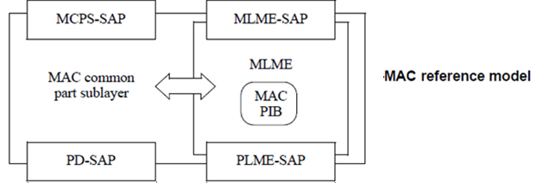
802.15.4 Reference Model
MAC Service Access Point (SAP)
MCPS : MAC Common Part Sublayer Data service
MLME : MAC Layer Management Entity service
PHY Service Access Point (SAP)
PD: PHY Data service
PLME : PHY Layer Management Entity service

Slide 6
Ranging in 15.4-2011 Overview
PHY support in 802.15.4-2011
UWB PHY provides precision ranging (added in 802.15.4a-2007)
Signal structure, bandwidth optimized for ToA measurement
Defines local timers for TX and RX time capture sub nansecond resolution.
Supports ranging on any data frame (initiated with MCPS-DATA request)
Can be used for round-trip time of flight, or single direction synchronous
MAC support
Defines attributes for PHY configuration and control (MLME-Set)
Provides for controlling ranging (enable/disable) on data exchange (MCPS-Data)
Management services for channel sounding and preamble selection (MLME) specific to the UWB PHY
Provides local timestamps to higher layer
No MAC additions to support exchange of ToA measurements
Exchange between peers “assumed” to be handled by higher layer function

Slide 7
Ranging in 802.15.4m
3 PHYs which support (non-precision) ToF
Ranging field (1-bit) in PHR
Adapted 15.4-2011 text to allow previously UWB-PHY dependent actions to be applied to use of TVWS PHYs.
Added an IEs for exchange of captured times (Timestamp IE, Timestamp Difference IE)
Added a field to the TVWS PHY-specific capabilities IE to indicate support for ranging
Adds informative annex on ranging/localization applied to operation in TVWS

Slide 8
Description
MAC provides
Primitives for performing ranging steps
Interface to PHY(s) ranging counters (ToF timers)
Supplies information to higher layer
Means to exchange data
*new in 4e* are mechanisms that support capabilities exchange, other advertisements in beacons
Hooks for initiating/managing internal calibration
PHY provides
Ranging counters: Time-stamp to high precision TX and RX times
Support for channel sounding

Slide 9
MAC Services MCPS
Introduced in 15.4a-2007:
MCPS-Data.Request parameters to control ranging
MCPS-Data.Confirm parameters to pass ranging measurement information to the higher layer
MCPS-Data.Indication includes parameters to pass ranging measurement information with received data frame

Slide 10
MAC services MLME
Introduced in 15.4a-2007:
MLME-RX-ENABLE
Added Parameter to enable Ranging measurement
MLME-DPS.request
Controls preambles used for UWNB PHY ranging
MLME-SOUNDING.request
Request PHY to return channel multi-path profile measurement
Algorithm not defined (implementation specific)
MLME-CALIBRATE.request
Supports reporting internal delay offsets
Calibration method not defined (implementation specific)

Slide 11
TG4r Opportunities
Enhance interoperability by
Adding more advanced/complete/flexible data exchange definitions to support broader methods
Various resolutions of ToF
Beyond ToF
Exchange reports between peers and ability for peers to relay neighbor reports
Exchange of processed measurements
Standard defined requirements for transformational processing
Ranging methods beyond basic time of flight
PHY enhancements to support other than ToF
MAC enhancements to support other than ToF
MAC enhancements to improve upon existing ToF
Application oriented guidance on applying standard

Slide 12
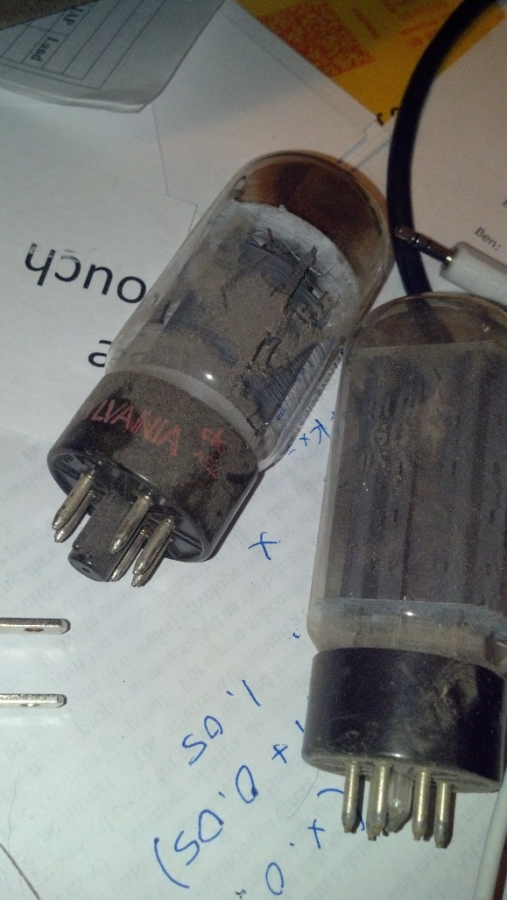
Conclusion
Several PHYs with basic support for ToF already defined
More possibilities than ToF
Not much above PHY specified
Opportunities to enhance the usefulness of the standard

