Slide 1
Project: IEEE P802.15 Working Group for Wireless Personal Area Networks (WPANs)
Submission Title: Security Threats in IEEE 802.15.8 PAC
Date Submitted: [14 July 2014]
Source: [Byung-Jae Kwak, Kapseok Chang, Moon-Sik Lee]¹,
[Sangseok Yun, Sanghun Im, Jeongseok Ha]²
Company: [ETRI, Daejeon, Korea]¹, [KAIST, Daejeon, Korea]²
Address: [218 Gajeong-ro, Yuseong-gu, Daejeon, Korea]¹, [291 Daehak-ro, Yuseong-gu, Daejeon, Korea]²
Voice: [+82-42-860-6618], [+82-42-350-7524]
E-Mail: [bjkwak@etri.re.kr]¹, [ssyun@kaist.ac.kr]²
Re:
Abstract: Discussion of the possible threats in IEEE 802.15.8 PAC from physical layer point of view.
Purpose: Discussion
Notice: This document has been prepared to assist the IEEE P802.15. It is offered as a basis for discussion and is not binding on the contributing individual(s) or organization(s). The material in this document is subject to change in form and content after further study. The contributor(s) reserve(s) the right to add, amend or withdraw material contained herein.
Release: The contributor acknowledges and accepts that this contribution becomes the property of IEEE and may be made publicly available by P802.15.

Slide 2
Security Threats in IEEE 802.15.8 PAC
July 2014

Slide 3
Introduction
This document presents potential security threats of distributed synchronization mechanism
Distributed synchronization mechanism is vulnerable to malfunction and malicious attack
  Just 1 malicious node can mess up the entire synchronization process
Some physical layer security techniques can be used to prevent these threats effectively

Slide 4
Security Issues
Confidentiality
  Messages sent over wireless links must be encrypted
Authentication
  Origin of messages received over wireless links must be verified
Integrity
  Integrity of messages received over wireless links must be verified
Confidentiality
Non-repudiation
  User cannot deny having received nor sent
Access control
  Access to the network should be provided only to legitimate entities
Availability*
  The information must be available when it is needed
Security Issues
Authentication
Integrity
Non-
repudiation
Access control
Availability

Slide 5
Security Threats in IEEE 802.15.8 PAC
Synchronization
  Malicious timing reference signal
Discovery/Peering
  Battery drain attack
Communication
  Eavesdropping

Slide 6
Synchronization
Firefly Synchronization
Timing offset
Synchronized

Slide 7
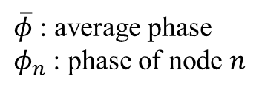
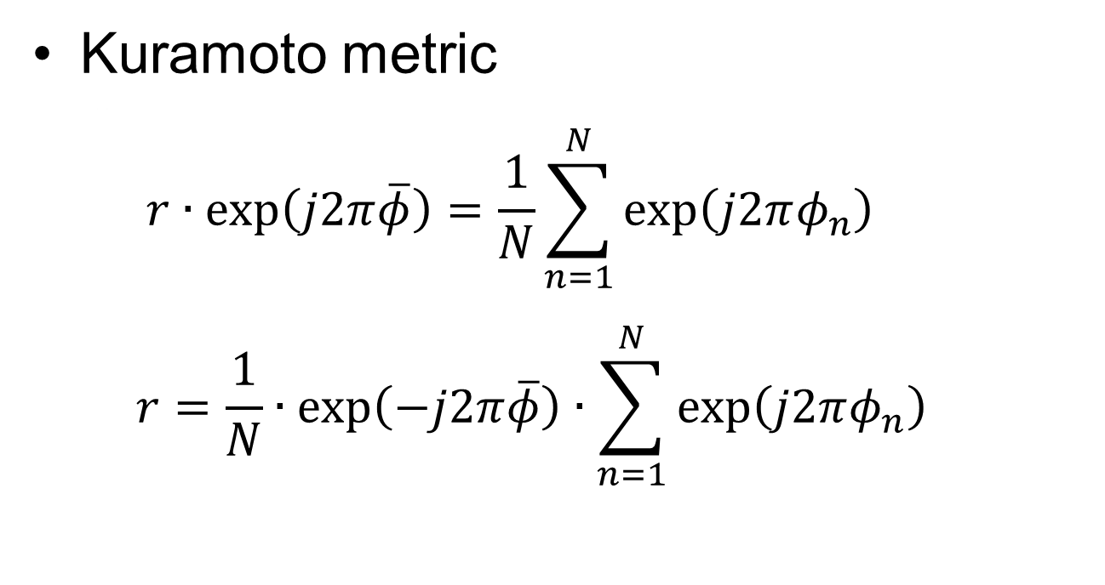
Synchronization
Kuramoto metric
  $r∙\exp\left(j2π\overline{φ}\right)=\frac{1}{N}\sum_{n=1}^{N}{\exp\left(j2πφ_{n}\right)}$
  $r=\frac{1}{N}∙\exp\left(−j2π\overline{φ}\right)∙\sum_{n=1}^{N}{\exp\left(j2πφ_{n}\right)}$
$\overline{φ}$ : average phase
$φ_{n}$ : phase of node $n$

Slide 8
Simulation Results
# of legitimate node vs. malicious node
  10 vs. 0, 9 vs. 1, 8 vs. 2
Attack model
  Static attack : Malicious nodes never adjust their phases with others. They just transmit timing reference signal according to their own clocks
  Dynamic attack : Malicious nodes change their phases randomly after transmitting timing reference signal

Slide 9
Without Malicious Nodes

Slide 10
With 1 Malicious Node: static attack

Slide 11
With 1 Malicious Node: worst case
When attacker’s phase is
slower than network slightly

Slide 12
With 1 Malicious Node

Slide 13
With 2 Malicious Nodes: static attack

Slide 14
With 1 Malicious Node: dynamic attack

Slide 15
With 2 Malicious Nodes: dynamic attack

Slide 16
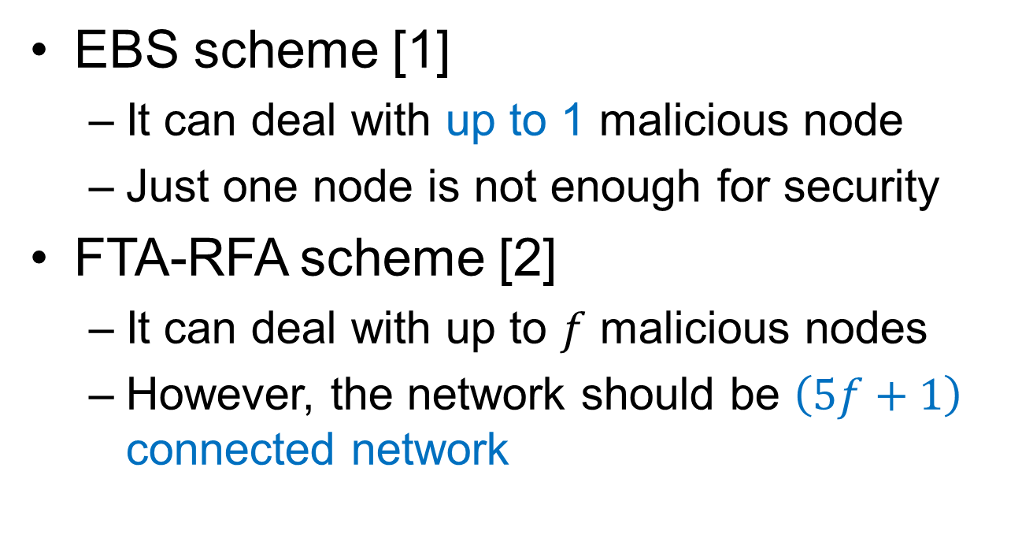
Conventional Techniques
EBS scheme [1]
  It can deal with up to 1 malicious node
  Just one node is not enough for security
FTA-RFA scheme [2]
  It can deal with up to $f$ malicious nodes
  However, the network should be $\left(5f+1\right)$ connected network

Slide 17
Physical Layer Security Technique
Ignore pulses from malicious nodes using some features of physical layer
How do you recognize timing reference signal from a malicious device?
  Ex: Signalprints
    Location-specific channel response
    Received signal strength indication

Slide 18
Malicious Node Elimination
Network synchronized
after elimination

Slide 19
Malicious Node Elimination
Network synchronized
after elimination

Slide 20
Conclusion
Disturbance from just 1 node can perturb entire network’s synchronization
Conventional approaches are not suitable for IEEE 802.15.8 PAC model
Physical layer security techniques can successfully eliminate malicious node’s attack with low complexity
Every user should have the ability to detect and eliminate an attack from malicious nodes for network stability
Some countermeasures to attacks in physical layer (not limited to the synchronization attack) should be dictated/enforced by standard due to the distributed nature of PAC

Slide 21
References
[1] P. Yadav, J. A. McCann, “EBS: decentralized slot synchronization for broadcast messaging for low-power wireless embedded systems,” ACM COMSWARE 2011, Verona, July, 2011
[2] R. Leidenfrost, W. Elmenreich, C. Bettstetter, “Fault-tolerant averaging for self-organizing synchronization in wireless ad hoc networks,” IEEE ISWCS 2010, York, Sep., 2010

