Slide 1
Project: IEEE P802.15 Working Group for Wireless Personal Area Networks (WPANs)
Submission Title: Realistic Distribution Model of PDs for PAC: Clustered Random Drop
Date Submitted: July 14, 2014
Source: Nah-Oak Song (KAIST), Junhyuk Kim (KAIST), June-Koo Kevin Rhee (KAIST),
Byung-Jae Kwak (ETRI), Kapseok Chang (ETRI), Moon-Sik Lee (ETRI)
Address: KAIST, Daejeon, Korea; ETRI, Daejeon, Korea
Voice:
E-Mail: nsong@kaist.ac.kr, kim.jh@kaist.ac.kr, rhee.jk@kaist.edu,
bjkwak@etri.re.kr, kschang@etri.re.kr, moonsiklee@etri.re.kr
Re: TG8 Technical Guidance Document (DCN 15-12-0568-08)
Abstract: This document proposes a new realistic distribution model of PDs for improved performance evaluation of PAC network. The proposed model produces a more realistic distribution of PDs compared to the conventional uniform random distribution for representing PAC network.
Purpose: Discussion and Approval.
Notice: This document has been prepared to assist the IEEE P802.15. It is offered as a basis for discussion and is not binding on the contributing individual(s) or organization(s). The material in this document is subject to change in form and content after further study. The contributor(s) reserve(s) the right to add, amend or withdraw material contained herein.
Release: The contributor acknowledges and accepts that this contribution becomes the property of IEEE and may be made publicly available by P802.15.

Slide 2
Realistic Distribution Model of PDs for PAC:
Clustered Random Drop
July 2014

Slide 3
Introduction
Clustered Random Drop was presented in May 2014 meeting (DCN 15-14-0251-01)
Background
  Uniform random drop
    Unrealistic
    Represents best case scenario
  Clustered random drop
    Realistic
    Better representation of real-world scenarios
Today: Text proposal for TGD (DCN 15-14-0411-01)

Slide 4
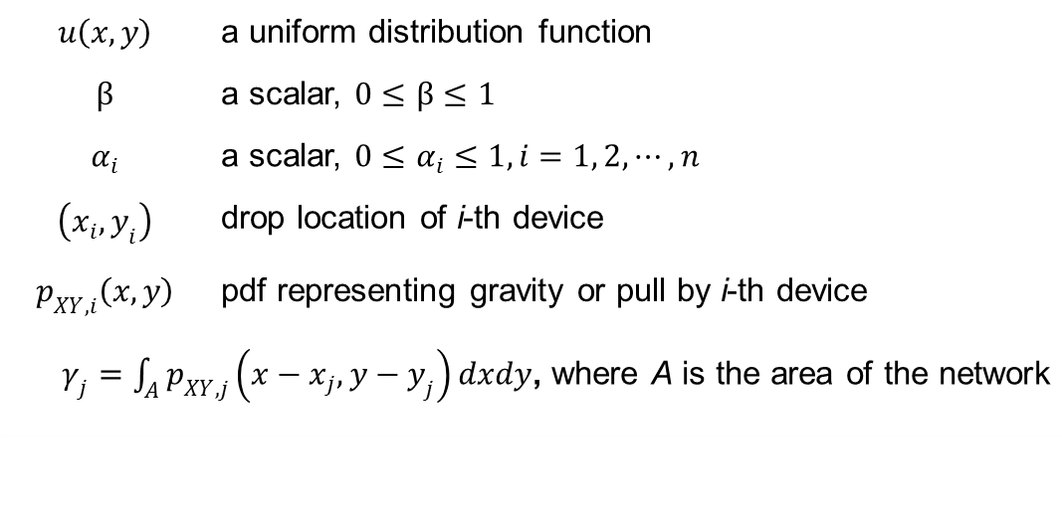

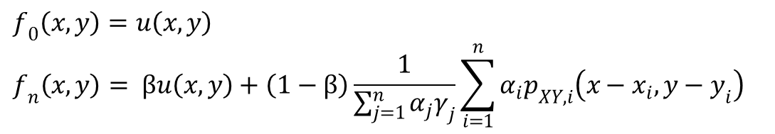
Recap the Last Meeting
$f_{n}\left(x,y\right) :$Distribution Model of PDs after dropping $n$ devices as follows:
where
$$f_{0}\left(x,y\right)=u\left(x,y\right)$$
$$f_{n}\left(x,y\right)= βu\left(x,y\right)+\left(1−β\right)\frac{1}{\sum_{j=1}^{n}{α_{j}γ_{j}}}\sum_{i=1}^{n}{α_{i}p_{XY,i}\left(x−x_{i},y−y_{i}\right)}$$
$$u\left(x,y\right)$$ | a uniform distribution function
$$β$$ | a scalar, $0≤β≤1$
$$α_{i}$$ | a scalar, $0≤α_{i}≤1, i=1, 2, ⋯, n$
$$\left(x_{i},y_{i}\right)$$ | drop location of i-th device
$$p_{XY,i}\left(x,y\right)$$ | pdf representing gravity or pull by i-th device
$γ_{j}=\int_{A}^{ }{p_{XY,j}\left(x−x_{j},y−y_{j}\right)dxdy}$, where A is the area of the network

Slide 5
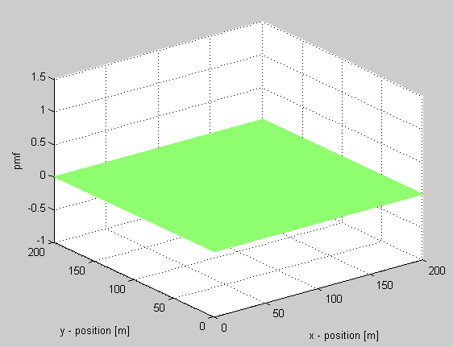
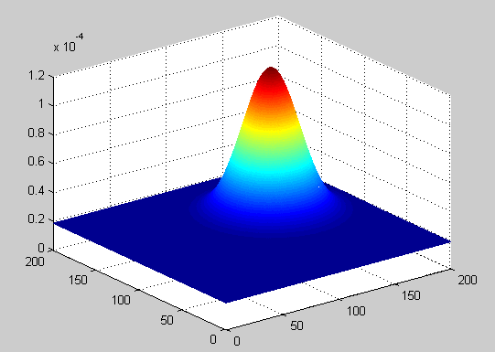
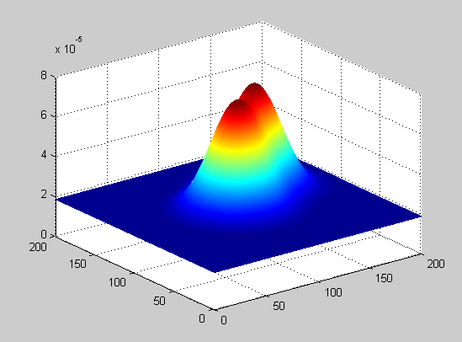
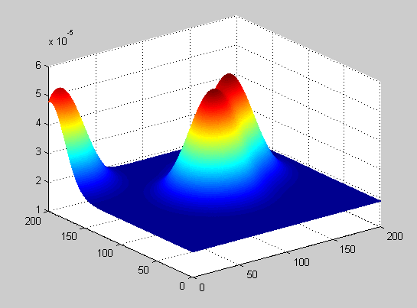
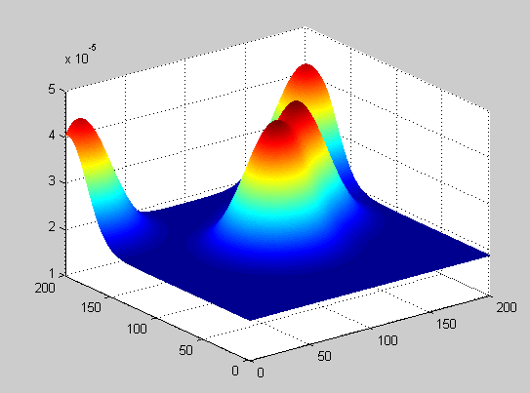
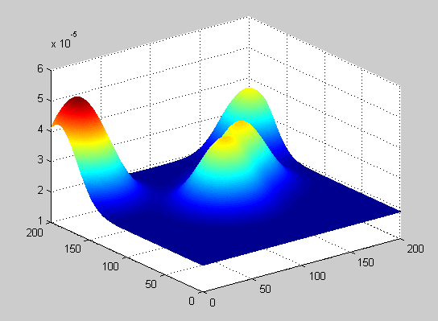
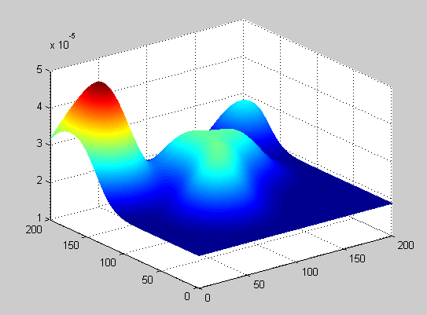
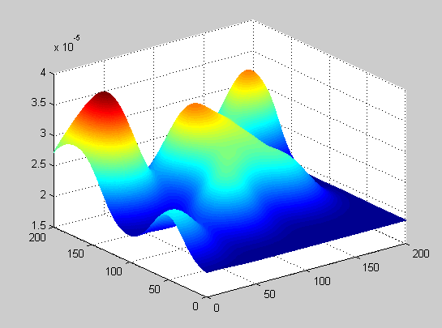
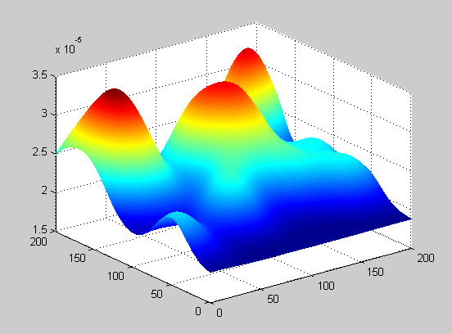
Evolution of PD Distribution
0
1
2
3
4
5
9
14
19

Slide 6
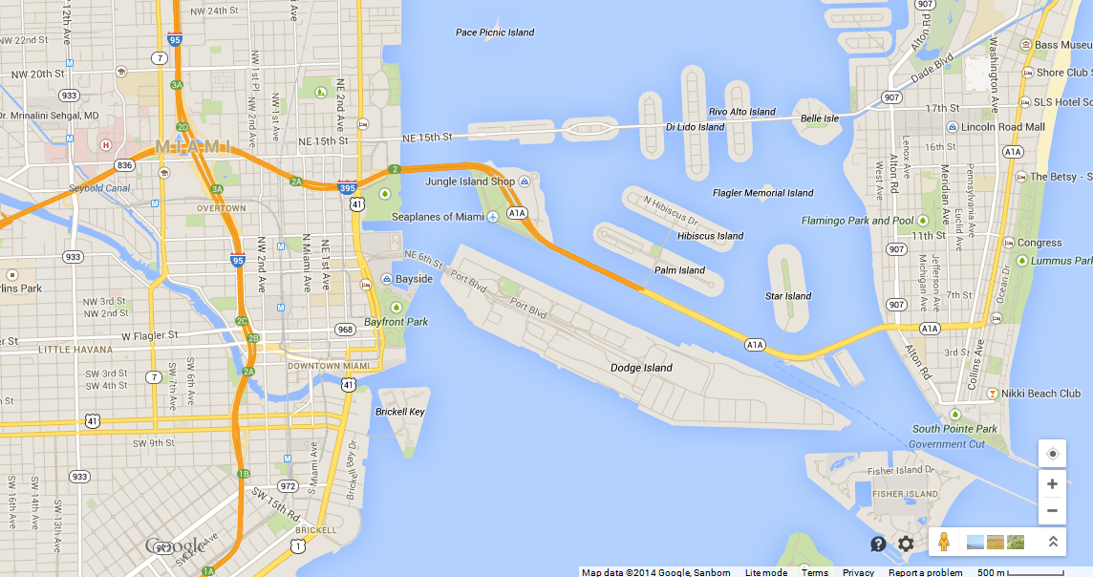
Miami Map

Slide 7
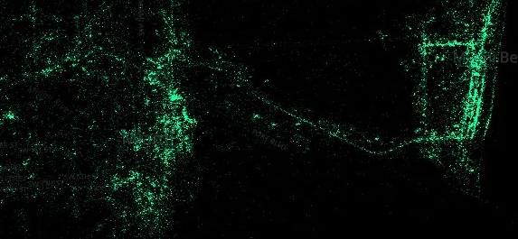
500m x 500m Area
Android Users in Miami
(Source: http://www.businessinsider.com/android-is-for-poor-people-maps-2014-4)

Slide 8




Examples of Clustered Random Drop
500m x 500m area
2000 PDs
$σ=50$m
(a) $β=0.2$
(b) $β=0.6$
(c) $β=1$

Slide 9
Source Code
Matlab source code:

Slide 10
Motion
Motion: “Approve the text proposal in DCN 15-14-0411-02-0008 to update IEEE 802.15.8 PAC TGD revision 9 (DCN 15-12-0568-09-0008) to revision 10.”
Moved by: Byung-Jae Kwak
Seconded by: SS Joo.
Voting
  Yes: 13
  No: 0
  Abstain: 1
  Result: Pass

