Slide 1
Project: IEEE P802.15 Working Group for Wireless Personal Area Networks (WPANs)
Submission Title: [Discussion on some concepts related to PAC]
Date Submitted: [July 1 2014]
Source: [Huan-Bang Li, Marco Hernandez, Igor Dotlic, and Ryu Miura] Company [NICT]
Address [3-4 Hikarino-oka, Yokosuka, Kanagawa, Japan]
Voice:[+81 468475104], FAX: [:[+81 468475431], E-Mail:[lee@nict.go.jp]
Re: [Response to call for contribution of 15.8 PAC
Abstract: [Discussion on some concepts of PAC]
Purpose: [This document describe some basic concepts for merging proposals]
Notice: This document has been prepared to assist the IEEE P802.15. It is offered as a basis for discussion and is not binding on the contributing individual(s) or organization(s). The material in this document is subject to change in form and content after further study. The contributor(s) reserve(s) the right to add, amend or withdraw material contained herein.
Release: The contributor acknowledges and accepts that this contribution becomes the property of IEEE and may be made publicly available by P802.15.

Slide 2
Discussion on Some Concepts Related to PAC
Huan-Bang Li
Marco Hernandez
Igor Dotlic
Ryu Miura
National Institute of Information and Communications Technology (NICT), Japan

Slide 3
Mandatory vs. Common
Mandatory parameters are usually PHY related and defined in many standards such as 15.4 and 15.6,
Mandatory modulations
Mandatory data rate
Mandatory channel coding
In case that several different modulations, data rates are defined, common mode means the minimum commonality to be kept among devices to keep connectivity. Therefore, ‘common’ has the similar meaning as ‘mandatory’ in this aspect.

Slide 4
Common Mode in TG8 TGD
As described per TGD:
Common mode (e.g., for discovery and communication) shall be supported for interoperability.
The benefits is to save time, e.g., to start discovery, to start communication.
Common mode used in different frequency bands needs not necessarily be the same.
The benefit is the reduced complexity by allowing single frequency band implementation.

Slide 5
What Should Be In Common Mode
RF channel, modulation, channel coding, and data rate need to be defined for the common mode.
If local regulation requirements have difference for an operating frequency band, common mode is not a necessity.

Slide 6
Operation of Common Mode
Broadcasting/sending emergency message shall use the common mode.
To guarantee connectivity and rapidity.
Common mode should not be exclusive for other applications.
It is desired to use common mode for starting discovery, or for initiating a PAC group.

Slide 7
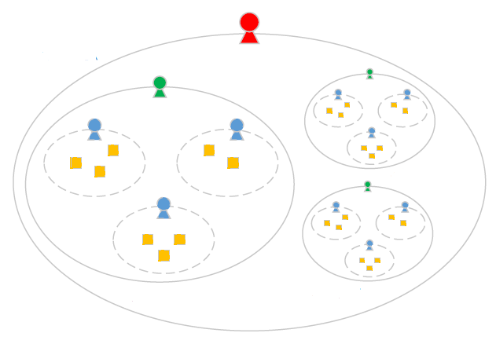
Different Levels of ‘Distributed PAC’
big leader
local leader
users
applications

Slide 8
Different levels For Synchronization
Synchronization is necessary to use frame structure
Global synchronization
How to realize for multi-hop.
Local synchronization
Easily but need to coordinate with other local groups

Slide 9
Different Levels of Leaders
Big leaders
Centralized like?
Local leaders
Fixed or alternately
No leaders
How to control, e.g., GTS

Slide 10
Distributed System
(from 802.15-08-0448-02-0006)
temporary control
(dynamic organization)
C
S₂
System A
System B
System C
Application
S₁
S₄
Distributed control, i.e. middleware architecture
S₃
Local system control (HW, OS)
Local system control (HW, OS)
Local system control (HW, OS)
Communication network

Slide 11
Self-Organized System
(from 802.15-08-0448-02-0006)
Local interactions (environment, neighborhood)
C
S₁
C
Local system control
S₂
C
C
S₃
S₄
Simple local behavior
C
S₅
C
S₆

Slide 12
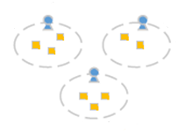
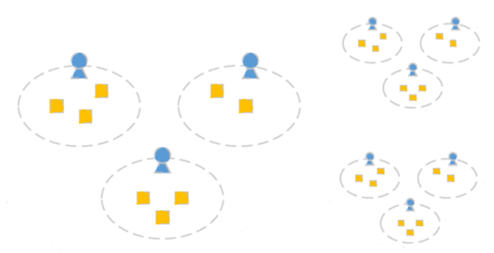
Distributed Local Temporary Control
Temporary
control

Slide 13
Latency vs. Connectivity
Low latency is one of the main features of PAC.
Definitely if PD are within one hop range
Difficult if multi-hops are required
Connectivity is more important in many cases
Broadcast
Advertisement
E-mail
Be aware of application!

Slide 14
Conclusion Remarks
Solutions change according to conditions
Network size (geographically or number of PDs)
Number of hops
Latency
connectivity
Need to stick with PAR and TGD

