Slide 1
Project: IEEE P802.15 Working Group for Wireless Personal Area Networks (WPANs)
Submission Title: Further Investigation on CID 201/202/235 and CID 55
Date Submitted: May 01, 2014
Source: Liang Li, Vinno; Z.W. Xie, Feng-yuan Kang, BUPT
Suite 202, Building D, No.2 Xinxi Lu, Beijing, China,
Voice: 1-949-813-7909, FAX: 1-949-813-7909,
E-Mail: liangli@vinnotech.com
Abstract: Tech Proposal for TG4n(MBAN) Task Group
Purpose: Outline accomplishments from the March 2012 meeting and planned tasks for this meetin
Notice: This document has been prepared to assist the IEEE P802.15. It is offered as a basis for discussion and is not binding on the contributing individual(s) or organization(s). The material in this document is subject to change in form and content after further study. The contributor(s) reserve(s) the right to add, amend or withdraw material contained herein.
Release: The contributor acknowledges and accepts that this contribution becomes the property of IEEE and may be made publicly available by P802.15.

Slide 2
Abstract
Discussion of frequency offset and toleration for CMB OQPSK PHY
Discussion of Rx-to-Tx and Tx-to-Rx turnround Time.
Provide the more results for CID 201/202/235 and CID 55

Slide 3
Compared to the frequency offsets in IEEE802.15.4-2006/2011
In IEEE802.15.4-2006/2011, the offsets tolerate and frequency shifts at different frequency bands for QPSK receiver:
At 2.4 GHz , +/- 40 ppm ~ →+/-96kHz,
At 900MHz , +/- 40 ppm ~ →+/- 36kHz,
For IEEE802.15.4N, the offset tolerate rates and frequency shifts are listed as :
At 195 MHz , +/- 40 ppm ~ →+/- 8kHz, +/- 30 ppm ~ → +/- 6k Hz, +/- 20ppm ~ → +/- 4 kHz
416 MHZ (497-425Mhz) , +/- 40 ppm ~ →+/- 16kHz, +/- 30 ppm ~ → +/- 12k Hz, +/- 20ppm ~ → +/- 8 kHz
619MHz (608-630 MHz) +/- 40 ppm ~ →+/- 24kHz, +/- 30 ppm ~ → +/- 18k Hz, +/- 20ppm ~ → +/- 12 kHz

Slide 4
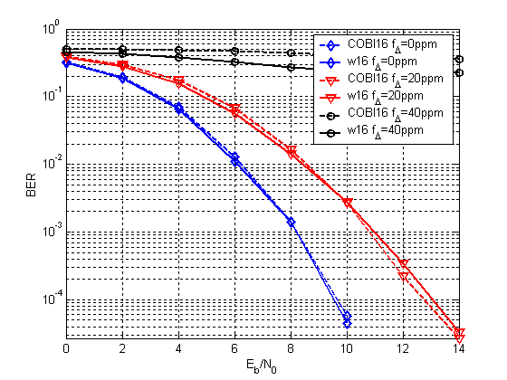
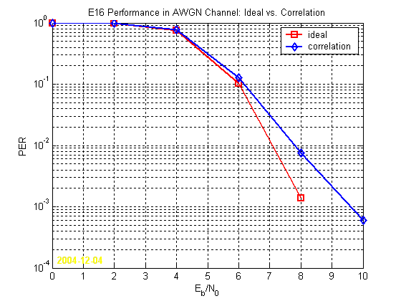
Frequency Offset Correction
Here is one simulation of PER vs SNR for different frequency offsets as correlation algorithm are applied. (copy from 15-05-0103-01-004b)
The data rate 250kb/s, 16 sequence of 4 bits mapping DSSS, Chip rate = 1Mchip/sec.
The left figure: the receiver performance ( PER-vs-Eo/No) at 0 ppm, 20 ppm and 40 ppm.
The right figure is the correlation receiver performance (PER-vs-Eo/No) with offset correlation

Slide 5
Frequency Offset Correction
IEEE802.15.4-2003 was developed in the 2003.
The frequency offset algorithms are matured for receiver operation and applied to transceiver (15.4B/4C and more)
It is easy to correct the phase errors at Baseband caused by frequency offset +/- 40ppm.

Slide 6
The Investigation on Turnaround Time(1)
Appreciate a couple of emails between Ken, James and Ben are about Turnaroundtime.
Ken describes as: “The TX-to-RX turnaround time is defined as the time at the air interface from the trailing edge of the last part/chip (of the last symbol) of a transmitted PPDU to the time that the PHY is ready to receive the leading edge of the first part/chip (of the first symbol) of the next received PPDU.”
James describes as: “Turnaround time is critical for the CSMA algorithm. ACKs are normally sent a SIFS after a frame and so a SIFS >= aTurnaroundTime. A short turnaround time generally means that the local oscillators need to locked. You need some time to cancel DC offsets in the receiver and some time to turn the PA on and off.”

Slide 7
The Investigation on Turnround Time (2)
aTurnaorundTime (Rx-to-Tx and Tx-to-Rx) of QPSK operation is defined in 8.2.1 and 8.2.2 of IEEE802.15.4-2011
The aTurnaroundTime adopted in IEEE802.15.4G is also same as the ones IEEE802.15.4-2011.
The maximum data rate (500 kb/s) and chip rate (2Mchip/s) are same in IEEE802.15.4N and 4G.
There are no reasons not to accept the different aTurnaorundTime (Rx-to-Tx and Tx-to-Rx).

Slide 8
The Investigation on Turnaround Time(3)
Discussed with several Transceiver (15.4g) Design engineers. They did not meet any troubles between Tx-to-Rx/Rx-to-Tx for current aTurnaroundTime definition.
My directive experiment on Transceiver RFIC (15.4C) also did not find difficult to implement the Turnaround too.

Slide 9
Conclusion
At three operation bands, the +/- 40 ppm frequency offset is reasonable
aTurnaorundTime (Rx-to-Tx and Tx-to-Rx) could be defined 12 symbols same as ones in IEEE802.15.4-2006 and IEEE802.15.4G

