Slide 1
Project: IEEE P802.15 Working Group for Wireless Personal Area Networks (WPANs)
Submission Title: Real usage of the kiosk downloading
Date Submitted: 13 May, 2014
Source: Ken Hiraga, Masashi Shimizu, Toshimitsu Tsubaki, Hideki Toshinaga and Tadao Nakagawa
Company: NTT corporation
Address: Hirarinooka 1-1, Yokosuka Japan
Voice:+81-46-859-3474, FAX: +81-46-855-1497, E-Mail:hiraga.ken@lab.ntt.co.jp
Re: []
Abstract: This document describes one of the up-and-coming usages of the kiosk downloading
Purpose: To clarify the usage model of the kiosk service.
Notice: This document has been prepared to assist the IEEE P802.15. It is offered as a basis for discussion and is not binding on the contributing individual(s) or organization(s). The material in this document is subject to change in form and content after further study. The contributor(s) reserve(s) the right to add, amend or withdraw material contained herein.
Release: The contributor acknowledges and accepts that this contribution becomes the property of IEEE and may be made publicly available by P802.15.

Slide 2









Our Target Usage Models
We are focusing on the usage of 60-GHz communications with ultra-short-range (non-contact) communication.
The total contact time must be less than 1 second.
  Fast link establishment is required: less than around 100 msec.
High Speed Download Service
Public use
Local use
Authentication
Audio and Video equipment
⇔ mobile terminal
Throughput >2Gbps
Range < 5cm
Content Holder
movie
Throughput >2Gbps
Range < 5cm
Home GW
Kiosk
Notes:
2013年11月会合で話した

Slide 3
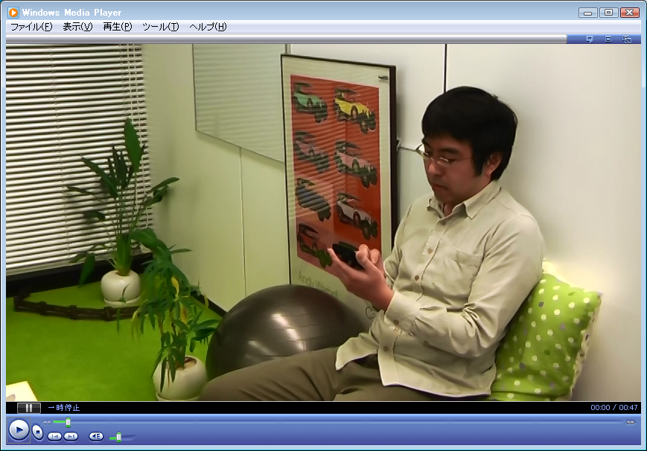

A prototype of High Speed Download Service System using current 60GHz Wi-Fi module
After the last Dallas meeting, we prototyped system with current 60 GHz Wi-Fi (WiGig) module.
It takes a few second for the initial link setup (association and authentication).

Slide 4
Real touch and get
  The total contact time have to be less than 1 second.
  We need a fast link establishment (<100 msec).
Video on YouTube: “Automatic ticket gates keep screaming,” by sknb, http://youtu.be/_r5rjvjquzY
This video shows busy toll gates in the train station in Japan, where NFC tickets to ride train are widely used to pay fares.
Our goal of the download service is to get Gbytes-class content with instantaneous touch action just like this gate.

Slide 5
Conclusion
The up-and-coming usage of the kiosk in the 60-GHz band and the requirements are presented.
Our goal of the download service is to get Gbytes-class content with instantaneous touch action just like this gate.
After the last Dallas meeting, we prototyped system with current 60 GHz Wi-Fi (aka WiGig) module.

Slide 6
backup

Slide 7
Our Target Usage Models
We are focusing on the usage of 60-GHz communications with ultra-short-range (non-contact) communication.
The total contact time must be less than 1 second.
High Speed Download Service
Public use
Local use
Authentication
Audio and Video equipment
⇔ mobile terminal
Throughput >2Gbps
Range < 5cm
Content Holder
movie
Throughput >2Gbps
Range < 5cm
Home GW
Kiosk
  We need a fast link establishment (<100 msec).
Notes:
2013年11月会合で話した

