Slide 1
Project: IEEE P802.15 Working Group for Wireless Personal Area Networks (WPANs)
Submission Title: [Proposal on Updating PAR Draft for Spectrum Resources Usage in WPANs]
Date Submitted: [9 May 2014]
Source: [Masayuki Ariyoshi]
Company [Advanced Telecommunications Research Institute International (ATR)]
Address [2-2-2 Hikaridai, Seika-cho, Kyoto 619-0288 Japan]
Voice:[+81-774-95-1141], FAX: [ ], E-Mail:[ariyoshi@atr.jp]
Re: []
Abstract: [This document provides a proposal for updating PAR draft for SRU in WPANs.]
Purpose: [For SG discussions]
Notice: This document has been prepared to assist the IEEE P802.15. It is offered as a basis for discussion and is not binding on the contributing individual(s) or organization(s). The material in this document is subject to change in form and content after further study. The contributor(s) reserve(s) the right to add, amend or withdraw material contained herein.
Release: The contributor acknowledges and accepts that this contribution becomes the property of IEEE and may be made publicly available by P802.15.

Slide 2
Proposal on Updating PAR Draft
for Spectrum Resources Usage in WPANs
Authors:
Name | Affiliations | Address | Phone | email
Masayuki Ariyoshi | Advanced Telecommunications Research Institute International (ATR) | 2-2-2 Hikari-dai, Seika-cho, Kyoto 619-0288 Japan | +81-774-95-1141 | ariyoshi@atr.jp
Shoichi Kitazawa |  |  |  | kitazawa@atr.jp
Mineo Takai | Space Time Engineering | 609 Deep Valley Dr Rolling Hills Estate, CA 90274 | +1.310.265.4441 | mineo@spacetime-eng.com
Shusaku Shimada | Schubiquist Technologies Guild | 1-28 Nishiarai Chuo-shi Yamanashi, 409-3802 Japan | +81-55-274-1266 | shusaku@ieee.or
Mitsuru Iwaoka | Yokogawa Electric Corporation | 2-9-32 nakacho, Musashino-shi, Tokyo 180-8750 Japan | +81-422-52-5519 | Mitsuru.Iwaoka@jp. yokogawa.com

Slide 3
Summary
This contribution proposes to update the PAR for SRU by clarifying the target.
The main scope would be narrowed down to Radio Resource Measurement for WPANs.
Specifications for management stuff could be pushed back as the next step.
We aim at finalizing the PAR during this May meeting.

Slide 4
Outline
Background
  Revisiting the assumed use cases
  Radio Resource Measurement and Management as formerly studied functions
Modified scope for SRU PAR
Proposed updates on the PAR

Slide 5
Use Case: Medical/Health-care
Numerous nodes generate a variety of application traffic in different required quality and data size.
Based on measured information about radio resources usage, the radio channels and resources are appropriately allocated so that more important applications can run in practical quality.
A Use Case of Self-Organizing Wireless Network for Medical System(15-13-0306r0)

Slide 6
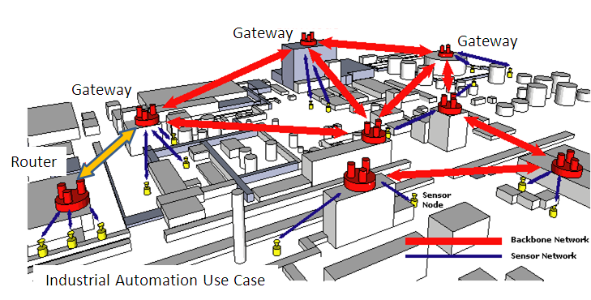
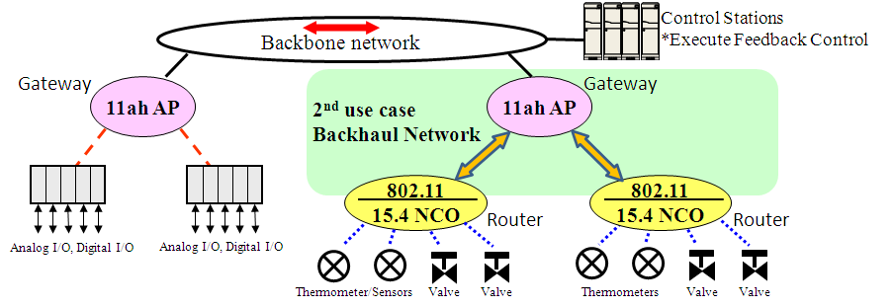
Use Case: Flexible Deployment of Industrial Wireless Network
Quick additional deployment
Quick withdrawal, relocation
Inexpensive and reusable
Additional
Temporal network deployment
Episodic/Unexpected traffic
Disaster responsiveness
Emergency action
to prevent accident
Gateway
Additional use case of temporal and flexible industrial network deployment (15-13-0654r1)

Slide 7
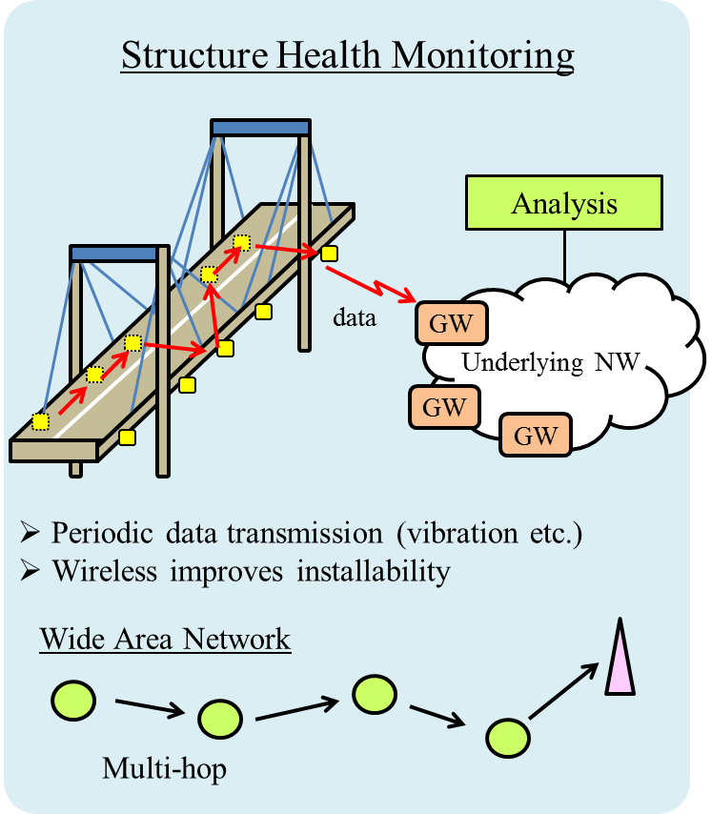
Use Case: Infrastructure Monitoring
Application Server
Status Management
network condition
(maximum data rate, …)
desired QoS
(data rate, delay, ...)
Radio Resource
Management Entity
Optimization Function
measurement result
(interference, battery, …)
communication parameters
(interval, topology, ...)
Wireless Node
Radio Resource
Measurement
Configuration
Modification
Proposal of radio resource management architecture(15-13-0285r1)

Slide 8
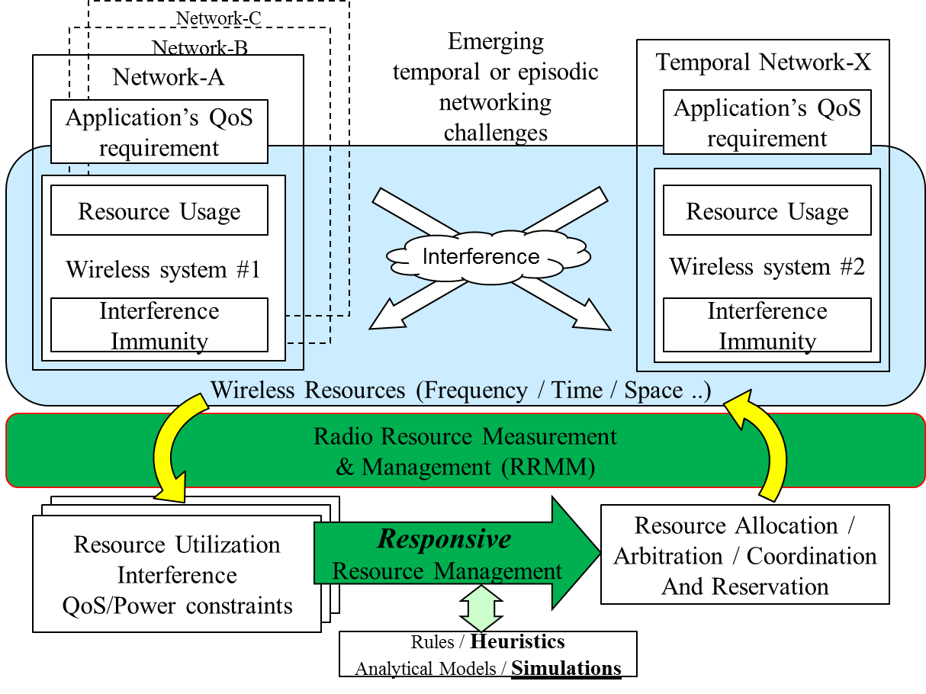
Radio Resource Measurement and Management
Additional use case of temporal and flexible industrial network deployment (15-13-0654r1)

Slide 9
Key Functions for RRMM
Measurement related functions:
  An enhanced function on the Receiver Energy Detection defined in 802.15.4
  A function to get knowledge about radio resource utilization ratio, which can be calculated from channel load information
  Measurements for QoS related metrics, including packet error rate and delay
  Measurements for link quality related metrics, including RSSI and LQI
Management functions:
  Advanced channel selection for optimizing spectrum resources utilization for WPANs, such as adaptive frequency selection
  Transmit power control
  Intelligent radio resource control within the operating PAN
Messaging for collecting/distributing information
  Collecting/exchanging the measured information to/with PAN coordinator
  Conveying management commands/information

Slide 10
Modified Scope for SRU PAR
In Scope:
  Radio resource measurement functions
  Information elements and data structures for radio resource measurements
  Procedures for collecting and exchanging the radio resource measurement information to/with PAN coordinator
Out of Scope:
  Radio resource management functions and algorithms
  Example procedures for the management based on the measurements may appear in Annex
Rationale for the change:
  Measurement and management should be independently specified, as there may be several combinations of measurement and management
  Shorten the standard development period for quicker publication

Slide 11
Proposed Updates on SRU PAR (1/4)
Project Number:
  802.15.4? (to be assigned by IEEE-SA)
Title:
  [r3] Amendment: Radio Resource Measurement and Management Interface and Data Structures for Efficient Spectrum Resources Usage in WPANs
  [update] Amendment: Radio Resource Measurement Mechanisms for Efficient Spectrum Resources Usage in WPANs
Approximate number of people expected:
  [r3] 30 → [update] 20

Slide 12
Proposed Updates on SRU PAR (2/4)
Scope:
  [r3] This amendment to IEEE Std 802.15.4 defines logical interface and supporting data structures used for information exchange for radio resource measurement and management.
  [update] This amendment to IEEE Std 802.15.4 defines radio resource measurement mechanisms for efficient spectrum resource utilization in WPANs. It specifies:
    radio resource measurement functions;
    information elements and data structures for the radio resource measurements; and
    procedures for collecting and exchanging radio resource measurement information to/with PAN coordinator.

Slide 13
Proposed Updates on SRU PAR (3/4)
Purpose:
  [r3] The purpose of this standard is to define radio resource measurement and management interfaces and data structures in 802.15.4 WPANs that will facilitate efficient spectrum resources usage in WPAN operational frequency bands.
  [update] The purpose of this standard amendment is to define radio resource measurement mechanisms in 802.15.4 WPANs. The specified radio resource measurement mechanisms will facilitate management functions in WPAN so that it can efficiently operate in spectrum resource usage.

Slide 14
Proposed Updates on SRU PAR (4/4)
Need for the project:
  [r3] As various wireless systems are deployed in the shared and license exempt frequency bands including 2.4GHz and 915MHz bands, heavy interference has been occurred that limits the performance of the wireless systems. In order for these wireless systems to operate in better quality, a standardized set of interfaces and data structures is needed for radio resource measurement and management to achieve more efficient spectrum resource utilization.
  [update] As various wireless systems are deployed in the shared and license exempt frequency bands including 2.4GHz and 915MHz bands, heavy interference has been occurred that limits the performance of the wireless systems. In order for these wireless systems to operate in better quality, a standardized set of radio resource measurement mechanisms is needed which will facilitate management functions in WPAN to achieve more efficient spectrum resource utilization.

Slide 15
References
Proposal of radio resource management architecture (15-13-0285r1)
A use case of self-organizing wireless network for medical system (15-13-306-0)
Additional use case of temporal and flexible industrial network deployment (15-13-0654r1)
Initial proposal on drafting PAR for Spectrum Resources Usage in WPANs (15-13-0550r1)
SRU working draft PAR (15-13-0615r4)
Working draft of SG SRU CSD (15-14-0175r1)
SG SRU technical guidance document (15-14-0176r0)

