Slide 1
Project: IEEE P802.15 Working Group for Wireless Personal Area Networks (WPANs)
Submission Title: [Reliable Multicast for PAC]
Date Submitted: [5 May 2014]
Source: [Tao Han, Chonggang Wang, Qing Li, Hongkun Li, Zhuo Chen]
Company [InterDigital Communications Corporation]
Address [781 Third Avenue, King of Prussia, PA 19406-1409, USA]
Voice:[610-878-5695], FAX: [610-878-7885], E-Mail:[Qing.Li@InterDigital.com]
Re: [ Call for Final Contributions]
Abstract: [This document presents reliable multicast schemes for 802.15.8 TG]
Purpose: [To discuss technical feasibility of the proposed reliable multicast schemes for 802.15.8 TG]
Notice: This document has been prepared to assist the IEEE P802.15. It is offered as a basis for discussion and is not binding on the contributing individual(s) or organization(s). The material in this document is subject to change in form and content after further study. The contributor(s) reserve(s) the right to add, amend or withdraw material contained herein.
Release: The contributor acknowledges and accepts that this contribution becomes the property of IEEE and may be made publicly available by P802.15.

Slide 2
Requirements
Excerpts from IEEE 802.15.8 TGD [1]:
  6.9 Multicast: “IEEE 802.15.8 may support a reliable multicast transmission including both one-hop and multi-hop cases.”
Excerpts from IEEE 802.15.8 PFD [2]:
  5.6.2 Multicast: “Multicast is a one-to-many data communication to a group or groups of PDs which may be addressed by multicast group ID(s).”

Slide 3
Motivation
  Group communication is one of the key features required for PAC, which is not fully supported by the current IEEE 802.15.
There are many multicast PAC use cases (e.g., conference meeting), as described in Application Matrix.
PAC multicast reliability needs to be provided in an efficient way.

Slide 4
Terms and Concepts
Reliable Multicast
  To provide reliable data transmission in multicast from one PD to multiple or all PDs within proximity.

Slide 5
Definitions
  CFP: Contention Free Period.
  CAP: Contention Access Period

Slide 6
MAC Multicast Use Cases (1/5)
Centralized One-Hop Multicast (e.g. Live Streaming)
  The PD 1 controls all transmissions.
  Only PD 1 multicasts data.

Slide 7
MAC Multicast Use Cases (2/5)
Hybrid One-Hop Multicast (e.g. Conference Meeting)
  The PD 1 controls all transmissions..
  PDs can directly multicast data.

Slide 8
MAC Multicast Use Cases (3/5)
Distributed One-Hop Multicast (e.g. Group Chat)
  PDs manage themselves.
  PDs can directly multicast data.

Slide 9
MAC Multicast Use Cases (4/5)
Centralized Multi-Hop Multicast (e.g. Live Streaming)
  PD1 controls all transmission.
  Only PD 1 multicast data.

Slide 10
MAC Multicast Use Cases (5/5)
Hybrid Multi-Hop Multicast (e.g. Conference Meeting)
  PD 1 control all the multicast.
  PDs can directly multicast data.

Slide 11
MAC Multicast Reliability Management
    Multicast Reliability Management
      Manage multicast reliability to provide context-aware flexible reliability of multicast.
    Context-Aware Flexible Multicast Reliability
      Using different ACK policies between the sender PD and receiver PDs to achieve multicast reliability in more efficient way.

Slide 12
    MAC Multicast Reliability Management (1/4)
    ACK Policy:
      All ACK: All PDs (i.e. receivers) need to send ACK.
      Any ACK: ACK is only required from any PD (i.e. receiver).
      Partial ACK: Only some PDs (i.e. receivers) send ACK.
      Location-based ACK: Only PDs around a location need to send back ACK. In this case, additional location information will be contained in this field.
      Context-based ACK: Only peers without mobility or low mobility need to send back ACK.
      Information-based ACK: Indicate if ACK is required for each packet or just for some packets or just when intended information such as a command or an event is fully decoded.

Slide 13
MAC Multicast Reliability Management (2/4)
All ACK Use Case: Conference Meeting
  PD 1-4 have an important conference meeting.
  PD 1 is the speaker who multicasts data to PD 2-4.
  PD 2-4 are required to send ACK to PD 1 to acknowledge receiving the multicast data.
  PD 1 multicasts new data only after receiving all ACKs from PD 2-4.

Slide 14
MAC Multicast Reliability Management (3/4)
Any ACK Use Case: Data Backup (Caching)
  PD 1-4 are a group of PDs running a data backup/caching application.
  PD 1 aims to backup its data in one of the PDs in its group.
  Any PDs in group can send an ACK to PD 1 to confirm the data backup.
  PD 1 multicasts new data as long as receiving one ACK from PD 2-4.

Slide 15
MAC Multicast Reliability Management (4/4)
Partial ACK Use Case: Personalized Advertisement
  PD 1 multicasts its advertisement to a group of targeted customers, PD 2-5.
  PD 1 aims to ensure at least 50% of its targeted customers receive the advertisement.
  1 or more PDs in the group can send an ACK to PD 1.
  PD 1 multicasts new data only after receiving ACKs from at least 50% of the PDs.

Slide 16
MAC Multicast Simulation

Slide 17
MAC Multicast Simulation Topology
100 PDs are randomly distributed in the blue circle. The radius of the circle is 40 m.
The radius of the circle indicates the transmission range of a PD.
All PDs run the same multicast application and have already associated with each other.
Only one PD broadcast data packets. The PD 0 is at the center of the blue circle and broadcast data packets to the other PDs.

Slide 18
Implemented MAC Multicast Mechanisms
    ACK Policy:
      All ACK: All PDs need to send ACK. The sender multicasts new data only after receiving all ACKs from the PDs in the multicast group.
      Any ACK: ACK is only required from any PD (i.e. receiver). The sender multicasts new data as long as receiving one ACK from the PDs in the multicast group.
      Partial ACK: Only some PDs (i.e. receivers) send ACK. The sender multicasts new data only after receiving ACKs from at least a certain percentage of the PDs in the multicast group. In the simulation, the transmitter requires to receive ACKs from at least 50% of the PDs.

Slide 19
Simulation Scenarios
Scenario 1:
  MAC Reliable Multicast Data Transmission in CFP
Scenario 2:
  MAC Reliable Multicast Data Transmission in CAP

Slide 20
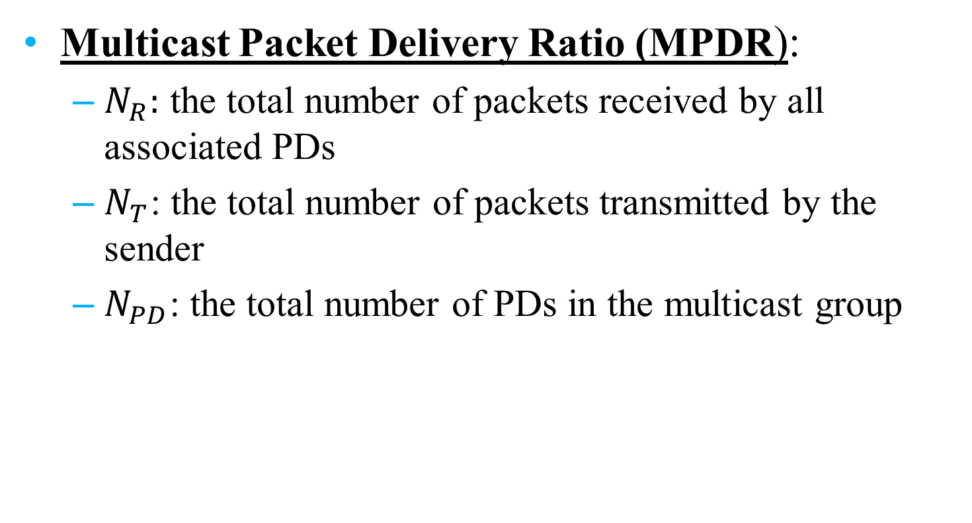

Performance Metrics (1/2)
Multicast Packet Delivery Ratio (MPDR):
  $N_{R}:$ the total number of packets received by all associated PDs
  $N_{T}$: the total number of packets transmitted by the sender
  $N_{PD}$: the total number of PDs in the multicast group
$$MPDR=\frac{N_{R}}{N_{T}×N_{PD}}$$

Slide 21
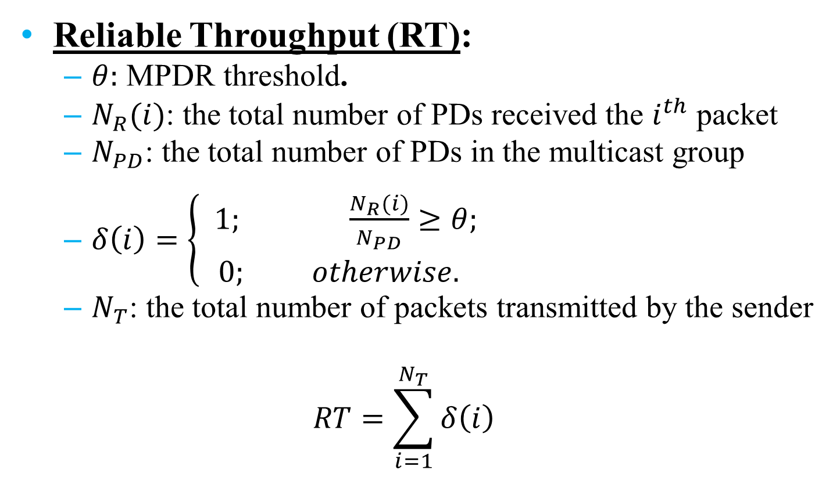
Performance Metrics (2/2)
Reliable Throughput (RT):
  $θ:$ MPDR threshold.
  $N_{R}(i)$: the total number of PDs received the $i^{th}$ packet
  $N_{PD}$: the total number of PDs in the multicast group
  $δ\left(i\right)=\left\{\begin{aligned} 1; \frac{N_{R}(i)}{N_{PD}}≥θ; \\ 0; otherwise. \end{aligned}\right.$
  $N_{T}$: the total number of packets transmitted by the sender
  $$RT=\sum_{i=1}^{N_{T}}{δ\left(i\right)}$$

Slide 22
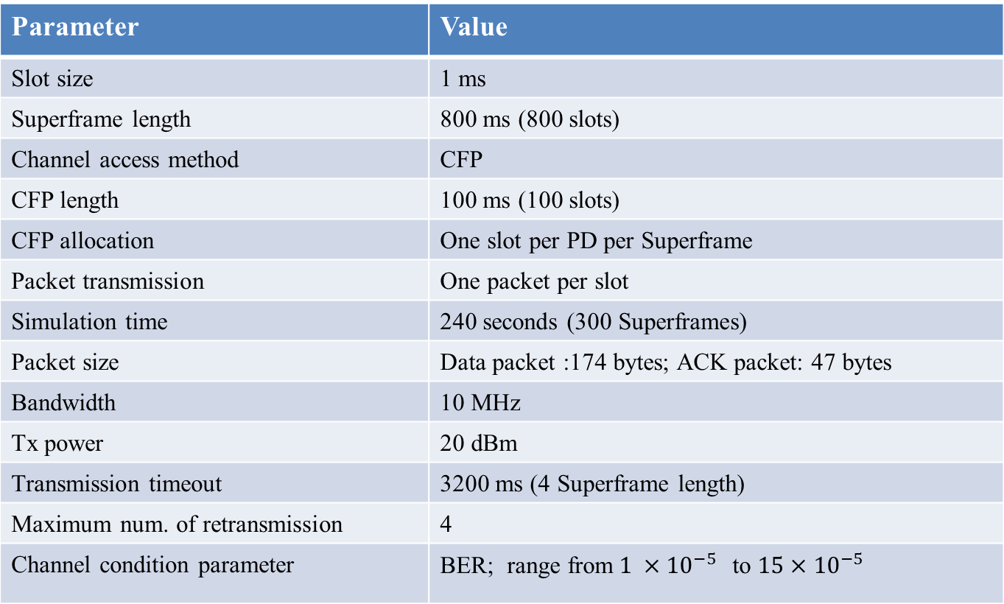
Simulation Parameters in Scenario 1
Parameter | Value
Slot size | 1 ms
Superframe length | 800 ms (800 slots)
Channel access method | CFP
CFP length | 100 ms (100 slots)
CFP allocation | One slot per PD per Superframe
Packet transmission | One packet per slot
Simulation time | 240 seconds (300 Superframes)
Packet size | Data packet :174 bytes; ACK packet: 47 bytes
Bandwidth | 10 MHz
Tx power | 20 dBm
Transmission timeout | 3200 ms (4 Superframe length)
Maximum num. of retransmission | 4
Channel condition parameter | BER; range from${ 1 ×10}^{−5}$ to $15×{10}^{−5}$

Slide 23

Simulation Results in Scenario 1 (1/2)
The ACK policy for reliable multicast should be context aware. A PD should select different ACK policy based on the application’s reliability requirement and BER.
“All ACK” achieves the highest packet delivery ratio that means “All ACK” is the most reliable.
When BER ≥$9×{10}^{−5}$. “All ACK” and “Partial ACK” have the same MPDR. The MPDR is limited by the BER. Therefore, under this context (BER), “Partial ACK” is a better policy even when the application requires high reliability.

Slide 24

Simulation Results in Scenario 1 (2/2)
Different ACK policy should be applied for different context, e.g., reliability and throughput requirements of applications.
BER is $5×{10}^{−5}$.
Low reliability requirement, e.g. $θ$<=48%, “Any ACK” achieves higher throughput.
Medium reliability requirement, e.g., 48%< $θ$<=70%, “Partial ACK” achieves higher throughput.
High reliability requirement, e.g., $θ$>70%, “All ACK” achieves higher throughput.

Slide 25
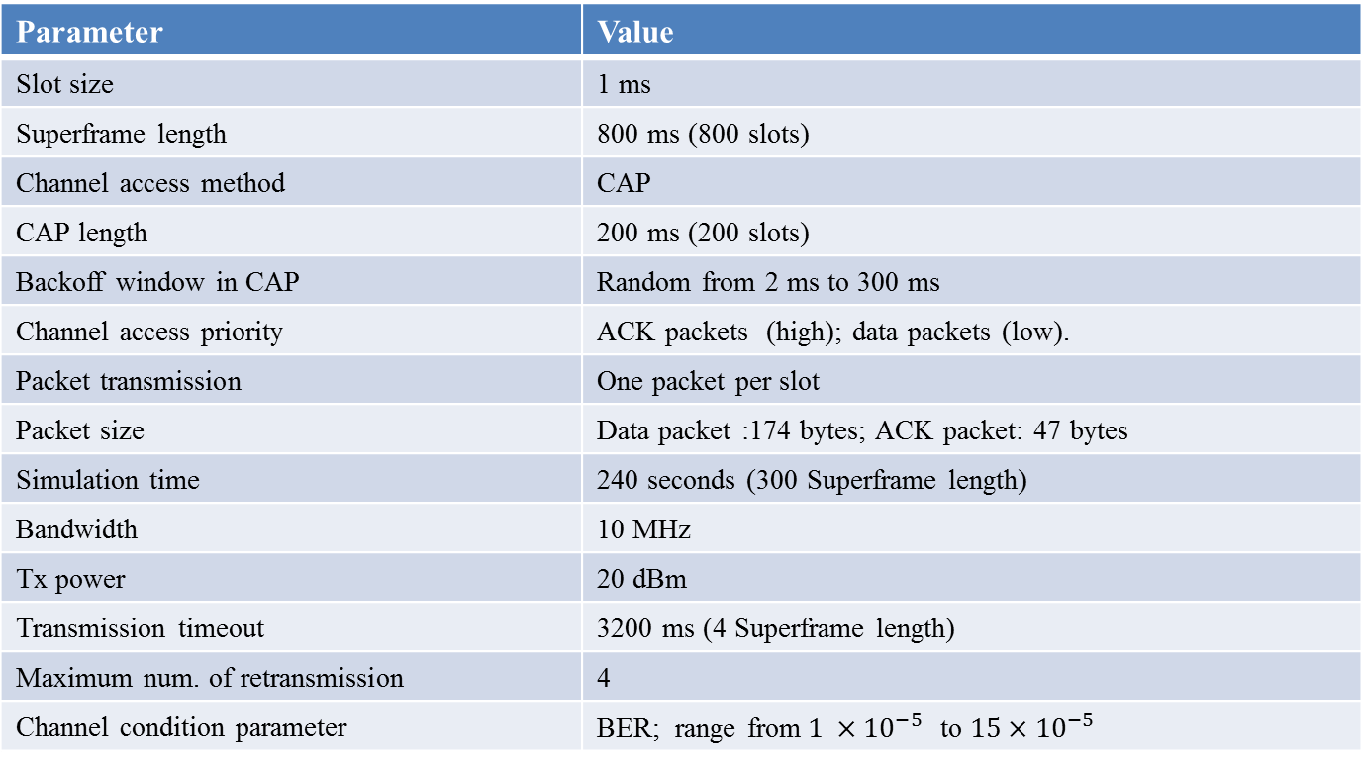
Simulation Parameters in Scenario 2
Parameter | Value
Slot size | 1 ms
Superframe length | 800 ms (800 slots)
Channel access method | CAP
CAP length | 200 ms (200 slots)
Backoff window in CAP | Random from 2 ms to 300 ms
Channel access priority | ACK packets (high); data packets (low).
Packet transmission | One packet per slot
Packet size | Data packet :174 bytes; ACK packet: 47 bytes
Simulation time | 240 seconds (300 Superframe length)
Bandwidth | 10 MHz
Tx power | 20 dBm
Transmission timeout | 3200 ms (4 Superframe length)
Maximum num. of retransmission | 4
Channel condition parameter | BER; range from${ 1 ×10}^{−5}$ to $15×{10}^{−5}$

Slide 26

Simulation Results in Scenario 2 (1/2)
The ACK policy for reliable multicast should be context aware. A PD should select different ACK policy based on the application’s reliability requirement and BER.
“All ACK” achieves the highest packet delivery ratio that means “All ACK” is the most reliable.
When BER ≥$7×{10}^{−5}$. “All ACK” and “Partial ACK” have the almost same MPDR. The MPDR is limited by the BER. Therefore, under this context (BER), “Partial ACK” is a better policy when the application requires high reliability.

Slide 27

Simulation Results in Scenario 2 (2/2)
Different ACK policy should be applied for different context, e.g., reliability and throughput requirements of applications.
BER is $5×{10}^{−5}$.
Low reliability requirement, e.g. $θ$<=49%, “Any ACK” achieves higher throughput.
Medium reliability requirement, e.g., 49%< $θ$<=72%, “Partial ACK” achieves higher throughput.
High reliability requirement, e.g., $θ$>72%, “All ACK” achieves higher throughput.

Slide 28
Conclusion
  Reliable Multicast for PAC
    Reliability Management: to manage multicast reliability and provide flexible reliability of multicast via various ACK policy.
      All ACK
      Any ACK
      Partial ACK
      Location-based ACK
      Context-based ACK
      Information-based ACK

Slide 29
References
  [1] PAC TGD: 15-12-0568-08-0008-tg8-technical-guidance-document.
  [2] PAC PFD: 15-14-0085-01-0008-tg8-pac-framework-document.

