Slide 1
Project: IEEE P802.15 Working Group for Wireless Personal Area Networks (WPANs)
Submission Title: [Performance evaluation of CAU proposal]
Date Submitted: [May 05th, 2014]
Source: [Jeongseok Yu, Woongsoo Na, Hyoungchul Bae, Taejin Kim, Yunseong Lee, Juho Lee, Zeynep Vatandas, Hyunsoo Kwon, Changhee Han, Sungrae Cho, and Junbeom Hur]
Company [Chung-Ang University, Korea]
E-Mail:[jsyu@uclab.re.kr, wsna@uclab.re.kr, hcbae@uclab.re.kr, tjkim@uclab.re.kr, yslee@uclab.re.kr, jhlee@uclab.re.kr, zvatandas@uclab.re.kr, khs910504@hanmail.net, manjungs@gmail.com, srcho@cau.ac.kr, jbhur@cau.ac.kr]
Re: [This is the original document]
Abstract: [This documents include simulation result of multi-hop multicast protocol for IEEE 802.15.8]
Purpose: [To provide materials for discussion in 802.15.8 TG]
Notice: This document has been prepared to assist the IEEE P802.15. It is offered as a basis for discussion and is not binding on the contributing individual(s) or organization(s). The material in this document is subject to change in form and content after further study. The contributor(s) reserve(s) the right to add, amend or withdraw material contained herein.
Release: The contributor acknowledges and accepts that this contribution becomes the property of IEEE and may be made publicly available by P802.15.

Slide 2
Introduction
In the TGD (DCN#: 568), the following functional requirements shall be met by IEEE 802.15.8
  6.9. Multicast: IEEE 802.15.8 may support a reliable multicast transmission including both on-hop and multi-hop cases.
  6.11 Multi-hop support: IEEE 802.15.8 shall provide at least 2-hop relaying function. Only relay-enabled PD shall relay discovery message and/or traffic data from PDs in the proximity.
  6.14 Security: The impact of security procedures on the performance of other system procedures, such as discovery and peering procedures should be minimized.
Especially, in the PAC Application Matrix (DCN#: 701), some applications require the above features.
  E.g., Hazard Notification, Peer-aware Monitoring/Assistance, etc.

Slide 3
Necessity
In the application matrix (15-12-0350-04-0008), the following service categories need multicast and/or multi-hop support and/or security.
Service Category | Needs | Exemplary applications
Social Networking | Multicast (1:n or group), Multi-hop (Med range), Security (Privacy preserving) | - Messenger services
Shopping/Entertaining - Advertisement | Multicast, Multi-hop (Med-High range), Security | - Store ads
USER-CENTRIC SERVICES - Activities at Proximity | Multicast (multi-users), Security | - Game playing - Similar to messenger type but more open in nature
SMART ENVIRONMENT - Home/ Office (Device based) | Multicast, Security | - Office management - S/W downloads
HEALTH/Energy-Monitoring/Service | Multicast, Security | - Multicast of emergency situation
Public Safety | Multicast | - Hazard notification - Public emergency
Network Offloading/Coverage Extension | Multi-hop, Security | - To extend P2P network for different applications.
Navigation Service | Multi-hop, Security | - Indoor/outdoor navigation

Slide 4
Finding/Joining Multicast Group
A multicast group consists of two or more PDs with the same application type ID, application specific ID, application specific group ID, and device group ID.
A multicast group can be formed only if two or more PDs can recognize themselves.
Before a PD joins a multicast group, it has to find the multicast group within K-hop coverage.
  If the PD cannot find the group, then it finds the group periodically.
  In order to find a multicast group, a PD broadcasts an Advertisement Command Frame (ACF) after random timer T_{j} where the maximum TTL is set to K. Range of T_{j} is [0, T_{jmax} ].

Slide 5
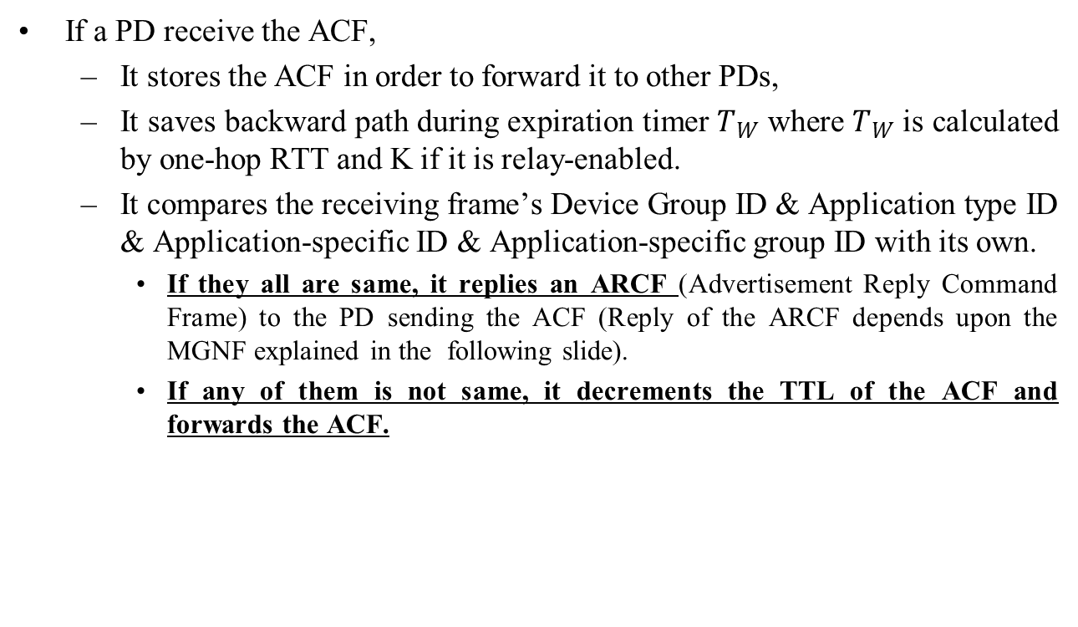
Finding/Joining Multicast Group (con’t)
If a PD receive the ACF,
  It stores the ACF in order to forward it to other PDs,
  It saves backward path during expiration timer $T_{W}$ where $T_{W}$ is calculated by one-hop RTT and K if it is relay-enabled.
  It compares the receiving frame’s Device Group ID & Application type ID & Application-specific ID & Application-specific group ID with its own.
    If they all are same, it replies an ARCF (Advertisement Reply Command Frame) to the PD sending the ACF (Reply of the ARCF depends upon the MGNF explained in the following slide).
    If any of them is not same, it decrements the TTL of the ACF and forwards the ACF.

Slide 6
Finding/Joining Multicast Group (con’t)
In order to limit the duplicate ARCF, PDs replying the ARCF multicast a Multicast Group Notification Frame (MGNF) after random time.
Then, the PD multicasting the MGNF replies source PD with an ARCF by using backward path.
A PD receiving both ACF and MGNF does not reply an ARCF.
A PD receiving the ARCF whose destination is not itself is referred to as “FORWARDING PD” and it acts like group member but it just forwards the data.
A PD receiving the ARCF whose destination is itself saves path with the PD which transmitted ARCF.

Slide 7
Flowchart of Finding/Joining Multicast Group
PD 1
PD 2
Group1
PD 1
Group1
PD 2
Group Join Request
(Sends ACF)
Forwards ACF
Send MGNF (Type = 0)
Group Join Reply
(Sends ARCF)
Forwarding PD
Forwards ARCF
Group Joining Complete

Slide 8
Multicasting
If a PD receives a multicast data frame, it has to decide forwarding the frame or not.
The PD receiving the multicast data frame compares the source address of the data frame and next-hop address entries of its neighbor table.
PD checks the next hop addresses in its neighbor table. If it finds
  one or more next-hop entries which not overlapped with the source address of the received frame and
  those next-hop entries have same device group ID with the received frame.
  Then, the PD forwards the incoming data frame to other PDs.
Otherwise, the PD do not forward the incoming frame.

Slide 9
Flowchart of Multicasting
Group1
PD 1
Forwarding
PD
Group1
PD 2
Group1
PD 3
Transmit Multicast
Data
Check Neighbor Table
Forwarding
Multicast Data
Multicasting Complete

Slide 10
Reliability – Selective Group ACK
When sender PD sends a multicast data frame, it chooses the groups to acknowledge the frame in the multicast group.
To avoid the feedback implosion problem, a sender forms groups of nodes in its neighbor table.
Then, the sender transmits multicast data frame including the information of the group who sends their Block ACK.
When the nodes in the group receive all multicast data frames successfully, they transmit Block ACK to the sender by notifying that they received all frames successfully.
If all data frames being transmitted, sender sends request block ACK frame to acquire non-transmitted block ACKs from ACK groups to satisfy full reliability.
ACK
Group 1
ACK
Group 2
ACK
Group 3
ACK
Group 1
ACK
Group 2
Data
Data
Data
: Block ACK
: Request Block ACK

Slide 11
Block ACK Mechanism
Block ACK Group1
Block ACK Group2
PD 1
PD 2
PD 3
PD 4
PD 5
Send Multicast Data #1
#1 Block ACK
#1 Block ACK
Send Multicast Data #2
#1, #2 Block ACK
#2 Block ACK
Retransmit Multicast Data #1
#1 Block ACK
Send Request Block ACK for #2
#2 Block ACK
#2 Block ACK
Reliable Transmit Complete

Slide 12
Pre-ACK
  If a PD overhears a data sent by transmitter and it does not have the transmitter’s ID in its neighboring table, the PD sends pre-ACK to the PDs in the neighboring table.
  Pre-ACK includes
    Originator Address of Data
    Sequence Number of Data
    Address of Receivers
  If a PD receives pre-ACK, it creates an ACK table.
  If all receivers in the ACK table are acknowledged, the PD does not forward the data to reduce the number of unnecessary transmission.

Slide 13
Pre-ACK Mechanism
PD 1
PD 2
PD 3
PD 4
PD 5
Send Multicast Data
ACK
Pre-ACK
ACK
Does not forward
because Pre-ACK
Forward
Multicast data
ACK
Multicast Complete

Slide 14
Multi-hop Multicasting
Simulation Results

Slide 15
MAC Parameters Used in Simulations
Parameter | Value
ACF Frame Size | 32.75 bytes
MPDU | 512 bytes
MGNF Size | 48 bytes
Data Type | Multicast
Number of Groups | 1
Topology Size | Scenario 1,2 : 50m x 50m (1-hop scenario) Scenario 3: 500m x 500m (Multi-hop scenario)
PHY | BPSK (1/2)
Number of Channels | 1
General Parameters | TGD Revision 8
# of Nodes | 1~512

Slide 16
MAC Parameters Used in Simulations
Parameter | Value
Data arrival Rate | Scenario 1: Full Buffer Scenario 2, 3: 2 Frames/sec per transmitter
Mobility | Static Mobility
Drop | 2-stage Drop
Data Rate | 10Mbps
Multi-hop | Supported
RTS/CTS | Enable (Only Multi-hop scenario)
NAV | Enable (Only Multi-hop scenario)
ACK/NACK | Enable
CSMA/CA | Exponential increases of CW
Carrier Sensing | Enable
CWMin | 2⁴
Cwmax | 2¹⁰
Retry Limit | 7

Slide 17
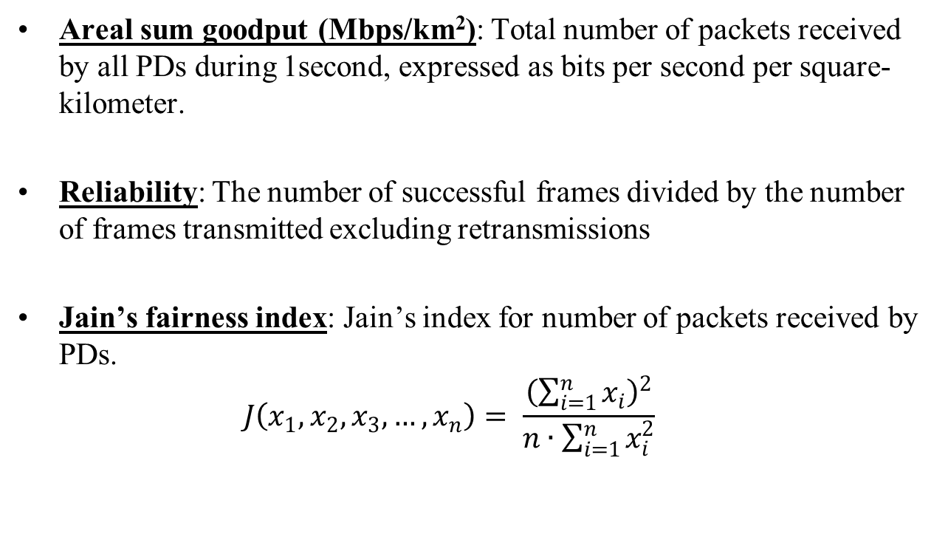
Performance Metrics
Areal sum goodput (Mbps/km²): Total number of packets received by all PDs during 1second, expressed as bits per second per square-kilometer.
Reliability: The number of successful frames divided by the number of frames transmitted excluding retransmissions
Jain’s fairness index: Jain’s index for number of packets received by PDs.
  $$J\left(x_{1},x_{2},x_{3},…,x_{n}\right)= \frac{{\left(\sum_{i=1}^{n}{x_{i}}\right)}^{2}}{n∙\sum_{i=1}^{n}{x_{i}^{2}}}$$

Slide 18
Simulation Scenario Description
Scenario 1 (Single hop scenario with full-buffer)
  Topology size: 50m x 50m
  1 transmitter (it generates multicast data)
  Full-buffer
  All PDs are located in 1-hop range of transmitter.
Scenario 2 (Multiple transmitters, multi-hop scenario (Max-hop: 2))
  Topology size: 50m x 50m
  Multiple transmitter
  Inter arrival rate: 2 frames/sec (Poisson)
  All PDs are uniformly distributed in 50m x 50m (Maximum hop range: 2-hop)
Scenario 3 (Multiple transmitters, multi-hop scenario (Max-hop: 10))
  Multiple transmitter
  Inter arrival rate: 2 frames/sec (Poisson)
  All PDs uniformly distributed in 500m x 500m (Maximum hop range: 10-hop)

Slide 19
Simulation Scenario Description (con’t)
Scenario 1
Scenario 2
Scenario 3
: Transmitter
: Receiver
Transmission
Range: 50m
Transmission
Range: 50m
Relay
Relay
2-hop range
Relay
500m
Relay
Relay
Relay
Relay
Relay
A transmitter generates data with full-buffer.
The number of receivers increases up to 512.
All receivers are located in 1-hop range of transmitter.
The number of receivers increases up to 512.
All PDs are located in 50m x 50m (some PDs might be located in 2-hop range from a transmitter).
500m
Multiple transmitters are located in 500m x 500m (Multi-hop transmission).

Slide 20
Area Sum Goodput (Scenario 1)
In our proposed scheme, the goodput has 2.1x10⁴ Mbps/km² while 2.6x10⁴ Mbps/km² in the No-ACK based scheme when the number of nodes is 512.
No-ACK based scheme achieves the best performance since there is no collision in this scenario. (# of transmitter is 1)
In our proposed scheme, ACK frames collided among the receivers.
The goodput of the proposed scheme is 20% less than the No-ACK based scheme when the number of nodes is 512 due to ACK overhead.
This gap indicates
ACK frame overhead

Slide 21
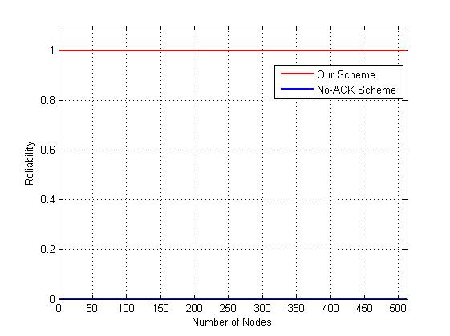
Reliability (Scenario 1)
The proposed scheme shows full reliability (100%) while No-ACK based scheme cannot provide any reliability (0%).

Slide 22
Fairness (Scenario 1)
Jain’s fairness index is almost 1
  The group-ACK scheme provides fairness receive within 1-hop PDs.

Slide 23
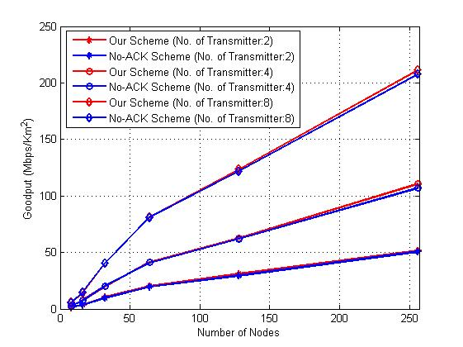
Area Sum Goodput (Scenario 2)
In both of the schemes, the goodput increases as the number of nodes increases.
Proposed scheme is higher than No-ACK based scheme different from scenario 1 since the transmitted data collided among transmitters.
The goodput of the proposed scheme is 3% higher than the No-ACK based scheme when the number of nodes is 250 and the number of transmitter is 8.
This is because, No-ACK based scheme does not provide retransmission function when a data frame collided.
More generated traffic
cause the more
higher goodput

Slide 24
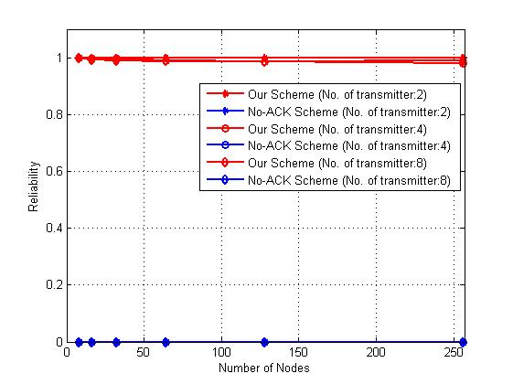
Reliability (Scenario 2)
The proposed scheme shows almost full reliability (100%) while No-ACK based scheme cannot provide any reliability (0%).
When a large number of PDs are densely located (200~250), retransmitted ACK frames collided more frequently.
→ Reason why our proposed scheme cannot provide full reliability.

Slide 25
Fairness and Efficiency (Scenario 2)
Jain’s fairness index is almost 1
  This is because, all transmitters have same inter arrival rate and PDs are uniformly distributed.
  Also, The group-ACK scheme provides fairness receive within 1-hop PDs.

Slide 26
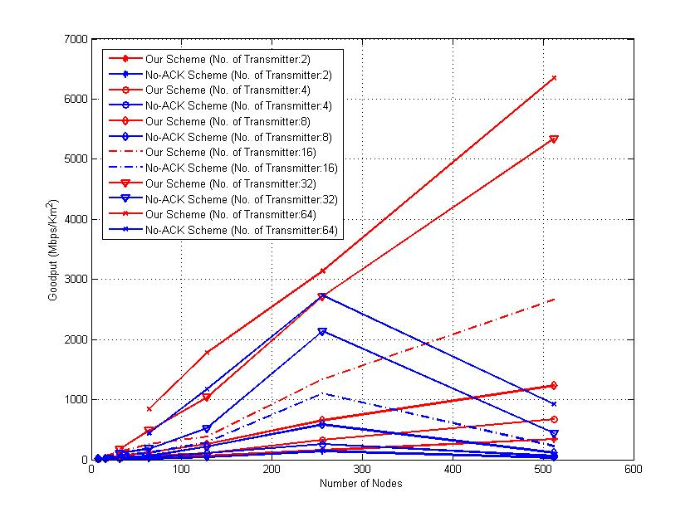
Area Sum Goodput (Scenario 3)
In our proposed scheme, the goodput increases as the number of nodes increases.
However, the goodput of the No-ACK based scheme decreases after the number of nodes is 256 since ACK frames more collided and hidden node problem occurs in this scenario.
Also, if a relay node does not receive, it does not forward anymore in the No-ACK based scheme.
Pre-ACK and Block-ACK technique can reduce the transmitted ACK frames in our scheme.
→ Collisions are reduced.
Goodput increases
when # of PDs < 256
Goodput decreases
when # of PDs > 256 for No-ACK

Slide 27
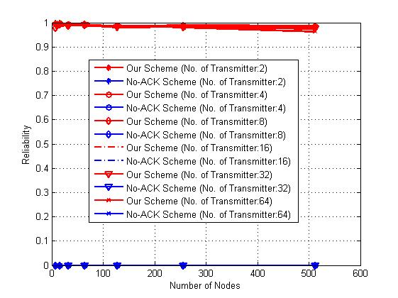
Reliability (Scenario 3)
The proposed scheme shows full reliability (100%) while No-ACK based scheme cannot provide any reliability (0%).
In the multi-hop scenario, our scheme still satisfies full reliability.

Slide 28
Fairness and Efficiency (Scenario 3)
Jain’s fairness index is almost 1
  This is because, all transmitters have same inter arrival rate and PDs are uniformly distributed.
  Also, The group-ACK scheme provides fairness receive within 1-hop PDs.

Slide 29
Security Mechanism for PAC

Slide 30

Infrastructureless Architecture
No coordinator or AAA (authentication, authorization, accountability) server
Using PIN (symmetric), or certificate (asymmetric) issued by the trusted third party
  Cf) Bluetooth pairing
Slide 30

Slide 31
PIN Establishment Issue
Offline establishment
  Not scalable
Online establishment
  Not secure in multi-hop environment
    Main-in-the-middle attack
    Replay attack
  E.g., Bluetooth authentication

Slide 32







PIN Establishment Issue
E.g., Bluetooth Authentication
A
B
User A enters $PIN$
Generate a random number $IN_RAND$
$$E22\left({ADDR}_{B}, PIN, IN_RAND\right)→K_{init}$$
$$IN_RAND$$
$K_{init}$ correspond to
AUTH_KEY
User B enters$PIN$
$$E22\left({ADDR}_{B}, PIN, IN_RAND\right)→K_{init}$$
Pairing

Slide 33
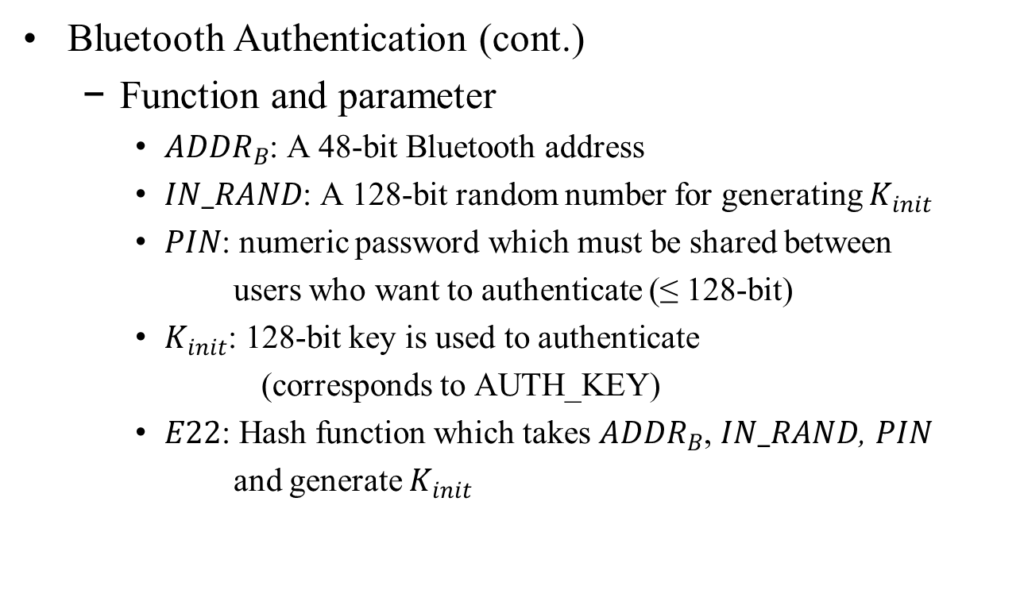
PIN Establishment Issue
Bluetooth Authentication (cont.)
  Function and parameter
    ${ADDR}_{B}$: A 48-bit Bluetooth address
    $IN_RAND$: A 128-bit random number for generating $K_{init}$
    $PIN$: numeric password which must be shared between
    users who want to authenticate (≤ 128-bit)
    $K_{init}$: 128-bit key is used to authenticate
    (corresponds to AUTH_KEY)
    $E22$: Hash function which takes ${ADDR}_{B}$, $IN_RAND$, $PIN$
    and generate $K_{init}$

Slide 34
Authentication without Infrastructure 1
Device-to-device connection
Security requirement
  Secure against MITM, replay attack by relaying nodes in multi-hop environment
PIN establishment
  E.g., TLS 1.0/1.2, …
  Out of scope of specification, but spec needs to suggest protocol options allowed

Slide 35




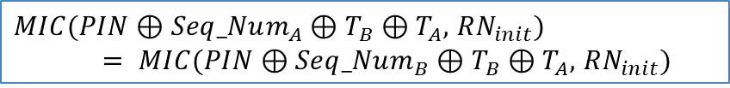




A
B
User A enters $PIN$
Secure PIN establishment
(out of specification scope)
$$TLS(T_{B}, PIN)$$
Set$Seq_Num_{A}= 0$
Set$Seq_Num_{B}= 0$
Generate a random number$RN_{init}$
$$PRF\left(RN_{init} , PIN \right)→{AUTH_KEY}_{AB}$$
$RN_{init},MIC(PIN⊕Seq_Num_{A}⊕T_{B}⊕T_{A},$ $RN_{init})$
User B enters$PIN$
$MIC(PIN⊕Seq_Num_{A}⊕T_{B}⊕T_{A},$ $RN_{init})$
$= MIC(PIN⊕Seq_Num_{B}⊕T_{B}⊕T_{A},$ $RN_{init})$
$$PRF\left(RN_{init} , PIN \right)→{AUTH_KEY}_{AB}$$
Slide 35

Slide 36
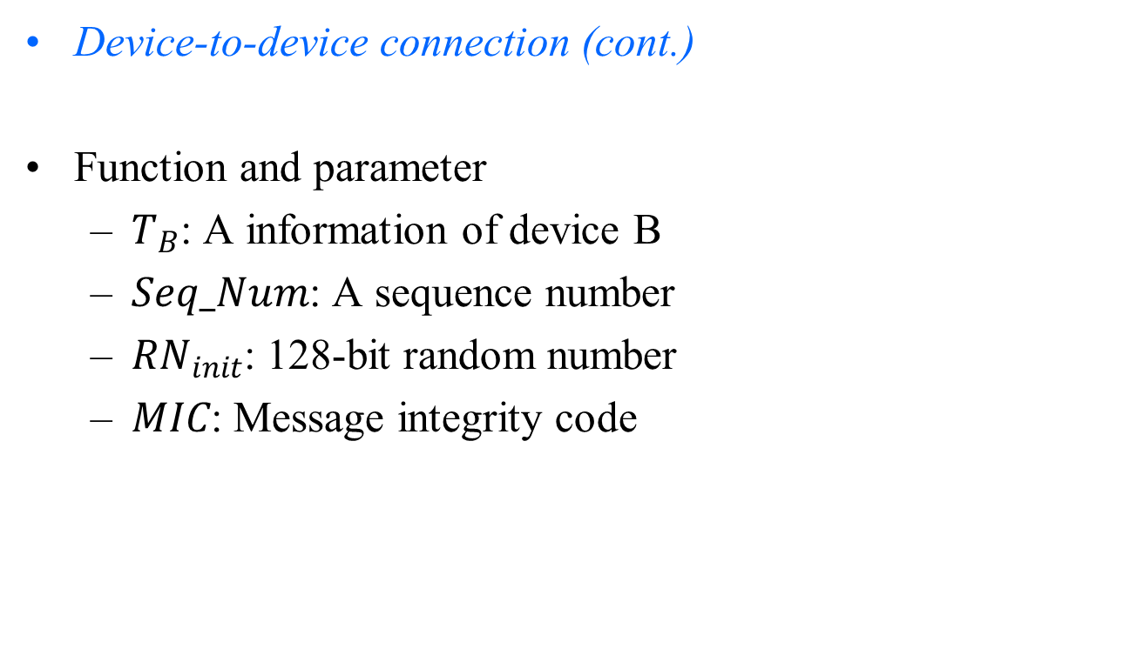
Authentication without Infrastructure 1
Device-to-device connection (cont.)
Function and parameter
  $T_{B}$: A information of device B
  $Seq_Num$: A sequence number
  $RN_{init}$: 128-bit random number
  $MIC$: Message integrity code

Slide 37
Authentication without Infrastructure 2
Device-to-(devices in a specific group) connection
Security requirement
  Secure against MITM, replay attack by relaying nodes and a group manager in multi-hop environment

Slide 38










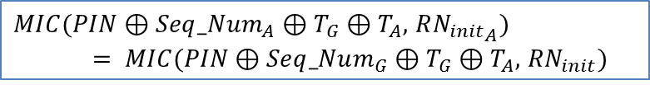


A
GM
G
User A enters$PIN$
$$TLS(T_{G}, PIN)$$
Set $Seq_Num_{A}= 0$
Set$Seq_Num_{G}= 0$
Generate a random number $RN_{init}$
Group member
$RN_{init} ,MIC(PIN⊕Seq_Num_{A}⊕T_{G}⊕T_{A},$ $RN_{init})$
B
User B enters $PIN$
$MIC(PIN⊕Seq_Num_{A}⊕T_{G}⊕T_{A},$ $R{N_{init}}_{A})$
$= MIC(PIN⊕Seq_Num_{G}⊕T_{G}⊕T_{A},$ $RN_{init})$
$$Entity Request$$
$$TLS(T_{AB}, TK_{AB})$$
$$TLS(T_{AB}, TK_{AB})$$
$$PRF\left(RN_{init} , PIN , TK_{AB}\right)→{AUTH_KEY}_{AB}$$
$$PRF\left(RN_{init} , PIN , TK_{AB}\right)→{AUTH_KEY}_{AB}$$
Slide 38

Slide 39
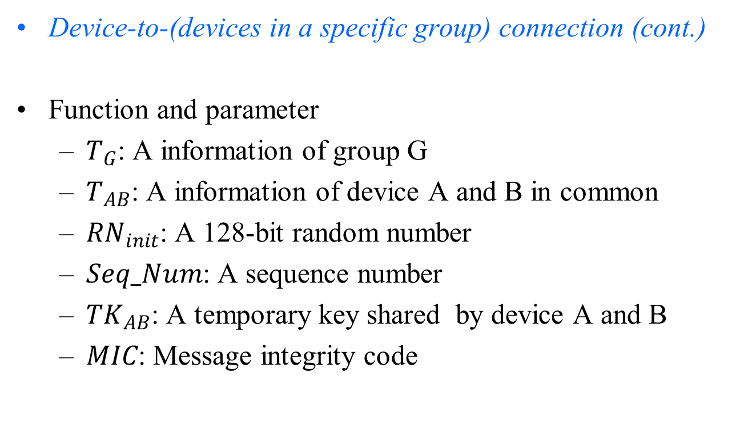
Authentication without Infrastructure 2
Device-to-(devices in a specific group) connection (cont.)
Function and parameter
  $T_{G}$: A information of group G
  $T_{AB}$: A information of device A and B in common
  $RN_{init}$: A 128-bit random number
  $Seq_Num$: A sequence number
  $TK_{AB}$: A temporary key shared by device A and B
  $MIC$: Message integrity code

Slide 40
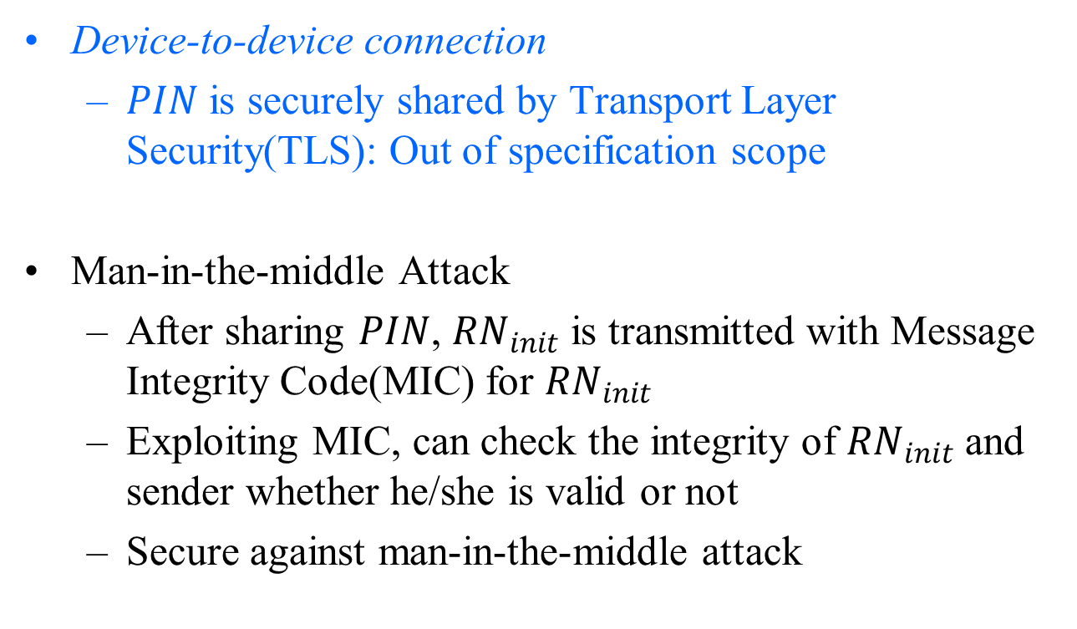
Security Analysis
Device-to-device connection
  $PIN$ is securely shared by Transport Layer Security(TLS): Out of specification scope
Man-in-the-middle Attack
  After sharing $PIN$, $RN_{init}$ is transmitted with Message Integrity Code(MIC) for $RN_{init}$
  Exploiting MIC, can check the integrity of $RN_{init}$ and sender whether he/she is valid or not
  Secure against man-in-the-middle attack

Slide 41
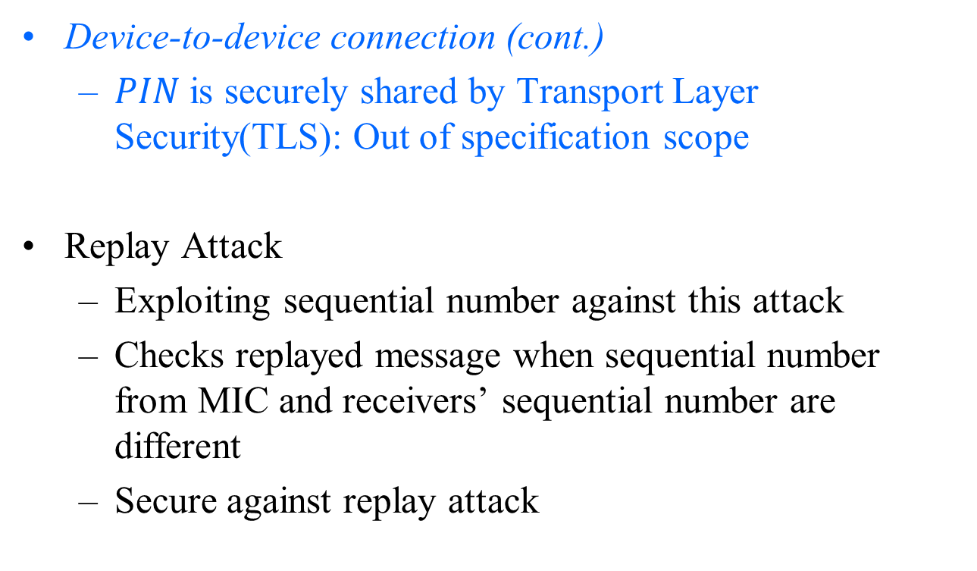
Security Analysis
Device-to-device connection (cont.)
  $PIN$ is securely shared by Transport Layer Security(TLS): Out of specification scope
Replay Attack
  Exploiting sequential number against this attack
  Checks replayed message when sequential number from MIC and receivers’ sequential number are different
  Secure against replay attack

Slide 42
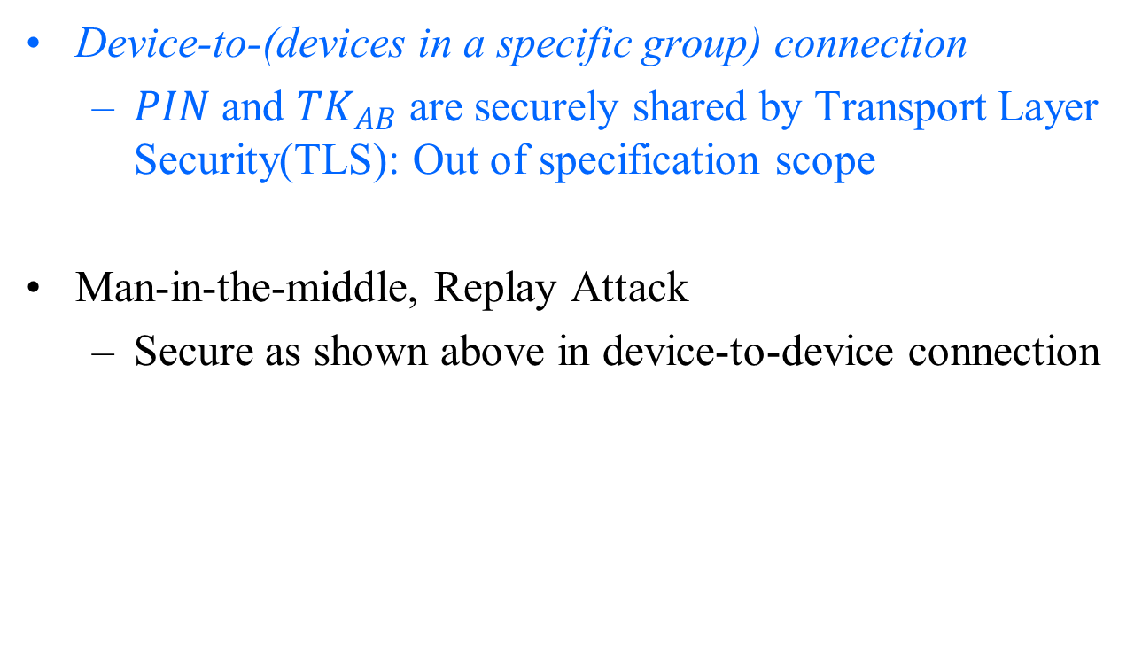
Security Analysis
Device-to-(devices in a specific group) connection
  $PIN$ and $TK_{AB}$ are securely shared by Transport Layer Security(TLS): Out of specification scope
Man-in-the-middle, Replay Attack
  Secure as shown above in device-to-device connection

Slide 43
Conclusion
The proposed multi-hop multicast scheme provides more higher goodput than No-ACK based scheme except for 1-hop topology.
Our proposed scheme provides almost full reliability (100%) regardless of 1 hop or multi-hop.
Pre-ACK and Block ACK can reduce significantly the transmitted ACK frame. → When a large number of PDs are densely located, our scheme can improve the goodput with reliability.
All of PDs have same opportunity to receive multicast data. (i.e., the Jain’s fairness index is 1)
Proposed authentication algorithm has security from MITM and replay attack.

