Slide 1
Project: IEEE P802.15 Working Group for Wireless Personal Area Networks (WPANs)
Submission Title: Physical Layer Security as a Key Technology for D2D
Date Submitted: May 5, 2014
Source: [Byung-Jae Kwak, Kapseok Chang, Moon-Sik Lee]¹, [Jeongseok Ha]²
Address: [ETRI, Daejeon, Korea]¹, [KAIST, Daejeon, Korea]²
Voice:
E-Mail: {bjkwak, kschang, moonsiklee}@etri.re.kr
Re: TG8 PAC Call for Contributions (CFC), 15-14-0087-00-0008, Jan 23, 2014.
Abstract: Introduction of physical layer security as a key technology for D2D communications
Purpose: Discussion
Notice: This document has been prepared to assist the IEEE P802.15. It is offered as a basis for discussion and is not binding on the contributing individual(s) or organization(s). The material in this document is subject to change in form and content after further study. The contributor(s) reserve(s) the right to add, amend or withdraw material contained herein.
Release: The contributor acknowledges and accepts that this contribution becomes the property of IEEE and may be made publicly available by P802.15.

Slide 2
Physical Layer Security as a Key Technology for D2D
May 2014

Slide 3
Security Issues
Confidentiality
Authentication
Integrity
Access Control
Availability
Replay detection (freshness)

Slide 4
Physical Layer Security
Def: Explores the possibility of achieving perfect security by taking advantage of the fundamental ability of the physical layer
Information theoretic security provides the theoretical basis behind physical layer security

Slide 5
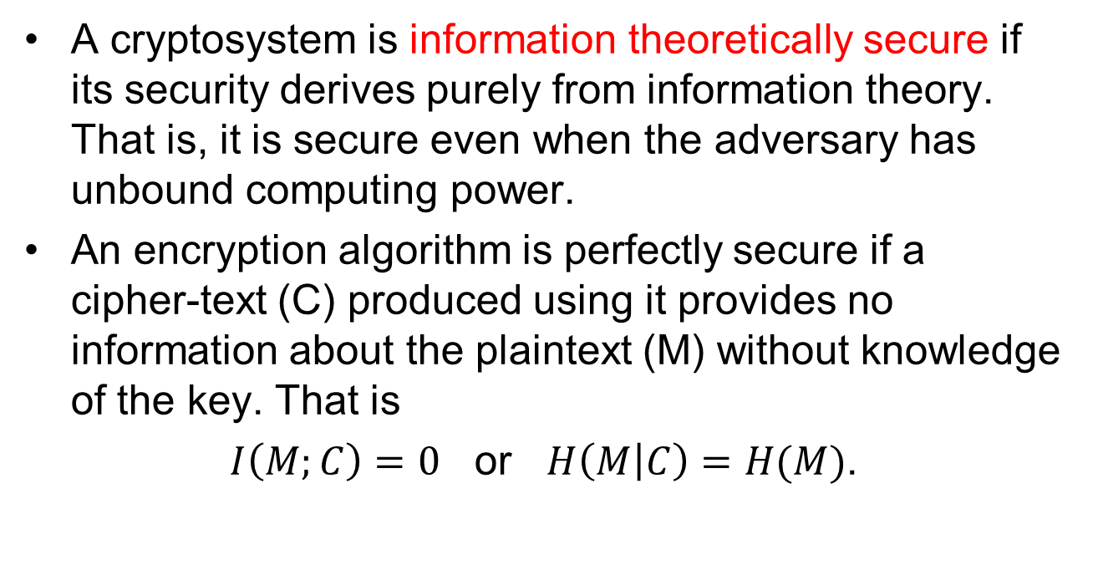
Information Theoretic Security
A cryptosystem is information theoretically secure if its security derives purely from information theory. That is, it is secure even when the adversary has unbound computing power.
An encryption algorithm is perfectly secure if a cipher-text (C) produced using it provides no information about the plaintext (M) without knowledge of the key. That is
$I\left(M;C\right)=0$ or $H\left(M | C\right)=H(M)$.

Slide 6
Why Physical Layer Security?
Traditional Approaches
  RSA (Rivest-Shamir-Adleman) for public cryptography systems and ECC (Elliptic-Curve Cryptography) for digital signature: “these two problems are like the two little legs on which the whole big body of digital signature and public cryptography stands”
Upcoming Threats to the Conventional Secrecy Systems
  Powerful computing machines such as quantum computers
  Advances in hacking tools (e.g., the side-channel analysis attack)

Slide 7
Why Physical Layer Security?
Cross-layer optimization
  Security has been considered only in the application layer
  System throughput can be enhanced by sharing security burden across layers
Traditional solutions may not be appropriate
  For devices with limited resources: sensor devices, RF IDs)
  Ultra-fast devices: Wireless NAS, short distance communications
New network Architecture
  D2D communications: security depends heavily on user discretion
  Distributed systems: distributed key distribution & maintenance

Slide 8
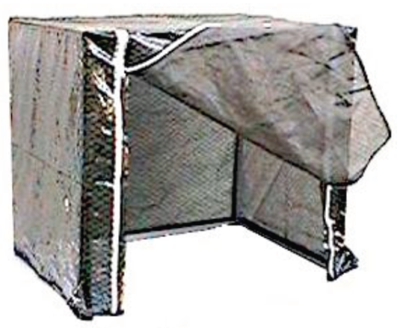
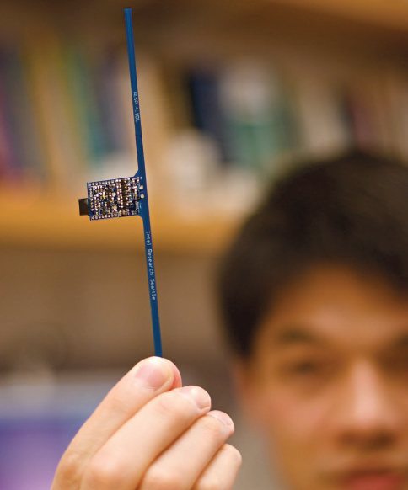
Physical Layer Security for PAC
Virtual Faraday Cage
E-Commerce: mobile payment
Access Control: premises, cars, etc.
Security before association
Etc.

Slide 9
Conclusion
Steep competition between D2S Communications & Service Discovery Technologies: Wi-Fi Direct, LTE Direct, iBeacon
PHY security can be a distinguishing feature of PAC
  Can make PAC the “secure D2D”
  Expand the spectrum of applications of PAC

