Slide 1
Project: IEEE P802.15 Working Group for Wireless Personal Area Networks (WPANs)
Submission Title: Clustered Random Drop of PDs for Performance Evaluation of PAC
Date Submitted: May 5, 2014
Source: Nah-Oak Song (KAIST), Junhyuk Kim (KAIST), June-Koo Kevin Rhee (KAIST),
Byung-Jae Kwak (ETRI), Kapseok Chang (ETRI), Moon-Sik Lee (ETRI)
Address: KAIST, Daejeon, Korea; ETRI, Daejeon, Korea
Voice:
E-Mail: nsong@kaist.ac.kr, kim.jh@kaist.ac.kr, rhee.jk@kaist.edu, bjkwak@etri.re.kr, kschang@etri.re.kr,
moonsiklee@etri.re.kr
Re: TG8 Technical Guidance Document (DCN 15-12-0568-08)
Abstract: This document proposes a new method of randomly distributing PDs for performance evaluation of PAC network. The proposed method produces a more realistic distribution of PDs compared to the conventional uniform random distribution.
Purpose: Discussion.
Notice: This document has been prepared to assist the IEEE P802.15. It is offered as a basis for discussion and is not binding on the contributing individual(s) or organization(s). The material in this document is subject to change in form and content after further study. The contributor(s) reserve(s) the right to add, amend or withdraw material contained herein.
Release: The contributor acknowledges and accepts that this contribution becomes the property of IEEE and may be made publicly available by P802.15.

Slide 2
Clustered Random Drop of PDs for Performance Evaluation of PAC
May 2014
Nah-Oak Song, Junhyuk Kim,
Byung-Jae Kwak, Kapseok Chang

Slide 3
Unique Characteristics of PAC Network
Infra-less: PDs are not attached to a BS or an AP
Multi-hop: a single-hop link between PDs is not always guaranteed (hidden terminal problem)
Mobility: PDs are not expected to stay at the same location
Clustering: PDs flock around points of attractions rather than points of connections

Slide 4
Uniform Drop of PDs
Use uniform random distribution to drop (i.e., locate) devices
Simple but unrealistic
  Interference between neighboring devices is underrepresented: not appropriate for D2D, MU-MIMO, etc.
  Simulation of (localized) high density of devices is not possible
Widely used for SLS of cellular systems
  Communication is mostly between BS and UE, and interference between neighboring UEs is avoided by scheduling

Slide 5
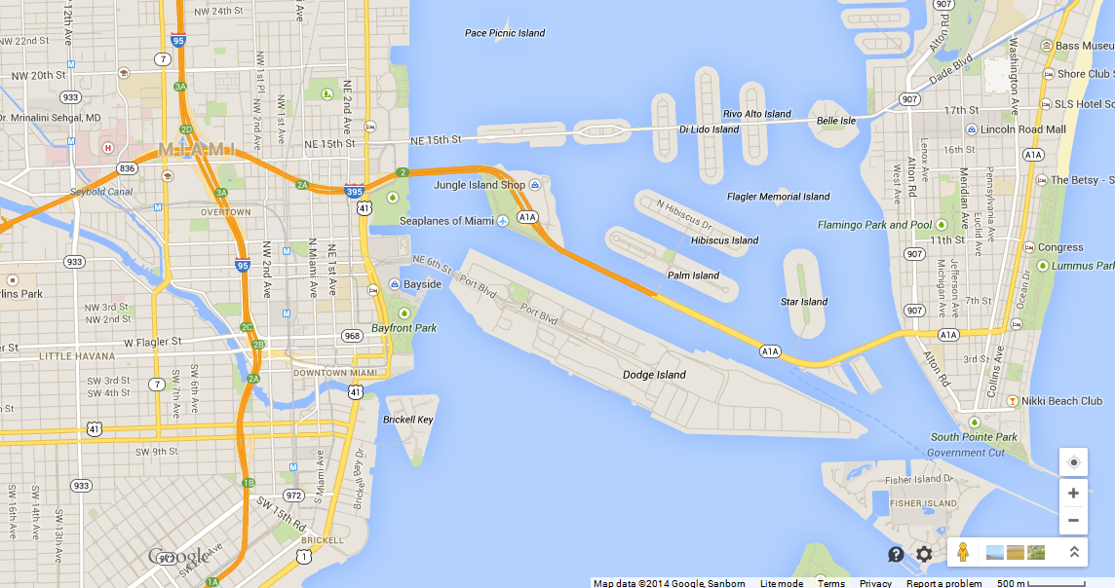
Miami Map

Slide 6
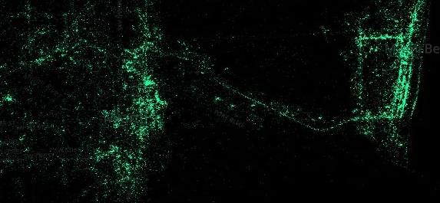
An Example of Real Device Distribution
Android Users in Miami
(Source: http://www.businessinsider.com/android-is-for-poor-people-maps-2014-4)

Slide 7
500m x 500m Area
Android Users in Miami
(Source: http://www.businessinsider.com/android-is-for-poor-people-maps-2014-4)

Slide 8
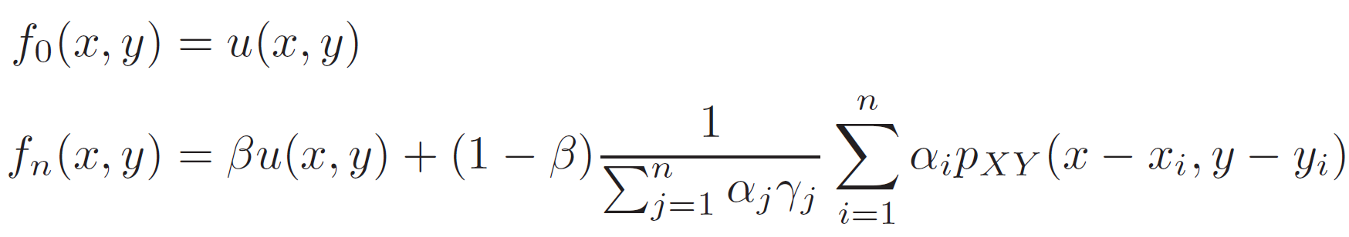
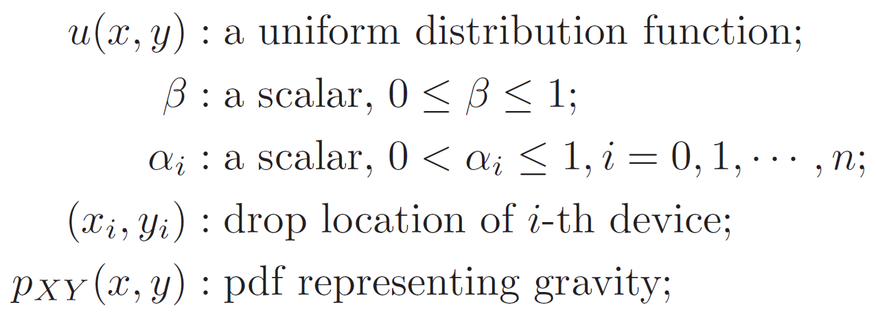
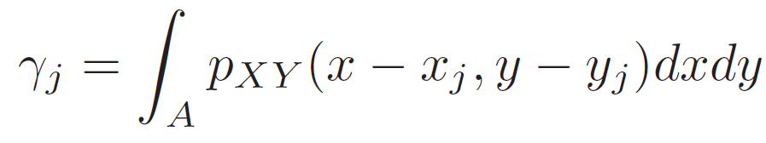

Clustered Random Device Drop
Let $f_{n}\left(x,y\right)$ be the probability distribution of the devices after dropping $n$ devices, then
where

Slide 9
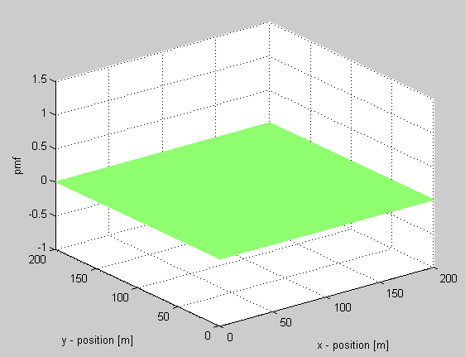
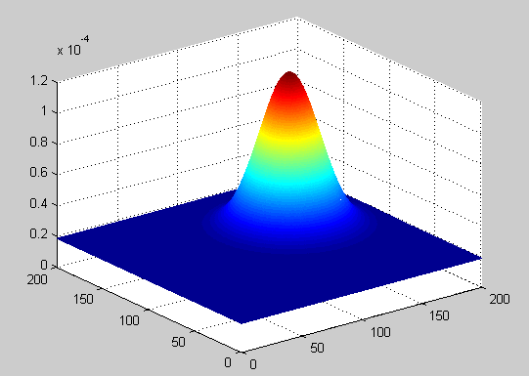
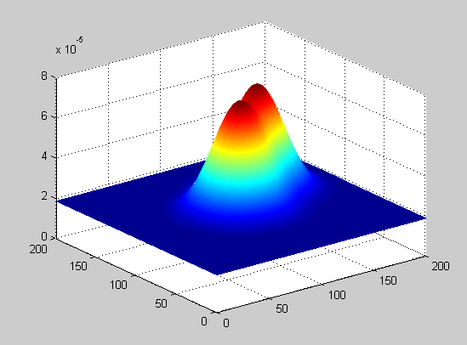
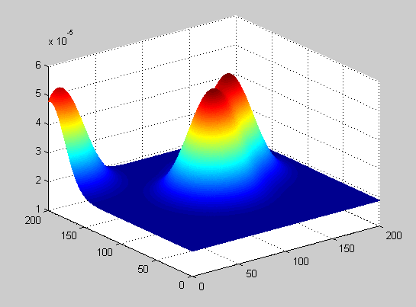
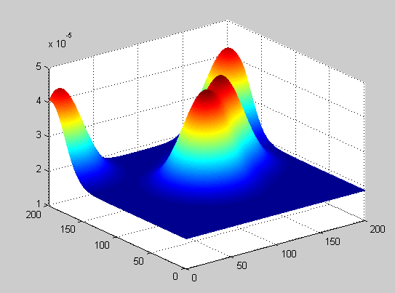
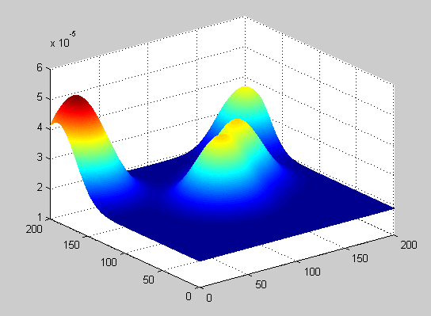
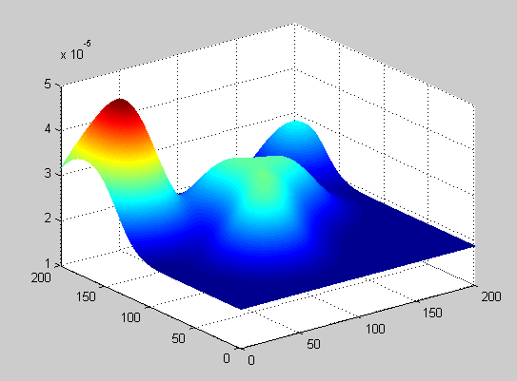
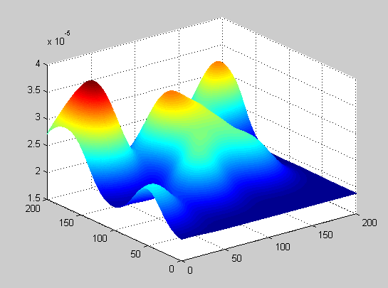
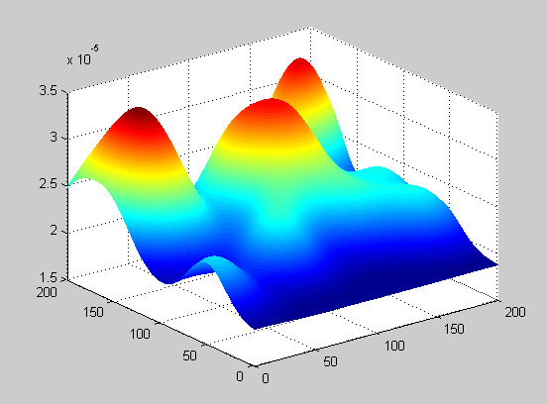
Evolution of PD Distribution
0
1
2
3
4
5
9
14
19

Slide 10
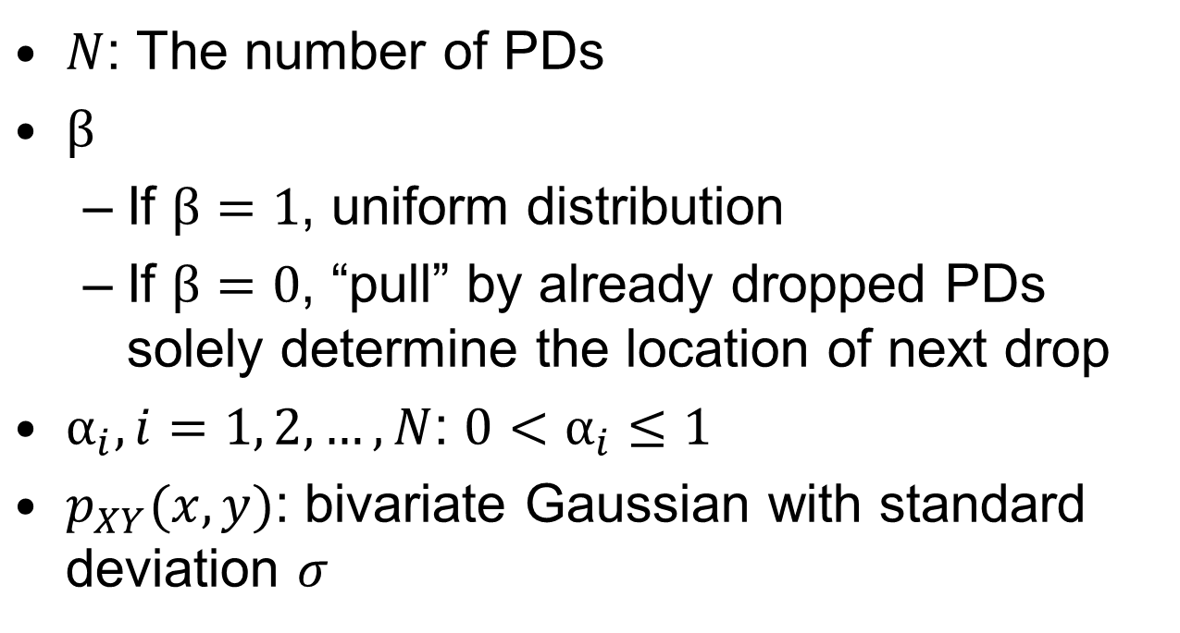
Model Parameters
$N$: The number of PDs
$β$
  If $β=1$, uniform distribution
  If $β=0$, “pull” by already dropped PDs solely determine the location of next drop
$α_{i}, i=1, 2, …, N$: $0<α_{i}≤1$
$p_{XY}(x,y)$: bivariate Gaussian with standard deviation $σ$

Slide 11






Effect of Parameters
$$β=0.2$$
$$β=0.5$$
$$β=0.8$$
$$σ=10$$
$$σ=20$$
$$σ=30$$

Slide 12




Examples of Clustered Random Drop
500m x 500m area
2000 PDs
$σ=50$m
(a) $β=0.2$
(b) $β=0.6$
(c) $β=1$

Slide 13
Examples of Clustered Random Drop
Clustered vs. Uniform: # PDs in Range

Slide 14
Conclusion
Unrealistic device drop model can lead to incorrect performance evaluation
Proposed “Clustered Random Drop” model produces realistic device distribution
  Localized high density of clustered PDs is well represented
  Expected to produce more accurate performance evaluation

