Slide 1
Project: IEEE P802.15 Working Group for Wireless Personal Area Networks (WPANs)
Submission Title: Performance Evaluation of Fully Distributed Synchronization Mechanism for PAC
Date Submitted: 5 May, 2014
Source: [Byung-Jae Kwak, Kapseok Chang, Moon-Sik Lee, Seong-Soon Joo]¹,
[Junhyuk Kim, June-Koo Kevin Rhee]²,
[Seung-Hoon Park, Kyungkyu Kim, Anil Agiwal, Youngbin Chang, Hyunseol Ryu,
Daegyun Kim, Won-il Roh]³
Address: [ETRI, Daejeon, Korea]¹, [KAIST, Daejeon, Korea]², [Samsung Electronics, Suwon, Korea]³
Voice:
E-Mail: {bjkwak, kschang, moonsiklee, ssjoo}@etri.re.kr, kim.jh@kaist.ac.kr, rhee.jk@kaist.edu,
shannon.park@samsung.com
Re: TG8 PAC Call for Contributions (CFC), 15-14-0087-00-0008, Jan 23, 2014.
Abstract: This document provides the result of performance evaluation of a fully distributed synchronization mechanism for PAC
Purpose: To discuss the merits of the proposed fully distributed synchronization mechanism for PAC
Notice: This document has been prepared to assist the IEEE P802.15. It is offered as a basis for discussion and is not binding on the contributing individual(s) or organization(s). The material in this document is subject to change in form and content after further study. The contributor(s) reserve(s) the right to add, amend or withdraw material contained herein.
Release: The contributor acknowledges and accepts that this contribution becomes the property of IEEE and may be made publicly available by P802.15.

Slide 2
Performance Evaluation of Fully Distributed Synchronization Mechanism for PAC
May 2014

Slide 3
Introduction
This is document presents the result of performance evaluation of the harmonized fully distributed synchronization mechanism for PAC between ETRI and Samsung
The proposed fully distributed synchronization is designed for
  Coexistence with other networks in the same band
  Scalability
The overhead is less than 0.5%

Slide 4
Frame Structure
Sync slot
  Timing reference signal is transmitted/received
  Transmitted using random access
  Contains timing offset information
  Frame boundary: arrival time + timing offset
Other slots are explained in 15-14-0254-00-0008

Slide 5
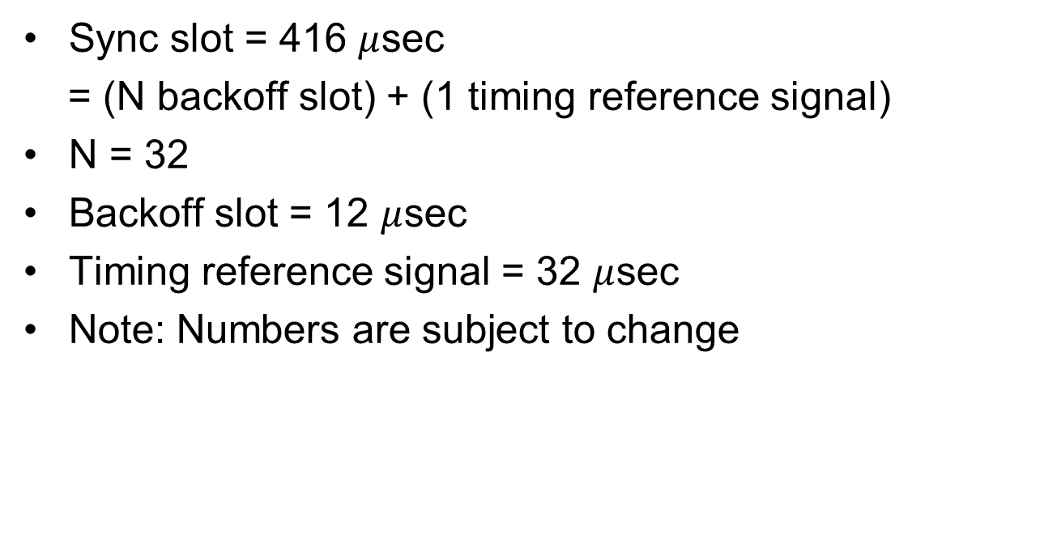
Structure of Sync Slot
Sync slot = 416 $μ$sec
= (N backoff slot) + (1 timing reference signal)
N = 32
Backoff slot = 12 $μ$sec
Timing reference signal = 32 $μ$sec
Note: Numbers are subject to change

Slide 6
Design Strategy of Random Access Based on CSMA/CA for Sync
Adaptive
  If # PDs large → large CW
  If # PDs small → small CW
Update strategy of CW
  Collision indicates CW is too small
  Missing timing reference signal indicates CW is too large
  CW update follows EIED mechanism
Fairness
  PDs broadcast their own CW sizes
  PDs update their CW size to minimize the variance of CW sizes among PDs

Slide 7
Tone Based Collision Detection: Concept
Assumption:
  PDs are synchronized in time and frequency
Collision
  Backoff counters of A & B expire (zero)
  A & B transmit timing reference signal simultaneously
  0-0 collision
Collision Detection
  More than 2 tones → Collision
Problem: Requires precise timing & frequency synchronization

Slide 8
Tone Based Collision Detection: Remedy
Requirement:
  PDs are loosely synchronized in time
  Synchronization in frequency not required
Collision
  Backoff counter of A expires (zero) & A transmits timing reference signal
  Backoff counter of B becomes 1 & B transmits random tones
  0-1 collision
Collision Detection
  More than 2 tones → Collision
  ‘0-1 collision’ is statistically equivalent to ‘0-0 collision’

Slide 9
0-0 Collision vs. 0-1 Collision
N=256
N=128
N=64
N=32
N=16

Slide 10

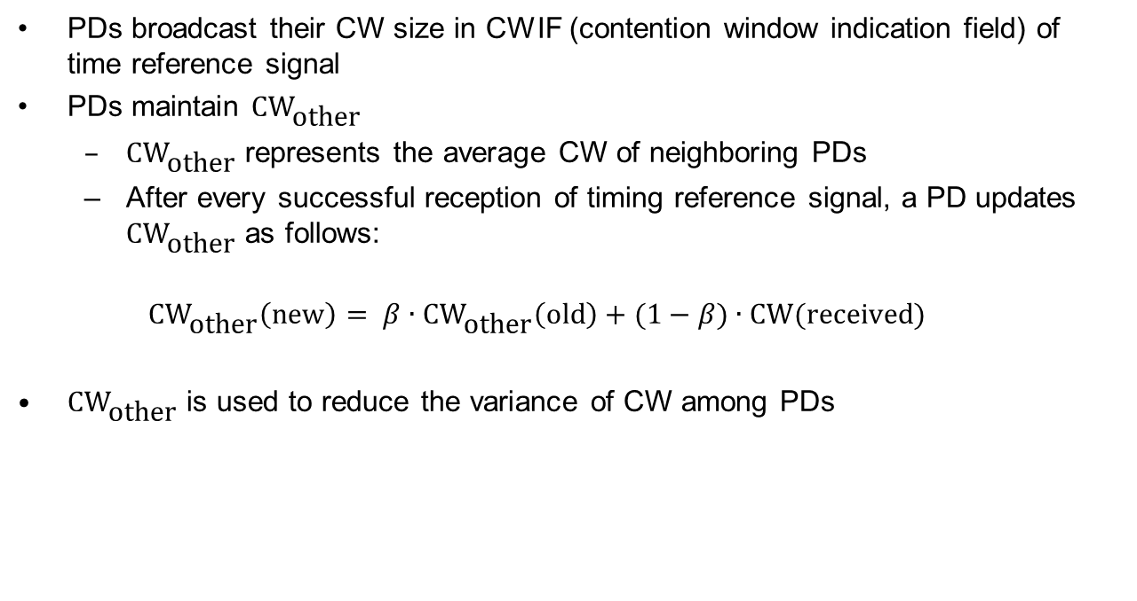
Fairness: Broadcast of CW
PDs broadcast their CW size in CWIF (contention window indication field) of time reference signal
PDs maintain ${\text{CW}}_{\text{other}}$
  ${\text{CW}}_{\text{other}}$ represents the average CW of neighboring PDs
  After every successful reception of timing reference signal, a PD updates ${\text{CW}}_{\text{other}}$ as follows:
  $${\text{CW}}_{\text{other}}\left(\text{new}\right)= β∙{\text{CW}}_{\text{other}}\left(\text{old}\right)+(1−β)∙\text{CW}(\text{received})$$
${\text{CW}}_{\text{other}}$ is used to reduce the variance of CW among PDs

Slide 11
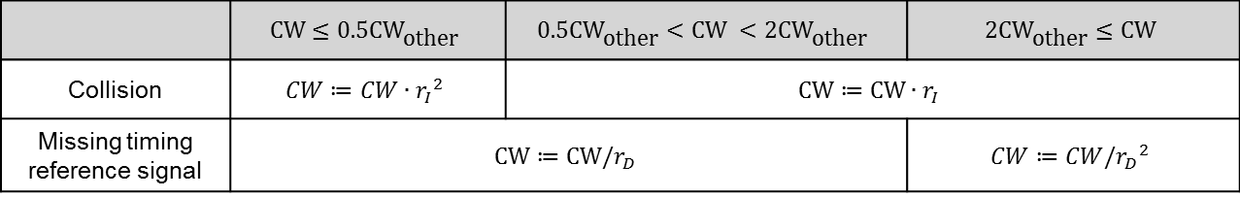
Update of CW
PDs increase their CW when a collision is detected
PDs decrease their CW when no timing reference signal is received in the current sync slot
 | $$\text{CW}≤0.5{\text{CW}}_{\text{other}}$$ | $$0.5{\text{CW}}_{\text{other}}<\text{CW} <2{\text{CW}}_{\text{other}}$$ | $$2{\text{CW}}_{\text{other}}≤\text{CW}$$
Collision | $$CW≔CW∙{r_{I}}^{2}$$ | $$\text{CW}≔\text{CW}∙r_{I}$$
Missing timing reference signal | $$\text{CW}≔\text{CW}/r_{D}$$ |  | $$CW≔CW/{r_{D}}^{2}$$

Slide 12
Synchronization Procedure
When a PD is initialized, the PD scans the channel to detect an existing timing reference. If it detects an existing timing reference, it adjusts its own timing to the detected timing reference and participates in the synchronization procedure. If no existing timing reference is detected, it chooses an arbitrary timing reference and initiate synchronization procedure.
A PD participating in a synchronization procedure transmits timing reference signal using CSMA/CA based random access.
Timing reference signal can be transmitted using random access anywhere in the sync slot as long as the transmission of the timing reference signal can be completed within the sync slot.
If a PD detects a timing reference signal transmitted by a neighboring PD, the PD takes the following steps.
  It updates its timing according the timing reference received in the timing reference signal.
  If its own backoff counter is 1, it transmits random tones in the collision detection field.
  If its own backoff counter is not 1, it checks the CDF to detect a collision. If a collision is detected, it increases its CW.
  It updates CW_other using the CW value contained in the timing reference signal.
If a PD detects no transmission attempt of timing reference signal in the current sync slot, it decreases its CW.
If the remaining time left in the current sync slot is less than the length of timing reference signal, it halts backoff procedure until the next sync slot.

Slide 13
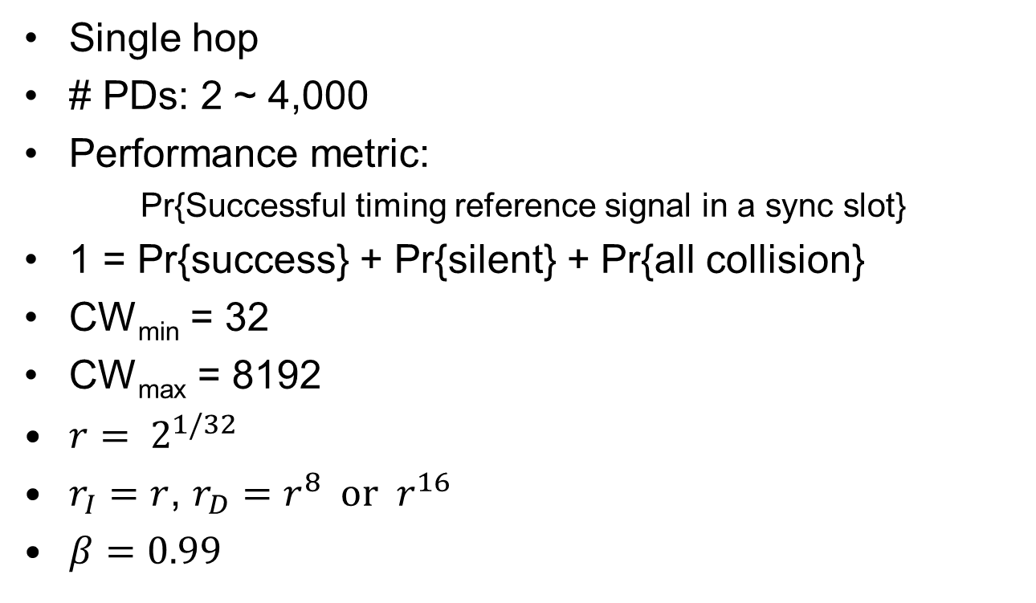
Simulation Scenario
Single hop
# PDs: 2 ~ 4,000
Performance metric:
Pr{Successful timing reference signal in a sync slot}
1 = Pr{success} + Pr{silent} + Pr{all collision}
CW_{min} = 32
CW_{max} = 8192
$r= 2^{1/32}$
$r_{I}=r$, $r_{D}=r^{8} \text{or} r^{16}$
$β=0.99$

Slide 14
Simulation Results:
Successful Transmission of Timing Reference Signal

Slide 15
Simulation Results
Distribution of CW

Slide 16
Simulation Results
Distribution of CW

Slide 17
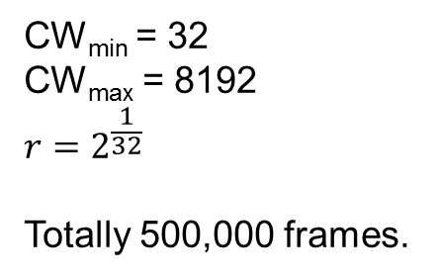
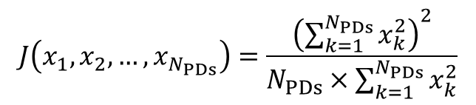
Simulatino Results:
Fairness Index
Jain’s fairness index
$$J\left(x_{1}, x_{2}, …, x_{N_{PDs}}\right)=\frac{{\left(\sum_{k=1}^{N_{PDs}}{x_{k}^{2}}\right)}^{2}}{N_{PDs}×\sum_{k=1}^{N_{PDs}}{x_{k}^{2}}}$$
CW_{min} = 32
CW_{max} = 8192
$$r=2^{\frac{1}{32}}$$
Totally 500,000 frames.

Slide 18
Random Access Scheme for Peering Slot and CAP (Contention Access Period)
Unicast, multicast, or broadcast data packets are transmitted using CSMA/CA based random access, which is similar to the scheme used in sync slot for distributed synchronization.
The differences are as follows:
  A PD increases it CW when it does not receive an ACK after transmitting a unicast packet, in addition to when it detects a collision.
  It decreases its CW when a PD detects no collision for predetermined period of time T_{d}.
  The increase and decrease of CW follows EIED backoff algorithm. The increase factor and decrease factor for packet transmission is [TBD].

Slide 19
References
[1] Jung-Hyun Kim, Jihyung Kim, Kwangjae Lim, Dong Seung Kwon, “Distributed Frequency Synchronization for Global Synchronization in Wireless Mesh Networks,” World Academy of Science and Technology, vol. 70, 2012, pp. 1080-1084.
[2] Nah-Oak Song, Byung-Jae Kwak, Jabin Song, L. E. Miller, “Enhancement of IEEE 802.11 Distributed Coordination Function with Exponential Increase Exponential Decrease Backoff Algorithm,” Proceedings of IEEE 57th Vehicular Technology Conference (VTC 2003-Spring), vol. 4, pp. 2775−2778, Jeju, Korea, April 22−25, 2003.

