Slide 1
Project: IEEE P802.15 Working Group for Wireless Personal Area Networks (WPANs)
Submission Title: [Proposal Outline of Completely Distributed Power Control Mechanism for Peer-Aware Communications ]
Date Submitted: [May 2nd, 2014]
Source: [David Smith †, Nicole Sawyer †, Siyu Zhou †, Marco Hernandez, Huan-Bang Li, Igor Dotlić, Ryu Miura]
Company: [NICTA† Australia, NICT Japan]
Address: [Tower A, 7 London Circuit, Canberra ACT 2601, Australia]
Voice:[+61 2 62676200] Fax: [+61 2 62676220] E-Mail:[David.Smith@nicta.com.au]
Re: [In response to call for technical contributions to TG8]
Abstract: [ ]
Purpose: [Material for discussion in 802.15.8 TG]
Notice: This document has been prepared to assist the IEEE P802.15. It is offered as a basis for discussion and is not binding on the contributing individual(s) or organization(s). The material in this document is subject to change in form and content after further study. The contributor(s) reserve(s) the right to add, amend or withdraw material contained herein.
Release: The contributor acknowledges and accepts that this contribution becomes the property of IEEE and may be made publicly available by P802.15.
†NICTA is funded by the Australian Government through the Department of Communications and the Australian Research Council
through the ICT Centre of Excellence Program.

Slide 2
Introduction
Completely distributed transmit power control, including prioritized communications (at PHY layer), for any number of Tx/Rx, source/destination pairs (single-hop) or source/relays/destination pairs (multi-hop).
This is based on research work by David Smith, Nicole Sawyer and Siyu Zhou, NICTA Australia, and presented as a joint proposal with NICT Japan to TG8.
Accompanying specification for this mechanism is given in DCN 14-246r0.

Slide 3
Introduction
The power control mechanism is a refinement of distributed discrete SINR balancing, by incorporating game-theoretic utility maximization, in order to obtain Pareto optimal outcomes.
It rapidly converges to acceptable packet delivery ratio (PDR) for high priority communications, faster than conventional power control techniques
Moreover, the proposal reduces power consumption across all sources, significantly, compared to conventional power control techniques

Slide 4
Packet Delivery Ratio (PDR) – Modeling
PDR=1−PER , where PER=Packet Error Rate.
The PDR, P_{d}, can be accurately modeled with a two-parameter compressed exponential function [Smith2013] of inverse signal- to-interference-plus-noise ratio as:
  where γ = SINR, a_{c} and b_{c} are constant parameters that depend of the modulation and coding scheme.
  The above expression is restated in the following equivalent form, with two parameters, for later analysis :

Slide 5
Packet Delivery Ratio (PDR) – Modeling
Assuming interference as aggregate Gaussian noise, the metric E_{s}/N₀ described in the TGD and contribution DCN 13-169r1 can be expressed as
  where T_{sym} is symbol time and T_{s} is sampling time.
  Hence, SINR=E_{s}/N₀−4.77 dB = γ
  For convolutional code rate and modulation type, table on next page

Slide 6
Packet Delivery Ratio (PDR) – Modeling
Table 1
Please note the parameters a_{c} and b_{c} are for 150 packet size.
For any packet size M_{p}, the PDR is given by
  where

Slide 7
Packet Delivery Ratio (PDR) – Modeling
P_{d} compared with curves, 3 examples from DCN 13-169r1, shows
a very good approximation (across all 9 fits from Table 1,
root-mean-square error ≤ 0.0021)

Slide 8
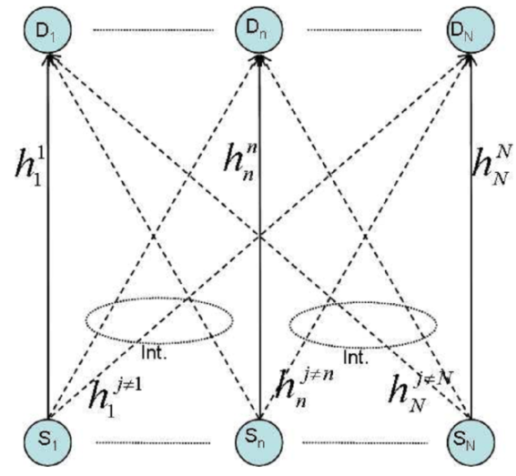
Distributed Power Control - Scenario
Single hop with N source-destination pairs
  All non-paired sources act as hidden terminals (e.g., non-coordinated at MAC layer in terms of scheduling, undiscovered etc.)
  Aim to minimize Tx power and obtain target PDR (equivalently target SINR)
  Prioritized communications at PHY level, i.e., priority levels low, medium, high can implement three different target PDRs for any source/destination pair.

Slide 9
Distributed Power Control - Scenario
Multi-hop
  Completely decentralized, no coordination of interfering pairs.
  Prioritized communications at PHY level, i.e., priority levels low, medium, high can implement three different target PDRs for any source/destination pair.
  This scenario is feasible for proposed power control if decode-and-forward (or alternatively detect-and-forward) communications is implemented.
s₁
r_{1,1}
r_{1,m}
d₁
s₂
r₂
r_{2,m}
d₂
s₃
r₃
r_{3,m}
d₃

Slide 10
Power Control Mechanism
Assume any Tx power from a discrete available transmit power levels vector:
  P_{vec} ϵ (0, 1W] for the 2.4 GHz and 5.7 GHz bands
  P_{vec} ϵ (0, 1mW] band A,D, (0, 20 mW] band B, (0, 250 mW] band C of sub-1GHz band for Japan.
Assume power control finitely repeated for T stages in contiguous frames.
  In order to ensure Pareto optimality (Tx power is minimized and target PDR is at least reached).

Slide 11

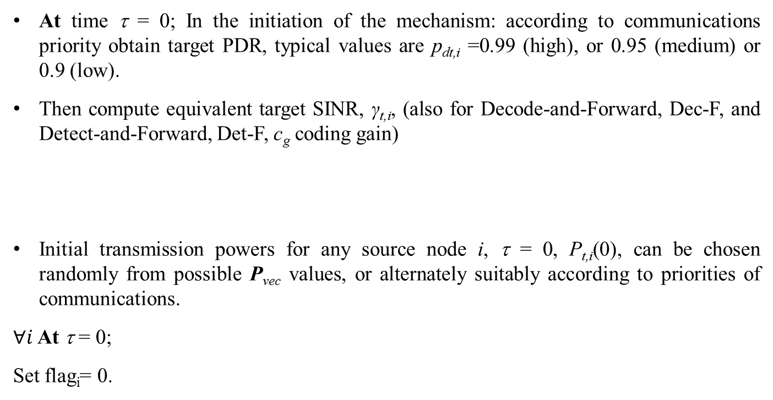
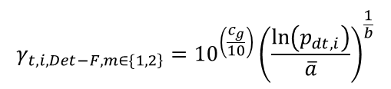
Power Control Algorithm - Initialization
At time τ = 0; In the initiation of the mechanism: according to communications priority obtain target PDR, typical values are p_{dt,i} =0.99 (high), or 0.95 (medium) or 0.9 (low).
Then compute equivalent target SINR, γ_{t,i}, (also for Decode-and-Forward, Dec-F, and Detect-and-Forward, Det-F, c_{g} coding gain)
Initial transmission powers for any source node i, τ = 0, P_{t,i}(0), can be chosen randomly from possible P_{vec} values, or alternately suitably according to priorities of communications.
$∀i$ At τ = 0;
Set flag_{i}= 0.
$$γ_{t,i,Dec−F}=γ_{t,i,}={\left(\frac{\ln\left(p_{dt,i}\right)}{\overline{a}}\right)}^{\frac{1}{b}}$$
$$γ_{\left.t,i,Det−F,m∈\{1,2\right\}}={10}^{\left(\frac{c_{g}}{10}\right)}{\left(\frac{\ln\left(p_{dt,i}\right)}{\overline{a}}\right)}^{\frac{1}{b}}$$

Slide 12
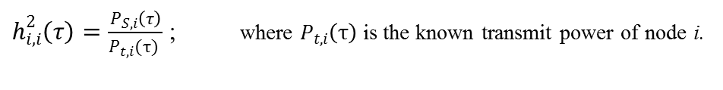

Power Control Algorithm (cont.) - Inputs
$∀i$From time τ = 0,…,T-1,
where in estimate denominator of received interference + noise power;
and received target signal power
using common methods for SINR estimation (references in DCN??)
$h_{i,i}^{2}\left(τ\right)=\frac{P_{S,i}\left(τ\right)}{P_{t,i}(τ) }$ ; where $P_{t,i}\left(τ\right)$is the known transmit power of node i.
τ = τ+1;

Slide 13
Power Control (cont.) 1st step –with conditions
if τ ≥ 3 ∧ γ_{i}(τ-1)≈ γ_{i}(τ-2) ∧ P_{i}(τ-1)= P_{i}(τ-2) ∧ flag_{i} = 1,
flag_{i} = 2;
elseif τ ≥ 2 ∧ γ_{i}(τ-1)≈ γ_{i}(τ-2) ∧ P_{i}(τ-1)= P_{i}(τ-2) ∧ flag_{i} = 0,
flag_{i} = 1;
end if
If flag_{i} = 0,
; else,
; end if

Slide 14
Power Control 2nd step –Refinement Basis
According to non-cooperative repeated game with imperfect information (as PDs act concurrently), a unique Nash equilibrium is obtained by maximizing for link i:
  where U_{i}() is an utility function, d_{i}() is a weighting factor, p_{d} (P_{i}(τ)) is a PDR value as function of P_{i}(τ) for stage τ, ν_{i}=3.

Slide 15
Power Control (cont.) 2nd step –Refinement
The powers P_{t,i}(τ) for each link i at stage τ is computed as
where ν=3.
(A vector of length L of possible utilities ∀i)
(Find the unique Nash equilibrium point for PD i)
. Transmit P_{t,i}(τ) from PD i at time slot τ ;
End Algorithm at T = τ, when flag_{i} = 2, ∀i.

Slide 16
Simulation Set-Up
Considering an square area of 500mx500m, transmitters/sources dropped randomly with uniform distribution, unicast transmissions
  Paired receivers/destinations dropped with uniform distribution (single-hop)
  Paired relays+destinations dropped with uniform distribution (two-hop)
  Consider N source/destination (or source/relay/destination) pairs from these, which act as hidden terminals to each other – undiscovered at MAC (or PHY)
    Same for two-hop as single-hop
Model from DCN 12-459r7 Sec 2.2.6 “Path loss between terminals located below roof-top for 900 MHz and 2.4 GHz bands” with
  Frequency =2.4 GHz, p=50% and L_{urban}=6.8 dB
Maximum transmit power 20 dBm (Minimum 0-dBm, but effective for lower limits also.)
  Antenna gains are 0 dBi.
  Receivers noise figure 7 dB; implementation losses and fade margin 8 dB
  Discrete power level spacing of 2 dB, with a total of 11 discrete power levels
Both Static Fading and Slow Rayleigh fading considered
  Slow fading, fading parameter f_{D}T_{s} = 0.002, f_{D} Doppler spread, T_{s} power sampling period, generated using Jakes model

Slide 17
Simulation-1 Results
Further Simulation parameters:
  ¾ coding rate with BPSK modulation
  Packet size M_{p} = 512 bytes
  Single-hop with repeated power control mechanism applied on 1000 occasions, with T=40 stages in each occasion.
  Static Fading
  N = 20 links or source/destination pairs with distances chosen at random with uniform distribution in [10m, 30m].
  N(N−1) interfering links distances having a minimum of 2.0 m and an average of 270m for interfering source/s to target destination
  AWGN noise variance between 10⁻¹⁰ to 10⁻¹¹ mW
  Comparison with decentralized SINR balancing, using first-step, with modification in this outline to completely decentralize that of [Andersin1998]

Slide 18
Simulation-1 Results
Power Saving of 22.7 dBm over the N = 20 links

Slide 19
Simulation-2 Results
Further Simulation parameters:
  ¾ coding rate with BPSK modulation
  Packet size M_{p} = 512 bytes
  Single-hop with repeated power control mechanism applied on 1000 occasions, with T=120 stages in each occasion.
  Slow Rayleigh Fading, f_{D}T_{s} = 0.002
  N = 20 links or source/destination pairs with distances chosen at random with uniform distribution in [10m, 30m].
  N(N−1) interfering links distances having a minimum of 1.7 m and an average of 270m for interfering source/s to target destination
  AWGN noise variance between 10⁻¹⁰ and 10⁻¹¹ mW
  Comparison with decentralized SINR balancing, using first-step, with modification in this outline to completely decentralize that of [Andersin1998]

Slide 20
Simulation-2 Results
Power Saving of 33.7 dBm

Slide 21
Simulation-3 Results
Further Simulation parameters:
  ¾ coding rate with QPSK modulation
  Packet size M_{p} = 64 bytes
  Two-hop, Decode-and-Forward with repeated power control mechanism applied on 1000 occasions, with T=40 stages in each occasion.
  Static Fading
  N = 20 links or 20 source/relay/destinations with each hop distance chosen at random with uniform distribution in [10m, 25m], thus total source/destination distance uniformly distributed in [20,50m].
  N(N−1) interfering links distances having a minimum of 2.4 m and an average of 270m for interfering sources to target relays, and interfering relays to target destinations
  AWGN noise variance between 10⁻¹⁰ to 10⁻¹¹ mW
  Comparison with decentralized SINR balancing, using first-step, with modification from this outline to completely decentralize that of [Andersin1998]

Slide 22
Simulation-3 Results
Power Saving of 23.0 dBm

Slide 23
Simulation-4 Results
Further Simulation parameters:
  ¾ coding rate with BPSK modulation
  Packet size M_{p} = 64 bytes
  Two-hop, Decode-and-Forward, with repeated power control mechanism applied on 1000 occasions, with T=120 stages in each occasion.
  Slow Rayleigh Fading, f_{D}T_{s} = 0.002
  N = 20 links or 20 source/relay/destinations with each hop distance chosen at random with uniform distribution in [10m, 25m], thus total source/destination distance uniformly distributed in [20,50m].
  N(N−1) interfering links distances having a minimum of 1.0 m and an average of 270m for interfering sources to target relays, and interfering relays to target destinations AWGN noise variance between 10⁻¹⁰ and 10⁻¹¹ mW
  Comparison with decentralized SINR balancing, using first-step, with modification in this outline to completely decentralize that of [Andersin1998]

Slide 24
Simulation-4 Results
Power Saving of 31.6 dBm

Slide 25
Simulation-5 Results
Further Simulation parameters:
  ¾ coding rate with BPSK modulation, Packet size M_{p} = 512 bytes
  Two-hop, Decode-and-Forward, compared with single hop with repeated power control mechanism applied on 1000 occasions, with T=40 stages
  Static fading
  N = 20 links or 20 source/relay/destinations with each hop distance chosen at random with uniform distribution in [10m, 25m], thus single-hop source/destination distance uniformly distributed in [20,50m].
  N(N−1) interfering links distances having a minimum of 0.94 m and an average of 270m for interfering sources to target relays, and interfering relays to target destinations, multi-hop, 0.26m and 273m for interfering sources to target destinations single-hop
  AWGN noise variance between 10⁻¹⁰ and 10⁻¹¹ mW

Slide 26
Simulation-5 Results

Slide 27
Simulation-6 Results
Further Simulation parameters:
  ¾ coding rate with BPSK modulation, Packet size M_{p} = 512 bytes
  Two-hop, Decode-and-Forward, compared with two-hop detect and forward with repeated power control mechanism applied on 1000 occasions, with T=40 stages
  Static fading
  N = 20 links or 20 source/relay/destinations with each hop distance chosen at random with uniform distribution in [10m, 25m], thus total source/destination distance uniformly distributed in [20,50m].
  N(N−1) interfering links distances having a minimum of 3.5 m and an average of 271m for interfering sources to target relays, and interfering relays to target destinations, multi-hop
  AWGN noise variance between 10⁻¹⁰ and 10⁻¹¹ mW

Slide 28
Simulation-6 Results
Tx Power Saving of 38.3 dBm of Decode-and-Forward hop over Detect-and-Forward hop

Slide 29
Simulation-7 Results
Further Simulation parameters:
  ¾ coding rate with BPSK modulation, Packet size M_{p} = 512 bytes
  Two-hop, Decode-and-Forward, compared with two-hop detect and forward with repeated power control mechanism applied on 1000 occasions, with T=120 stages
  Slow Rayleigh fading, f_{D}T_{s} = 0.002
  N = 20 links or 20 source/relay/destinations with each hop distance chosen at random with uniform distribution in [10m, 25m], thus total source/destination distance uniformly distributed in [20,50m].
  N(N−1) interfering links distances having a minimum of 3.5 m and an average of 271m for interfering sources to target relays, and interfering relays to target destinations, multi-hop
  AWGN noise variance between 10⁻¹⁰ and 10⁻¹¹ mW

Slide 30
Simulation-7 Results
Tx Power Saving of 44.1 dBm of Decode-and-Forward hop over Detect-and-Forward hop over N = 20 links

Slide 31
Conclusions
  Relatively simple (and very effective) Tx power control mechanism that does not rely on channel prediction.
  Significant Tx power savings. From 22 dBm to 34 dBm.
  Prioritized communications enabled at PHY: important in disaster response (high priority communications reaching target PDR, generally in less time stages than simply using SINR balancing).

Slide 32
Conclusions
  Power control enabled by simple, accurate PDR model based on the TGD and contribution DCN 13-169r1.
  The proposed power control method shown to be applicable in slow fading channels, where direct channel gains vary between stages of power control.
  Also, the proposed power control can be applied asynchronously as all sources (relays) do not need to transmit concurrently
  Simulations based on single-hop communications, and multi-hop communication with decode-and-forward or detect-and-forward
    All schemes viable with the power control mechanism here
    Decode-and-Forward significantly more efficient needing much lower output Tx power than Detect-and-Forward

Slide 33
References
  [Smith2013] Smith, D.; Portmann, M.; Tan, W.; Tushar, W., "Multi Source-Destination Distributed Wireless Networks: Pareto-Efficient Dynamic Power Control Game with Rapid Convergence," IEEE Transactions on Vehicular Technology, December 2013. [Available online under subscription]
  Google: doi 10.1109/TVT.2013.2294019
  [Andersin1998] Andersin, Michael, Zvi Rosberg, and Jens Zander. "Distributed discrete power control in cellular PCS." Wireless Personal Communications 6.3 (1998), pp. 211-231.

