Slide 1
Project: IEEE P802.15 Working Group for Wireless Personal Area Networks (WPANs)
Submission Title: RoF-Based Terahertz Fronthaul for Mobile/Wireless Access Systems
Date Submitted: January 20, 2014
Source: Atsushi Kanno, Toshiaki Kuri, Tetsuya Kawanishi Akifumi Kasamatsu, Norihiko Sekine,
Iwao Hosako, and Hiroyo Ogawa, NICT
4-2-1, Nukuikita, Koganei, 184-8795, Tokyo, Japan
Voice: +81 42 327 6876, FAX: +81 42 327 7938, E-Mail: kanno@nict.go.jp
Yuki Yoshida and Ken’ichi Kitayama, Osaka University
Voice: +81 6 6879 7728, FAX: +81 6 6879 7688, E-Mail: kitayama@comm.eng.osaka-u.ac.jp
Re: n/a
Abstract: The aim of this contribution is to provide configuration of Radio over Fiber (RoF) based terahertz fronthaul for mobile/wireless access systems.
Purpose: Informing 802.15.3d on RoF based terahertz technologies for fixed point-to-point link.
Notice: This document has been prepared to assist the IEEE P802.15. It is offered as a basis for discussion and is not binding on the contributing individual(s) or organization(s). The material in this document is subject to change in form and content after further study. The contributor(s) reserve(s) the right to add, amend or withdraw material contained herein.
Release: The contributor acknowledges and accepts that this contribution becomes the property of IEEE and may be made publicly available by P802.15.

Slide 2
RoF-Based Terahertz Fronthaul for Mobile/Wireless Access Systems
Atsushi Kanno, Toshiaki Kuri, Tetsuya Kawanishi,
Akifumi Kasamatsu, Norihiko Sekine,
Iwao Hosako and Hiroyo Ogawa
National Institute of Information and Communications Technology (NICT), Japan

Slide 3
Purpose of this Contribution
At the last IEEE802.15 meeting, the technologies of fronthaul for broadband mobile/wireless access systems were proposed using Radio over Fiber (RoF). Several technical questions were raised regarding to the system architecture. The purpose of this contribution is to answer these questions and to provide clear pictures of fronthaul.
ITU-T SG15 Q2 is now drafting a text of Supplement on “Radio-over-fiber (RoF) technologies and their applications”. The definition of mobile fronthaul was proposed by NICT and it was agreed to be included in the section of Definition. This contribution intends to adopt this definition as a terahertz fronthaul.

Slide 4
Definition of Fronthaul at ITU-T
3.2 Terms defined in this Supplement
This Supplement defines the following terms:
3.2.1 Mobile backhaul (MBH): The connection among base stations and the other mobile network nodes
3.2.2 Mobile backhaul link: A link to establish a mobile backhaul
3.2.3 Mobile fronthaul (MFH): The connection between one and the other of separated radio transceiver functions within a base station
3.2.4 Mobile fronthaul link: A link to establish a mobile fronthaul
Reference: “Proposal of definition of “mobile fronthaul” in G Suppl. RoF”, ITU-T Q2/15 Interim Meeting, D72, February 20, 2014.

Slide 5
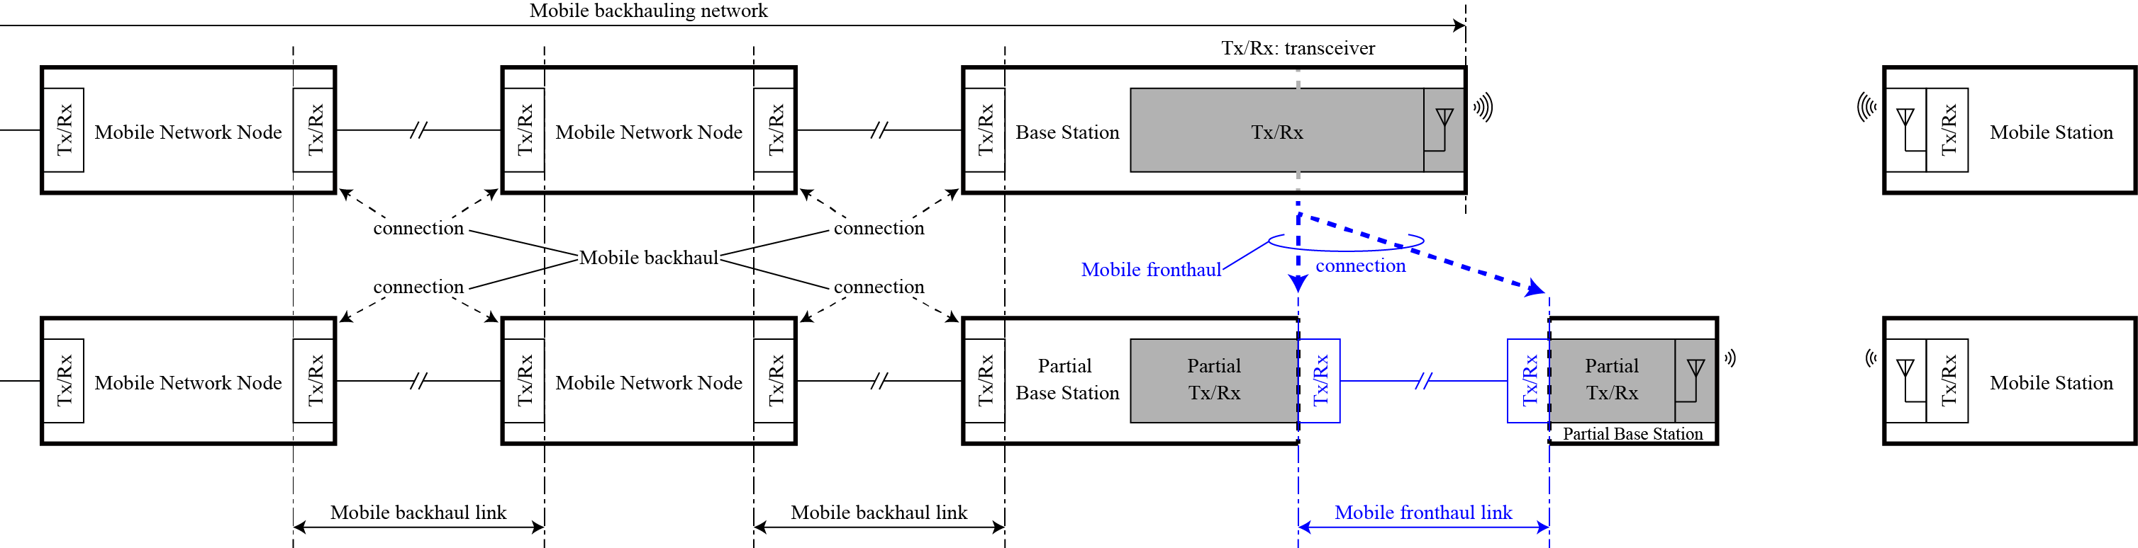
Definition of Fronthaul at ITU-T
Fig. 2: Definition of “mobile fronthaul (MFH)” and “mobile fronthaul link”:
(upper) conventional architecture, (lower) possible architecture with mobile fronthaul.
Reference: “Proposal of definition of “mobile fronthaul” in G Suppl. RoF”, ITU-T Q2/15 Interim Meeting, D72, February 20, 2014.

Slide 6
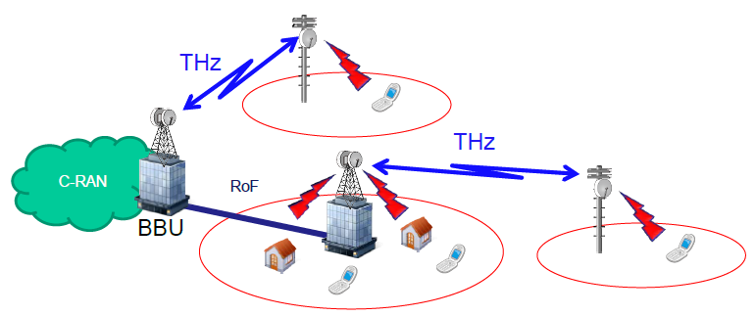
Mobile/wireless access networks using RoF-based Terahertz Fronthaul

Slide 7


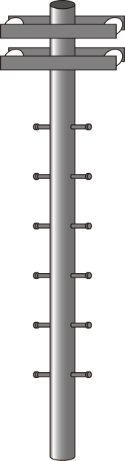





RoF-Based Terahertz Fronthaul
Base Station
THz Transceiver
THz and RoF Transceiver
Terahertz P-to-P
(>275 GHz) 40/100 Gb/s
MW/MMW/THz
(5G mobile
/6G WiFi)
MW/MMW/THz
(5G mobile
/6G WiFi)
User Terminal
RoF Transceiver
Radio on Fiber (RoF)

Slide 8
Block Diagram of Base Station
RoF Transceiver
THz and RoF Transceiver
Optical
SHIQM
Photomixer
IQ data
LO
WDM
WDM
LO
SHM
Optical
coherent
receiver
Terahertz
P-to-P
Optical Tx
Optical spectrum
Terahertz
Wavelength

Slide 9
Observed SSB phase noise of 300-GHz sinusoidal signal using O-SHIQM*
300-GHz signal
20 log 24
LO signal for
measurement SHM
20 log 30
LO signal for optical SHIQM (10 GHz)
        SHIQM (Sub-harmonic IQ Mixer) was presented in the document: IEEE 802.15-14-0022-00-0thz

Slide 10
Summary and Discussion
RoF-based terahertz fronthaul for broadband mobile/wireless access systems is proposed again using definition adopted by ITU-T SG15 Q2 meeting held on February 20, 2014..
The radio transceiver functions of base station are connected through optical fiber cables.
Terahertz signal distribution to THz transceivers through RoF feeder lines can be achieved without terahertz local oscillators and other RF components at THz transceiver whose configuration can be simplified.
RoF feeder link can extend a distance up to 100 km between RoF and THz transceivers.

