Slide 1
doc.: IEEE 802.15-14- 0166 -01-007a
Project: IEEE P802.15 Working Group for Wireless Personal Area Networks (WPANs)
Submission Title: [Application of digital signal processing in high speed OCC system]
Date Submitted: [March, 2014]
Source: [Nan Chi]
[Fudan University]
Address [Shanghai, China]
Voice:[86-021-65642983], FAX: [86-021-65642983], E-Mail:[nanchi@fudan.edu.cn]
Re: []
Abstract: [Application of digital signal processing in high speed OCC system]
Purpose: [Contribution to IEEE 802.15.SG7a OCC]
Notice: This document has been prepared to assist the IEEE P802.15. It is offered as a basis for discussion and is not binding on the contributing individual(s) or organization(s). The material in this document is subject to change in form and content after further study. The contributor(s) reserve(s) the right to add, amend or withdraw material contained herein.
Release: The contributor acknowledges and accepts that this contribution becomes the property of IEEE and may be made publicly available by P802.15.
Notes:
doc.: IEEE 802.15-09-0117-00-0007
<month year>

Slide 2
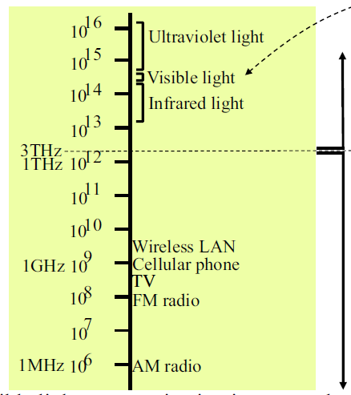
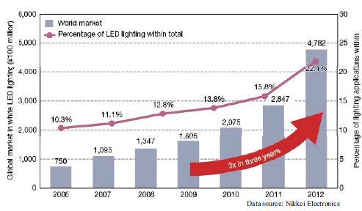
doc.: IEEE 802.15-14- 0166 -01-007a
Background & Research Motivation
VLC
Light Wave
LED lighting in the global marketing
Radio Wave
Visible light communication motivated by the dramatic development of LED technologies and the scarce spectrum resources.
Wireless information transmission via light, simultaneously supporting illumination and communication
Potential large bandwidth and electromagnetic interference free
Complementary to radio for wireless access

Slide 3
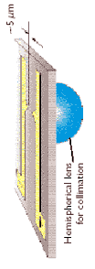
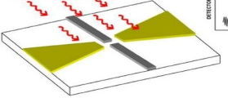
doc.: IEEE 802.15-14- 0166 -01-007a
    Schematic of VLC System
Visible light transmission
LED Modulation
Rx Module
Tx Module
I
Demodulator
AD
Decoder
Phase
coding
modulation
Pre-equalization
AD
Q
Baseband
LED
O to E
Signal processing

Slide 4
doc.: IEEE 802.15-14- 0166 -01-007a
LED | equa | Modulation format | Data rate | Receiver | length | institute | publication
white |  | OOK-NRZ | 1022bit/s | Image sensor | 2km | VLCC
white | Pre | OOK-NRZ | 40Mbit/s | PIN | 2m | University of Oxford | PTL2008
blue | Pre | OOK-NRZ | 80Mbit/s | PIN | 10cm | University of Oxford | ECOC20n08
white |  | OOK-NRZ | 100Mbit/s | APD | 3m | Nakagawa Laboratories | OEPT2009
blue | Post | OOK-NRZ | 100Mbit/s | PIN | 10cm | Samsung Electronics | PTL2009
blue |  | DMT-QAM | 200Mbit/s | PIN | 2m | Fraunhofer HHI | PTL2009
MIMO white | Post | DMT-QPSK | 220Mb/s | Image sensor | 100cm | University of Oxford | OWC2010
white |  | DMT-QAM | 513Mb/s | APD | 27cm | Siemens | JLT2010
RGB | Pre | OFDM | 800Mb/s | PIN | 66cm | Fudan University | OPEX2012
RGB |  | DMT-WDM | 803Mb/s | APD | 12cm | Fraunhofer HHI | OFC2011
RGB |  | DMT | 806Mb/s | PIN | 8cm | Fraunhofer HHI | ICTON2012
blue |  | DMT-QAM | 1Gb/s | APD | 10cm | Scuola Superiore Sant’Anna | PJ2012
white | Post | CAP | 1.1Gb/s | PIN | 23cm | National Chiao Tung University | PTL2012
RGB | Pre | OFDM | 2.1Gb/s | APD | 2.5m | Fudan University | OPEX2013
RGB |  | DMT | 3.4Gb/s | APD | 10cm | Scuola Superiore Sant’Anna | OPEX2013
RGB | Post | SC-FDE | 3.75Gb/s | APD | 1cm | Fudan University | COL2013
MicroLED | Post/Pre | HW OFDM | 3 Gb/s (10Gb/s) | APD | 5cm | Edinbourgh University | PTL2014

Slide 5
32-order FIR Filter for different modulation formats
doc.: IEEE 802.15-14- 0166 -01-007a
QPSK
8QAM
16QAM
64QAM
128QAM
512QAM

Slide 6
Channel equalization
doc.: IEEE 802.15-14- 0166 -01-007a
Original spectrum
Received spectrum
Pre-equalization
  Obtain the channel knowledge(H) at the RF domain
  Make pre-equalization Tx*1/H at the baseband
Post-equalization
Pilot-aided phase estimation
LS estimator according to the pilot information

Slide 7
doc.: IEEE 802.15-14- 0166 -01-007a
Bi-directional transmission based on WDM
Downlink: Green and Red, the BER is within the FEC limit at a distance of 66cm Uplink: P-LED, the BER performance almost remained the same at the bi-directional envionrenment.

Slide 8
doc.: IEEE 802.15-14- 0166 -01-007a
Bi-directional transmission based on WDM and SCM
Uplink: RGB LED (Blue)
Downlink: RGB LED (red green blue)
Data rate: 875-Mb/s downstream and 125-Mb/s upstream transmission

Slide 9
Conclusions
doc.: IEEE 802.15-14- 0166 -01-007a
Blue phosphor LED maximum bitrate up to 225Mb/s
RGB LED maximum bitrate up to1Gb/s
Both pre-equalization and post equalization are applied
Challenge on nonlinearity at Tx and Rx to further increase the transmission speed

