Slide 1
Project: IEEE P802.15 Working Group for Wireless Personal Area Networks (WPANs)
Submission Title: Simulation of flat Ricean fading channel
Date Submitted: January 21, 2014
Source: Jinesh P Nair¹, Kiran Bynam¹, Youngsoo Kim^{1,}, Chandrashekhar Thejaswi PS¹, Frederik Beer².
¹Samsung Electronics, ²FAU/IIS
Phone: +918041819999-464, Fax: +918041819999
E-Mail: jinesh.p@samsung.com
Abstract: Description of simulation of flat Ricean fading channel
Purpose: Reference on channel models for fair comparison of proposals and system evaluation
Notice: This document has been prepared to assist the IEEE P802.15. It is offered as a basis for discussion and is not binding on the contributing individual(s) or organization(s). The material in this document is subject to change in form and content after further study. The contributor(s) reserve(s) the right to add, amend or withdraw material contained herein.
Release: The contributor acknowledges and accepts that this contribution becomes the property of IEEE and may be made publicly available by P802.15.
Jinesh P Nair, Kiran Bynam and Youngsoo Kim

Slide 2
Objective
Simulation of a flat Ricean fading channel
LOS component : K = 0 dB
Equal distribution of power among LOS and NLOS components
Mobility : 2 miles/hr
Reference channel model for a fair evaluation of proposals

Slide 3
Description of Parameters
Input
Ricean K factor
Mobility
Center frequency of operation
Channel sampling rate
Output
Flat fading channel co-efficients as a function of time sampled at the channel sampling rate

Slide 4
Ricean K factor
Ricean Distribution Generation
Set of complex zero-mean Gaussian distributed numbers is generated
Total average power of this distribution is 1
For a Ricean distribution (K>0 implied)
Constant path component ‘m’ has to be added to the Rayleigh set of coefficients.
Ratio of powers between this constant part and the Rayleigh (variable) part is specified by the K-factor.

Slide 5
Ricean K factor
Distribution of power for the general case
Total power is normalized to 1
$1= {\left|m\right|}^{2}+σ^{2}, σ^{2}$ the variance of the complex Gaussian set
The ratio of powers is
$K= \frac{{\left|m\right|}^{2}}{σ^{2}}$
Power of the complex Gaussian and the power of the constant part
${\left|m\right|}^{2}=\frac{K}{K+1}, σ^{2}=\frac{1}{K+1}$

Slide 6
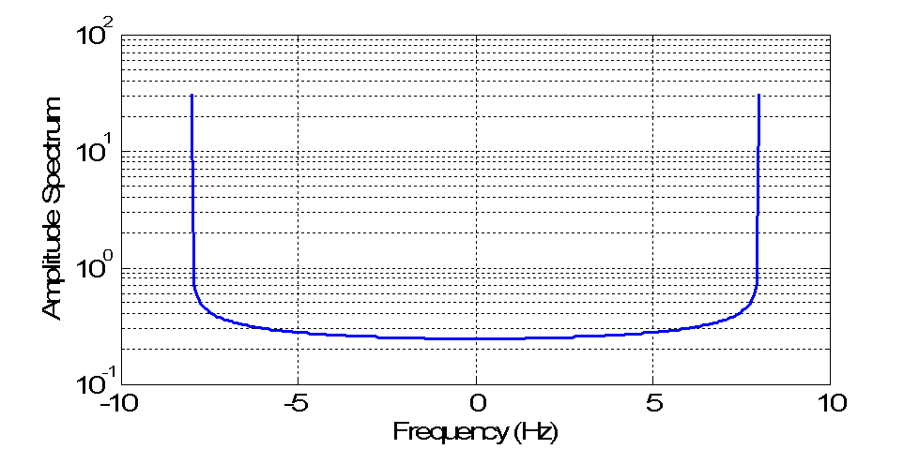
Mobility
Complex Gaussian distributed numbers are filtered using Doppler filters
$S(f)=\frac{1}{πf_{d}\sqrt{1−{\left(\frac{f}{f_{d}}\right)}^{2}}}, \left|f\right|<f_{d}, f_{d}=\frac{vf_{c}}{c}$

Slide 7
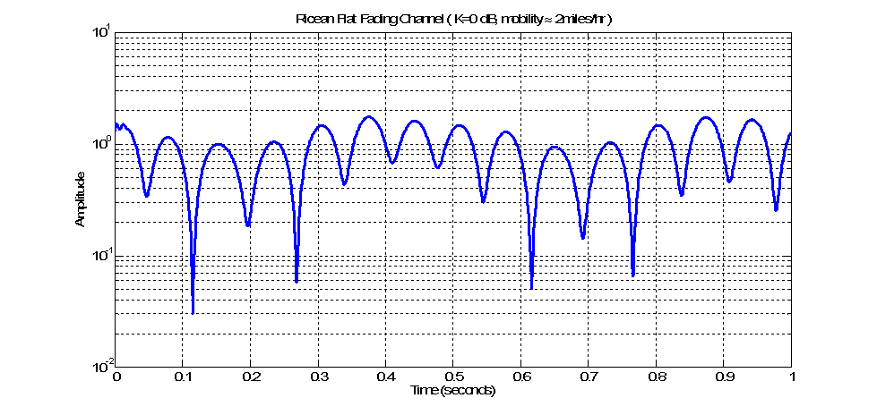
Observations
Exemplary channel realizations as a function of time

Slide 8
Simulation Code
function f = ChannSim4q()
clc;close all;clear all;
v = 3.6; % Km/hr equivalent to 2.23miles/hr;
fc = 2.4e9; % Center Frequency Hz
Kf = 0; % Ricean K factor in dB
fs = 1e6; % Channel Sampling Rate in Hz
h = FlatFad2(Kf, v, fc, fs);
figure;
semilogy([0:floor(length(h)/10)-1].*1./fs,abs(h(1:floor(length(h)/10))));
xlabel('Time (seconds)');
ylabel('Amplitude');
title('Ricean Flat Fading Channel')
end

Slide 9
Simulation Code
function Str = FlatFad2(Kf, m, fc, BWsamp)
%--------------------Derived Parameters -----------------------------------
v = m*1e3/(3600); % Velocity in m/s
c = 3e8; % Velocity of light in m/s
fd = floor(v*fc/c); % Maximum Doppler Frequency in Hz
fsamp = 256; % Number of frequency smaples within Doppler Bandwidth
fdmax = 100; % Hz (BW = 2*fdmax)
K = 10^(0.1*Kf); % dB to linear scale conversion
s2 = 1./(K+1); % Calculate variance scaling for complex Gaussian process
m2 = K./(K+1); % Calculate constant power for specular component
randPhase = rand(1)*2*pi; % Random initial phase in the LOS component
freqOffset = 2*pi*randi(fd,1,1)/fdmax; % Frequency Offset limited by the maximum Doppler

Slide 10
Simulation Code
%--------------------Doppler Filter----------------------------------------
ft = [-fd:2*fd/(fsamp):fd]; % Frequency axis of Doppler Filter
Sf = 1.5./(pi*fd*sqrt(1-(ft/fd).^2)); % Doppler Filter
Sf(1) = 1000; % limiting the infinite values
Sf(end) = Sf(1);
Sf = sqrt(Sf);
%-------------------Frequency axis for fdmax sampling ---------------------
fre = round((fdmax-fd)*fsamp/(2*fd));
lft = [ -fd-fre*2*fd/(fsamp):2*fd/(fsamp):-fd-2*fd/(fsamp)];
rft = [ fd + 2*fd/(fsamp):2*fd/(fsamp): fd + fre*2*fd/(fsamp)];
faxis = [lft ft rft];
%-------------------Generation of In-phase component-----------------------
I = randn(1,fsamp/2)+randn(1,fsamp/2)*1i; % Complex Gaussian Process
Im = [I 0 fliplr(conj(I))]; % Symmetrical Output
ISfiltBB = [Sf(1+fsamp/2:end).*Im(1+fsamp/2:end) zeros(1,2*fre)...
Sf(1:fsamp/2).*Im(1:fsamp/2)]; % Frequency Domain Filtering and
% Interpolation
In = ifft([ISfiltBB]); % Generation of In-phase component
In = 1./sqrt(2)*In./(sqrt(mean(In.^2))); % Normalization

Slide 11
Simulation Code
%-------------------Generation of Quadrature component---------------------
Q = randn(1,fsamp/2)+i*randn(1,fsamp/2)*1i; % Complex Gaussian Process
Qm = [Q 0 fliplr(conj(Q))]; % Symmetrical Output
QSfiltBB = [Sf(1+fsamp/2:end).*Qm(1+fsamp/2:end) zeros(1,2*fre)...
Sf(1:fsamp/2).*Qm(1:fsamp/2)]; % Frequency Domain Filtering and
% Interpolation
Qn = ifft([QSfiltBB]); % Generation of Quadrature component
Qn = 1./sqrt(2)*Qn./(sqrt(mean(Qn.^2))); % Normalization
Sr = (In+Qn*1i); % Generation of the Rayleigh Fading Component
% St = sqrt(m2) + sqrt(s2).*Sr; % Generation of the Ricean Fading i.e. LOS and NLOS
St = sqrt(m2).*exp(1j*(randPhase + freqOffset.*(1:length(Sr)))) + sqrt(s2) .* Sr;
Str = resample(St(1:2000),BWsamp/1,(2*fdmax)); % Matching to Channel Sampling Rate
% 10 seconds simulation at 1MHz sampling
end

Slide 12
References
1. Marco Hernandez et al, “Channel models for TG8” IEEE P802.15 Working Group for Wireless Personal Area Networks (WPANs), Sept 2012
Jinesh Nair, Kiran Bynam and Youngsoo Kim, “Channel Models for IEEE 802.15.4q” IEEE P802.15 Working Group for Wireless Personal Area Networks (WPANs), DCN: 15-12-0329-00, May. 2013
T. Rappaport, “Wireless Communications” Pearson Education, 2nd Edition, 2002.

