Slide 1
Project: IEEE P802.15 Working Group for Wireless Personal Area Networks (WPANs)
Submission Title: Additional Results for Samsung’s Physical Layer Proposal
Date Submitted: 21 January, 2014
Source: Chandrashekhar Thejaswi PS, Jinesh Nair, Young-Jun Hong, Youngsoo Kim.
E-Mail: c.thejaswi@samsung.com
Abstract: Samsung’s PHY proposal as response to IEEE 802.15.4q CFP
Purpose: Response to Call for Proposals
Notice: This document has been prepared to assist the IEEE P802.15. It is offered as a basis for discussion and is not binding on the contributing individual(s) or organization(s). The material in this document is subject to change in form and content after further study. The contributor(s) reserve(s) the right to add, amend or withdraw material contained herein.
Release: The contributor acknowledges and accepts that this contribution becomes the property of IEEE and may be made publicly available by P802.15.

Slide 2
Background and Objective
Based on the previous proposal
ref. document: IEEE 802. 5-13-0705-00-004q
Performance results of ULP with ideal non-coherent receiver.
  Comparison of modulation schemes with FEC and without FEC.
  Performance of modulation schemes with FEC in Ricean fading channel.
  Evaluation of synchronization algorithm
  Link budget analysis.
Power spectral density plots of the transmitted signal.

Slide 3
Transmitter Block Diagram
Uncoded
Data
Stream
Shortened
BCH
codes
Bit
interleaver
Bits-to-symbol
conversion
(M bits/symbol)
Symbol-to- chip mapper
(SF = L/M)
Random sequence inversion
Pulse shaping
Preamble + SFD sequence
Fig. 1. Block diagram of the ULP transmitter.

Slide 4
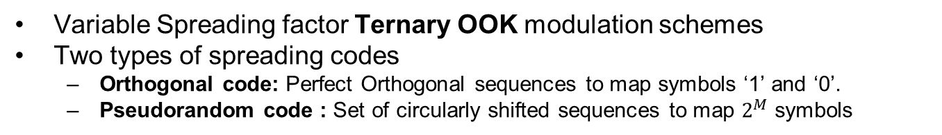
Modulation
Variable Spreading factor Ternary OOK modulation schemes
Two types of spreading codes
  Orthogonal code: Perfect Orthogonal sequences to map symbols ‘1’ and ‘0’.
  Pseudorandom code : Set of circularly shifted sequences to map $2^{M}$ symbols
M | L | Nomenclature | Orthogonal Sequences (symbols: ‘1’ / ‘0’)
1 | 1 | 1/1-TOOK | 1/0
 | 2 | 1/2-TOOK | 1 0/ 0 -1
 | 4 | 1/4 –TOOK | 1 0 0 1/0 -1 -1 0
 | 8 | 1/8 –TOOK | 1 0 -1 0 0 -1 0 1 / 0 -1 0 1 1 0 -1 0
M | L | Nomenclature | Basic Pseudorandom Sequence
2 | 4 | 2/4-TOOK | 1 0 0 0
3 | 8 | 3/8-TOOK | 0 0 0 1 -1 0 1 1
4 | 16 | 4/16-TOOK | 1 -1 0 0 0 0 1 0 -1 0 0 1 1 0 1 1
5 | 32 | 5/32-TOOK | -1 0 0 1 0 1 -1 0 -1 -1 1 -1 0 1 0 1 0 0 0 1 0 0 1 1 -1 0 0 0 0 0 1 1

Slide 5
Preamble Structure
Base Preamble
Base Preamble
Base Preamble
Base
Preamble
Spreaded
SFD
Payload
N_{rep} times Repetition
Spreading Factor (SF) | Spreading sequence for SFD
S1 (2) | 10/0 -1
S2 (4) | 1 0 0 1/ 0 -1 -1 0
S3 (8) | 1 0 -1 0 0 -1 0 1/ 0 -1 0 1 1 0 -1 0
S4 (16) | 1 0 -1 0 -1 0 1 0 0 1 0 -1 0 -1 0 1/ 0 -1 0 1 0 1 0 -1 -1 0 1 0 1 0 -1 0
Spreading Factor
8 bit SFD
Spreaded SFD
Preamble Def | Spreading Factor (SF) | Base Preamble Sequence | Number of Repetition (N_{rep})
P1 | 2 | -1 0 -1 0 1 0 1 0 -1 0 -1 0 1 0 -1 0 1 0 1 0 1 0 -1 0 -1 0 1 0 -1 0 -1 0 | 2
P2 | 4 | 1 0 0 1 1 0 0 1 1 0 0 1 1 0 0 -1 -1 0 0 1 -1 0 0 1 -1 0 0 1 -1 0 0 -1 | 4
P3 | 8 | 1 0 -1 0 0 -1 0 -1 1 0 1 0 0 -1 0 1 1 0 1 0 0 -1 0 1 -1 0 1 0 0 1 0 1 | 8
P4 | 16 | -1 0 -1 0 -1 0 -1 0 0 -1 0 1 0 1 0 -1 -1 0 1 0 -1 0 1 0 0 1 0 1 0 -1 0 -1 | 16

Slide 6
Data Rates-Proposal
Data Rate Number | Code used | Modulation Duty Cycle | Inter-leaver depth (d) | M (bits per Symbol) | L (chips Per Symbol) | Data Rate in 2.4 GHz (kbps) | Data Rate in 900 MHz (kbps) | Preamble used | SFD Spreading used
D1 | 1-TOOK | 0.50 | 1 | 1 | 1 | 809.5 | 485.7 | P2 | S2
D2 | 2/4-TOOK | 0.25 | 2 | 2 | 4 | 404.8 | 242.8 | P2 | S2
D3 | 3/8-TOOK | 0.50 | 3 | 3 | 8 | 303.6 | 182.1 | P3 | S3
D4 | 1/4-TOOK | 0.50 | 1 | 1 | 4 | 202.4 | 121.4 | P3 | S3
D5 | 4/16-TOOK | 0.50 | 4 | 4 | 16 | 202.4 | 121.4 | P3 | S3
D6 | 5/32-TOOK | 0.50 | 5 | 5 | 32 | 126.5 | 75.9 | P4 | S4
D7 | 1/8-TOOK | 0.50 | 1 | 1 | 8 | 101.2 | 60.7 | P4 | S4
Chip rate used = 1MHz for 2.4 GHz, 600 KHz for 900 MHz band
FEC code specified : BCH(63,51)
Data Rate Number | D1 | D2 | D3 | D4 | D5 | D6 | D7
Payload efficiency for 40 bytes (% age) | 69.69 | 82.14 | 83.63 | 82.14 | 82.14 | 78.63 | 82.14

Slide 7
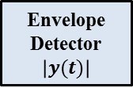
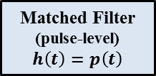
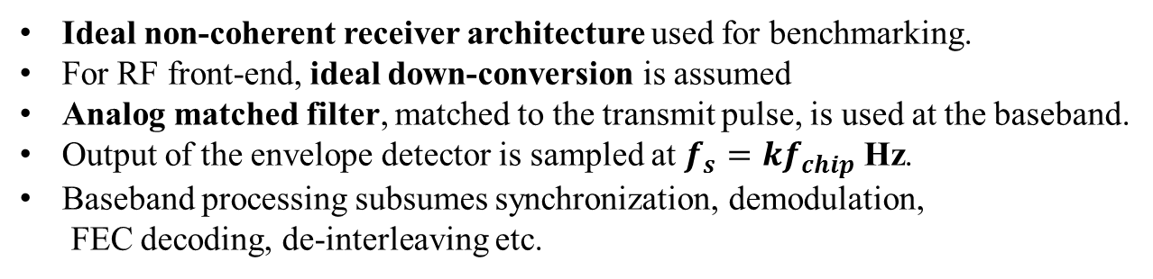
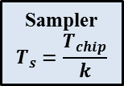

Ideal Receiver Architecture
Low pass
complex envelope
of the received signal
Matched Filter
(pulse-level)
$$h\left(t\right)=p\left(t\right)$$
$$y\left(t\right)$$
Envelope
Detector
$$\left|y(t)\right|$$
Sampler
$$T_{s}=\frac{T_{chip}}{k}$$
ADC
Baseband
Processing
Fig.2. Block diagram of the ideal non-coherent receiver.
From
ADC
Energy
Detect
Timing
Synchronization
Frame & Fine
Synchronization
Demodulation
De-Inter leaver
BCH Decoder
Fig.3. Block diagram of the baseband stage.
Ideal non-coherent receiver architecture used for benchmarking.
For RF front-end, ideal down-conversion is assumed
Analog matched filter, matched to the transmit pulse, is used at the baseband.
Output of the envelope detector is sampled at $f_{s}=kf_{chip}$ Hz.
Baseband processing subsumes synchronization, demodulation,
FEC decoding, de-interleaving etc.

Slide 8
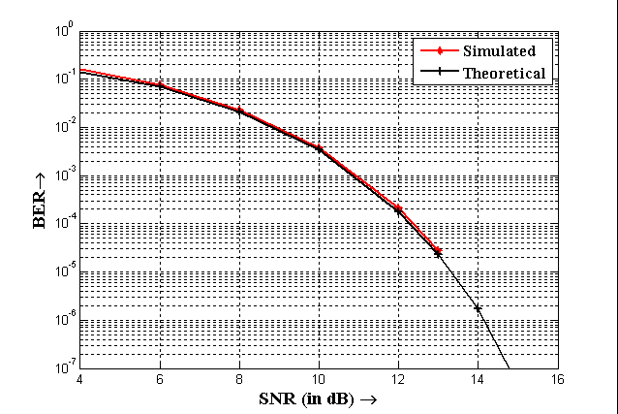
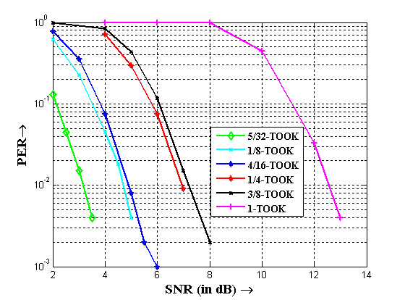
Performance curves with rectangular pulse shaping
Fig.3. Comparison of BER performance of 1-TOOK with
simulated and analytical values.
Fig.4. BER performance of various modulation
schemes without FEC.
Rectangular pulse, with one pulse per chip: infinite reception bandwidth, no ISI.
Perfect synchronization.
Matched filter output is sampled at the chip rate.

Slide 9
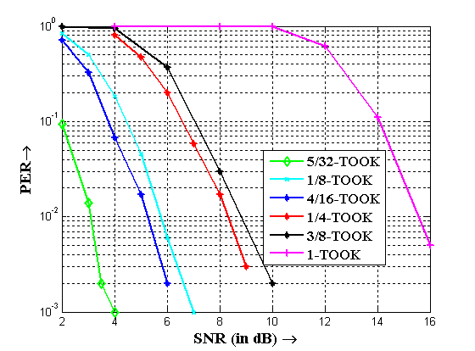
Packet error rate in AWGN: without FEC
Gaussian pulse shaping
Perfect synchronization
Fig. 5. Performance of Non-coherent receiver for uncoded communications in AWGN channel.

Slide 10
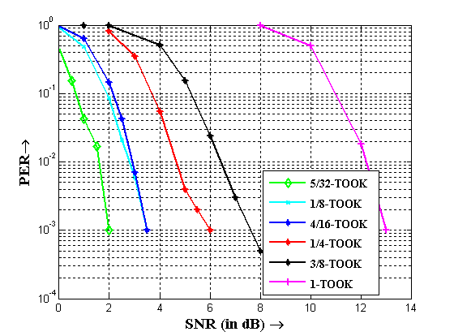
Packet error rate in AWGN: with FEC
Gaussian pulse shaping
Perfect synchronization
Fig. 6. Performance of Non-coherent receiver in AWGN channel, with BCH$\text{(63−}ℓ, 51−ℓ)$.

Slide 11
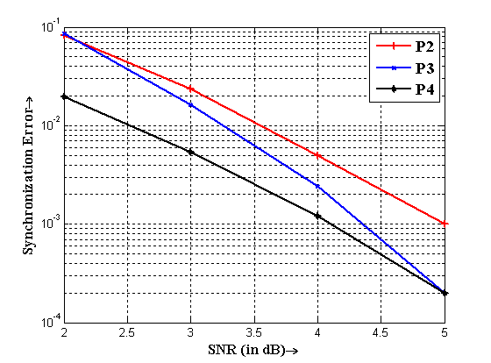
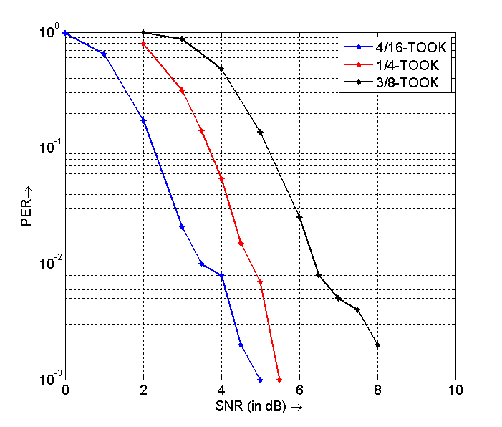
Synchronization Performance
Fig. 7. Synchronization error plots for various preambles.
Fig. 8. PER results with the proposed preamble structures.
P4 yields about 1dB gain over P2.
For moderate SNRs, P3 and P4 converge in the performance.

Slide 12
PER results for synchronization
Fig.9. PER results with ideal synchronization.
Fig.10. PER results with synchronization for the
proposed preamble structures.
The performance loss incurred by the synchronization algorithm for various modulation formats is negligible.
Preamble proposed ensures good synchronization performance.

Slide 13
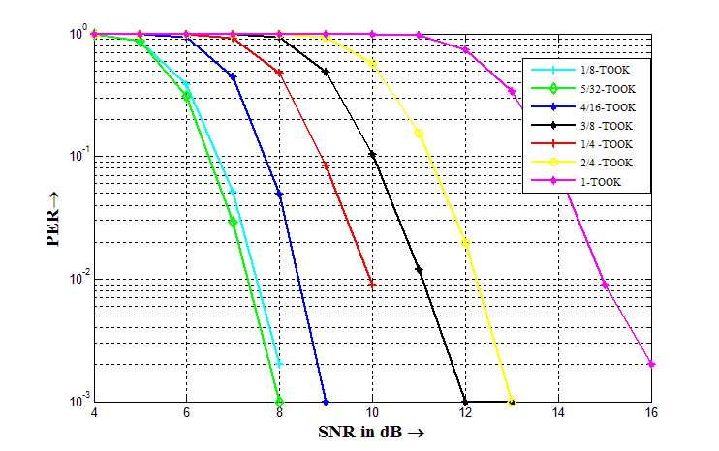
Comparison with SRR results
Fig.11. PER results for SRR over AWGN with FEC
Fig.12. PER results for ideal non-coherent receiver over
AWGN with FEC
1-OOK suffers performance loss owing to the increased detection errors due to thresholding.
Gain due to FEC is more in the case of 1/N-OOK when compared to k/N-OOK schemes.
Depending on the modulation schemes, the ideal non-coherent receiver is better
than SRR by 4-6 dB.

Slide 14
Link Budget Calculations for AWGN with FEC
Parameter | D7 (1/8- T OOK) | D6 (5/32-TOOK ) | D5 (4/16-TOOK ) | D4 (1/4-TOOK ) | D3 (3/8-TOOK ) | D1 (1-TOOK)
Transmitter Budget
Payload Data Rate (R_{b}) in kbps | 101.20 | 126.48 | 202.40 | 202.40 | 303.56 | 809.50
distance (d) in m | 30.00 | 30.00 | 30.00 | 30.00 | 30.00 | 30.00
Bandwidth (B) in MHz | 1.00 | 1.00 | 1.00 | 1.00 | 1.00 | 1.00
Tx Antenna Gain (G_{T}) in dB | 0.00 | 0.00 | 0.00 | 0.00 | 0.00 | 0.00
Center Frequency (F_{C} ) in MHz | 2450.00 | 2450.00 | 2450.00 | 2450.00 | 2450.00 | 2450.00
Average Transmit Power (P_{t}) in dBm | -5.00 | -5.00 | -5.00 | -5.00 | -5.00 | -5.00
Receiver Budget
Path Loss at distance d m | 69.77 | 69.77 | 69.77 | 69.77 | 69.77 | 69.77
Rx Antenna Gain (G_{R}) in dB | 0.00 | 0.00 | 0.00 | 0.00 | 0.00 | 0.00
Received Power (P_{rx}) in dBm | -74.77 | -74.77 | -74.77 | -74.77 | -74.77 | -74.77
Average Noise Per bit (N) in dBm | -123.95 | -122.98 | -120.94 | -120.94 | -119.18 | -114.92
System Noise Figure (NF) in dB | 10.00 | 10.00 | 10.00 | 10.00 | 10.00 | 10.00
Minimum EbNo Required in dB | 11.78 | 9.56 | 8.77 | 10.77 | 10.79 | 12.50
Imple mentation Loss (I) in dB | 3.00 | 3.00 | 3.00 | 3.00 | 3.00 | 3.00
System Performance
Link Margin (LI) in dB | 24.40 | 25.65 | 24.40 | 22.40 | 20.62 | 14.65
Receiver Sensitivity (S) in dBm | -99.17 | -100.42 | -99.17 | -97.17 | -95.39 | -89.42

Slide 15
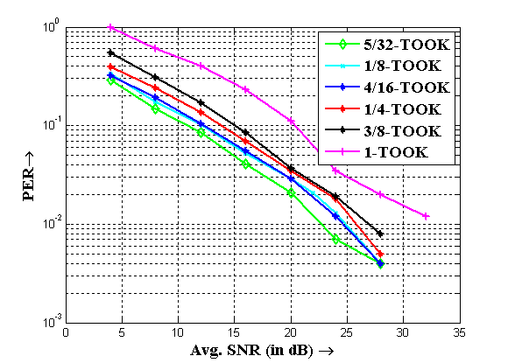
PER plots for Ricean Fading channel: with FEC
Ricean flat fading channel with K = 0 dB. Velocity, v=3.6 km/h.
Fig.13. PER plots for modulation schemes with FEC in a Ricean fading
channel with K = 0 dB.
Ex: for 5/32-TOOK, Rx sensitivity = -80dBm.

Slide 16
Spectrum of 4/16-TOOK with all zeros transmitted
(dB)
Fig.14. PSD of 4/16-TOOK with 6 DAC bits and transmission of an all zero sequence

Slide 17
Summary
Proposal for air interface for Low range applications requiring ultra low power consumption
Performance of ideal non-coherent receiver architecture is addressed
Performance analysis is obtained for all the proposed data rates.
Results are obtained for the system under Ricean fading channels
Link budget analysis is performed and is demonstrated that all proposed modulation schemes allow positive link margin.

