Slide 1
Project: IEEE P802.15 Working Group for Wireless Personal Area Networks (WPANs)
Submission Title: The Challenge of Phase Noise in 100Gb/s Express
Date Submitted:
Source: Cai Yunlong, Huawei
Address: Huawei Building, No.3 Xinxi Road, Shangdi, District Haidian, Beijing, 100085, China
E-Mail: <caiyunlong@huawei.com>
Abstract: The phase noise can severely degrade the performance in QAM_OFDM system. In this contribution, we discuss the model and the residual error rate of phase noise, and investigate the publication of the millimeter oscillators, and compare the 60GHz standard phase noise profile with the possible 300GHz/100Gbps one.
Purpose: Input for THz technique discussion
Notice: This document has been prepared to assist the IEEE P802.15. It is offered as a basis for discussion and is not binding on the contributing individual(s) or organization(s). The material in this document is subject to change in form and content after further study. The contributor(s) reserve(s) the right to add, amend or withdraw material contained herein.
Release: The contributor acknowledges and accepts that this contribution becomes the property of IEEE and may be made publicly available by P802.15.

Slide 2
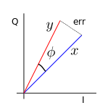
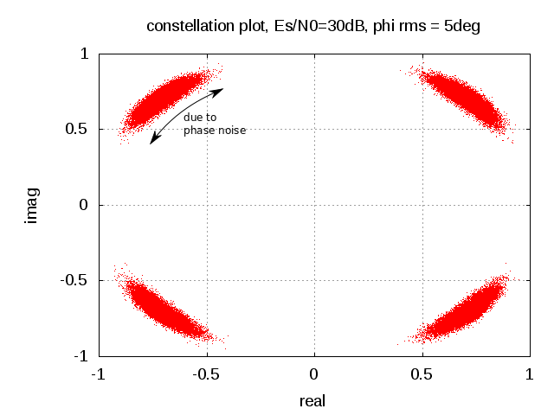

The effect of Phase Noise in Transceiver
Severely impairs the communication system performance today.
Oscillators’ spec., and its theory is not perfect ；
OFDM is severely affected by HPA non-linearity and by the phase noise.
(orders of magnitude more sensitive than SC)
noise

Slide 3
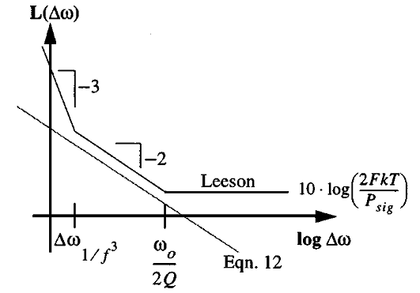
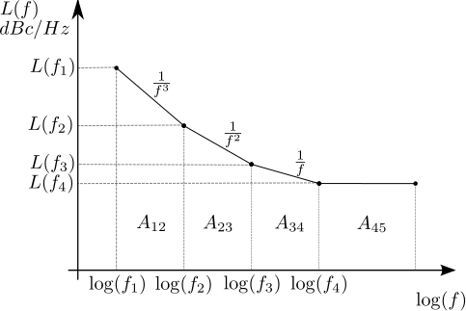
Phase Noise Model
Phase noise: Leeson VS 1/f² model
1，Thomas H. Lee, IEEE JOURNAL OF SOLID-STATE CIRCUITS, VOL. 35, NO. 3, MARCH 2000, “Oscillator Phase Noise: A Tutorial”,
2，http://www.dsplog.com/2012/06/22/phase-noise-psd-to-jitter/, “Phase noise power spectral density to Jitter”

Slide 4
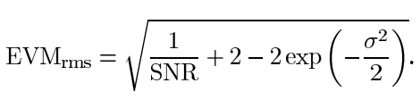
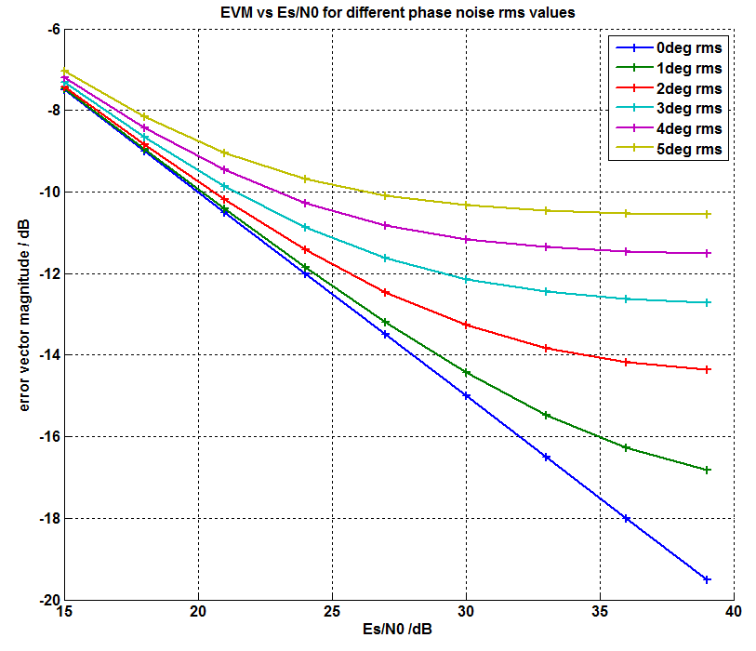
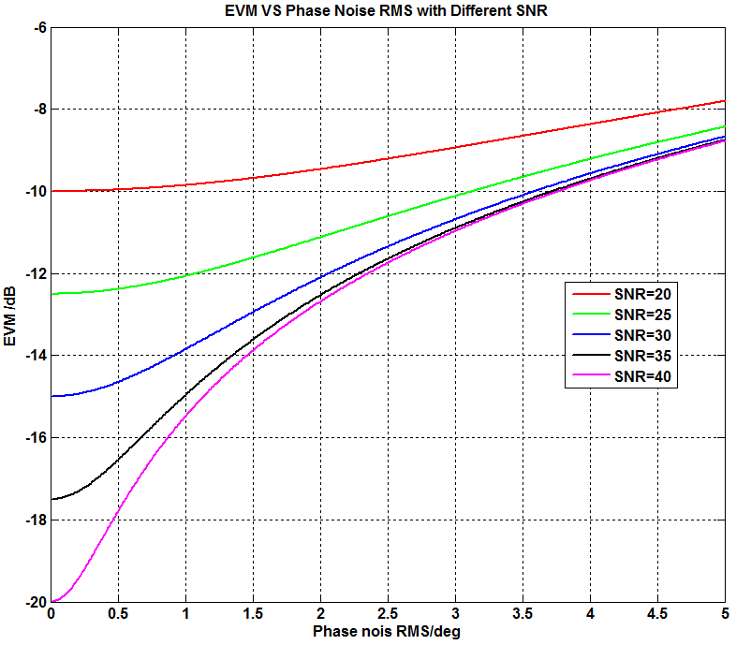
Plots of EVM VS SNR or Phase Noise

Slide 5
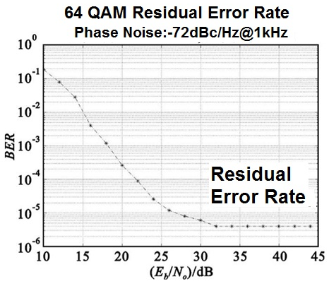
Residual Error Rate
When the SNR reaches a value and increasing, the BER is not getting better.
-87 dBc/Hz preferred for 8-PSK, how about 16/64QAM
“15-07-0691-01-003c-phy-layer-submission-15-3c-imec.ppt”

Slide 6
The Phase Noises of the Publications(1)
Hz
The references are shown in the remark
Notes:
M. E. Belkin,"A Microwave Optoelectronic Oscillator: Mach-Zehnder Modulator or VCSEL Based Layout Comparison", Progress In Electromagnetics Research Symposium Abstracts, Moscow, Russia, August 19,2012
J Zhang,"local oscillator uncorrelated phase noise analysis for millimeter-wave passive imager bhu-2d frequency synthesizer",Progress In Electromagnetics Research B, Vol. 54, 89-106, 2013
HF Zhou,"a low power low phase noise LC voltage-controlled oscillator", Progress In Electromagnetics Research Letters, Vol. 38, 65-73, 2013
Z Xu, "An Integrated Frequency Synthesizer for 81-86GHz Satellite Communications in 65nm CMOS ", 2010 IEEE Radio Frequency Integrated Circuits Symposium, University of California, Los Angeles, CA 90025, USA
HL Kao, "A Low Phase Noise Ka-Band Voltage Controlled Oscillator Using 0.15 μm GaAs pHEMT Technology ",Design and Diagnostics of Electronic Circuits & Systems (DDECS), 2012 IEEE 15th International Symposium on
Hsuan-ling Kao, "High Power and Low Phase Noise MMIC VCO Using 0.35 µm GaN-on-Si HEMT ",International Journal of Computer Theory and Engineering vol. 5, no. 6, pp. 910-913, 2013.
B Razeghi, "Phase Noise Calculation in CMOS Single-Ended Ring Oscillators", Majlesi Journal of Telecommunication Devices Vol. 2 , No. 3 , September 2013
Syamsundar De,"Phase Noise of the Radio Frequency (RF) Beatnote Generated by a Dual-Frequency VECSEL",JOURNAL OF LIGHTWAVE TECHNOLOGY, 2013
C. H. Doan et al. Millimeter-wave CMOS design[J]. IEEE J. Solid-State Circuits, 2005, 40(1): 144-155.
L. Li. Design and analysis of a 90 nm mm-Wave Oscillator using Inductiv-Division LC Tank Millimeter-wave voltage-controlled oscillator in 0.13-um CMOS technology[J]. IEEE J. Solid-State Circuits, 2009, 44(7), 140 1950-1957.
C. Cao. Millimeter-Wave Voltage-Controlled Oscillators in 0.13-um CMOS Technology[J]. IEEE J. Solid-State Circuits, 2006, 41(6), 1297-1303.
M. Tiebout, H. D, Wohlmuth and W. Simburger. A 1 V 51 GHz fitlly-integrated VCO in 0.12um CMOS [J]. IEEE Int. Solid-State Circuirts Dig. Tech. Papers, 2002, 465-468.
B. Sadhu,"A linearized, low-phase-noise VCO-based 25-GHz PLL with autonomic biasing", In Proceedings of J. Solid-State Circuits. 2013, 1138-1150.
M. Moslehi Bajestan,"A 5.12-12.95GHz Triple-Resonance Low Phase Noise CMOS VCO for S oftware-Defined Radio Applications", 2013 IEEE Radio Frequency Integrated Circuits Symposium
Callahan, P.T. ,"Phase Noise Measurements of a Dual-Wavelength Brillouin Fiber Laser", Microwave Photonics (MWP), 2010 IEEE Topical Meeting on
A Katz,"Design and Optimization of a Low-Noise Cross-Coupled Fundamental VCO in 90nm CMOS for 60GHz Applications", Silicon Monolithic Integrated Circuits in RF Systems (SiRF), 2011 IEEE 11th Topical Meeting on
VP Trivedi , "A 77GHz CMOS VCO with 11.3GHz Tuning Range, 6dBm Output Power, and Competitive Phase Noise in 65nm Bulk CMOS ", Radio Frequency Integrated Circuits Symposium (RFIC), 2011 IEEE
Garcia, A. ,"Optical Generation of Low-Phase Noise Microwave Signals using Nonlinear MZM and Ultra-Long SOA",Microwave & Optoelectronics Conference (IMOC), 2011 SBMO/IEEE MTT-S International
Abdul-Latif, M.M.,"A 3.16 – 12.8GHz Low Phase Noise N-Push/M-Push Cyclic Coupled Ring Oscillator",Radio Frequency Integrated Circuits Symposium (RFIC), 2011 IEEE
Juntunen, E,"A High-Efficiency, High-Power Millimeter-Waven Oscillator Using a Feedback Class-E Power Amplifier in 45 nm CMOS",IEEE MICROWAVE AND WIRELESS COMPONENTS LETTERS, VOL. 21, NO. 8, AUGUST 2011
Xiaolei Gai,"A 35 GHz Dual-loop PLL with Low Phase Noise and Fast Lock for Millimeter Wave Applications", Microwave Symposium Digest (MTT), 2011 IEEE MTT-S International
Lianming Li ,"A Colpitts LC VCO with Miller-Capacitance Gm Enhancing and Phase Noise Reduction Techniques", ESSCIRC (ESSCIRC), 2011 Proceedings of the
Abdul-Latif, M.M., "Low Phase Noise Wide Tuning Range N -Push Cyclic-Coupled Ring Oscillators", IEEE JOURNAL OF SOLID-STATE CIRCUITS, VOL. 47, NO. 6, JUNE 2012
Banin, R. ,"V-band low phase noise QVCO in 90nm CMOS technology using a gate-connected tank", ELECTRONICS LETTERS 16th August 2012 Vol. 48 No. 17
Voinigescu, S.P.,"A Study of SiGe Signal Sources in the 220-330 GHz Range", Bipolar/BiCMOS Circuits and Technology Meeting (BCTM), 2012 IEEE
Min Huang, "A Low-Power 24 GHz Phase Lock Loop with Gain-Boosted Charge Pump Embedded in 0.18 μ m COMS Technology", Proceedings of APMC 2012, Kaohsiung, Taiwan, Dec. 4-
Matsumura, H. , "Ultra-Low Phase Noise 76-81 GHz PLL Synthesizer for FMCW Radar in 65 nm CMOS ", Proceedings of APMC 2012, Kaohsiung, Taiwan, Dec. 4-7, 2012
Beom-Ik Son ,"Design of a Low Phase Noise Voltage Tuned DRO based on ImprovedG Dielectric Resonator Coupling Structure ",Proceedings of APMC 2012, Kaohsiung, Taiwan, Dec. 4-7, 2012
Qiyang Wu ,"A 10mW 37.8GHz Current-Redistribution BiCMOS VCO with an Average FOMT of -193.5dBc/Hz",Solid-State Circuits Conference Digest of Technical Papers (ISSCC), 2013 IEEE International
Mammei, E. ,"A 33.6-to-46.2GHz 32nm CMOS VCO with 177.5dBc/Hz Minimum Noise FOM Using Inductor Splitting for Tuning Extension",ISSCC 2013 / SESSION 20 / FREQUENCY GENERATION / 20.3
D Cai,"A 76 GHz Oscillator by High-Q Differential Transmission Line Loaded with Split Ring Re sonator in 65-nm CMOS",Silicon Monolithic Integrated Circuits in RF Systems (SiRF), 2013 IEEE 13th Topical Meeting on
Yang Shang,"Design of High-Q Millimeter-Wave Oscillator by Differential Transmission Line Loaded With Metamaterial Resonator in 65-nm CMOS",IEEE TRANSACTIONS ON MICROWAVE THEORY AND TECHNIQUES, VOL. 61, NO. 5, MAY 2013
Weber, R. ,"A 67 GHz GaN Voltage-Controlled Oscillator MMIC With High Output Power",IEEE MICROWAVE AND WIRELESS COMPONENTS LETTERS, VOL. 23, NO. 7, JULY 2013
Danny Eliyahu,"Resonant Widely Tunable Opto-Electronic Oscillator", IEEE PHOTONICS TECHNOLOGY LETTERS, VOL.25, NO. 15, AUGUST 1, 2013
Ying Chen,"A Dual-band LO Generation System Using a 40GHz VCO with a Phase Noise of -106.8dBc/Hz at 1-MHz ",2013 IEEE Radio Frequency Integrated Circuits Symposium
Jianjun Yu,"Phase Noise Improvement Using Digitally Controlled Artificial Dielectric",Proceedings of the 43rd European Microwave Conference,7 -10 Oct 2013
Fan-Hsiu Huang,"A Low Phase Noise Quadrature Ring Oscillator Using 0.5 μm GaN-on-Si HEMT",Proceedings of the 8th European Microwave Integrated Circuits Conference, 6 -8 Oct 2013,
Lei Chen,"40GHz, 12% Tuning-Range , Fully Differential Low Phase-Noise LC VCO",Solid-State and Integrated Circuit Technology (ICSICT), 2012
Sorin P. Voinigescu,"A Study of SiGe HBT Signal Sources in the 220–330-GHz Range", IEEE JOURNAL OF SOLID-STATE CIRCUITS, VOL. 48, NO. 9, SEPTEMBER 2013
Pei Zhou,"A Compact Optoelectronic Oscillator Based on an Electroabsorption Modulated Laser",IEEE PHOTONICS TECHNOLOGY LETTERS, VOL. 26, NO. 1, JANUARY 1, 2014
Ma, S.,"A 75.7GHz to 102GHz rotary-traveling-wave VCO by tunable composite right/left hand T-line", Integrated Circuits Conference (CICC) 2013.
David Murphy,"A Low Phase Noise, Wideband and Compact CMOS PLL for Use in a Heterodyne 802.15.3c Transceiver",IEEE JOURNAL OF SOLID-STATE CIRCUITS, VOL. 46, NO. 7, JULY 2011

Slide 7
The Phase Noises of the Publications(2)

Slide 8
The Phase Noise with Different Materials

Slide 9
60GHz/300 Phase Noise Model
In 802.15.3c/802.11.ad*, it is modeled by
  PSD(0) = -90 dBc/Hz, PSD(infinity) = -130 dBc/Hz
  Pole frequency f_{p} = 1 MHz, Zero frequency f_{z} = 100 MHz
Frequency Multipliers**, for small β(20logN relationship):
  f(t)=cos(ω_{c}t+βsin(ω_{m}t))=cos(ω_{c}t)+(β/2)[cos(ω_{c}-ω_{m})t-cos(ω_{c}+ω_{m})t]
  Nf：f’(t)=cos(Nω_{c}t)+(Nβ/2)[cos(Nω_{c}-ω_{m})t-cos(Nω_{c}+ω_{m})t]
  For 300GHz: PSD‘(0) = -90 dBc/Hz-20log(300/60)=-76dBc/Hz?
*“11-09-1213-01-00ad-60ghz-impairments-modeling.ppt”
** http://www.qsl.net/va3iul/Frequency_Multipliers/Frequency_Multipliers.pdf “Frequency Multipliers ”, Iulian Rosu, YO3DAC / VA3IUL, http://www.qsl.net/va3iul
Notes:
IEEE Xplore DownloadPhase Noise Analysis of the OFDM Communication System.pdf

Slide 10
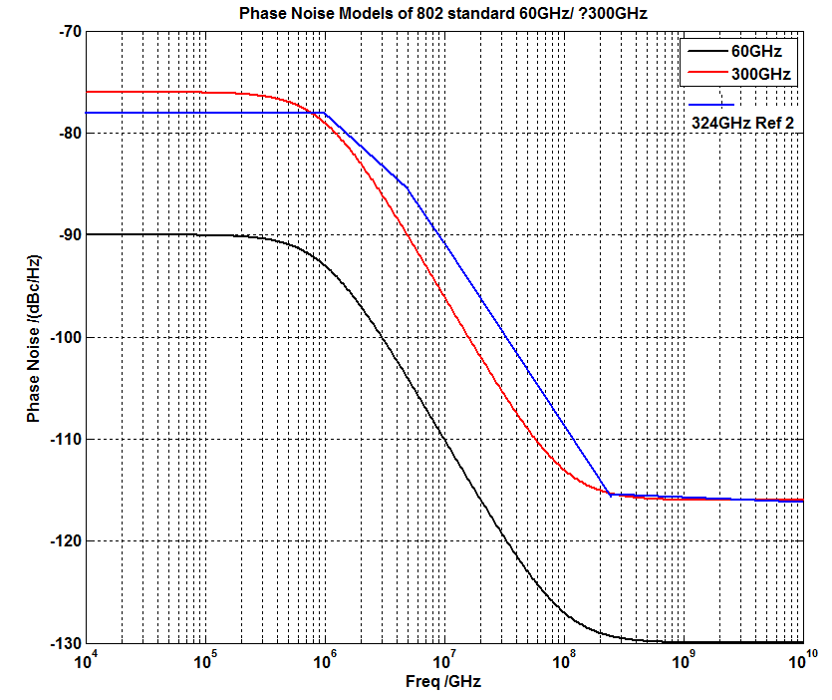
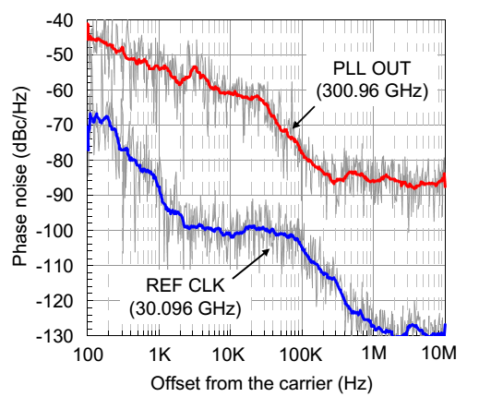
60GHz/300 Phase Noise Profile?
The data in Ref 2nd :
Offset | Pase Noise(f)
1 MHz | -78 dBc/Hz
5 MHz | -86 dBc/Hz
10 MHz | -91 dBc/Hz
1,Seo M,et al. “A 300 GHz PLL in an InP HBT technology”, IEEE MTT-S International Microwave Symposium Digest. Baltimore,, 2011:1-4.
2, HUANGD，et al．"324GHz CMOS frequency generator using lineasuperpositiontechnique",Proceedings of the IEEE International Solid-State Circuits Conference． San Francisco，CA，USA，2008: 476－477．

Slide 11
Conclusion
The oscillators of 300GHz is ready now?
The phase noise will be more worse in 300GHz system, how much?
-78 dBc/Hz @1MHz is ok? The phase noise profile is the same as that of 60GHz standard?

