Slide 1
Project: IEEE P802.15 Working Group for Wireless Personal Area Networks (WPANs)
Submission Title: In response to 15-14-08r0 “Proposal for PFD”
Date Submitted: [January 8th 2014]
Source: Marco Hernandez (NICT)
Address []
Voice: , FAX: [], E-Mail:
Re: 15-13-0328-09-0008, TG8 PAC Framework Document (Draft)
Abstract: Proposes a plan to complete 802.15.8 PFD
Purpose: Discussion
Notice: This document has been prepared to assist the IEEE P802.15. It is offered as a basis for discussion and is not binding on the contributing individual(s) or organization(s). The material in this document is subject to change in form and content after further study. The contributor(s) reserve(s) the right to add, amend or withdraw material contained herein.
Release: The contributor acknowledges and accepts that this contribution becomes the property of IEEE and may be made publicly available by P802.15.

Slide 2
Introduction
Due to problems to post in the TG8 mail
reflector. The present document is a
follow up discussion to 15-14-08r0.
The responses are highlighted in red.

Slide 3
Project: IEEE P802.15 Working Group for Wireless Personal Area Networks (WPANs)
Submission Title: Proposal for PFD
Date Submitted: []
Source: Byung-Jae Kwak (ETRI)
Address []
Voice: +82-42-860-6618, FAX: [], E-Mail: bjkwak@etri.re.kr
Re: 15-13-0328-09-0008, TG8 PAC Framework Document (Draft)
Abstract: Proposes a plan to complete 802.15.8 PFD
Purpose: Discussion
Notice: This document has been prepared to assist the IEEE P802.15. It is offered as a basis for discussion and is not binding on the contributing individual(s) or organization(s). The material in this document is subject to change in form and content after further study. The contributor(s) reserve(s) the right to add, amend or withdraw material contained herein.
Release: The contributor acknowledges and accepts that this contribution becomes the property of IEEE and may be made publicly available by P802.15.

Slide 4
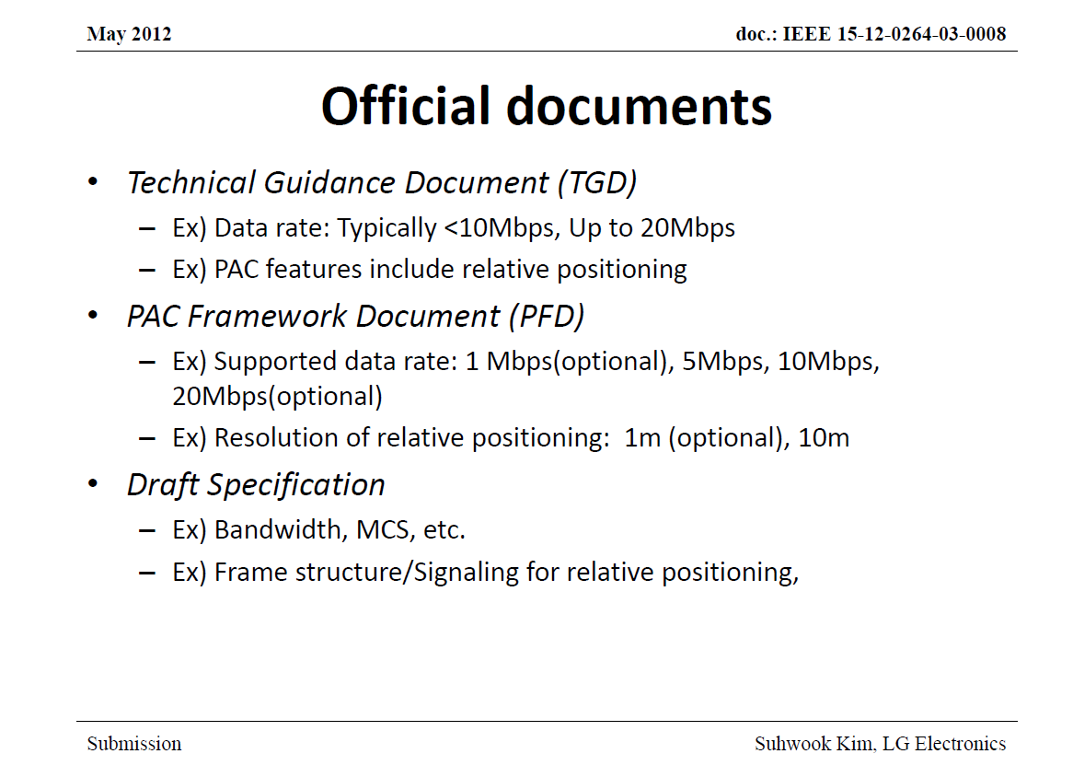
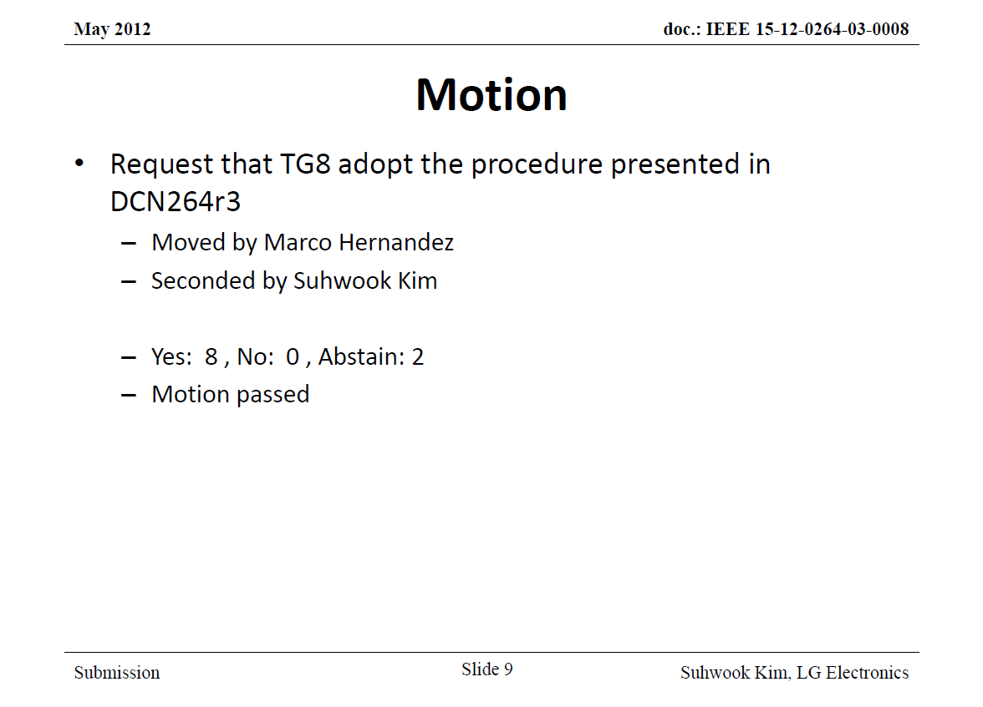
Introduction (1/3)
PAC procedure (15-12-0264-03)

Slide 5
Introduction (2/3)
Where are we now?
  2012-03: TG formation
  2013-01: TGD approval/call for proposal
  2013-11: PFD approval/call for contribution
  2014-01: PFD approval/call for contribution
  2014-09: Draft Standard P802.15.8 D1.0
  2015-05: Sponsor Ballet

Slide 6
Introduction (3/3)
What we have achieved so far
  Application Matrix
  TGD: Technical Guidance Document
  Proposals presentation & lots of discussion
  PFD draft
    Just a collection of Technical Proposals without consensus
    There has been some consensus in the PHY side.
    The technical depth between different clauses is not consistent
What’s holding us back
  Wide spectrum of Technical Proposals
  Too much detail in the draft PFD

Slide 7
What’s holding us back
  Wide spectrum of Technical Proposals
  We are trying to harmonize proposals without down selection and this seems to be a bad strategy.
  Too much detail in the draft PFD
  At the moment the PFD has little details from technical proposals already.

Slide 8
Strategy to Make a Progress
Follow the agreed upon procedure
  PFD is a “framework” document, not a specification → High level description
Find the largest common set of proposals and include it
Make everybody happy as much as we can
  If there are multiple competing proposals each supported by a sizable group of people, PFD should allow contributions for both proposals
  This does not guarantee every proposal mentioned in PFD will be included in the final standard

Slide 9
Follow the agreed upon procedure
  PFD is a “framework” document, not a specification → High level description
  It is unclear what is “high level description” after a call for
  technical proposals.

Slide 10
Current Status & Action Plan
PFD is already delayed. Any more delay is not desirable, but it will be quite a challenge to approve it in Jan 2014 meeting
Experience taught us that we can make only so much progress during the face-to-face meeting
  Ex: We spent hours to define the meaning of “synchronization,” only to fail to reach a consensus; we now have to competing definition of synchronization in draft PFD
  We have to do as much time consuming tasks as possible online, before Jan. meeting starts
Down selection
  Bad news:
    The TG is not ready for down selection
    We don’t have time – We want to approve PFD in Jan. 2014
  Good news:
    There are signs people are talking to each other for harmonization
    We now have a pretty good understanding of what others think
  Let’s
    make PFD inclusive rather than exclusive
    follow the guideline set by 15-12-0264-03 (high level description)

Slide 11
Experience taught us that we can make only some so much progress during the face-to-face meeting
  Ex: We spent hours to define the meaning of “synchronization,” only to fail to reach a consensus; we now have to competing definition of synchronization in draft PFD
  We have to do as much time consuming tasks as possible online, before Jan. meeting starts
I agree, the real problem is not defining things like synchronization, but to
choose one synchronization proposal, meaning to reject other proposals.

Slide 12
Down selection
  Bad news:
    The TG is not ready for down selection
    We don’t have time – We want to approve PFD in Jan. 2014
  Good news:
    There are signs people are talking to each other for harmonization
    We now have a pretty good understanding of what others think
  Let’s
    make PFD inclusive rather than exclusive
    follow the guideline set by 15-12-0264-03 (high level description)
So far we are following the guidelines.
We need to finish the PFD by January meeting in order to discuss if TG8 either harmonizes proposals towards the specification or a down selection would be
required.

Slide 13
Proposal (1/2)
The PAC technical editors volunteer to work on PFD to generate texts by Jan 2014 meeting
  Technical editors collect comments and texts through PAC e-mail reflector to generate the text
  The comments should be based on the Technical Proposals already presented; however, comments that complement PFD by providing critical features may be allowed
  All comments and text should use 328r9 as a baseline
  Iterate at least two rounds of “comment – edit” cycle before Jan 2014 meeting
Decisions on the generated texts will be made by voting/straw poll during Jan 2014 meeting

Slide 14
Proposal (2/2)
“Comment – edit” cycle schedule
  2014-01-08 (Wed): PAC teleconference
  2014-01-10 (Fri): 1st round of comments/texts submission due
  2014-01-13 (Mon): Upload revised PFD (328r10) by PAC technical editors
  2014-01-15 (Wed): 2nd round of comments/texts submission due
  2014-01-17 (Fri): Upload revised PFD (328r11) by PAC technical editors

Slide 15
Last Conference Call Approved Agenda

Slide 16
Last Conference Call Approved Agenda
The ad hoc PHY discussion has produced results (consensus
and some harmonized proposals) that are summarized in
document DCN 13-745r0. This has to be taken into account
for the PFD.

