Slide 1
Project: IEEE P802.15 Working Group for Wireless Personal Area Networks (WPANs)
Submission Title: [MSK with FEC PHY proposal for IEEE 802.15.4q - Presentation]
Date Submitted: [ 13 Nov, 2013 ]
Source: [Frederik Beer] Company [Friedrich-Alexander University (FAU) / Fraunhofer Institue for Integrated Circuits (IIS)] Address:[Am Wolfsmantel 33, 91058 Erlangen, GERMANY] Voice:[+49 9131 85 25 123], FAX: [+49 9131 85 25 102], E-Mail: [frederik.beer@fau.de]
Abstract: [A proposal for the 4q group, focusing on MSK modulation and FEC schemes]
Purpose: [Presentation of submitted proposal.]
Notice: This document has been prepared to assist the IEEE P802.15. It is offered as a basis for discussion and is not binding on the contributing individual(s) or organization(s). The material in this document is subject to change in form and content after further study. The contributor(s) reserve(s) the right to add, amend or withdraw material contained herein.
Release: The contributor acknowledges and accepts that this contribution becomes the property of IEEE and may be made publicly available by P802.15.

Slide 2
MSK with FEC PHY proposal for IEEE 802.15.4q - Presentation

Slide 3
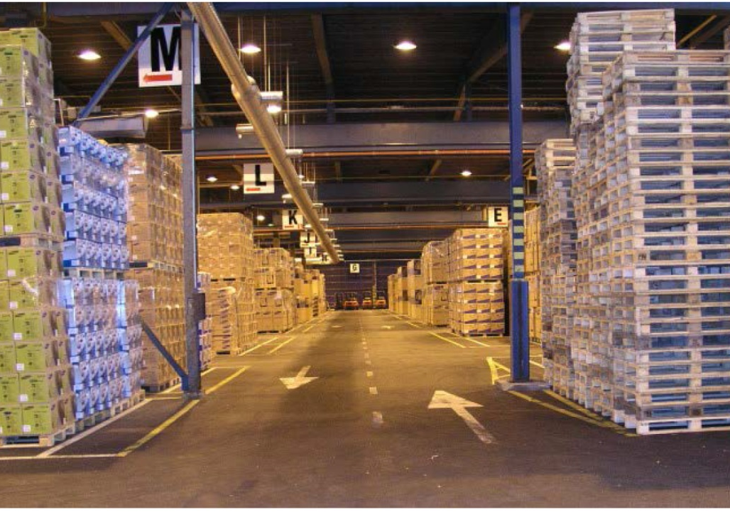
Motivation (1) - Application
Suitable devices for an ULP standard are for example Smart/Shelf Labels
Smart/Shelf Labels may be used in supermarkets or warehouses where instant price adjustments or real-time inventory is desirable

Slide 4
Motivation (2) – Network Structure
Our proposal follows a centralized approach, where one concentrator device is handling communication from/to the ULP end-devices
This leads to a star/cluster topology
The concentrator may have a larger power source and more computing power for more complex algorithms
Advantages over mesh approach:
No power needed for routing and network management
No additional power consumption for ULP end-devices near the destination due to relaying frames
Approx. same lifetime for each end-device → deterministic lifetime of the whole network

Slide 5
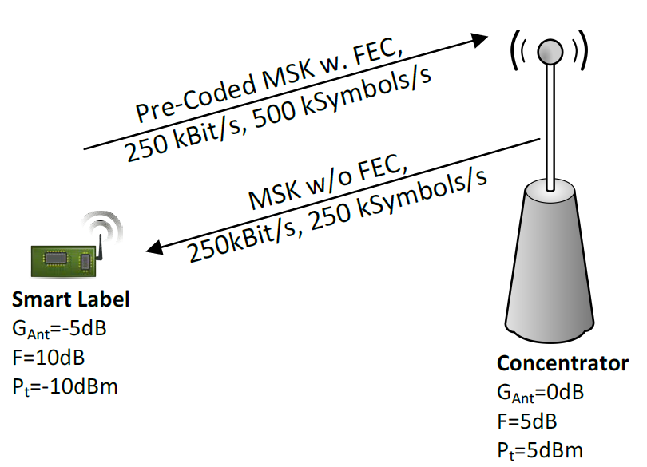
Motivation (3) – Asymmetric Links
Simple ULP end-devices
Limited transmit power
Limited computing power
More complex concentrator
Higher transmit power
Sophisticated RX algorithms

Slide 6
Overview
Proposal is based upon the IEEE 802.15.4g/4k amendments with some new features for ULP applications
Well-known and widely supported techniques
Already available chips
Key features
High datarate MSK modulation
Optional precoding
Two R=1/2 convolutional FEC schemes
Asymmetric up-/downlink capabilities

Slide 7
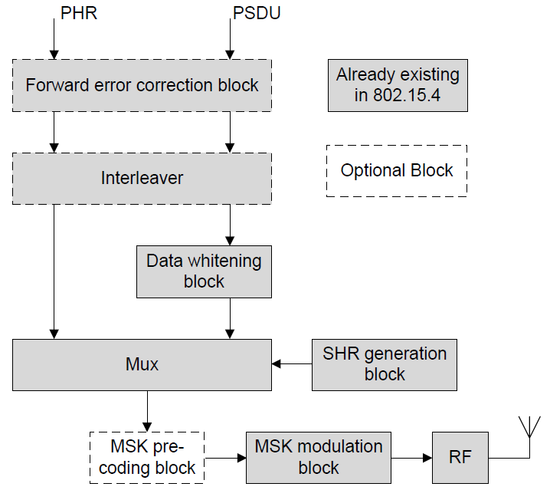
Modulator block diagram

Slide 8
Frame Structure (1)
 |  | Octets
 |  | 1 | Variable
Preamble | SFD | As defined in 10.1 | PSDU
SHR |  | PHR | PHY payload
The preamble consists of two multiples of the 8-bit sequence “01010101”
The maximum PSDU size is limited to 63 octets

Slide 9
Frame Structure (2)
The SFD consists of one of the following 2 octet sequences:
Optimal aperiodic ACF with main peak of 16, maximum side peak of 2
Optimal with additional usage of preamble
Optimal CCF between these 3 sequences
Octets | 1 | 2
Bit map w/o FEC | 0101 1011 | 1111 0001
Bit map with FEC K=4 | 0110 1000 | 0111 0111
Bit map with FEC K=7 | 0100 1000 | 1000 1111

Slide 10
Forward Error Correction
Two convolutional forward error correction schemes are proposed:
R=1/2, K=4 (15,17) scheme from IEEE 802.15.4g
R=1/2, K=7 (133,171) scheme from IEEE 802.15.4k
Both schemes are easy to encode
Compared to blockcodes convolutional codes have the advantage of being packet length agnostic
Well-known usage of soft-decoding possible with deterministic processing latency

Slide 11
Interleaver
Usage of interleaver is mandatory when using one of the proposed FEC schemes
Interleaver is as defined in the IEEE 802.15.4k amendment

Slide 12
MSK Modulation
Modulation scheme shall be an MSK modulation, i.e. an FSK modulation scheme with modulation index of 0.5 (as already specified in IEEE 802.15.4g/k)
Supported datarates shall be 250 kBit/s and 500 kBit/s
When using FEC this leads to 500 kSymbols/s and 1 MSymbols/s respectively
Higher datarates have positive effects on power efficiency ( cf. “Considerations for optimal data rates”, DCN 322)
MSK is a constant envelope modulation which enables the usage of highly efficient power amplifiers

Slide 13
Precoded MSK
Ordinary MSK modulation results in a differential encoding of the data
BER performance is suboptimal due to error propagation
A (optional) differential precoding of the input data is proposed to cancel that disadvantage:
Coherent decoding of a precoded MSK signal yields optimal BER results

Slide 14
OOK/PPM drawbacks (1)
OOK/PPM related modulation schemes were also evaluated
In OOK/PPM related modulation schemes some transmission symbols do not carry any energy
These symbols do not contribute to the E_{b}/N₀ on receiver side
However the transceiver still consumes power during these symbols, e.g. due to freq. synthesizers running Example from one transceiver chip:
8.4 mA during not sending but freq. synthesizers running
15 mA during transmission @ 0dBm

Slide 15
OOK/PPM drawbacks (2)
P_{t}
Transmitted power:
Consumed power:
1
0
1
0
1
0
1
t
P_{on}
1
0
1
0
1
0
1
t
wasted

Slide 16
Frequency Bands
IEEE 802.15.4q shall support all frequency bands above and including 433 MHz as specified in IEEE 802.15.4g/k. E.g.:
433 MHz
868 MHz
915 MHz
2.4 GHz.

Slide 17
MAC Layer Features
ULP devices shall use the multipurpose frame from IEEE 802.15.4e amendment
Maximum freedom for system designer in deciding which header fields are absolutely necessary
Each saved bit is saved energy
The beacon frame shall carry a header IE in order to signal which decoding methods are supported by the receiver (i.e. the concentrator)
phyMSKPrecoding: Boolean variable to indicate the ability to receive precoded MSK signals
phySupportedFEC: Enumeration to indicate the supported FEC coding schemes

Slide 18
Evaluation
We present some evaluations in the following slides
BER/PER curves have been created from actual packet simulations with a Viterbi decoder
Distance/Datarate curves have been produced by Matlab simulation using the following equation:
Ideal scenario: G_{RX} = G_{TX} = 0 dB, α = 2
Realistic scenario: G_{RX} = G_{TX} = -5 dB, α = 3

Slide 19
Evaluation
Power consumption equation has been presented by Jinesh et al. “System Considerations for ULP Communications”,DCN 426:
In order to evaluate not only the consumed power but also the consumed energy, we use the following equation:
This proposal focuses on reducing P_{t} and T_{ont}/T_{onr}

Slide 20
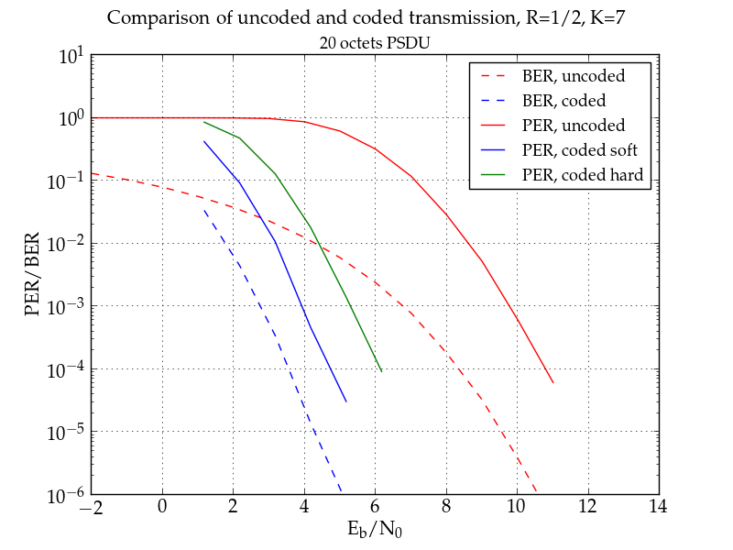
Evaluation (1)

Slide 21
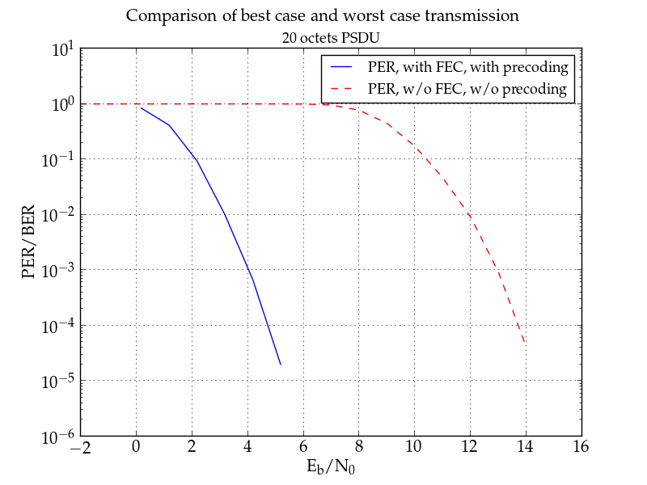
Evaluation (2)

Slide 22
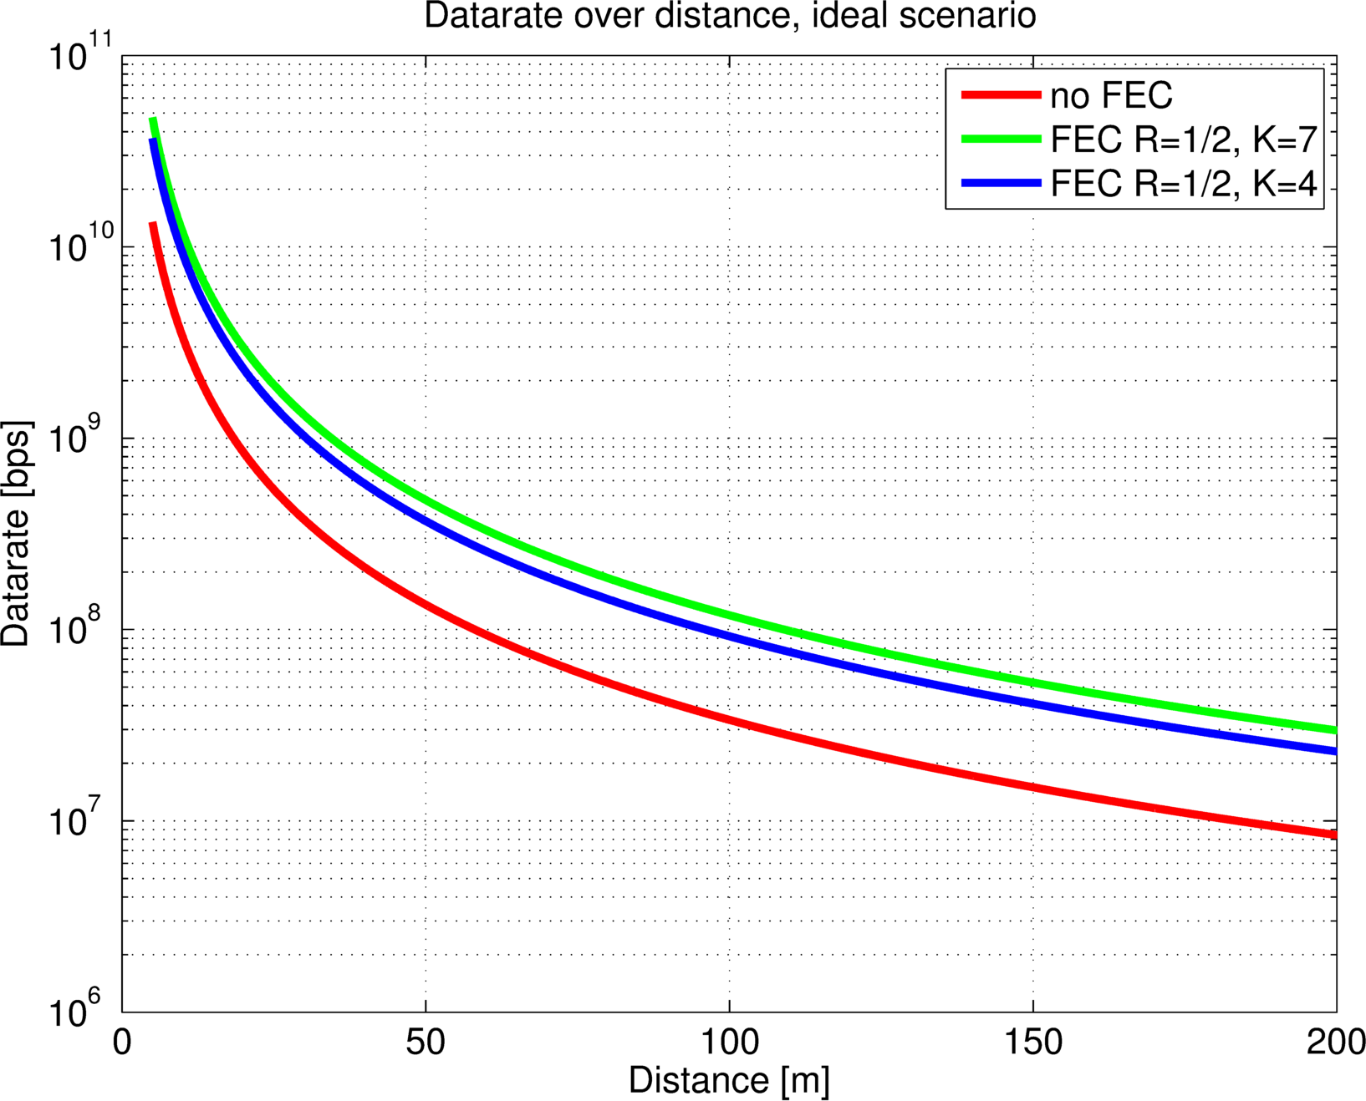
Evaluation (3)

Slide 23
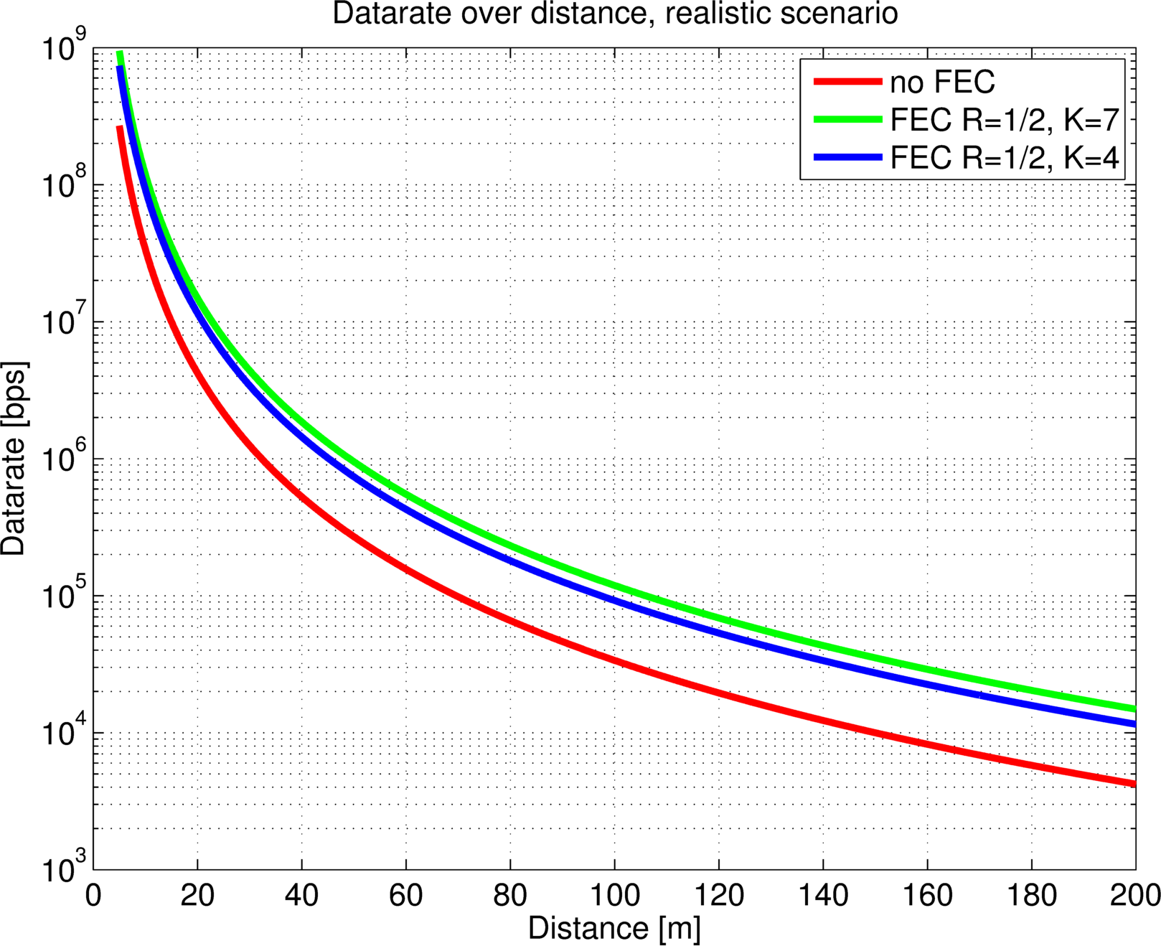
Evaluation (4)

Slide 24
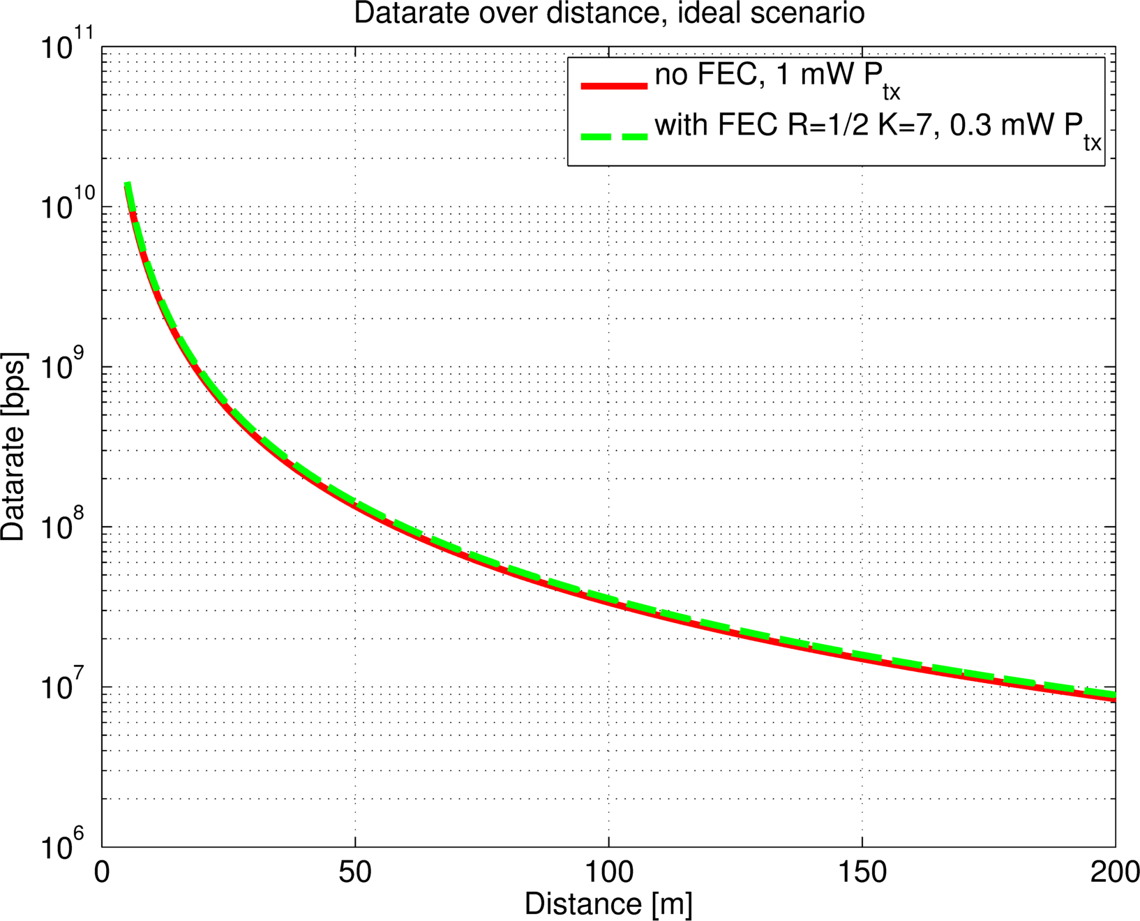
Evaluation (5)

Slide 25
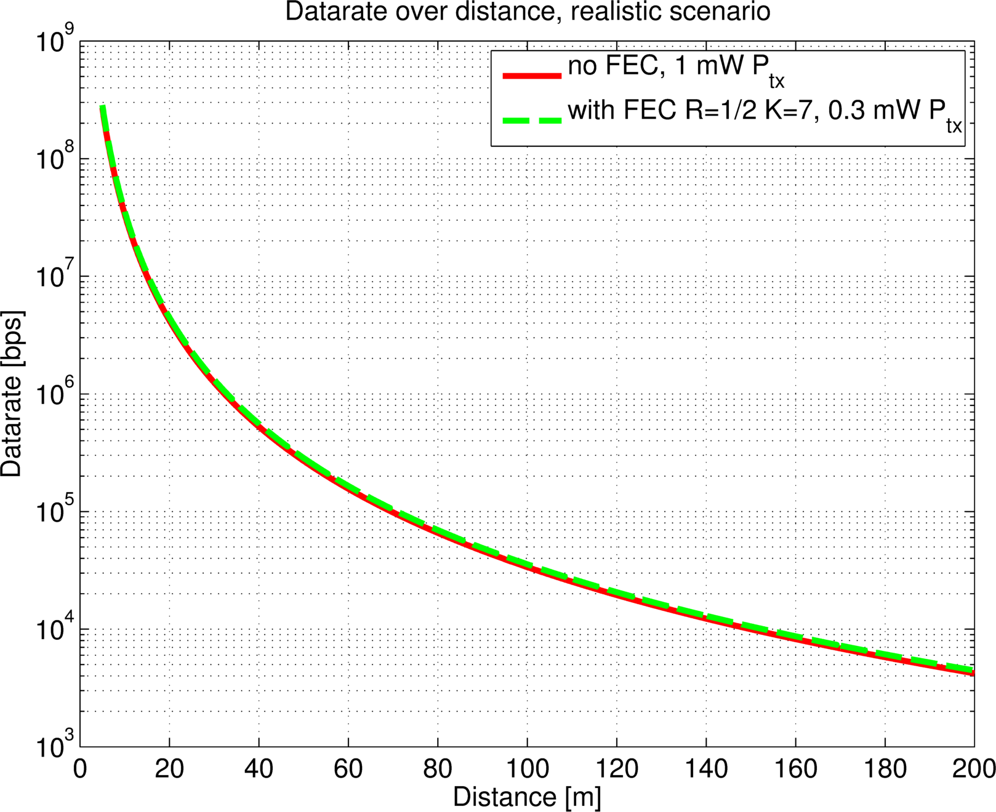
Evaluation (6)

Slide 26
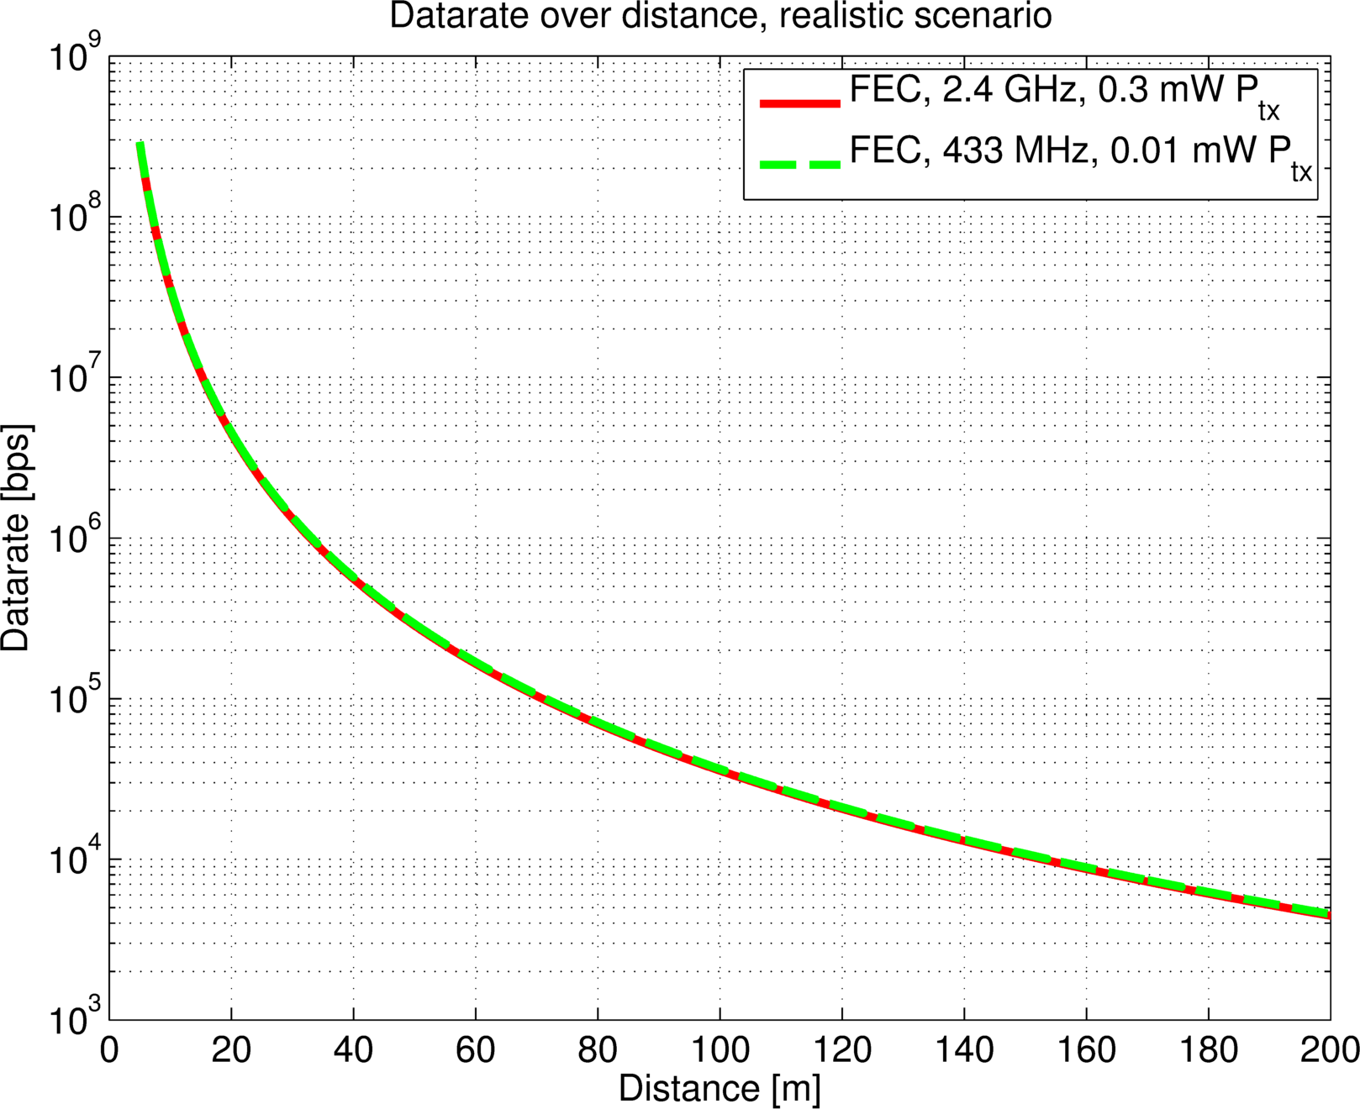
Evaluation (7)

Slide 27
Link Budget Calculations (1)
 | Low Datarate Mode | High Datarate Mode
Transmitter Parameters
Payload Data Rate (D_{B}) in kBit/s | 250 | 500
Distance (d) in m | 30 | 30
Tx Antenna Gain (G_{TX}) in dB | 0 | 0
Center Frequency (F_{C}) in MHz | 2450 | 2450
Average Transmit Power (P_{T}) in dBm | -5 | -5
Receiver Parameters
Path loss at distance d in dB | 69.77 | 69.77
Rx Antenna Gain (G_{RX}) in dB | 0 | 0
Received Energy per Bit in dBmJ | -128.75 | -131.75
System Noise Figure in dB | 10 | 10
Minimum E_{b}/N₀ required in dB | 3.2 | 3.2
Implementation Loss in dB | 3 | 3
Link Margin in dB | 29.05 | 26.05
Req. receiver Sensitivity in dBm | -103.82 | -100.82

Slide 28
Link Budget Calculations (2)
 | Uplink | Downlink
Transmitter Parameters
Payload Data Rate (D_{B}) in kBit/s | 250 | 250
Distance (d) in m | 30 | 30
Tx Antenna Gain (G_{TX}) in dB | -5 | 0
Center Frequency (F_{C}) in MHz | 868 | 868
Average Transmit Power (P_{T}) in dBm | -10 | +5
Receiver Parameters
Path loss at distance d in dB | 60.8 | 60.8
Rx Antenna Gain (G_{RX}) in dB | 0 | -5
Received Energy per Bit in dBmJ | -129.78 | -114.78
System Noise Figure in dB | 5 | 10
Minimum E_{b}/N₀ required in dB | 3.2 | 11.9
Implementation Loss in dB | 3 | 3
Link Margin in dB | 33.02 | 34.32
Req. receiver Sensitivity in dBm | -103.82 | -95.12

Slide 29
Conclusion
We proposed an (precoded) MSK PHY layer with high datarate to help energy efficiency
We proposed two convolutional FEC schemes
We propose the usage of asymmetric link capabilities
We showed why OOK/PPM related modulation schemes are not well-suited for ULP applications
We showed simulation and theoretical results how the usage of precoded MSK and FEC will affect the BER performance and possible datarates and ranges

