Slide 1
Project: IEEE P802.15 Working Group for Wireless Personal Area Networks (WPANs)
Submission Title: TG10 L2R and 802.15.4
Date Submitted: 12 November, 2013
Source: Clint Powell
Company: Powell Wireless Commsulting, LLC
Address: 1563 W Kaibab Dr, Chandler, AZ 85248
Voice:[], FAX: [],
E-Mail: cpowell@ieee.org
Re: Overview of 802.15.4 and Need for Layer 2 Routing.
Abstract: Layer 2 Routing
Purpose: Presentation at Joint TG10 and 802.1 Session in Dallas
Notice: This document has been prepared to assist the IEEE P802.15. It is offered as a basis for discussion and is not binding on the contributing individual(s) or organization(s). The material in this document is subject to change in form and content after further study. The contributor(s) reserve(s) the right to add, amend or withdraw material contained herein.
Release: The contributor acknowledges and accepts that this contribution becomes the property of IEEE and may be made publicly available by P802.15.

Slide 2
TG10 L2R and 802.15.4 - Overview of Mesh Networking over IEEE 802.15.4 (from 15-13-0493-01) - Why Layer 2 Routing in 802.15.4 (from 15-13-0495-00)

Slide 3
Overview of Mesh Networking over IEEE 802.15.4 Part 1

Slide 4
IEEE 802.15.4 Overview Importance & Historical?
~5 million 802.15.4 RFICs per month
Volumes are now increasing in an exponential fashion due to the installed bases including smart meters
Initial publication was 2003, revision in 2006 and 2011
Next revision is anticipated in 2014
First uses of IEEE 802.15.4 RFICs beyond ZigBee were often not compliant with standard, e.g. using chips for bits
First trend in RFIC industry was to buy MAC firmware companies and then include the MAC with their RFIC

Slide 5
IEEE 802.15.4 Overview
802.15.4 WPAN: a simple, low-cost communication network that allows wireless connectivity in applications with limited power and relaxed throughput requirements. The main objectives of the 802.15.4 WPAN are ease of installation, reliable data transfer, extremely low cost, and a reasonable battery life, while maintaining a simple and flexible protocol.
Addressing: All devices operating on an 802.15.4 WPAN have unique 64-bit MAC addresses, referred to as extended addresses. A device will use either the extended address for direct communication within the WPAN or the 16-bit short address that was allocated by the WPAN coordinator when the device associated

Slide 6
IEEE 802.15.4 Overview
MAC frame size:
typically <127 octets
Typical PHY data rates of 20kb/s to 250 kb/s yielding typical packet durations of 4 ms to 51 ms
Coherence time is the time duration over which the channel impulse response is considered to be not varying. Such channel variation is much more significant in wireless communications due to Doppler and multipath. Typical coherence times run from 2 – 25 ms
Network Components: 1) full-function device (FFD) and 2) reduced-function device (RFD). An FFD is a device that is capable of serving as the WPAN coordinator or a coordinator. An RFD is a device that is not capable of serving as either a PAN coordinator or a coordinator. An RFD is intended for applications that are extremely simple, such as a light switch or a passive infrared sensor; it does not have the need to send large amounts of data and only associates with a single FFD at a time. Consequently, the RFD can be implemented using minimal resources and memory capacity.

Slide 7
IEEE 802.15.4 Overview
Network types: beacon-enabled, non beacon-enabled
Beacon-enabled
Non beacon-enabled
Each device communicates directly with other devices in its radio communications range. In order to do this effectively, the devices wishing to communicate will need to either receive constantly or synchronize with each other. In the former case, the device can simply transmit its data. In the latter case, other measures need to be taken in order to achieve synchronization. Such measures are beyond the scope of this standard.

Slide 8
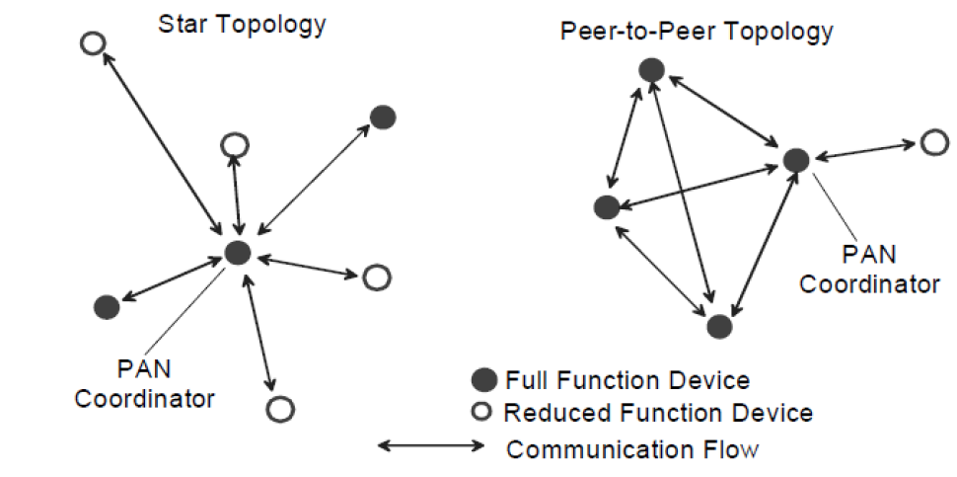
IEEE 802.15.4 Overview
Topologies: star, or peer-peer

Slide 9
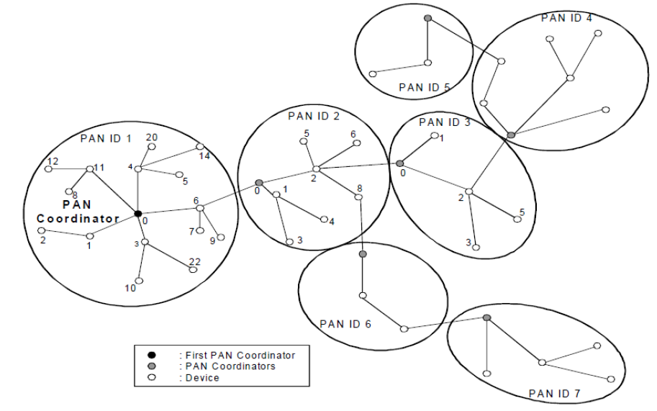
IEEE 802.15.4 Overview Cluster Tree as one form of a mesh

Slide 10
Mesh Standards
Focus in on mesh-under, not route over
Current mesh-under implementations run above MAC but below network layer
This is done due to lack of mesh mechanisms in 802.15.4 standard

Slide 11
Mesh Standards IEEE 802.15.5 Overview
This recommended practice provides a standard way of doing mesh networking over IEEE Std 802.15.4-2006 within the IEEE standard body
Supported features for LR-WPAN include the following:
unicast, multicast, and reliable broadcast mesh data forwarding
synchronous and asynchronous power saving for mesh devices
trace route function
portability of end devices

Slide 12
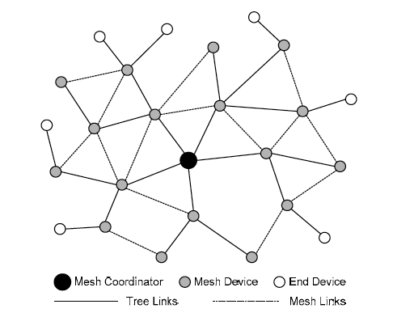
Mesh Standards IEEE 802.15.5 Overview

Slide 13
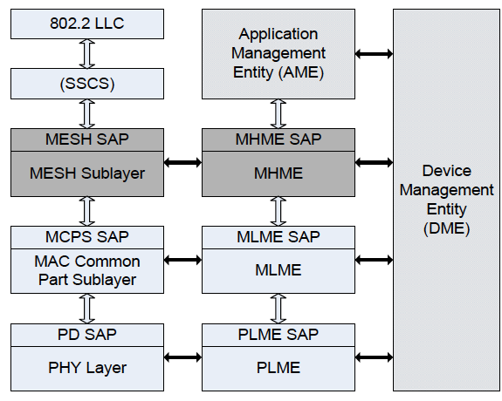
Mesh Standards IEEE 802.15.5 Overview

Slide 14
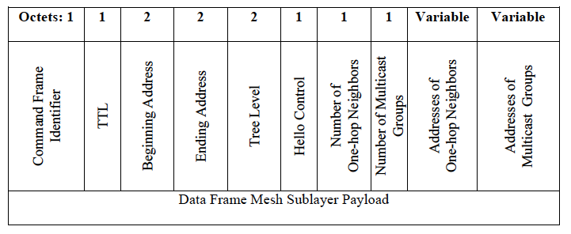
Mesh Standards IEEE 802.15.5 Overview
The hello command is used to exchange connectivity information among neighbors and to manage network and multicast group membership.

Slide 15
Mesh Standards IETF RPL Overview
RPL: distance vector IPv6 Routing Protocol for a Low power and Lossy Network
RPL: RFC 6553
LLN: RFC 6550
RPL constructs a Directed Acyclic Graph (DAG) that attempts to minimize path costs
RPL defines an IPv6 option, called the RPL Option, to be carried within the IPv6 Hop-by-Hop header
only for use between RPL routers participating in the same RPL Instance
provides a mechanism to include routing information with each datagram that a router forwards
This document also specifies the use of IPv6-in-IPv6 tunneling [RFC2473] when attaching a RPL option to a packet.

Slide 16
Mesh Standards Proprietary
Large number of companies that use IEEE 802.15.4 have developed and use their own mesh network
Such as smart meter companies – e.g. Silver Spring Networks
Some companies offer mesh networks for inclusion in products – e.g. Synapse
Current trend is for RFIC companies buying mesh network companies reminiscent of the initial trend of buying MAC companies
ARM purchased Sensinode
Silicon Labs purchased Ember
Linear Technology purchased Dust Networks

Slide 17
Industrial Mesh Networks Overview
Industrial applications (and some commercial applications) have critical requirements such as low latency, robustness in the harsh industrial RF environment, and determinism that are not adequately addressed by IEEE Std 802.15.4-2006
MAC behaviors added to IEEE 802.15.4 by the IEEE 802.15.4e amendment facilitate industrial applications such as:
IEC 62591 (Wireless HART)
IEC 62601 (WIA-PA)
IEC 62734 (ISA100.11a)
TSCH - Time Scheduled Channel Hopping

Slide 18
Utility Networks
Some of the world's leading utilities, energy service providers, product manufacturers and technology companies are supporting the development of ZigBee Smart Energy
ZigBee Smart Energy SE includes several important features including dynamic pricing enhancements, tunneling of other protocols, prepayment features, over-the-air updates

Slide 19
Utility Networks ZigBee Overview
Mesh Network: consists of ZigBee Coordinator, Routers, End nodes, with trust centers,
Mesh network routing permits path formation from any source device to any destination device via a path formed by routing packets through the device’s neighbors:
Radio Receivers on coordinator and routers must be on at all times
Table routing employs a simplified version of Ad Hoc On Demand Distance Vector Routing (AODV). This is an Internet Engineering Task Force (IETF) Mobile Ad Hoc Networking (MANET) submission

Slide 20
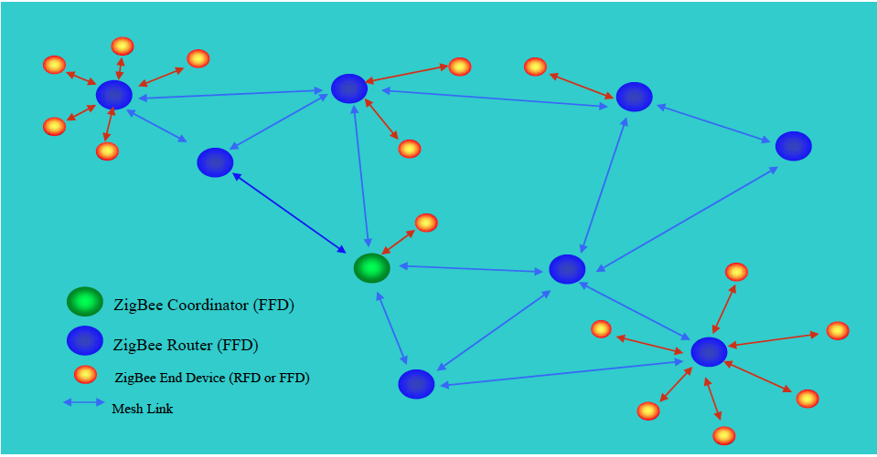
Utility Networks ZigBee Overview

Slide 21
Summary (Part 1)
Mesh Networks built on IEEE 802.15.4 exist in every application space
Mesh Networks today exist above the MAC due to the standard not including mesh routing but most use the MAC functions due to timing and other issues
Current trend is to drive some to all mesh functionality into the MAC

Slide 22
Summary Excerpt from a white paper written by a Smart Grid supplier
Harmonized existing proprietary technologies, including historical utility vendor mesh technologies – such as Silver Spring’s RF mesh – creating an interoperability framework. Incorporating support for existing deployments is a crucial advantage for utilities whose devices have been operating for years before the formal standard was ratified. It also benefits the industry overall, since the standard incorporated mature, proven technology rather than inventing or hypothesizing unproven techniques.

Slide 23
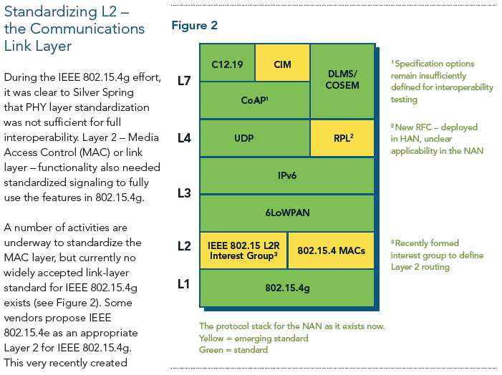
Summary Excerpt from a white paper written by a Smart Grid supplier

Slide 24
Why Layer 2 Routing in 802.15.4 (802.15 TG10) Part 2

Slide 25
Motivation for L2R
Growing use of 802.15 in large mesh network applications such as Utility and more generally in Field Area Networks
Need to address general requirements for L2 routing in Field Area Networks utilizing newer 15.4g and 15.4e amendments
Support and use in higher layer protocols – the Internet of Things

Slide 26
Some Example FANs
Smart Metering (HAN and NAN)
Smart City - Street Lighting/Parking/Meters…
Environmental Monitoring
Smart Home

Slide 27
Characteristics of These Applications
Data flows
One-to-many, Many-to-one
Point-to-point
Topologies
Collection tree
Mesh
Adaptive
Routing strategies
Proactive
Reactive
Management
Planned
Self Organising
Communications domains
Internal
External
Multiple ingress/egress points
Latency vs. QoS vs. reliability
Low latency
Priority of frames
Power saving
Sleepy end devices
Sleepy routers

Slide 28
Example Scenario for Managing FAN
Network should be configurable and work automatically.
Less cost repairing process is required when the network has a problem.
After the problem has gone, network should be reformed (maybe to almost the original ) to reduce the load.
PAN2
PAN1
PAN1
Concentrator2 is deactivated
Concentrator 2
Concentrator2
Concentrator 1
Concentrator1
Concentrator2 is reactivated
Concentrator3
Concentrator4
PAN3
PAN3

Slide 29
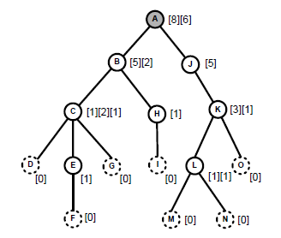
Scalability Issues in 802.15.5
Address allocation mechanism of IEEE 802.15.5
Step 1 : Create a tree structure by joining from top level to lower
Step 2 : Report the number of children (including reservation) to parent from lowest level nodes to the highest. After gathering all the number of children, root node assigns address spaces to nodes from top to bottom.
Issue
Network topology plan needs to be made before network formation.
Functionality of address space reservation for future use and adjustment of assignments is needed to help in extending network. However, it is difficult in this case, and the network must start over from address assignment to address changes in routing topology.
No address to allocate!
8
8
8
5
5
5
1
1
1
×
2
2
1
1
1
Join
2
1
1
1
New joiner
Inform number of children
Assign address spaces by root
Assign address spaces by root

Slide 30
Self Healing Issues in 802.15.5
Outline of routing algorithm of IEEE 802.15.5
Exchange the information with neighbors (address spaces, tree level etc.)
Choose next hop from the information
Issue
Since routing algorithm is based on address assignment, network must start over from address assignment to address changes in routing topology.
In public field area networks, changes in routing topology occur often.
Can’t merge address spaces!
[0:14]
[0:14]
A
A
[1:8]
[9:14]
[1:8]
[9:14]
B
J
B
J
[2:6]
[7:8]
[10:14]
[2:6]
[7:8],[11:13]
[10:14]
C
K
C
×
K
H
⇒
H
×
[11:13]
[11:13]
D
E
G
I
L
O
[14]
D
E
G
I
L
O
[14]
[3]
[4:5]
[6]
[8]
[3]
[4:5]
[6]
[8]
F
M
N
F
M
N
[5]
[12]
[13]
[5]
[12]
[13]

Slide 31
Why do L2 Routing?
Robustness & survivability
Multiple / Alternative paths
Avoid single point of failure
Load balancing
Avoid choke points in a network
Range Extension
Why not just shout louder?
Technology / Cost / Regulatory / Power consumption
Data Aggregation
Appropriateness
Notes:
Technology – cost of 15.4 vs 802.11 nodes
Regulatory – only allowed 1mW in many countries for 15.4
Tx/Rx is major component of power consumption in low power devices – increase range increases power consumed
Data aggregation – allows distribution of cheaper devices (less storage) at edges of network , reduces number of independent transmissions nearer to collection point – greater efficiency
Robustness – provide several ways to get to destination (may require more hops) to either help in face of failure/interference. Also helps with network installation where an extra routing node can be added to improve reachability of part of network. Avoid single point of failure (requires control of topology) Load balancing between multiple paths between source and destination if one route is becoming congested – switch to an alternative

Slide 32
Additional Requirements
Reliability
Reduction of End-to-End retransmissions
Failure detection
Scalability
Node density, network size etc.
Hardware resource requirements
Behaviour at restarts
Management of flooding, multicasts
Timing, grouping etc.
Congestion avoidance, flow control, Load balancing
Security
Provisioning, Joining

Slide 33
The Internet of Things
Aim to connect many billions of devices to the internet and each other
Enables finer control of processes
Enable new synergies between systems
Enable new applications and improve old ones
Its really cool to be able to control things from my phone, tablet, laptop…
Enabling communications to devices on this scale must be small fraction of overall cost to be viable
Wireless device eg 802.15.4, Bluetooth etc
But we still want to use the tried and tested protocols used on the Internet
Specifically, need to use IPv6 to cope with the expected volume of devices

Slide 34
IP Routing in Multi-hop Networks
Classic IP uses IP addresses to perform the routing between hosts on different subnets
Mechanisms (eg Neighbor Discovery) designed with the assumption that IP multicast will work over link-local scope
But this simple model breaks down if the underlying media doesn’t allow all hosts in a subnet to see each other (eg wireless)
In this case we need some way to connect the hosts in a subnet together – more routing
Two methods can be used
Route-Over (L3 or IP routing)
Mesh-Under (L2 routing)
Each has slightly different characteristics

Slide 35
Route-over
Treats each host as a router in an independent subnet
Each hop to the destination is an IP transfer
Therefore it looks like the message is going from one router between subnet to the next
Problems with Route-over
Breaks lots of things
Difficult to define the scope of message
Link-local is no longer equivalent to “my segment”
Efficiency issues

Slide 36
Mesh-under
Use L2 routing to connect devices in the subnet
Multiple L2 hops are transparent to L3
IP packet transfers from (Border) router is one IP hop
IP hop count controlling a packet’s Time-To-Live is still sensible
Media boundary (eg Wireless PAN) is link local scope
Maintains appearance of “ethernet like” network
Things just work
Multicast can be dealt with at L2

Slide 37
L2 Routing – Summary (Part 2)
Simplifies higher layers – doesn't break IP
Provides for hierarchical architecture
Can better fit to idiosyncrasies of link
Can improve performance
Remember fragmentation?
Each IP packet has to be fragmented at source and reassembled at destination
With Route-over solution this is every hop
With Mesh-under this only happens at the source and destination nodes – otherwise we just forward and route L2 packets
But it may not be as big a problem with the introduction of big L2 packets
Can provide more efficient multicast

Slide 38
Potential Issues to Resolve
Do we really need multicasting?
Really? Battery powered routers? Really!
Rapid connectivity changes
Wireless is not wired
Are all nodes in the mesh in a single IP subnet?
Making use of 6lowpan mesh header?
What functions of the MAC do we require (join)?

Slide 39
Things to Look At
Efficient multicast at L2
Leveraging recent MAC improvements (4e)
Information elements to carry routing information
Synchronisation mechanisms for low duty cycle (sleeping) networks
Security in the mesh
Securing multicast
Network security
Bridging
Cross Media bridging
Bridging between similar protocols (eg 4g & 4m)

