Slide 1
Project: IEEE P802.15 Working Group for Wireless Personal Area Networks (WPANs)
Submission Title: [6TiSCH + 802.1 for a new IPv6 MultiLink subnet]
Date Submitted: [12 November 2013]
Source: [Pascal Thubert] Company [Cisco]
Address [pthubert@cisco.com]
Re: [Presentation to 802.15 WNG]
Abstract: [Discuss IETF 6TiSCH Architecture and potential collaborations.]
Purpose: [Generate/focus activity on large Scale IPv6 multilink subnets federating 802.15.4e meshes.]
Notice: This document has been prepared to assist the IEEE P802.15. It is offered as a basis for discussion and is not binding on the contributing individual(s) or organization(s). The material in this document is subject to change in form and content after further study. The contributor(s) reserve(s) the right to add, amend or withdraw material contained herein.
Release: The contributor acknowledges and accepts that this contribution becomes the property of IEEE and may be made publicly available by P802.15.

Slide 2
6TiSCH + 802.1 + 802.15.4
A new IPv6 MultiLink subnet

Slide 3
The Case for Deterministic Wireless
Cables can be inappropriate
  for rotating devices, moving cranes, robots arms or mobile handheld devices
Cables are expensive
  Wire buried in conduit has high installation and maintenance cost, long lead time and extreme difficulties to repair
1% improvement leads to $15M/year in just 1 refinery
  Better process optimization and more accurate predictive maintenance increase profit
  Thus more and different sensors can be justified economically, if they can be connected

Slide 4
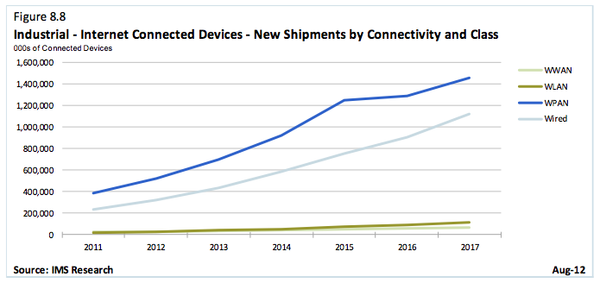
Industrial connected device growth

Slide 5
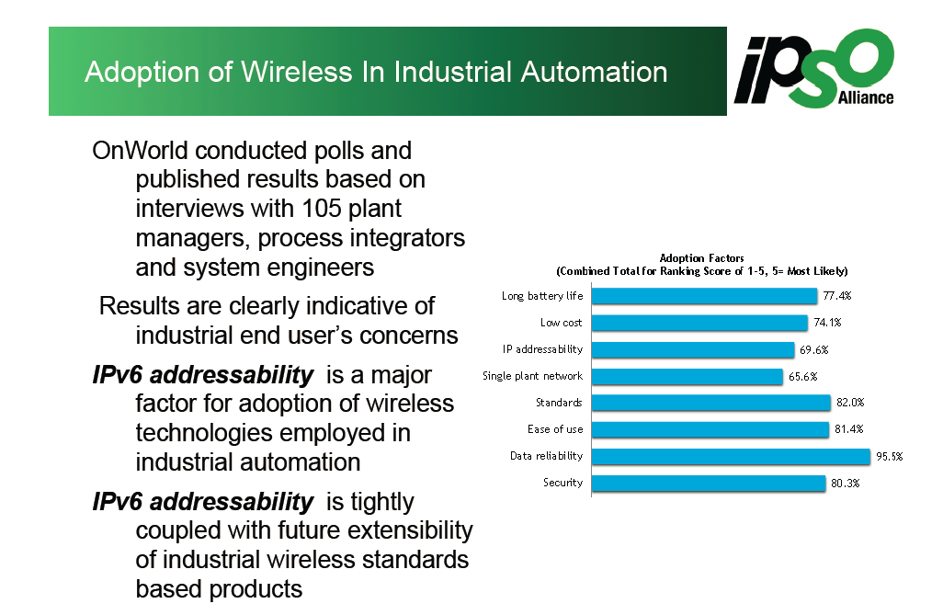
IPv6 to address and manage devices

Slide 6
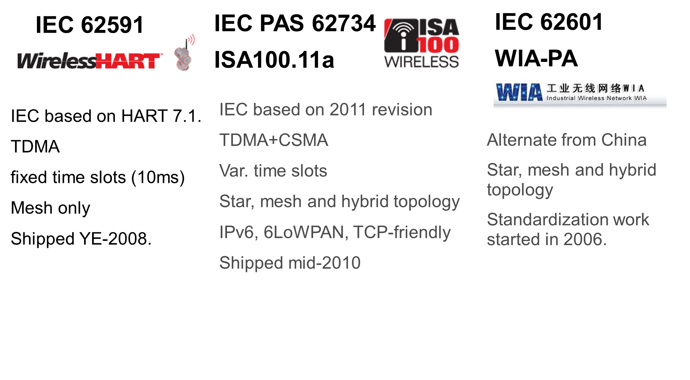
Industrial Landscape

Slide 7
6TiSCH Approach
to Wireless
Deterministic Networks

Slide 8
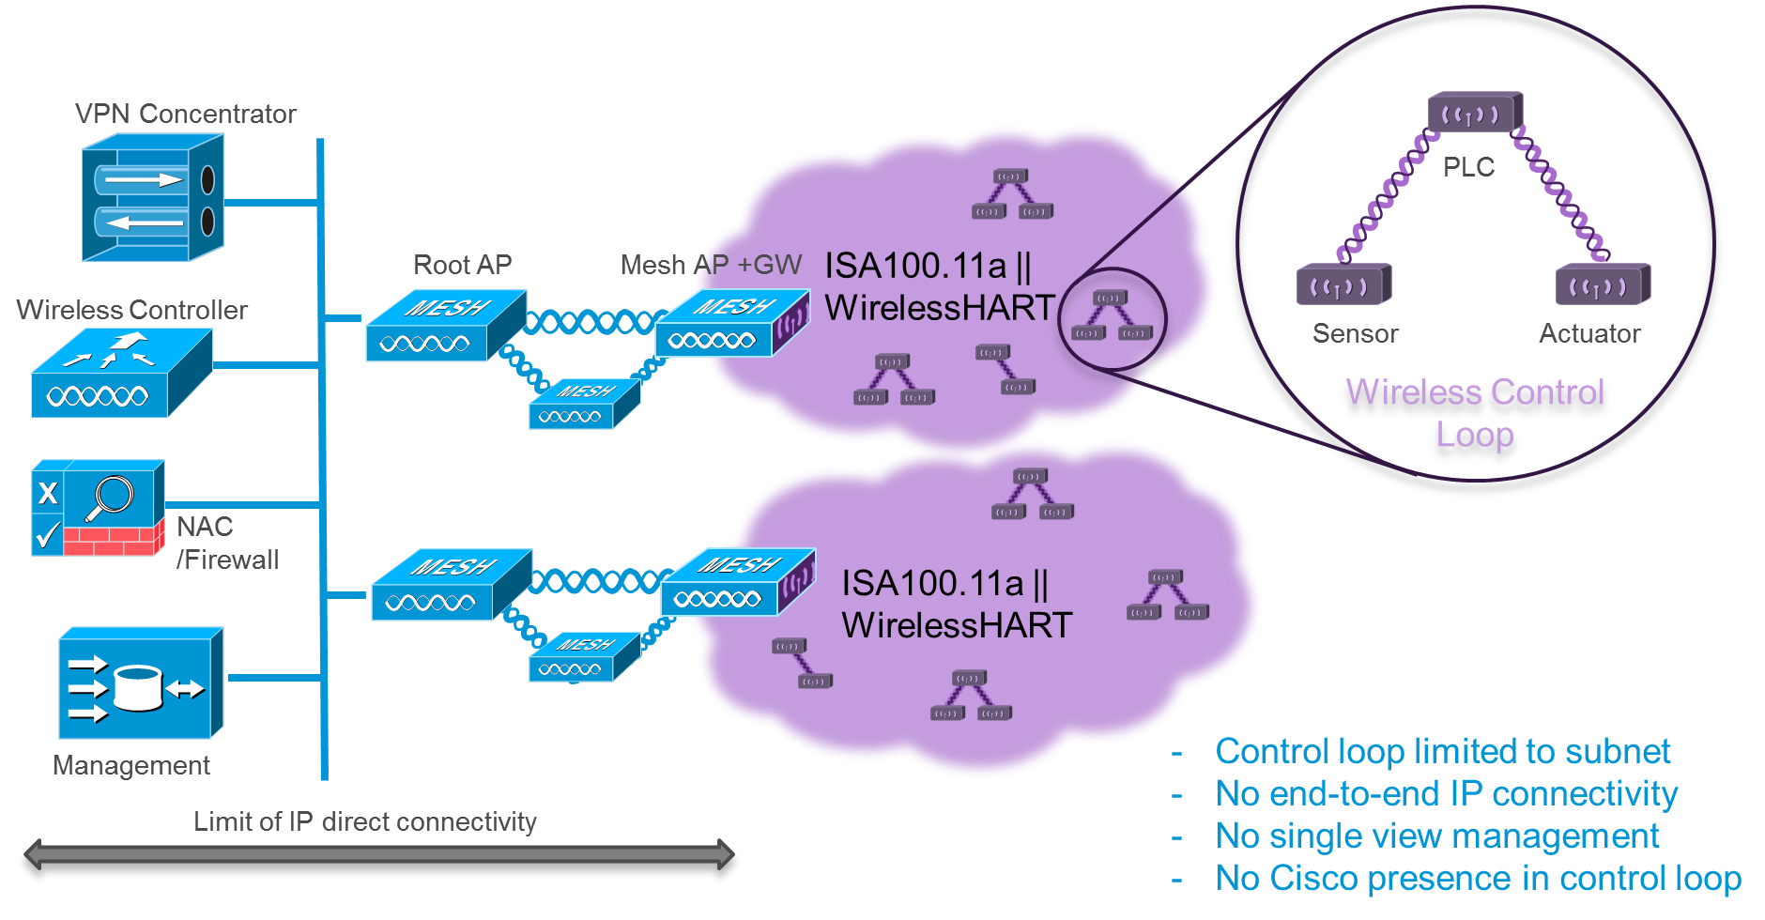
Current architecture: isolated networks

Slide 9
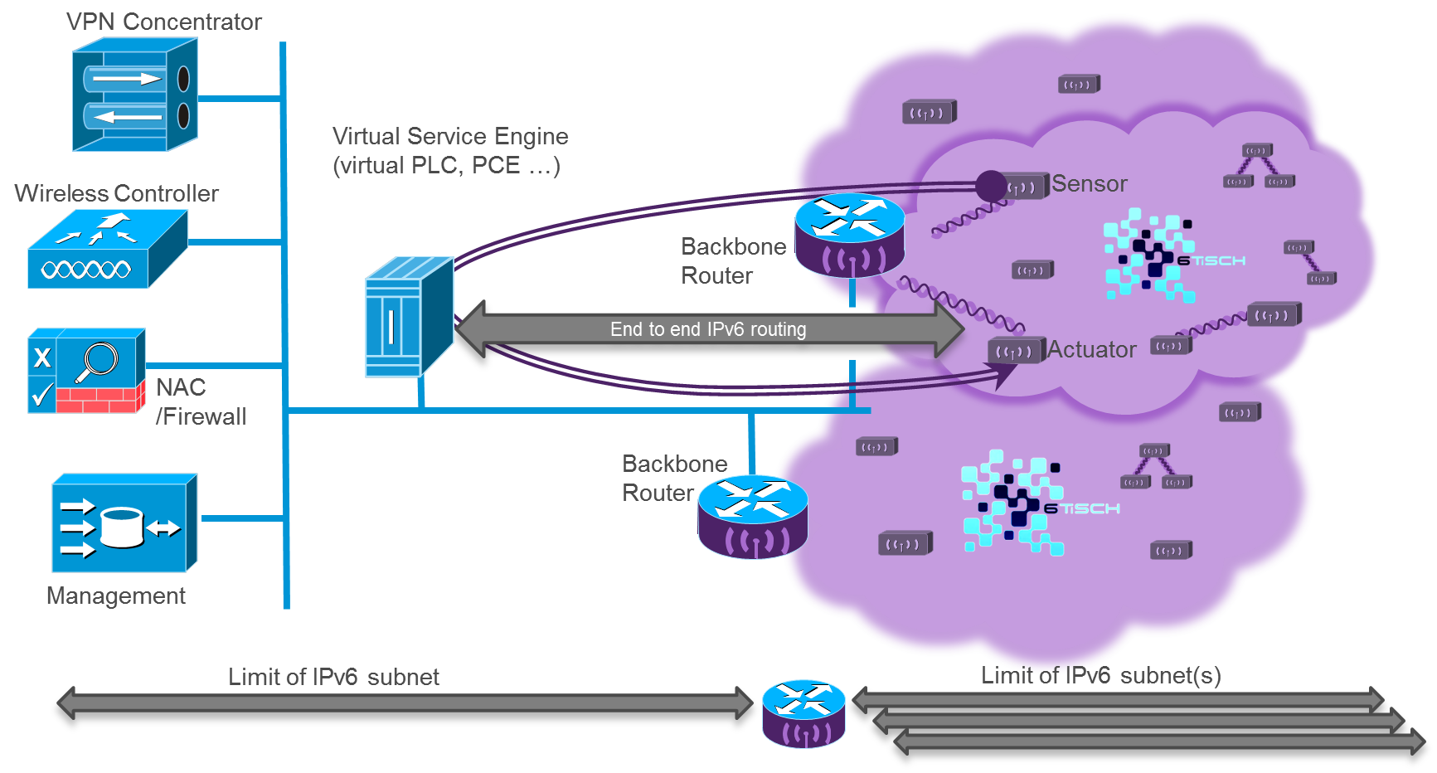
Step 1, 6TiSCH Subnets connected to carpeted floor

Slide 10
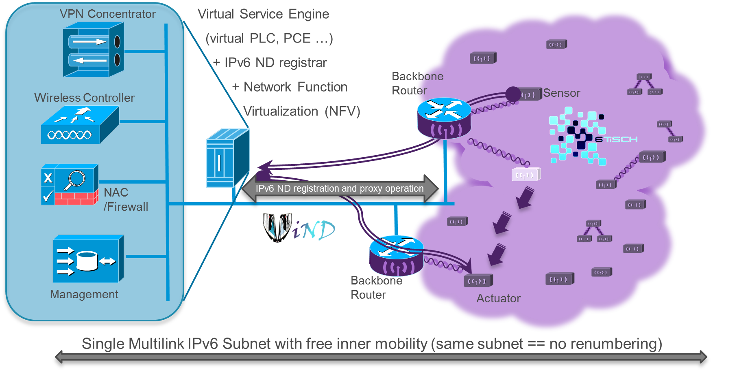
Step 2, Multilink Subnet enables unhindered mobility

Slide 11
Benefits
For Users
  A step toward Harmonization (Hour Glass model)
  COTS price, Standard experience (e.g. crypto),
  IPv6 end to end, enabling virtualization, thus easier install and mgnt
  Deterministic to the carpeted floor, enabling control loops with virtual PLC
For Vendors
  Extends value proposition, less dedicated hardware, more software
  Extends the reach of IP technology, save on generic soft and hard components
  Reusable Improvements on generic capabilities (e.g. deterministic switching)
  App Servers in the control loop, revenue from VSE, routing and analytics

Slide 12
Challenges
Network Configuration and Access Control
  Autonomic Behavior
Critical applications
  End-to-End determinism
  Scheduling L2+L3 Network AND virtualized devices Operation
Scaling IPv6 Subnets by 2 orders of magnitude
  Issues with link local multicast in discovery protocols even on high speed links (IPv6 Neighbor Discovery, mDNS, Bonjour…)
  DataCenters dissatisfaction (ARMD) answered by Overlay approaches (LISP, NVO3 …)

Slide 13
6TiSCH
in a nutshell

Slide 14

6TiSCH Charter and matching activity
Deterministic IPv6 over
IEEE802.15.4e TimeSlotted Channel Hopping
  The Working Group will focus on enabling IPv6 over the TSCH mode of the IEEE802.15.4e standard. The extent of the problem space for the WG is one or more LLNs, eventually federated through a common backbone link
  via one or more LLN Border Routers (LBRs).
Active drafts
  http://tools.ietf.org/html/draft-thubert-6tisch-architecture
  http://tools.ietf.org/html/draft-palattella-6tisch-terminology
  http://tools.ietf.org/html/draft-vilajosana-6tisch-minimal
  http://tools.ietf.org/html/draft-watteyne-6tisch-tsch
  http://tools.ietf.org/html/draft-wang-6tisch-6top
  http://tools.ietf.org/html/draft-ohba-6tisch-security
  http://tools.ietf.org/html/draft-sudhaakar-6tisch-coap

Slide 15
TSCH properties
Channel Hopping :
  retry around interference,
  round robin strategy
Time Slotted (or Synchronized) :
  Deterministic: through TDM, Synchronized + Time formatted in SlotFrame(s)
  Tracks: below IP, can be orchestrated by a third party like virtual circuits
  Slotted: benefits of slotted aloha vs. aloha => reduce chances of collisions
  Battery operation: when traffic profile is known, devices only wake upon need

Slide 16
6TiSCH: IPv6 over 4e TSCH MAC
Active IETF WG, 4 WG docs being adopted
Define an Architecture that links it all together
Align existing standards
  (RPL, 6LoWPAN, PANA, RSVP, PCEP, MPLS) over 802.15.4e TSCH
Support Mix of centralized and distributed deterministic routing
Design 6top sublayer for L3 interactions
Open source implementations (openWSN…)
Multiple companies and universities participating

Slide 17
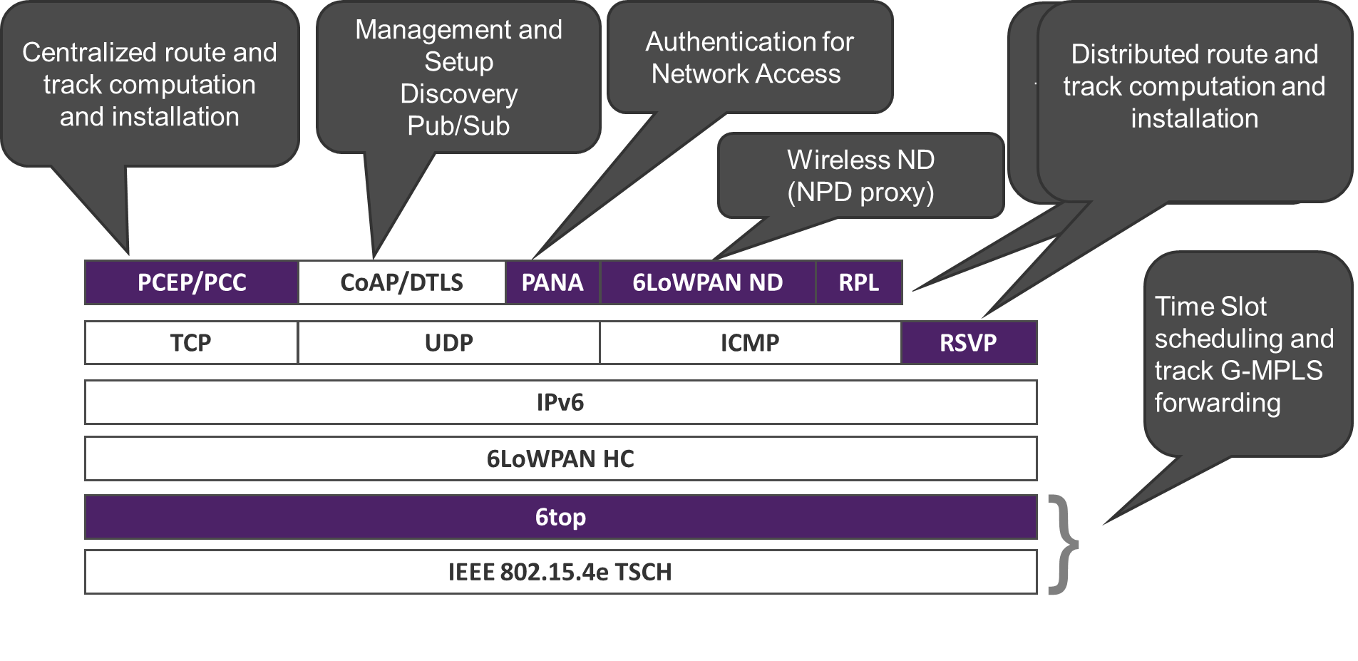
6TiSCH Client stack

Slide 18
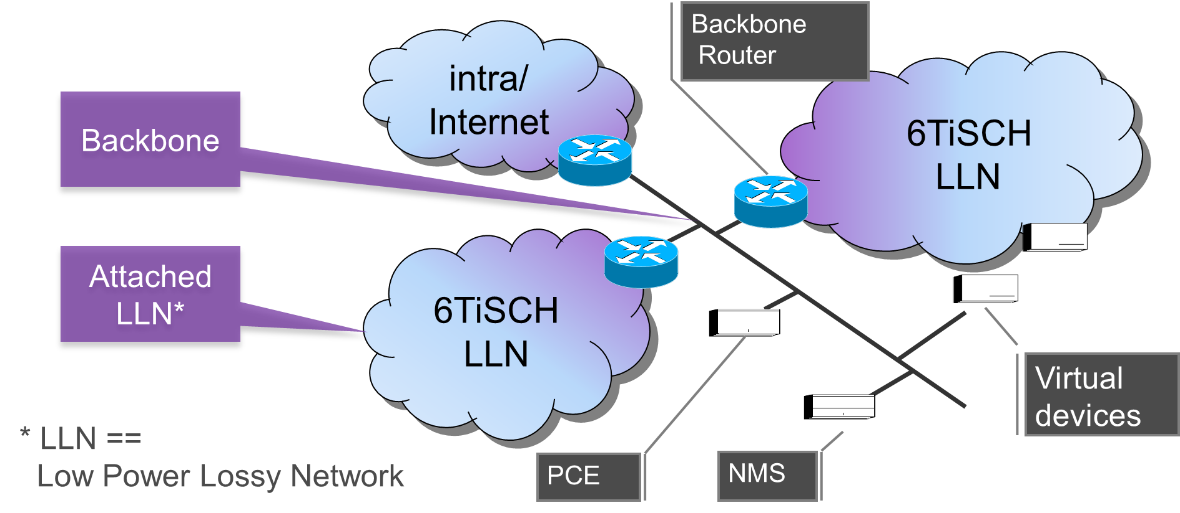
6TiSCH-based Multilink Subnet

Slide 19
6TiSCH
Requirements and Problems

Slide 20
Scalability requirements
10’s of thousands of LLN devices
  Classical + Virtual devices attached to backbone
Individual IPv6 addresses visible over backbone
  Aggregation at the Backbone router not expected
Classical IPv6 ND uses flooding to feed neighbor cache
  Most hosts only connect to a few other nodes
  Servers, routers, and firewalls connect to many

Slide 21
Single IPv6 Subnet requirements
10s of Ks devices with multihop LLN access
    No broadcast in the LLNs
    No renumbering (quasi permanent IPv6 address)
Continuous reachability as a LLN device moves in Subnet
    Radio conditions change cause network reorganisation
    Already use cases such as handheld, cranes, small vehicles
Backward Compatibility with classical IPv4 and v6 devices
Support of discovery protocols throughout the subnet

Slide 22
Routing requirements
Cost Optimized in the backbone
        Any to any traffic
        Multipath and load balancing a bonus
Power Optimized in the LLNs
      Most traffic flows to or from the LLN Backbone Router
      Control traffic must be limited vs. Data traffic
Broadcast or scalable multicast in the backbone
Multicast or Controlled dissemination in the LLN

Slide 23
Deterministic requirements
LLNs Time synchronization via the backbone
    to keep all LLNs in sync and
    allow movement from one LLN to the next
Slow deterministic LLNs (proces control)
    No need for Deterministic backbone
    Until scale and congestion loss becomes an issue
Upcoming faster deterministic wireless (factory automation)
    deterministic loops across networks and server OS

Slide 24
Compatibility requirements
End-to-End Deterministic
      Standard time exchange, common precision.
      Sync and schedule with the Deterministic backbone
MTU size a complex issue across networks
      Ideally harmonize MTUs across multilink subnet or
      at least detect discrepancies
Link Local lookups should be emulated
      Proxy operation (per protocol)
      Genralized hash based multicast

Slide 25
Pb1: Use AND implementation of multicast
IPv6 Discovery protocols use multicast flooding
  Assuming a lower layer multicast support
  Not just IPv6 NDP but also mDNS, etc…
Layer-2 destination set to 3333XXXXXXXX
Layer-2 fabric handles as broadcast (all nodes)
Broadcast clogs the wireless access at low access speed (typically 1Mbps) on all APs around the fabric
Broadcast self interferes on attached wireless mesh and drains the batteries on all nodes

Slide 26
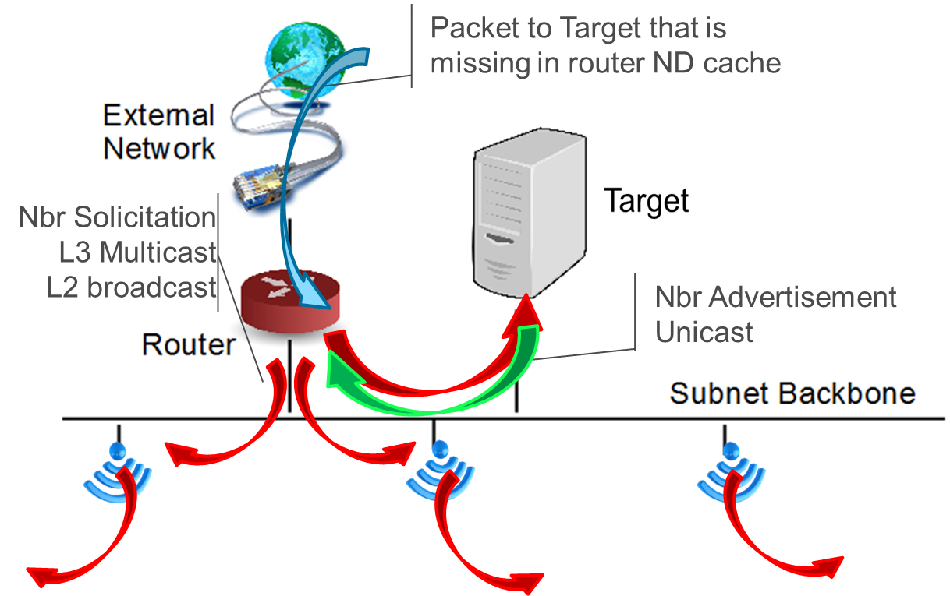
Flooding for IPv6 Neighbor Discovery

Slide 27
Flooding for IPv6 Neighbor Discovery
Packet comes in for 2001:db8::A1
Router looks up ND cache (say this is a cache miss)
Router sends NS multicast to solicited-node multicast @
mapped in this case to 3333 FF00 00A1
Targets answers unicast NA
Target revalidates ND cache for the router, usually unicast
Router creates ND cache entry
Routers have large caches and hosts very small ones

Slide 28
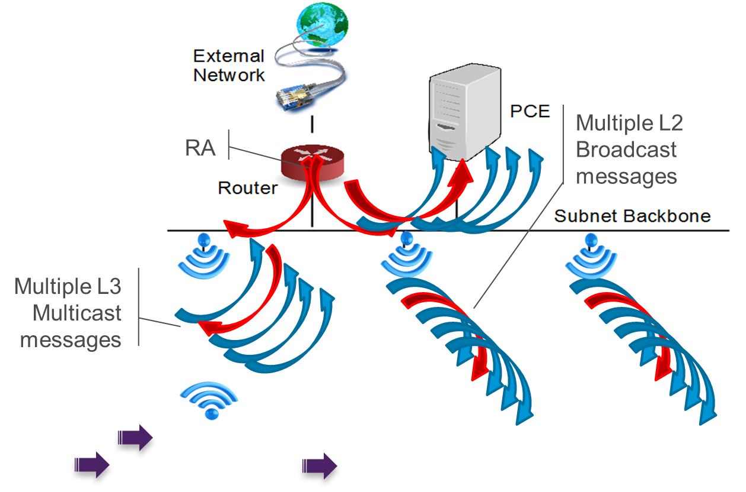

Flooding for mobility

Slide 29
Flooding for mobility
VM, NFV,Wireless or IoT device moves:
MAC address reachability flooded over L2 switch fabric
Device sends RS to all routers link scope multicast
Router answers RA (u or m)
Device sends mcast NS DAD to revalidate its address(es)
Device sends mcast NA(O)
All these steps can be checked for better efficiency

Slide 30
Problem2: cross-domain operations
Time synchronization (different precision, propagation)
MAC frames (different MTU, MAC address, header info)
End-to-End deterministic track setup (cross layer TSN)
Multicast and flooding implemented differently
Broadcast self interfering on attached wireless mesh and drains the batteries
A number of functionalities are implemented in products to prune some of those flooding with some degree of interference with the protocol operation.

Slide 31
6TiSCH-related
Collaboration opportunities

Slide 32
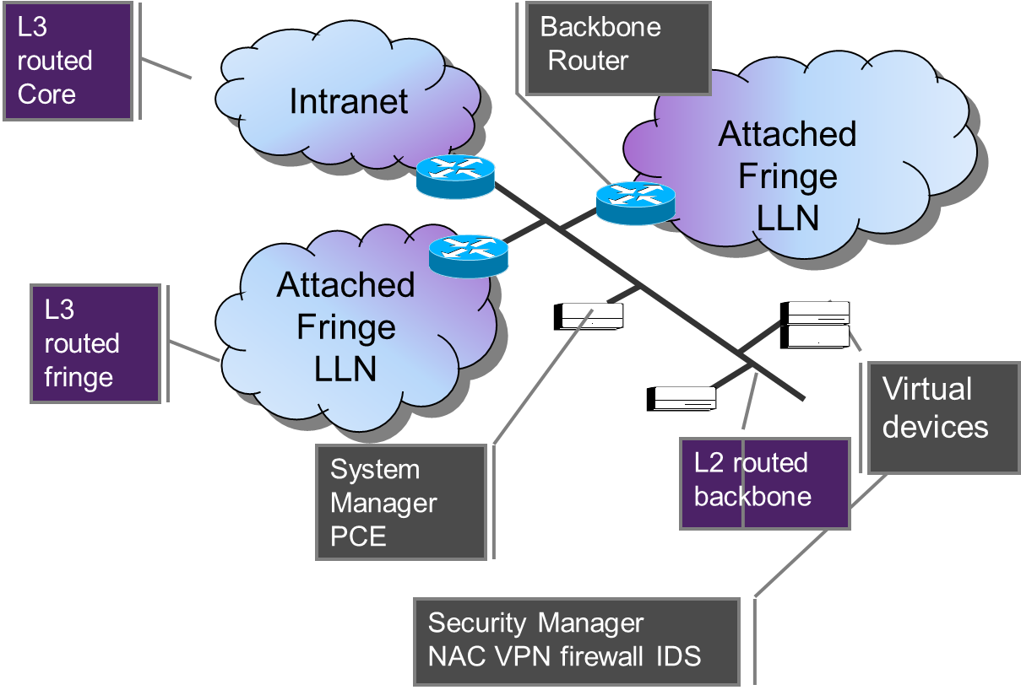
Current 6TiSCH model

Slide 33
Case for Layer-2 Backbone
L2 Routing optimizes any-to-any (all set)
  Integration of existing IPv4 and IPv6 hosts
  IPv6 ND and ARP over limited size broadcast domains
TBD: Avoid leaking LLN MAC addresses
  IPv6 proxy ND operation for attached LLNs
  IPv6 aggregation and routing at the Backbone Router
Possible work items:
  Highly scalable multicast routing to support discovery
  MTU harmonization and Time synchronization

Slide 34
Case for L3 Attached LLNs
L3 Abstracts Complex LLNs
      Multiple PHYs, very different properties
      End-to-end path optimization vs. Sequence of L2 paths.
      Cost and latency of the backbone usually negligible
RPL (RFC 6550) designed for Fringe Networking
      Optimized for traffic to/from the backbone.
      Objective Functions to adapt to any MAC/PHY
Low Power Lossy Networks fringe
      Incompatible with flooding – no broadcast (sleeping node + energy constraints)
      Multicast routing done in RPL (using unicast replications)
      Controlled dissemination done in MPL (gossiping technique based on trickle)
Possible work items:
      Wireless ND to proxy IPv6 ND for LLN attached devices
      802.15.4 Objective Function defined at IEEE

Slide 35
Case for X-SDO multicast
IPv6 link scope multicast addresses mapped to
    3333XXXXXXXX Layer-2 address
    In particular solicited-node in IPv6 ND 3333FFXXXXXX => 2^24 groups
Discovery Protocols (e.g. mDNS) to make good use of that space
L2 to manage multicast operation using portion of the 4 octets
More used bits => more multicast state, less wasted deliveries
RPL can carry multicast registrations to/from the backbone
Could extend in similar L2 operation over the backbone

Slide 36
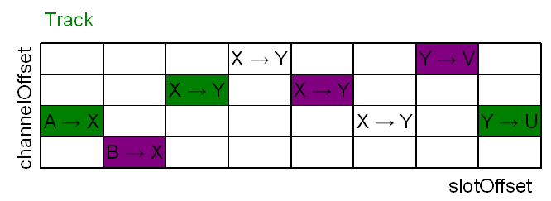
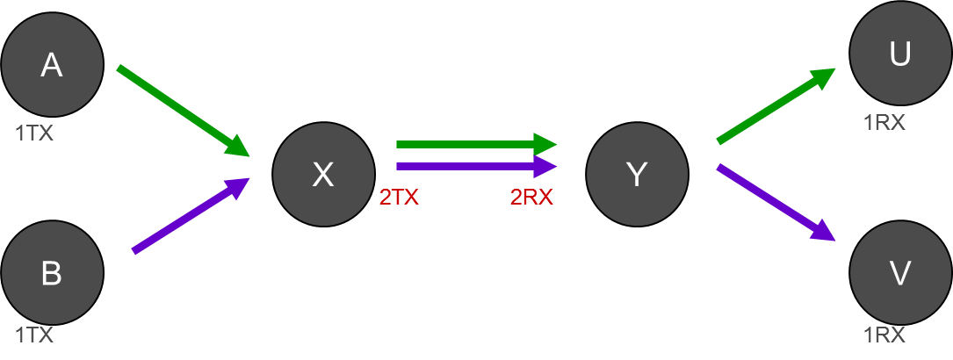
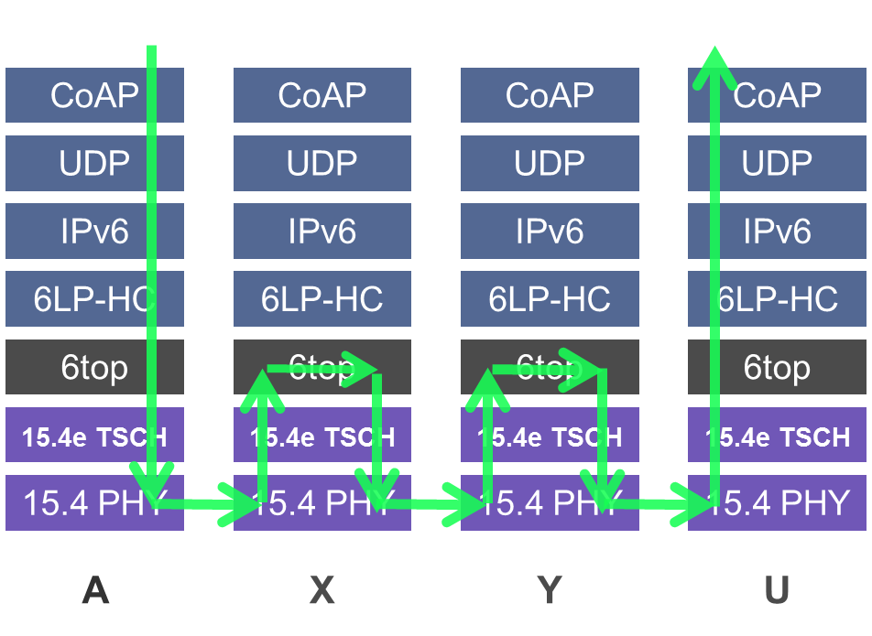
Case for X-SDO reservation / forwarding
6TiSCH supports
G-MPLS forwarding
L3 routing
Hybrid for 6LoWPAN fragments
Setup is still TBD:
Need to set up multihop tracks
IETF has RSVP, NSIS, LDP
IEEE 802.1 working on TSN
End-to-end “determinism”

Slide 37
6TiSCH Approach
The vision

Slide 38
Direction: IT/OT convergence
Requires new, higher-end paradigm
  Reaching more devices and data, farther, cheaper
  Guaranteed bandwidth + Optimum Capacity
  Scalable, IPv6 Multilink Subnet abstraction
MUST provide
  High availability, flow isolation, security,
  Deterministic guarantees for critical applications
  Unhindered Mobility for Wireless Devices
Making Convergence Happen
  Learn from Industrial, Air and Space
  IEEE + IETF to replicate and generalize with open standards
  Cooperate to share and optimize with mission specific SDOs

