Slide 1
Project: IEEE P802.15 Working Group for Wireless Personal Area Networks (WPANs)
Submission Title: The New Public Phone Service -Non Contact Ultra High Speed Contents Download Date Submitted: Novermber 12, 2013
Source: Masashi Shimizu, Ken Hiraga, Toshimitsu Tsubaki, Hideki Toshinaga, Tadao Nakagawa, Company NTT
Address: Hikarinooka 1-1, Yokosuka 239-0847 Japan
Voice: +81-46-859-3474, FAX: +81-46-855-1497, E-Mail: shimizu.masashi@lab.ntt.co.jp
Abstract: This contribution will present the non-contact ultra high speed transmission service over 60-GHz band. With this contribution, it is considered that the 60-GHz band will be useful in non-contact file download kiosk system with up to 24 G bit/s and with over 100 G bit/s using MIMO.
Purpose: Input for discussion on utilizing 60-GHz band for Kiosk download in SG 100G.
Notice: This document has been prepared to assist the IEEE P802.15. It is offered as a basis for discussion and is not binding on the contributing individual(s) or organization(s). The material in this document is subject to change in form and content after further study. The contributor(s) reserve(s) the right to add, amend or withdraw material contained herein.
Release: The contributor acknowledges and accepts that this contribution becomes the property of IEEE and may be made publicly available by P802.15.
Masashi Shimizu, NTT Corporation

Slide 2
Real WLAN Speed Measurements
9:00 AM at Tokyo Station
LTE Tethering 802.11g
Real Speed was estimated as 2.1Mbps
Slide 2

Slide 3







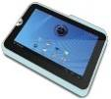
High Speed Data Download Service
NTT must provide carrier grade services.
P-to-P is mandate to keep high transmission rate.
Crowd server
4K Images
Book
Music
Data size is growing up
Movie
Big Data
Photo and Cam
Game
Optical NW
High speed
High Speed
Data rate was defined by the number of users.
Point-to-Point
LTE/3G, WiFi, WiMAX, etc
Reliable communication
(guaranteed quantity)
Point-to-Multipoint
Slide 3
Notes:
3

Slide 4










Service roadmap
・At first, Solution for contents provider will launch at 2015.
・Services will expand to public space application.
・Finally we will these services contain anywhere.
Service roadmap
Image of Contents Download Services
Contents Provider
Step３
57,000,000
Subscriber
Platform
Step ２
（Convenience Store:48,000、Station:9300
Public Phone 210,000)
Crowd Server
Cash Files
Any Where!!
NW
Stations
Convenience Stores
Step１
Contents Provider
(Rental Video)
Stations
Public phone
Gas station
Convenience Store
Cash Files
Public
Space
Rental Video
Contents Provider
Cash Files
NTT will built the new network to meet these demands.
Slide 4

Slide 5
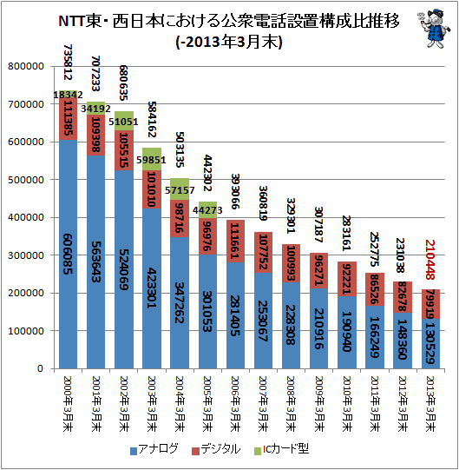
Number of Public Phone
2000~2013
FY 1999
FY 2000
FY 2001
FY 2002
FY 2003
FY 2004
FY 2005
FY 2006
FY 2007
FY 2008
FY 2009
FY 2010
FY 2011
FY 2012
Analog
Digital
Digital (IC-card payment)

Slide 6










Our Target Usage Models
We focus on the usage of millimeter wave communications with ultra short range communication (non contact).
Not only ultra high speed. The Total Contact Time must be less than 1 Second.
【 Rapid Download / Upload】
Public use
Local use
Audio and Video equipment
⇔ mobile terminal
Content Holder
Authentication
Throughput :
> 2Gbps
Throughput :
> 2Gbps
movie
Range :
< 5cm
Home GW
Range :
< 5cm
Kiosk
Slide 6

Slide 7
    Standard Comparison
Our target system concept is similar to TransferJet.
  But data rate is less than 1 Gbps.
Near field Communication
New standard
Throughput (Bps)
10G
Target
802.11ad
1G
TrasferJet Consortium
Promoters (9 Companies)
Sony Corporation
Toshiba Corporation
etc.
Adopters(36 Companies)
NTT Docomo, INC.
KDDI Corporation
etc.
Transfer Jet
100M
～
～
～
ISO14443
～
ISO15693
10cm
1m
10m
Communication Range
Slide 7

Slide 8
Standard Specifications
 | Frequency band | Modulation | Range | Beamforming | IP | Topology | DRM
TransferJet | 4.5 GHz | UWB 560Mbps (max) | < 5cm | Not Required | Not support | P to P | Support ( CPRM etc.)
IEEE 802.11ad | 60 GHz | 1.115Gbps（SC, BPSK） Option: 6.756Gbps（OFDM, 64QAM） | In room gaming,…5m Rapid sync-n-go file transfer…8m Projection to TV or projection in conf. room…8m | Mandatory | Support | AP-based BSS (Basic Service Set) PBSS (Personal BSS)…P to P | Support over IP (DTCP-IP)
Target | 60 GHz | >2Gbps OFDM or SC+FDE | < 5cm | Not Required | Support | P to P | Support
Notes:
8
8
8

Slide 9
Discussion
  We need a fast link establishment. (about 100 msec or less)
WiGig: Association/Authentication
About 1 sec
Target time
100 msec or less
SD: File System Mount
About 3 sec
Data transmission

Slide 10
Surveillance of Waiting Time for Web Site Response
How long can you wait a response on the web site without stress ?
(%)
 | Average | Men | Women | Age 20’s | Age 30’s | Age40’s
3Sec | 17.0 （17.0） | 20.9 | 12.2 | 22.8 | 14.0 | 14.9
5Sec | 23.8 （40.8） | 25.5 | 21.7 | 18.9 | 23.8 | 29.7
8Sec | 7.5 （48.3） | 5.0 | 10.6 | 7.1 | 7.6 | 7.9
10Sec | 25.0 （73.3） | 25.9 | 23.9 | 26.8 | 27.9 | 17.8
15Sec | 13.3 （86.6） | 11.8 | 15.0 | 12.6 | 11.0 | 17.8
30Sec | 8.0 （94.6） | 7.3 | 8.9 | 6.3 | 10.5 | 5.9
More than 30Sec | 5.5 （100） | 3.6 | 7.8 | 5.5 | 5.2 | 5.9
http://www.citizen.co.jp/research/index.html
Slide 10

Slide 11
Download Time Comparison
Contents | File size | Download time (Sec)
 |  | First Step | Second Step | Transfer Jet | 802.11ac (Draft)
 |  | Read Speed 2 Gbit/s | Read Speed 4 Gbit/s | Real Speed 375 Mbit/s | Read Speed 530 Mbit/s
Book | １ MByte | 0.004 | 0.002 | 0.021 | 0.015
Comic | 30 MByte | 0.12 | 0.06 | 0.64 | 0.45
Magazine | 300 MByte | 1.2 | 0.6 | 6.4 | 4.5
CD | 700 MByte | 2.8 | 1.4 | 14.9 | 10.6
Movie (1hour) | 1.8 GByte | 7.2 | 3.6 | 38.4 | 27.2
Movie (2hour) | 3.6 GByte | 14.4 | 7.2 | 76.8 | 54.3
Slide 11

Slide 12
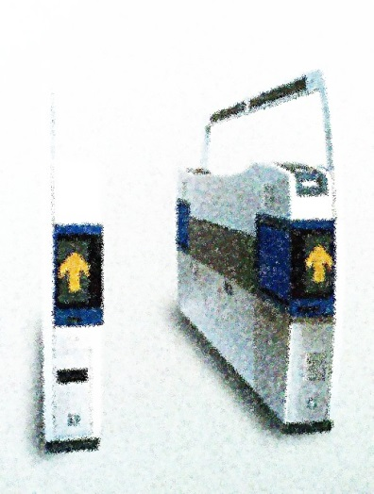

Realization of “Real touch-and-get”
Maximum file sizes allowed in 0.5-sec download
“Real touch-and-get” within 0.5 sec
download with toll-gate
100
Blu-ray Disc
10
1 DVD
File size [GBytes]
<0.5-sec download
1-hr Video
(MPEG2)
1
1 CD
1 Magazine
4 newspapers
100Gbit/s
0.1
2
4
10
40
100
400
1000
Video: Busy toll-gates in the train station
e.g., “http://youtu.be/_r5rjvjquzY”
Transmission rate [Gbit/s]
  With 100 Gbit/s, data sizes of up to a DVD (4.7 GBytes) are downloaded within 0.5 sec.
Notes:
MIMO or wider bandwidth is required

Slide 13
Transmission rates over 60-GHz band
Rate | Download time for DVD data (4.7 GBytes) | Modulation | No. of frequency channels | MIMO
4.5 Gbit/s | 8.4 sec | 16QAM | 1 | - (SISO)
6.8 Gbit/s | 5.5 sec | 64QAM | 1
27 Gbit/s | 1.4 sec | 64QAM | 4
100 Gbit/s | 0.4 sec | 16QAM | 2 | 16x16
 |  | 64QAM | 1
100 Gbit/s rates are attainable using MIMO
Short-Range MIMO (SR-MIMO)
IEEE802.11ad OFDM PHY
MCS#17: 2.1 Gbit/s (QPSK, Code rate=3/4)
MCS#21: 4.5 G bit/s(16QAM,Code rate=13/16)
MCS#24: 6.8 G bit/s (64QAM,Code rate=13/16)
TX
RX
#1
#1
#2
#2
Line-of-sight
environment
・
・
・
・
・
・
#M
#M
Notes:
Proportional relationship to the number of elements M

Slide 14
100 Gbit/s performance estimation
Electromagnetic simulation model of transmission channel
OFDM transmission simulation
Parameter | Value
Frequency channel | Ch2 (f_{c}=60.48 GHz), Ch3 (f_{c}=62.64 GHz)
No. of branches | 16 x 16
Transmission distance | D = 10 mm
Element spacing | d = 4.1 mm = 0.82 λ₀ (Optimized for this transmission distance)
MIMO detection | Zero Forcing (ZF)
No. of data subcarriers | 336
Subcarrier spacing | 5.15625 MHz
Modulation | QPSK, 16QAM, 64QAM
23mm
Rx array
Tx array
Microstrip antenna
d
d= 4.1 mm
Frequency channels
D = 10 mm
Ch1
Ch2
Ch3
Ch4
57 GHz
60.48
62.64
66 GHz

Slide 15
100 Gbit/s performance estimation
Simulated bit error rate (BER)
Transmission rates with each modulation
16 x 16 MIMO
Modulation | No. of frequency channels | Transmission rate
QPSK | 1 | 33 Gbit/s
 | 2 | 67 Gbit/s
16QAM | 1 | 72 Gbit/s
 | 2 | 144 Gbit/s
64QAM | 1 | 108 Gbit/s
 | 2 | 216 Gbit/s
Frequency channels in 60-GHz band
Ch1
Ch2
Ch3
Ch4
60.48
62.64
[GHz]
  Over 100 Gbit/s is attainable with 16x16 MIMO using small (23 mm x 23 mm) antenna arrays that can be installed on portable devices.

Slide 16
Capacity enhancement with SR-MIMO
With short-range MIMO transmission, channel capacity is almost in proportion to the number of MIMO branches.
Further capacity is expected.
25x25 MIMO
284 bit/s/Hz
16x16 MIMO
193bit/s/Hz
9x9 MIMO
115 bit/s/Hz
Calculation conditions
Transmission distance: D=1 mm
Element spacing: d = 2.5 mm

Slide 17
Summary of 100 G bit/s over 60-GHz band using short-range MIMO
Channel capacities of over 100 Gbit/s are attainable using MIMO at 60-GHz band
With 100 Gbit/s, data sizes of up to a DVD (4.7 GBytes) are downloaded within 0.5 sec.
  → “Real touch-and-get” will be realized.

Slide 18
Backup

Slide 19
Regulation will be Changed
EIRP
  47dB antenna with 10mW output power. Low gain antenna was not assumed. It will be changed keeping same EIRP.
Channel Bonding
  Now, channel band width was less than 2.15GHz. It is not arrowed Channel bonding. It will be changed.
Certifications formulation
  More easy process to have certification

Slide 20
Public kiosks with downloadable movies, such as at an airport, are a great way.
to make movies available to users with portable devices
• At multi-gigabit download speeds, a user can download an uncompressed, HD movie in one minute, or on the way to an airport gate before boarding.
• The kiosk can support multiple simultaneous transfers, which means even less time waiting in line.

Slide 21
Concept of short-range MIMO (SR-MIMO)
(a) General MIMO
(b) SR-MIMO
TX
RX
TX
RX
#1
#1
#1
#1
#2
#2
#2
#2
Multipath-rich
environment
Line-of-sight
environment
・
・
・
・
・
・
・
・
・
・
・
・
#M
#M
#M
#M
Low spatial correlation is achieved without multipath propagation
because path length differences is exploited
Notes:
There are multiple streams of signals even in finite element spacing in multipath-rich environments.
With few multi-path waves, it is difficult to transmit multiple streams.
Transmission distance is short compared with the aperture size.
Transmission lines are formed in parallel without multipath.
Both low spatial correlation and high SNR can be achieved with small interelement spacing.
Short-range MIMO is suitable for short-range, high-speed transmission.

Slide 22
Further advantage of SR-MIMO
We have clarified that the channel capacity obtained by zero forcing (ZF) at the receiver which does not use beam forming at the transmitter and channel state feedback is almost the same as that using eigenmode transmission when the element spacing is optimized.[1]
Hence transceiver’s transmission signal processing cost for MIMO detection will be reduced compared with eigenmode transmission.
Reference:
[1] Nishimori, K.; Honma, N.; Seki, T.; Hiraga, K., "On the Transmission Method for Short-Range MIMO Communication," Vehicular Technology, IEEE Transactions on , vol.60, no.3, pp.1247,1251, March 2011

Slide 23
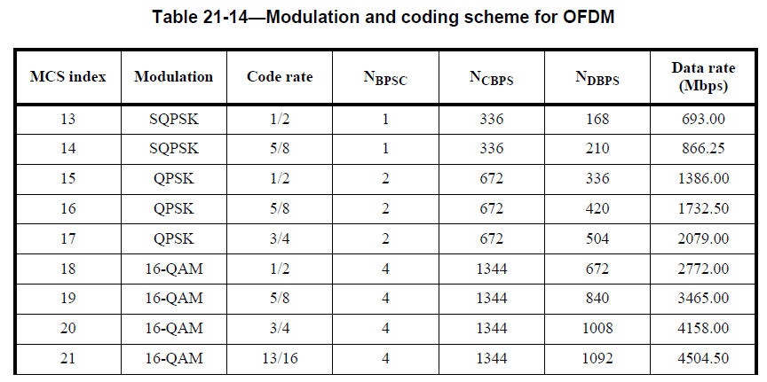
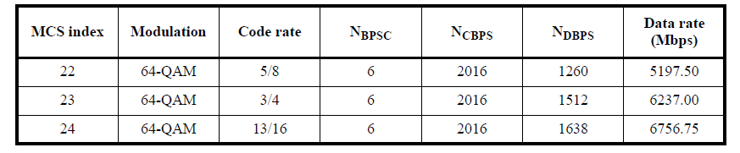
Ultra high rates using SR-MIMO
OFDM-PHY rate in
IEEE802.11ad wireless LAN
For over 100 G bit/s
No. of MIMO branches | No. of frequency channels | Modulation
16x16 | 2 | 16QAM
32x32 | 1 | 16QAM
16x16 | 1 | 256QAM
4.5 * 16 * 2 = 144 Gbit/s
For 1 T bit/s
No. of MIMO branches | No. of frequency channels | Modulation
64x64 | 2 | 256QAM
128x128 | 2 | 16QAM

Slide 24
Advantage of 60-GHz band
60-GHz band has huge unlicensed bandwidth.
The huge bandwidth represents great potential in capacity.
Frequency
Millimeter-wave
0 Hz
10 GHz
20 GHz
30 GHz
60 GHz
300 GHz
bandwidth
≈ 0.1 GHz
≈ 0.1 GHz
≈ 0.6 GHz
≈ 0.4 GHz
9 GHz
2.16 GHz
CH1
CH2
CH3
CH4
2.1 GHz band
2.4 GHz band
4.5 GHz band
5 GHz band
57 GHｚ
60 GHz band
66 GHｚ
LTE
IEEE802.11
TransferJet
IEEE802.11

Slide 25
Performance estimation in 4 x 4 MIMO

