Slide 1
doc.: IEEE 802.15-13-0669-00-0led
Project: IEEE P802.15 Working Group for Wireless Personal Area Networks (WPANs)
Submission Title: [Challenging Issues in CamCom System]
Date Submitted: [November, 2013]
Source: [Yeong Min Jang, Ratan Kumar Mondal, Nam Tuan Le, and Trang Nguyen]
[Kookmin University]
Address [Kookmin University, Seoul, Korea]
Voice:[82-2-910-5068], FAX: [82-2-910-5068], E-Mail:[yjang@kookmin.ac.kr]
Re: []
Abstract: [The scope, purpose and reason of the proposed project are described]
Purpose: [Contribution to IEEE 802.15 IG-LED]
Notice: This document has been prepared to assist the IEEE P802.15. It is offered as a basis for discussion and is not binding on the contributing individual(s) or organization(s). The material in this document is subject to change in form and content after further study. The contributor(s) reserve(s) the right to add, amend or withdraw material contained herein.
Release: The contributor acknowledges and accepts that this contribution becomes the property of IEEE and may be made publicly available by P802.15.
Notes:
doc.: IEEE 802.15-09-0117-00-0007
<month year>

Slide 2
Challenges of CamCom System
doc.: IEEE 802.15-13-0669-00-0led
Some challenges for implementing CamCom System:
Reception Technique:
Unstable camera frame rate
No suitable uplink for CamCom system
LED source separation for MIMO operation in CamCom transmitter

Slide 3
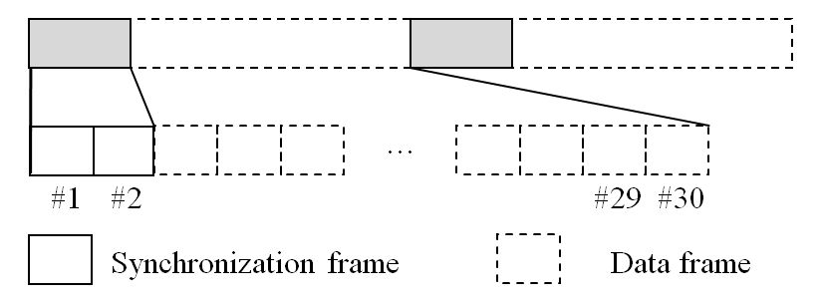
Synchronization of OOK CamCom System (1/2)
doc.: IEEE 802.15-13-0669-00-0led
Superframe Structure
…..
…..
#1
#2
#30
#1
#2
#29
#30
Synchronization
Loss of Synchronization

Slide 4
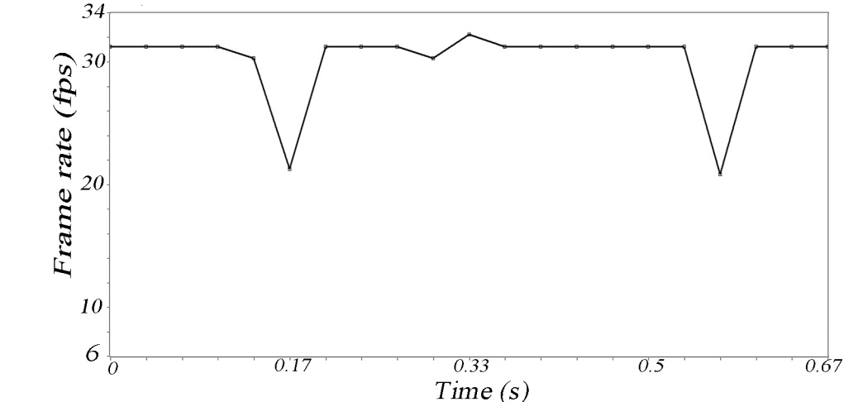
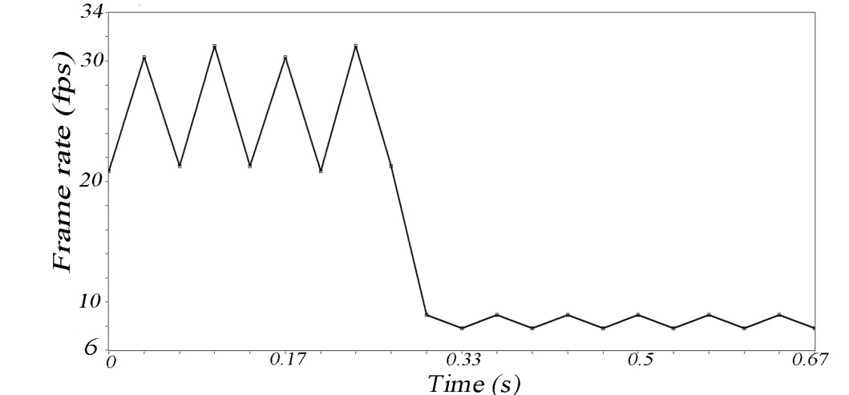
doc.: IEEE 802.15-13-0669-00-0led
Synchronization of OOK CamCom System (1/2)
The synchronization hampered due to the unstable frame rate of different kinds of cameras: According to the measurement the time duration between two capturing frame rate are not stable
<Webcam Samsung SPC-A400M>
< Webcam Colorvis >

Slide 5
Possible Candidates for Uplink
doc.: IEEE 802.15-13-0669-00-0led
Possible Candidate for Uplink in CamCom System:
Flash: It can be used as uplink. Though, credibility of the uplink reception depends on the receiver FOV(image sensor or PD), angle of incidence, angle of irradiance.
RF interfaces(Wi-Fi, bluetooth): Wi-Fi or bluetooth can be used as a potential uplink since both are already available in current smart phone. In that case system becomes more of a hybrid system requires RF-VLC cooperation.
Infrared: Infrared sources are already available in the some smart phones and can be used a uplink.

Slide 6
Conclusion
doc.: IEEE 802.15-13-0669-00-0led
Need to proposed a the synchronization process which can adapt with the different frame rate of the camera
The MIMO operation is effected by the separation of adjacent LED and the blur effect of the captured image. The diversity and multiplexing can be characterized with respect to the camera specifications.
The presented uplink candidates can be considered for the future research of CamCom for providing bi-directional communication.

