Slide 1
Project: IEEE P802.15 Working Group for Wireless Personal Area Networks (WPANs)
Submission Title: [Additional use case of temporal and flexible industrial network deployment]
Date Submitted: [14 Nov., 2013]
Source: [Shusaku Shimada] Company [Schubiquist Technologies Guild]
Address [1-28 Nishiarai Chuo-shi Yamanashi, 409-3802 Japan]
Voice:[+81-55-274-1266], FAX: [+81-3-3468-0625], E-Mail:[shusaku@ieee.org]
Re: [Call for contributions by IEEE802.15 SG-SRU on 21 Oct., 2013]
Abstract: [In case of a temporal or episodic network deployment, RRMM information is required to reallocate the radio resource responsively for extraordinary information and unexpected traffic.]
Purpose: [To support the drafting of PAR & 5C.]
Notice: This document has been prepared to assist the IEEE P802.15. It is offered as a basis for discussion and is not binding on the contributing individual(s) or organization(s). The material in this document is subject to change in form and content after further study. The contributor(s) reserve(s) the right to add, amend or withdraw material contained herein.
Release: The contributor acknowledges and accepts that this contribution becomes the property of IEEE and may be made publicly available by P802.15.

Slide 2
Additional use case of temporal and flexible industrial network deployment
In case of episodic and unexpected events, disaster and emergency

Slide 3
Utilizing flexibility of wireless network
Demand of exploiting the wireless flexibility is increasing in industrial control application field.
to reduce CapEx by quick deployment and relocation for reuse.
to reduce OpEx by responsive extra-sensing for optimal control.
Possible potential needs may emerge in other fields as well.
Hospital/medical system; e.g. Disaster/out-break responsiveness.
Infrastructural monitoring system; e.g. aftercare of earthquake.
Above is due to difficulties of forecasting a sporadic event and proactive readiness by fixed deployment against such event.
Minimizing the cost of permanent part of network deployment.
Mitigating risk of event; e.g. disaster, accident or market price.

Slide 4
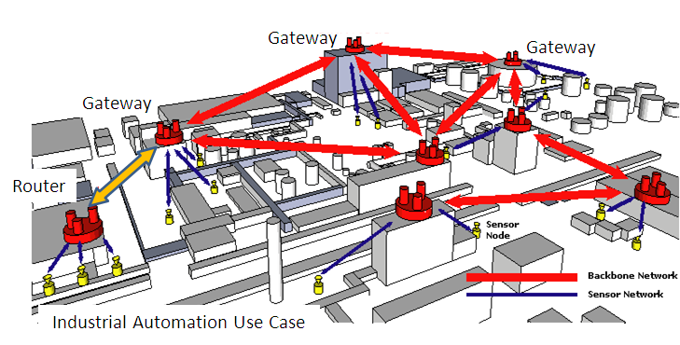
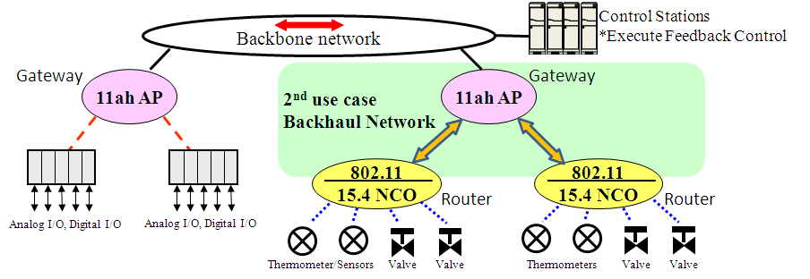
Flexible deployment of industrial wireless network
Quick additional deployment
Quick withdrawal, relocation
Inexpensive and reusable
Additional
Temporal network deployment
Episodic/Unexpected traffic
Disaster responsiveness
Emergency action to prevent accident
Gateway

Slide 5
Challenges in additional deployment over existing wireless network(s)
Additional network deployment may influence over near-by radio resource usage even if it is temporal deployment.
e.g. interference in frequency (channel), time (slot) and space (path).
In addition, the possible hidden node relationship may be engaged with existing wireless network, hence an appropriate coexistence management and provisioning are required, often responsively.
e.g. Operating channel assignment and allowable max. TX power control.
Proactive fixed network deployment against a sporadic events may not be usually cost effective.
Whereas, ordinary RRMM record of existing network can possibly facilitates a temporal deployment, e.g. by proactive simulation.

Slide 6
Challenge in use case of the temporal/episodic network deployment
Network-C
Network-B
Emerging
temporal or episodic networking
challenges
Network-A
Temporal Network-X
Application’s QoS requirement
Application’s QoS requirement
Wireless system #1
Wireless system #2
Resource Usage
Resource Usage
Interference
Interference Immunity
Interference Immunity
Wireless Resources (Frequency / Time / Space ..)
Radio Resource Measurement
& Management (RRMM)
Measurement
Assignment
Resource Utilization
Traffic
Interference
Responsive
Resource Management
Resource Utilization
Traffic
Interference
Resource Allocation / Arbitration / Coordination
And Reservation
Resource Utilization
Interference
QoS/Power constraints
Rules / Heuristics
Analytical Models / Simulations

Slide 7
Conclusion
RRMM information is important for a temporal network deployment over existing wireless network(s) in industrial control application.
RRMM information of existing network(s) can be instrumental for the provisioning of temporal network, even responsively.
RRMM record(s) of existing network(s) may facilitate a temporal network deployment against a sporadic events, by a hypothetic (proactive) simulation.

Slide 8
Discussion ?

