Slide 1
Project: IEEE P802.15 Working Group for Wireless Personal Area Networks (WPANs)
Submission Title: [Additional use case of temporal and flexible industrial network deployment]
Date Submitted: [10 Nov., 2013]
Source: [Shusaku Shimada] Company [Schubiquist Technologies Guild]
Address [1-28 Nishiarai Chuo-shi Yamanashi, 409-3802 Japan]
Voice:[+81-55-274-1266], FAX: [+81-3-3468-0625], E-Mail:[shusaku@ieee.org]
Re: [Call for contributions by IEEE802.15 SG-SRU on 21 Oct., 2013]
Abstract: [For a temporal or episodic network deployment, RRMM information is required to reallocate the radio resource responsively in order to accommodate unexpected additional traffic of information.]
Purpose: [To reinforce the requirements extracted from use case analysis in order to support PAR & 5C.]
Notice: This document has been prepared to assist the IEEE P802.15. It is offered as a basis for discussion and is not binding on the contributing individual(s) or organization(s). The material in this document is subject to change in form and content after further study. The contributor(s) reserve(s) the right to add, amend or withdraw material contained herein.
Release: The contributor acknowledges and accepts that this contribution becomes the property of IEEE and may be made publicly available by P802.15.

Slide 2
Additional use case of temporal and flexible industrial network deployment
Provisioning
for
Episodic and unexpected events, Disaster and Emergency

Slide 3
Utilizing flexibility of wireless network
Demand of exploiting the wireless flexibility is increasing.
  to reduce CapEx by quick deployment and relocation for reuse.
  to reduce OpEx by responsive extra-sensing for optimal control.
Possible potential needs may emerge in other fields as well.
  Hospital/medical system; e.g. Disaster/out-break responsiveness.
  Infrastructural monitoring system; e.g. aftercare of earthquake.
Usecases relate to difficulties in forecasting events and planning fixed or permanent network deployment to the sporadic events.
  Minimizing the cost of permanent part of network deployment.
  Provisioning to risk of event; e.g. disaster, accident or market price.

Slide 4
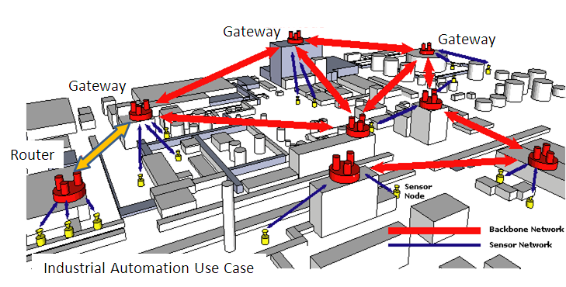
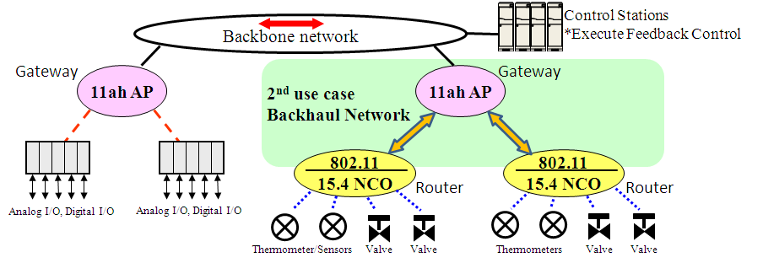
Flexible deployment of industrial wireless network
Quick additional deployment
Quick withdrawal, relocation
Inexpensive and reusable
Additional
Temporal network deployment
Episodic/Unexpected traffic
Disaster responsiveness
Emergency action
for accident prevention
Gateway

Slide 5
Challenges in additional deployment over existing wireless system
Additional network deployment influences over radio resource usage in circumference even if it is temporal deployment;
  e.g. frequency (channel), time (slot) and space (path).
In addition, possible hidden node relationship may be engaged and proper interference management is often required, proactively or responsively.
  Operating channel assignment and allowable max. TX power.
Proactive deployment to the sporadic events may not be usually cost effective.
  RRM data can be used to better simulate the temporal deployment.

Slide 6
Challenge in use case of the temporal/episodic network deployment
Network-C
Network-B
Emerging
temporal or episodic
networking
challenges
Network-A
Temporal Network-X
Application’s QoS requirement
Application’s QoS requirement
Wireless system #1
Wireless system #2
Resource Usage
Resource Usage
Interference
Interference Immunity
Interference Immunity
Wireless Resources (Frequency / Time / Space ..)
Radio Resource Measurement
& Management (RRMM)
Measurement
Assignment
Resource Utilization
Traffic
Interference
Provisioning and Resource Management
Resource Utilization
Traffic
Interference
Resource Allocation / Arbitration / Coordination
And Reservation
Resource Utilization
Interference
QoS/Power constraints
Rules / Heuristics
Analytical Models / Simulations

Slide 7
Discussion ?

