Slide 1
Project: IEEE P802.15 Working Group for Wireless Personal Area Networks (WPANs)
Submission Title: Collision Detection Based Random Access Scheme for IEEE 802.15 TG8 PAC
Date Submitted: 8 Nov. 2013
Source: Byung-Jae Kwak (ETRI), Kapseok Chang (ETRI), Moon-Sik Lee (ETRI),
Junhyuk Kim (KAIST), June-Koo Kevin Rhee (KAIST)
Address: ETRI, Daejeon, Korea; KAIST, Daejeon, Korea
Voice:
E-Mail: {bjkwak, kschang, moonsiklee}@etri.re.kr, kim.jh@kaist.ac.kr, rhee.jk@kaist.edu
Re: TG8 CFP (IEEE P802.15-13-0069-05-0008); 15-13-0374-01-0008
Abstract: This document provides additional simulation results for the proposed random access scheme
Purpose: Discuss the merits of the proposed scheme, especially the simplicity and efficiency.
Notice: This document has been prepared to assist the IEEE P802.15. It is offered as a basis for discussion and is not binding on the contributing individual(s) or organization(s). The material in this document is subject to change in form and content after further study. The contributor(s) reserve(s) the right to add, amend or withdraw material contained herein.
Release: The contributor acknowledges and accepts that this contribution becomes the property of IEEE and may be made publicly available by P802.15.

Slide 2
Collision Detection Based Random Access Scheme for IEEE 802.15 TG8 PAC
November 2013
Byung-Jae Kwak (ETRI), Kapseok Chang (ETRI), Moon-Sik Lee (ETRI),
Junhyuk Kim (KAIST), June-Koo Kevin Rhee (KAIST)

Slide 3
Objective
Clarification of the proposed random access scheme
Present simulation results
Discussion

Slide 4
Proposed Random Access Scheme (1/5)
Design Philosophy
  Simple: little book keeping
  Efficient: high performance, small overhead
  Scalable: support a large number of devices

Slide 5
Proposed Random Access Scheme (2/5)
Assumptions
  Passive distributed synchronization
    The time is divided into slots
    All times are measured in multiples of the slot
    All devices are synchronized in time domain in slot level
    All devices are synchronized in frequency domain
    The synchronization is achieved by overhearing the data frames in the air
    The proposed scheme tolerate lack of synchronization
  Independent of super frame structure
    The proposed scheme is independent of the underlying or the lack of super-frame structure

Slide 6
Proposed Random Access Scheme (3/5)
Collision Detection
  Our proposed random access scheme assumes that PDs can detect collision of packets transmitted by neighboring PDs
  The details of collision detection scheme is described in [1]

Slide 7
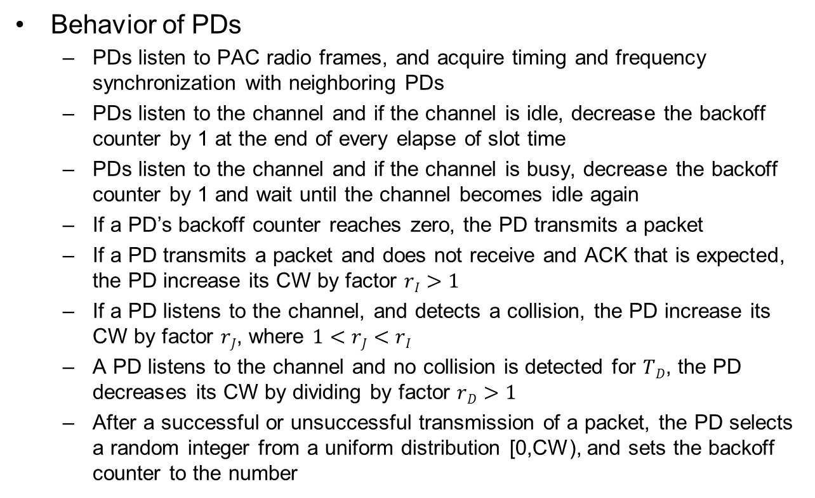
Proposed Random Access Scheme (4/5)
Behavior of PDs
  PDs listen to PAC radio frames, and acquire timing and frequency synchronization with neighboring PDs
  PDs listen to the channel and if the channel is idle, decrease the backoff counter by 1 at the end of every elapse of slot time
  PDs listen to the channel and if the channel is busy, decrease the backoff counter by 1 and wait until the channel becomes idle again
  If a PD’s backoff counter reaches zero, the PD transmits a packet
  If a PD transmits a packet and does not receive and ACK that is expected, the PD increase its CW by factor $rI>1$
  If a PD listens to the channel, and detects a collision, the PD increase its CW by factor $rJ$, where $1<rJ<rI$
  A PD listens to the channel and no collision is detected for $TD$, the PD decreases its CW by dividing by factor $rD>1$
  After a successful or unsuccessful transmission of a packet, the PD selects a random integer from a uniform distribution [0,CW), and sets the backoff counter to the number

Slide 8
Proposed Random Access Scheme (5/5)
Timing parameters (borrowed from 11a; TBD)
  Slot time: the unit time; every time period should be a multiple of this parameter; 8 μsec; 2 OFDM symbols
  SIFS = 2 x (1 slot time)
  PIFS = SIFS + (1 slot time)
  DIFS = PIFS + (1 slot time)

Slide 9
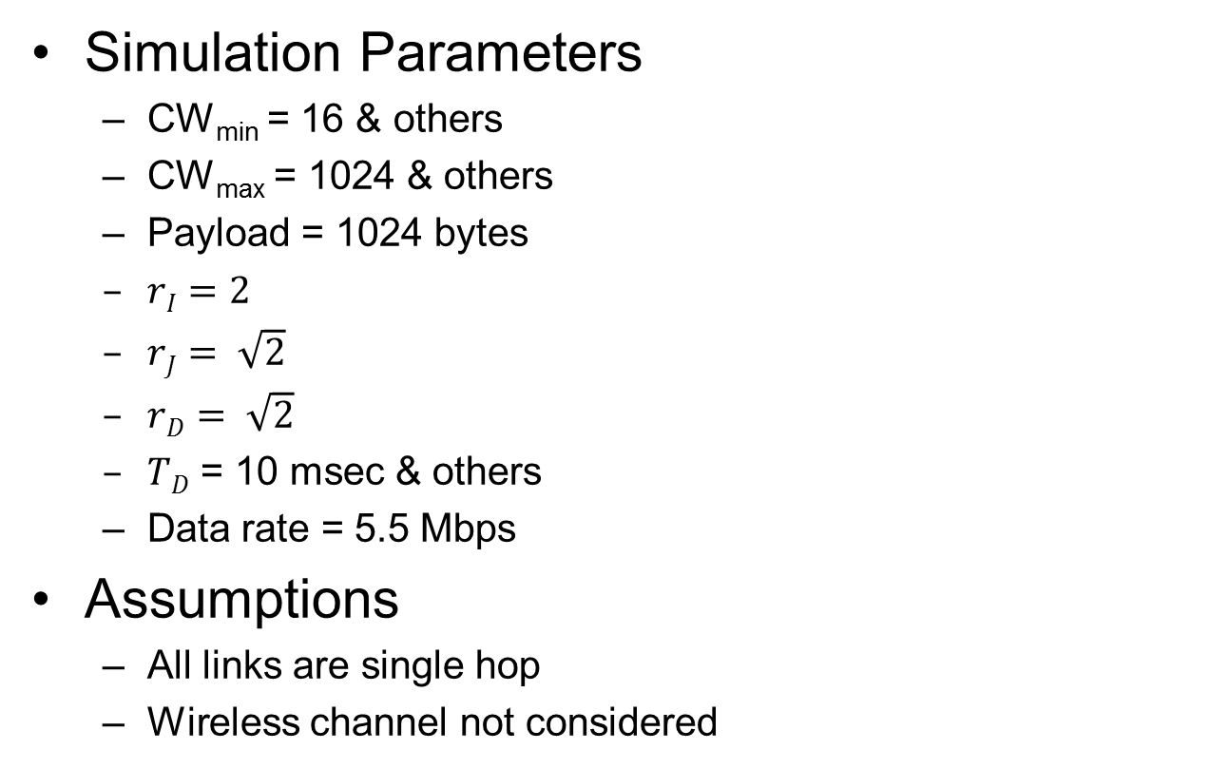
Simulation Results (1/10)
Simulation Parameters
  CW_{min} = 16 & others
  CW_{max} = 1024 & others
  Payload = 1024 bytes
  $rI=2$
  $rJ= \sqrt{2}$
  $rD= \sqrt{2}$
  $TD$ = 10 msec & others
  Data rate = 5.5 Mbps
Assumptions
  All links are single hop
  Wireless channel not considered

Slide 10
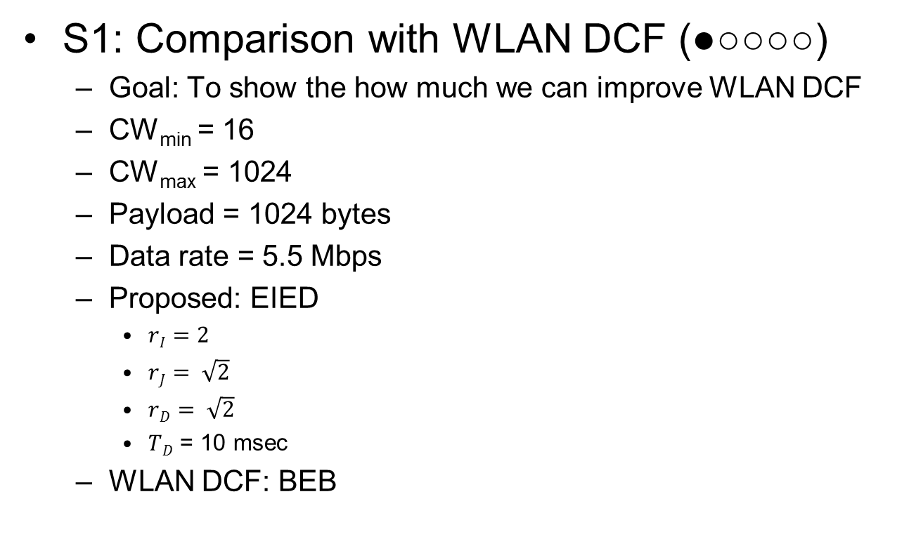
Simulation Results (2/10)
S1: Comparison with WLAN DCF (●○○○○)
  Goal: To show the how much we can improve WLAN DCF
  CW_{min} = 16
  CW_{max} = 1024
  Payload = 1024 bytes
  Data rate = 5.5 Mbps
  Proposed: EIED
    $rI=2$
    $rJ= \sqrt{2}$
    $rD= \sqrt{2}$
    $TD$ = 10 msec
  WLAN DCF: BEB

Slide 11

Simulation Results (3/10)
S1: Comparison with WLAN DCF (●●○○○)
$$CW_{min}=16,$$
$$CW_{max}=1024,$$
$$r_{J}=r_{D}=\sqrt{2}$$
$$r_{I}=2$$
$T_{D}=10$msec
$$data rate=5.5 Mbps$$
$$BASIC access$$

Slide 12
Simulation Results (4/10)
S1: Comparison with WLAN DCF (●●●○○)
(N=5)
(N=10)
Distribution of CW
(Basic Access)
(N=20)
(N=50)
(N=100)
(N=200)
(N=500)
(N=1000)

Slide 13

Simulation Results (5/10)
S1: Comparison with WLAN DCF (●●●●○ )
$$CW_{min}=16,$$
$$CW_{max}=1024,$$
$$r_{J}=r_{D}=\sqrt{2}$$
$$r_{I}=2$$
$T_{D}=10$msec
$$data rate=5.5 Mbps$$
$$RTS/CTS$$
See Extra slide for an explanation

Slide 14
Simulation Results (6/10)
S1: Comparison with WLAN DCF (●●●●●)
(N=5)
(N=10)
Distribution of CW
(RTS/CTS)
(N=20)
(N=50)
(N=100)
(N=200)
(N=500)
(N=1000)

Slide 15

Simulation Results (7/10)
S2: Scalability of Proposed Scheme (●○○○)
$$CW_{min}=16,$$
$$CW_{max}=1024, 2048,$$
$4096,8192$
$$r_{J}=r_{D}=\sqrt{2}$$
$$r_{I}=2$$
$T_{D}=10$msec
$$data rate=5.5 Mbps$$
$$Basic Access$$
About 70% efficiency

Slide 16
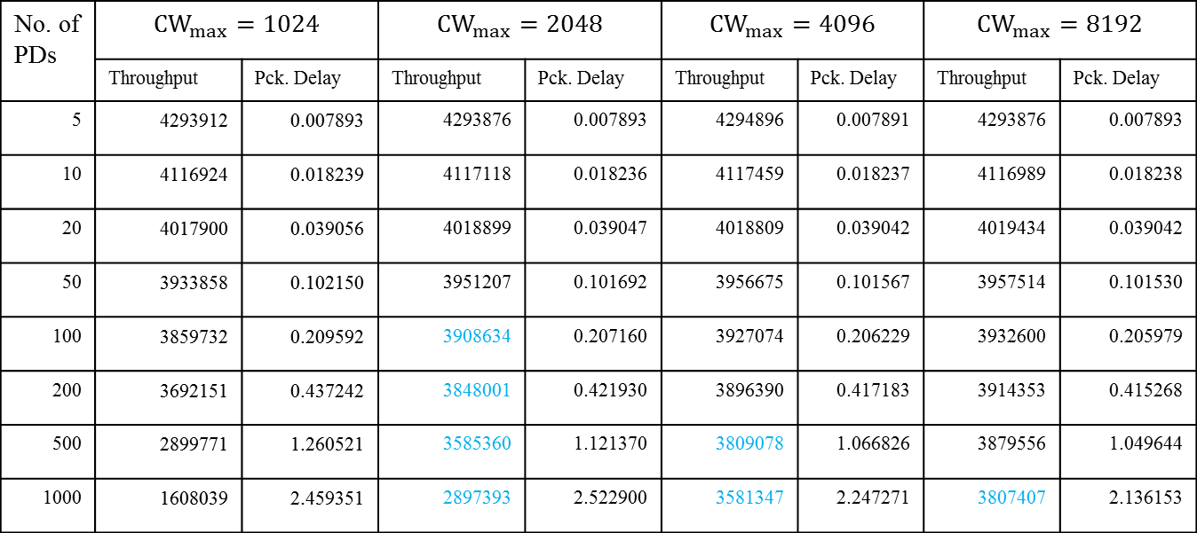
Simulation Results (8/10)
S2: Scalability of Proposed Scheme (●●○○)
Basic Access
No. of PDs | $$CW_{max}=1024$$ |  | $$CW_{max}=2048$$ |  | $$CW_{max}=4096$$ |  | $$CW_{max}=8192$$
 | Throughput | Pck. Delay | Throughput | Pck. Delay | Throughput | Pck. Delay | Throughput | Pck. Delay
5 | 4293912 | 0.007893 | 4293876 | 0.007893 | 4294896 | 0.007891 | 4293876 | 0.007893
10 | 4116924 | 0.018239 | 4117118 | 0.018236 | 4117459 | 0.018237 | 4116989 | 0.018238
20 | 4017900 | 0.039056 | 4018899 | 0.039047 | 4018809 | 0.039042 | 4019434 | 0.039042
50 | 3933858 | 0.102150 | 3951207 | 0.101692 | 3956675 | 0.101567 | 3957514 | 0.101530
100 | 3859732 | 0.209592 | 3908634 | 0.207160 | 3927074 | 0.206229 | 3932600 | 0.205979
200 | 3692151 | 0.437242 | 3848001 | 0.421930 | 3896390 | 0.417183 | 3914353 | 0.415268
500 | 2899771 | 1.260521 | 3585360 | 1.121370 | 3809078 | 1.066826 | 3879556 | 1.049644
1000 | 1608039 | 2.459351 | 2897393 | 2.522900 | 3581347 | 2.247271 | 3807407 | 2.136153

Slide 17

Simulation Results (9/10)
S2: Scalability of Proposed Scheme (●●●○)
$$CW_{min}=16,$$
$$CW_{max}=1024, 2048,$$
$4096,8192$
$$r_{J}=r_{D}=\sqrt{2}$$
$$r_{I}=2$$
$T_{D}=10$msec
$$data rate=5.5 Mbps$$
$$RTS/CTS$$
About 80% efficiency

Slide 18
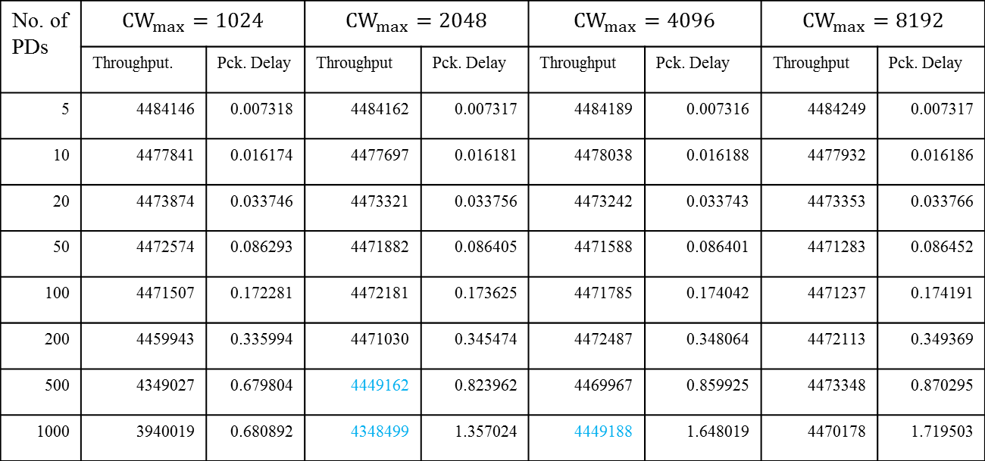
Simulation Results (10/10)
S2: Scalability of Proposed Scheme (●●●●)
RTS/CTS
No. of PDs | $$CW_{max}=1024$$ |  | $$CW_{max}=2048$$ |  | $$CW_{max}=4096$$ |  | $$CW_{max}=8192$$
 | Throughput. | Pck. Delay | Throughput | Pck. Delay | Throughput | Pck. Delay | Throughput | Pck. Delay
5 | 4484146 | 0.007318 | 4484162 | 0.007317 | 4484189 | 0.007316 | 4484249 | 0.007317
10 | 4477841 | 0.016174 | 4477697 | 0.016181 | 4478038 | 0.016188 | 4477932 | 0.016186
20 | 4473874 | 0.033746 | 4473321 | 0.033756 | 4473242 | 0.033743 | 4473353 | 0.033766
50 | 4472574 | 0.086293 | 4471882 | 0.086405 | 4471588 | 0.086401 | 4471283 | 0.086452
100 | 4471507 | 0.172281 | 4472181 | 0.173625 | 4471785 | 0.174042 | 4471237 | 0.174191
200 | 4459943 | 0.335994 | 4471030 | 0.345474 | 4472487 | 0.348064 | 4472113 | 0.349369
500 | 4349027 | 0.679804 | 4449162 | 0.823962 | 4469967 | 0.859925 | 4473348 | 0.870295
1000 | 3940019 | 0.680892 | 4348499 | 1.357024 | 4449188 | 1.648019 | 4470178 | 1.719503

Slide 19
Conclusion
Presented simulation results showing the performance of the proposed random access scheme
Features of the proposed random access scheme
  Simple: as simple as WLAN DCF
  Efficient: 70 ~ 80% channel efficiency
  Scalable: easily supports 1000 PDs without degradation of system throughput

Slide 20
References
[1] “ETRI Technical PHY proposal for IEEE 802.15 TG8 PAC Standard,” IEEE P802.15-13-0373-01-0008, July 2013.

Slide 21
Extra Slide

