Slide 1
Project: IEEE P802.15 Working Group for Wireless Personal Area Networks (WPANs)
Submission Title: [Two innovative energy efficient IEEE 802.15.4 MAC sub-layer protocols with packet concatenation: employing RTS/CTS and multi-channel scheduled channel polling]
Date Submitted: [13 November, 2013]
Source: [Norberto Barroca ¹, Luís M. Borges ¹, Fernando J. Velez ¹ and Periklis Chatzimisios ²]
Company [¹Instituto de Telecomunicações, DEM-UBI and ²CSSN Research Lab Depart. of Informatics]
Address [¹Faculdade de Engenharia, 6201-001 Covilhã, PORTUGAL || ²Alexander TEI of Thessaloniki,
57400, Greece]
Voice:[+351275329953], FAX: [+351275329972], E-Mail:[nbarroca@lx.it.pt, lborges@lx.it.pt, fjv@ubi.pt, peris@it.teithe.gr]
Re: [This is the original document]
Abstract: [This document presents two MAC layer performance enhancement by employing RTS/CTS combined with packet concatenation ]
Purpose: [To improve IEEE 802.15.4 MAC layer]
Notice: This document has been prepared to assist the IEEE P802.15. It is offered as a basis for discussion and is not binding on the contributing individual(s) or organization(s). The material in this document is subject to change in form and content after further study. The contributor(s) reserve(s) the right to add, amend or withdraw material contained herein.
Release: The contributor acknowledges and accepts that this contribution becomes the property of IEEE and may be made publicly available by P802.15.

Slide 2
Two innovative energy efficient IEEE 802.15.4 MAC sub-layer protocols with packet concatenation: employing RTS/CTS and multi-channel scheduled channel polling
Norberto Barroca, Luís M. Borges and Fernando J. Velez, Instituto de Telecomunicações-UBI
Periklis Chatzimisios (Alexander TEI of Thessaloniki)

Slide 3
Outline
Introduction
Packet concatenation employing RTS/CTS, including Sensor Block Acknowledgment – Medium Access Control Protocol:
  State Diagram;
  Scheme design with and with no Block ACK Request;
  Retransmissions Scenarios;
Multi-Channel-Scheduled Channel Polling Protocol:
  Extra Resolution Phase Decision Algorithm;
  Enhanced-Two Phase Contention Window Mechanism;
  Predictive Wake-up Mechanism and Influential Range (IR);
  Results.
Conclusions
Contributions

Slide 4
Packet concatenation employing RTS/CTS

Slide 5
Introduction
One of the fundamental reasons for the IEEE 802.15.4 standard Medium Access Control (MAC) inefficiency is overhead.
Within IEEE 802.15.4, the possible use of RTS/CTS, by itself, facilitates packet concatenation and leads to performance improvement.
In the presence of RTS/CTS two solutions are considered, one with DATA/ACK handshake and other with no ACKs, simply relying in the establishment of the NAV.

Slide 6
Introduction
By considering IEEE 802.15.4 basic access mode with RTS/CTS combined with the packet concatenation feature we improve channel efficiency by decreasing the deferral time before transmitting a data packet.
We propose two innovative mechanisms to reduce the overhead from IEEE 802.15.4 non-beacon enabled networks, i.e., block acknowledgment (BACK) and piggyback.
IEEE 802.15.4
Packet
Aggregation
Channel Optimization

Slide 7
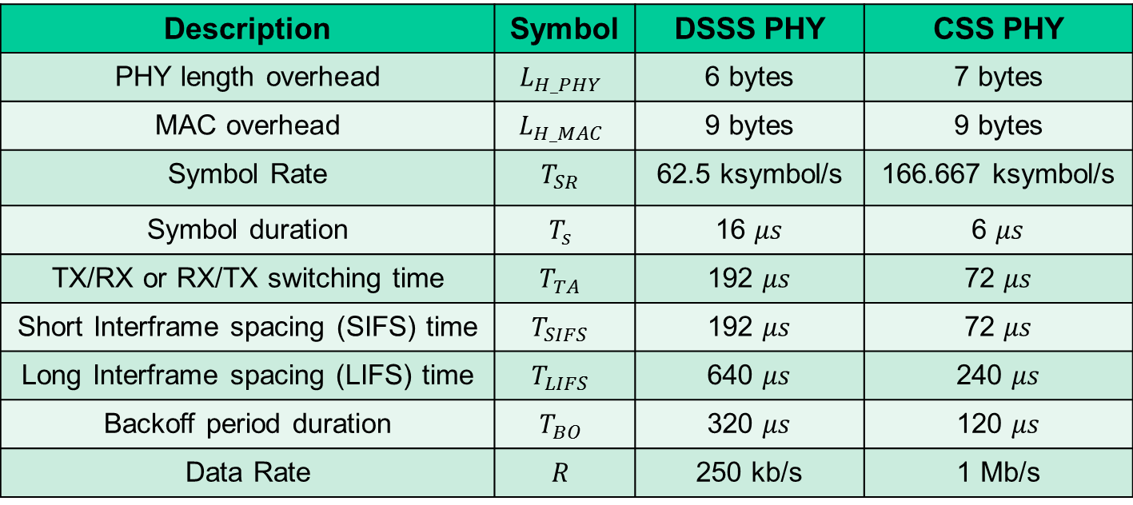
Parameters, symbols and values for IEEE 802.15.4 by considering the DSSS and CSS PHY Layers for the 2.4 GHz band
Description | Symbol | DSSS PHY | CSS PHY
PHY length overhead | $$L_{H_PHY}$$ | 6 bytes | 7 bytes
MAC overhead | $$L_{H_MAC}$$ | 9 bytes | 9 bytes
Symbol Rate | $$T_{SR}$$ | 62.5 ksymbol/s | 166.667 ksymbol/s
Symbol duration | $$T_{s}$$ | 16 $μs$ | 6 $μs$
TX/RX or RX/TX switching time | $$T_{TA}$$ | 192 $μs$ | 72 $μs$
Short Interframe spacing (SIFS) time | $$T_{SIFS}$$ | 192 $μs$ | 72 $μs$
Long Interframe spacing (LIFS) time | $$T_{LIFS}$$ | 640 $μs$ | 240 $μs$
Backoff period duration | $$T_{BO}$$ | 320 $μs$ | 120 $μs$
Data Rate | $$R$$ | 250 kb/s | 1 Mb/s

Slide 8









IEEE 802.15.4 MAC Channel Access
Clear Channel Assessment (CCA)
Channel BUSY
Channel IDLE
$NB=NB$ + 1
$$NB=0$$
$${cw}_{NB}=\left[2^{{BE}_{i}}\text{−} \text{1 }\right]$$
$${cw}_{NB}=\left[2^{{BE}_{i}}\text{−} \text{1 }\right]$$
${BE}_{i}=$ 3 , i=0
${cw}_{NB}=$ 15
${BE}_{i}=$ 4 , i=1
${cw}_{NB}=$ 7
${BE}_{i}=$ 5 , i$≥$2

Slide 9


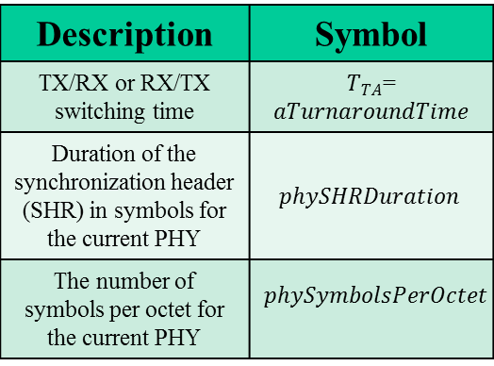
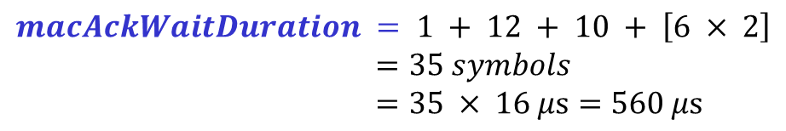
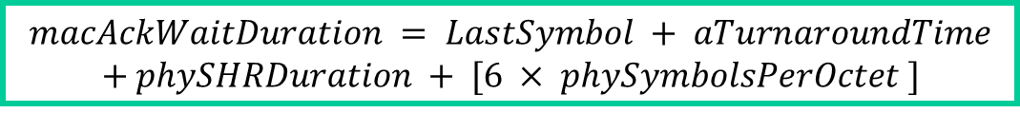
IEEE 802.15.4 MAC Channel Access
IEEE 802.15.4 at the Best-Case Scenario (no collisions)
···
DATA 1
DATA n
$$macAckWaitDuration = LastSymbol + aTurnaroundTime$$
$$+ phySHRDuration + [6 × phySymbolsPerOctet ]$$
Description | Symbol
TX/RX or RX/TX switching time | $T_{TA}$=$aTurnaroundTime$
Duration of the synchronization header (SHR) in symbols for the current PHY | $$phySHRDuration$$
The number of symbols per octet for the current PHY | $$phySymbolsPerOctet$$
$$macAckWaitDuration = 1 + 12 + 10 + \left[6 × 2\right]$$
$=35 symbols$
$$=35 × 16 μs=560 μs$$
CW
CCA
$$T_{TA }$$
DATA
ACK
$$IFS$$

Slide 10

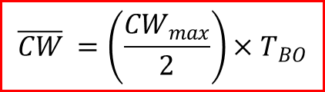

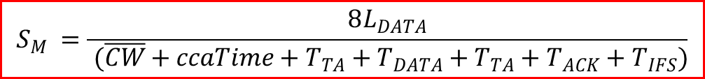


IEEE 802.15.4 MAC Channel Access
IEEE 802.15.4 at the Best-Case Scenario (no collisions, BE=3, CW_{max}=7)
$$\overline{CW} =\left(\frac{{CW}_{max}}{2}\right)×T_{BO}$$
$${CW}_{max} ={(2}^{BE}−1)$$
$$T_{BO}=320 μs$$
$$T_{DATA} =8×\frac{L_{H_PHY}+L_{H_MAC}{+L}_{DATA}}{R}$$
$$T_{ACK} =8×\frac{L_{H_PHY}{+L}_{ACK}}{R}$$
Maximum Average Throughput
$$S_{M} =\frac{8L_{DATA}}{ (\overline{CW}+ccaTime+T_{TA}+T_{DATA}+T_{TA}+T_{ACK}+T_{IFS})}$$
Minimum Average Delay
$$D_{min} =(\overline{CW}+ccaTime+T_{TA}+T_{DATA}+T_{TA}+T_{ACK}+T_{IFS})$$

Slide 11
Sensor Block Acknowledgment – Medium Access Control (SBACK-MAC) Protocol
The Block Acknowledgment (BACK) mechanism was previously introduced in the IEEE 802.11e standard.
The SBACK-MAC allows the aggregation of several acknowledgment (ACK) responses in one special frame called BACK Response.
Energy consumption will be greatly reduced because it is not needed to transmit and receive several ACK control packets (one for each data packet) which would lead to an extra energy waste.
aggregation
BACK
Piggyback

Slide 12
SBACK-MAC – State Diagram
BACK
Piggyback

Slide 13


SBACK-MAC – Block ACK Sequence
SBACK-MAC with BACK Request (concatenation)
SBACK-MAC with no BACK Request (piggyback)
···
DATA 1
DATA n
···
DATA 1
DATA n
CW
CCA
$$T_{TA }$$
RTS
ADDBA
CTS
ADDBA
DATA
$$IFS$$
BACK
Request
BACK
Response
ACK

Slide 14
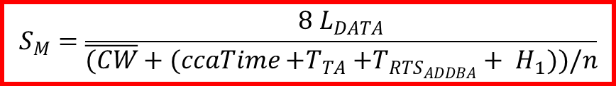
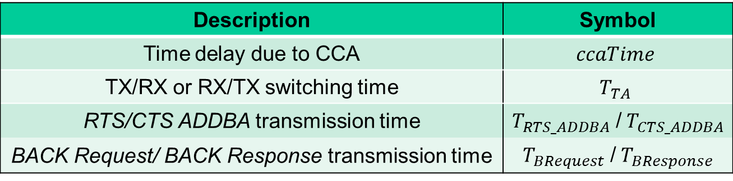
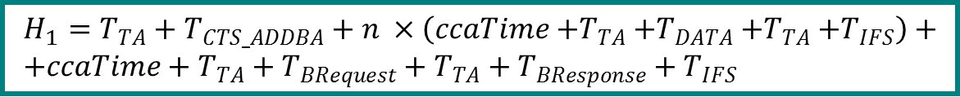
SBACK-MAC – Block ACK Sequence
SBACK-MAC with BACK Request
$$S_{M}=\frac{8 L_{DATA}}{\overline{(CW}+(ccaTime{+T}_{TA}+T_{RTS_{ADDBA}}+ H_{1}))/n}$$
Maximum Average
Throughput
Minimum Average Delay
$$D_{min} =(\overline{CW}+ccaTime+T_{TA}+T_{RTS_{ADDBA}}+H_{1})/n$$
$$H_{1}=T_{TA}+T_{CTS_ADDBA}+n ×\left(ccaTime{+T}_{TA}+T_{DATA}{+T}_{TA}+T_{IFS}\right)+ \\ {+ccaTime+T}_{TA}+T_{BRequest}+T_{TA}+T_{BResponse}+T_{IFS}$$
Description | Symbol
Time delay due to CCA | $$ccaTime$$
TX/RX or RX/TX switching time | $$T_{TA}$$
RTS/CTS ADDBA transmission time | $T_{RTS_ADDBA}$ /${ T}_{CTS_ADDBA}$
BACK Request/ BACK Response transmission time | $T_{BRequest}$ /${ T}_{BResponse}$

Slide 15
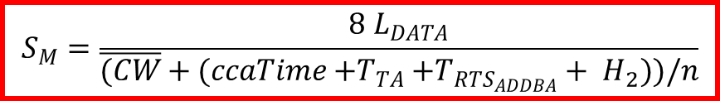

SBACK-MAC – Block ACK Sequence
SBACK-MAC with no BACK Request
$$S_{M}=\frac{8 L_{DATA}}{\overline{(CW}+(ccaTime{+T}_{TA}+T_{RTS_{ADDBA}}+ H_{2}))/n}$$
Maximum Average
Throughput
Minimum Average Delay
$$D_{min} =(\overline{CW}+ccaTime+T_{TA}+T_{RTS_{ADDBA}}+H_{2})/n$$
$$H_{2}=T_{TA}+T_{CTS_ADDBA}+[\left(n−1\right)×\left(ccaTime{+T}_{TA}+T_{DATA}{+T}_{TA}+T_{IFS}\right)]$$
$${+ccaTime+T}_{TA}+T_{DATA}+T_{TA}+T_{BResponse}+T_{IFS}$$
Description | Symbol
Time delay due to CCA | $$ccaTime$$
TX/RX or RX/TX switching time | $$T_{TA}$$
RTS/CTS ADDBA transmission time | $T_{RTS_ADDBA}$ /${ T}_{CTS_ADDBA}$
BACK Request/ BACK Response transmission time | $T_{BRequest}$ /${ T}_{BResponse}$

Slide 16
SBACK-MAC – Block ACK Sequence
IEEE 802.15.4
SBACK-MAC with BACK Request
SBACK-MAC with no BACK Request

Slide 17
Throughput: Comparison between IEEE 802.15.4 and SBACK-MAC with and with no BACK Request
8% - 13%
Increase
Smax (kb/s)
17% - 25%
Increase

Slide 18
End-to-End Delay: Comparison beetwen IEEE 802.15.4 and SBACK-MAC with and with no BACK Request
8% - 13%
Reduction
Dmin (ms)
17% - 25%
Reduction

Slide 19
Frame sequence with retransmissions
If there is no ACK reception
the backoff procedure is repeated
IEEE 802.15.4
SBACK-MAC in the presence of BACK Request
SBACK-MAC in the absence of BACK Request

Slide 20
Packet concatenation employing multi-channel scheduled channel polling (MC-SCP-MAC)

Slide 21
MC-SCP-MAC Protocol
MC-SCP-MAC explores the advantages of multi-channel features jointly with Enhanced Two-Phase Contention Window Mechanism;
It employs the Influential Range (IR) concept: reduces delay and packet redundancy;
It considers cognitive-based capabilities: Channel degradation sensing and Denial Channel List for opportunistic channel selection;
It employs an Extra Resolution Phase Decision (packet concatenation) algorithm to reduce the delay, increase the packet delivery ratio, whilst reducing energy consumption;
It considers a predictive channel based wake-up mechanism to choose the channel based on a Linear Congruential Generator (LCG).

Slide 22
Extra Resolution Phase Decision (Packet Concatenation) Algorithm
Each slot channel has a ER phase to TX more packets during the frame;
Problems that arise without an algorithm to assess if it is reliable to TX;
  Channel degraded due to interference and nodes mobility (unnecessary TX)
Assumptions to apply algorithm:
  Decision is based on “degradation” level of the channel;
  Checks if the slot channel is “good” (not in the denial channel list);
  Checks if the last three calls to the IR algorithm presented positive feedback from the same neighboring nodes;
  In case the IR feedback algorithm is not possible to apply the node checks if the last three accesses to medium were successful.

Slide 23
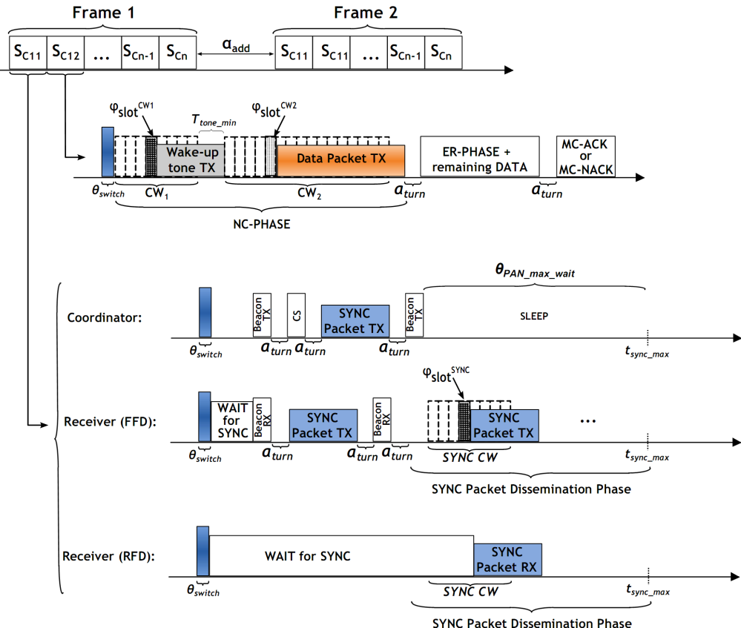
Fundamental of the Protocol - Enhanced-Two Phase Contention Window Mechanism
Envisaged scenarios:
  Tree
  Single-hop
  Multi-hop
  Cluster

Slide 24
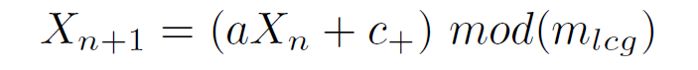



Predictive Wake-up Mechanism
Consider the LCG due to computation efficiency;
The channel of the PHY layer is defined as a slot channel;
General formula from the LCG:
Map de X_{n+1} value to one of 15 available channels (minus control channel):
Convert into a wake-up time:
m_{lcg} = 65536
a = 16807
c₊ = 0
σ_{current} – Current “time” of the node
α_{add} – Time between consecutive frames
Δ_{tSC} – Time duration in each slot channel
θ_{switch} – Time to switch within channels

Slide 25
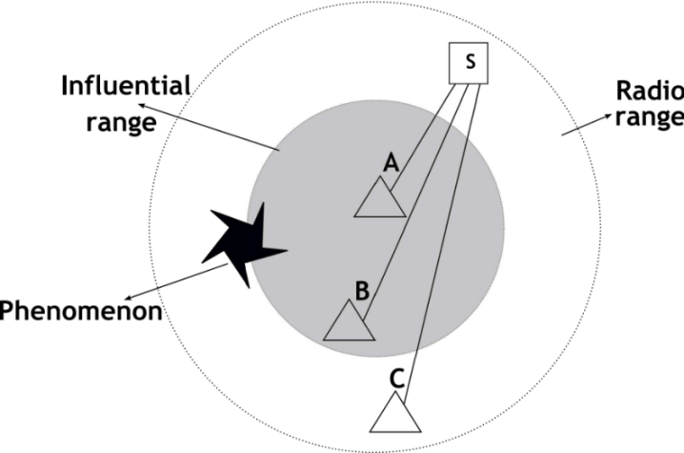
Influential Range (IR) algorithm
IR Concept: mitigate the overhearing problem
Steps to apply IR:
  Overhears packet: receives and decodes packet;
  Check if it is in the IR associated to IR threshold (Π_{irmax}):
  RSSI_{pkt} ≥ Π_{irmax} is in same IR
  RSSI_{pkt} < Π_{irmax} is not in same IR
  Overheard packet has the same parent node?
  Same IR and same parent node
  Π_{irmax} ∊ {-90;-80; -70; -60] dBm
Information of packets == Information of overheard packets?
Discards the redundant ones

Slide 26
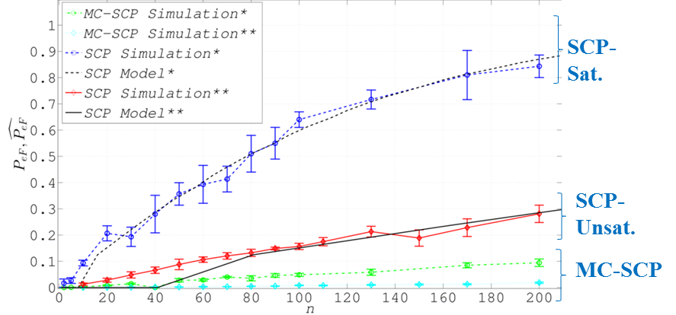
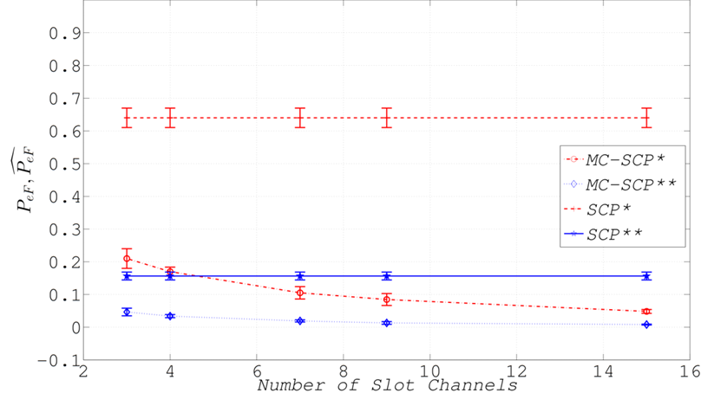
Collision Probabilities for MC-SCP-MAC
Fixed number of slot channels
max
max
CW₁ =CW₂ = 8
N_{ch}= 15 (MC-SCP-MAC)
N_{ch}= 1 (SCP-MAC)
A= 50x50 m²
λ= ½ s⁻¹
* → Saturated regime
** → Unsaturated regime
Variable number of slot channels
t_{F}=1 s
n=99 nodes
Δt_{SC}= t_{F}/(N_{ch}+1)

Slide 27
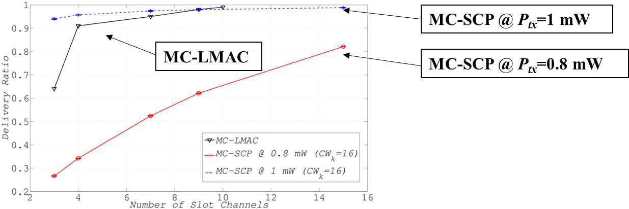
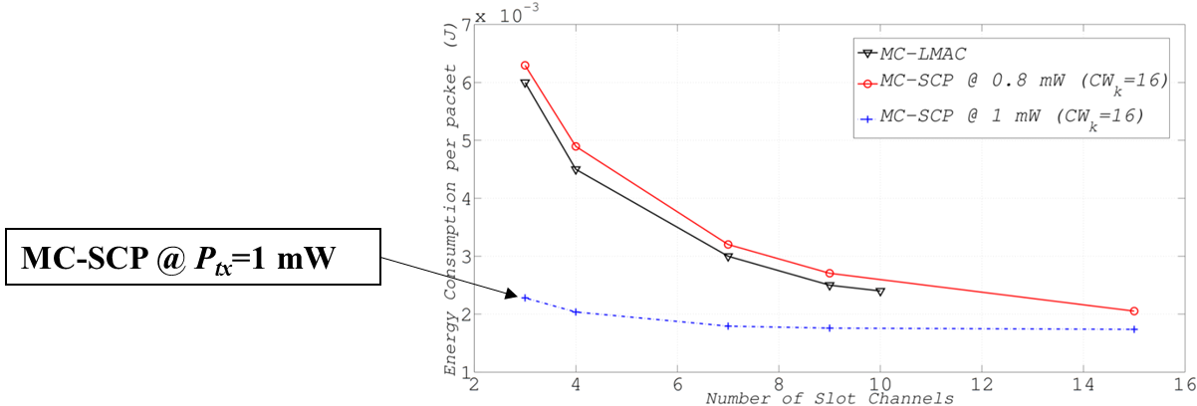
Energy and Delivery Efficiency with Multiple Slot Channels (comparison with MC-LMAC)

Slide 28
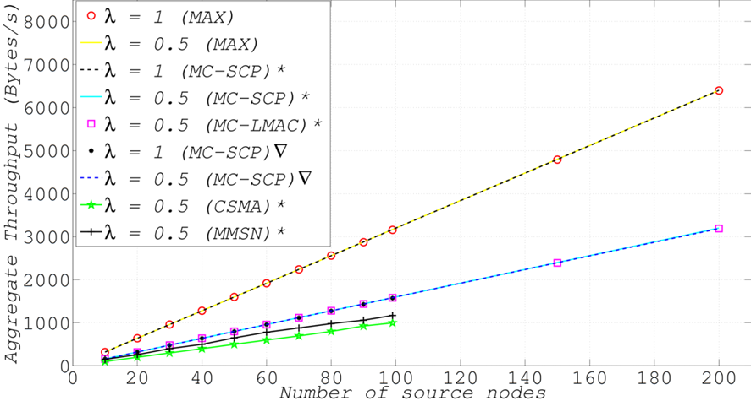
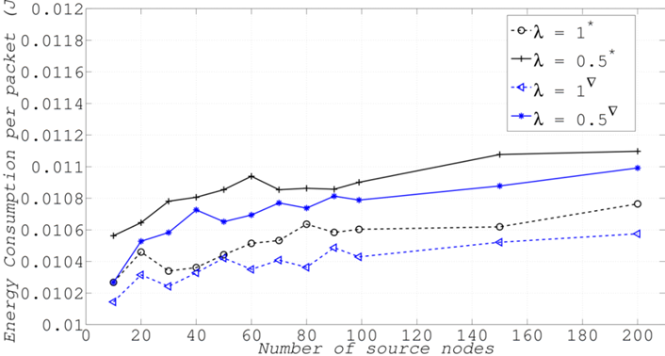
Impact of Traffic Periodic and Exponential Patterns in the Overall Performance (High Density of Nodes)
  max
  max
  CW₁ =CW₂ =80
A= 150x150 m²
decrease
A= 50x50 m²
* → Periodic traffic
∆
→ Exponential traffic

Slide 29
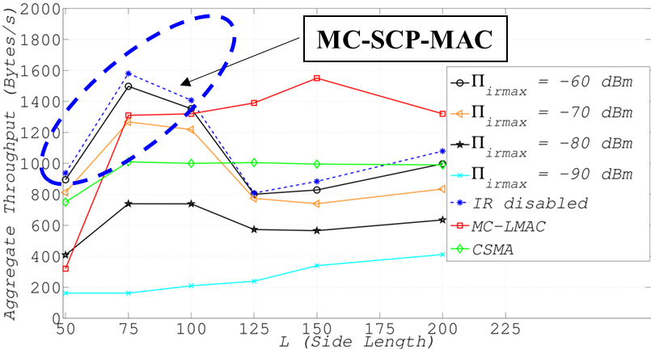
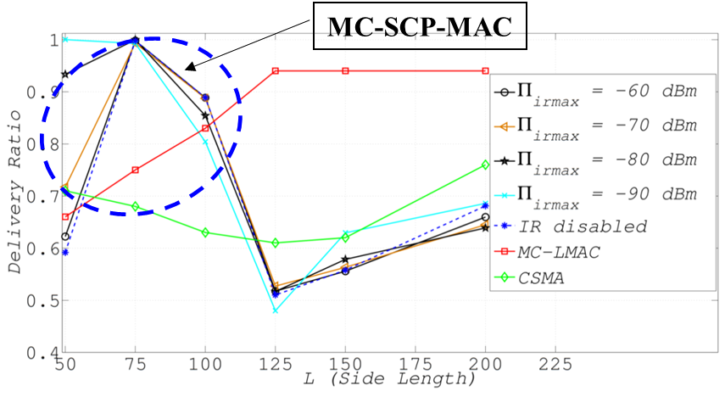
Impact of Node Density in MC-SCP-MAC
n=99 nodes
N_{ch}= 1 (CSMA)
N_{ch}= 8 (remaining ones)
  max
  max
  CW₁ =CW₂ =80
  t_{F}=1.57 s, Δt_{SC}=0.17 s (MC-SCP)
  t_{F}=1.6 s (MC-LMAC)
  Π_{irmax} ∊ {-90; -80; -70; -60} dBm
λ= 1/2 s⁻¹

Slide 30
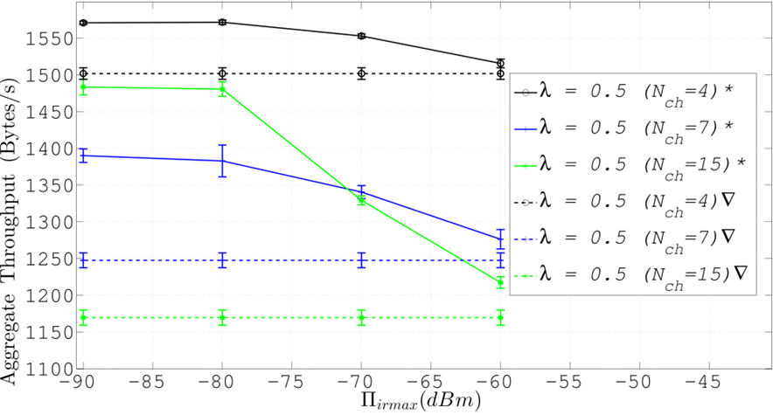
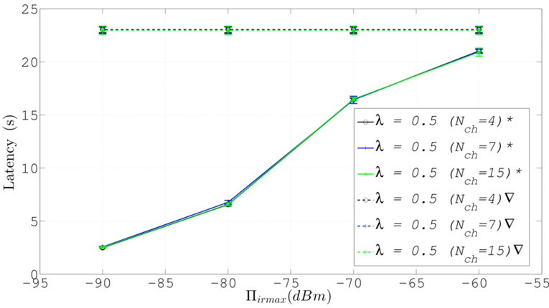
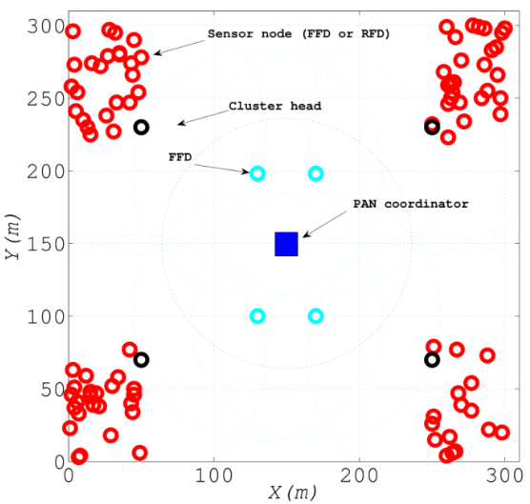
Performance Analysis in the Cluster Topology
  N_{ch} ∊ {4; 7; 15}
  max
  max
  CW₁ =CW₂ =80
  Π_{irmax} ∊ {-90; -80; -70; -60} dBm
λ= 1/2 s⁻¹
* → IR enabled
∆
→ IR disabled
Scenario:

Slide 31
Conclusions
In this work we propose the use of RTS/CTS to avoid the repetition of the backoff phase in IEEE 802.15.4.
In this talk we described in detail one subset of possible versions from this protocol, where we introduced two innovative mechanisms to reduce the overhead of IEEE 802.15.4, i.e., block acknowledgment (BACK) and piggyback.
By employing BACK, the aggregation of several ACK into only one results in the improvement of the channel efficiency.
Our study shows that the proposed aggregation schemes significantly improves the network performance for throughput and end-to-end delay.

Slide 32
Conclusions
The proposed Multi-Channel-Scheduled Channel Polling (MC-SCP-MAC) protocol is based on Scheduling Channel Polling and outperforms other multi-channel MAC protocols in high density scenarios.
The IR concept jointly with the multi-channel feature results in a higher packet delivery ratio, together with lower delay performance and lower redundant packets.
The use of packet concatenation in MC-SCP-MAC results in lower end-to-end delays and higher delivery ratios.

Slide 33
Conclusions
In the context of Cognitive Radio (CR):
  The MC-SCP-MAC protocol for the Secondary Users (SUs) uses the double stage mechanism in each channel to schedule each SU’s transmission:
    1st stage (CW1) - used to reduce the number of competing SUs in order to decrease the number of collisions by sensing the channel for Primary Users(Pus);
    2nd stage (CW2) - used to schedule the SUs competing for the medium, eliminating the situations of underutilization of idle frames from SUs.
  The SBACK-MAC protocol allows for decreasing the end-to-end delay whilst increasing throughput of the SUs, by decreasing the data transmission time. These extra time can be used to increase the sensing phase enabling for decreasing the number of packet collisions between SUs.

Slide 34
Contributions
Norberto Barroca, Fernando J. Velez and Periklis Chatzimisios, “Block Acknowledgment Mechanisms for the optimization of channel use in Wireless Sensor Networks”, in Proc. of the 24th Annual IEEE International Symposium on Personal, Indoor and Mobile Radio Communications (PIMRC 2013), London, UK, Sep. 2013.
Norberto Barroca, Luís M. Borges, Fernando J. Velez and Periklis Chatzimisios, "IEEE 802.15.4 MAC Layer Performance Enhancement by employing RTS/CTS combined with Packet Concatenation", submitted to IEEE International Conference on Communications (ICC), Sydney, Australia, Jun. 2014.
Norberto Barroca, Luís M. Borges, Fernando J. Velez and Periklis Chatzimisios, "Block Acknowledgment in IEEE 802.15.4 by Employing DSSS and CSS PHY Layers", submitted to The IEEE 79th Vehicular Technology Conference: VTC2014-Spring, Seoul, Korea, Feb. 2014.

Slide 35
Contributions
Luís M. Borges, Fernando J. Velez and António S. Lebres, “Performance Evaluation of the Schedule Channel Polling MAC Protocol Applied to Health Monitoring in the Context of IEEE 802.15.4,” (invited paper) in Proc. of the 17th European Wireless Conference 2011, Vienna, Austria, Apr. 2011.
Rodolfo Oliveira, Luís M. Borges, and Fernando J. Velez, “A Double Stage Random Access Scheme for Decentralized Single Radio Cognitive Networks”, in Proc. of The Tenth International Symposium on Wireless Communication Systems (ISWCS’13), Ilmenau, Germany, Aug. 2013.
Luís M. Borges, Rodolfo Oliveira and Fernando J. Velez, “A Two-Phase Contention Window Control Scheme for Decentralized Wireless Networks”, submitted to the IEEE Wireless Communications and Networking Conference (WCNC 2014), Istanbul, Turkey, Apr. 2014.

Slide 36
Thank you,
Questions are Welcome
ACKNOWLEDGMENT: This work was supported by the Ph.D. FCT grant FRH/BD/66803/2009, by PEst- OE/EEI/LA0008/2013, Marie Curie Reintegration Grant PLANOPTI (FP7-PEOPLE-2009-RG), the European Social Fund (ESF), UBIQUIMESH, OPPORTUNISTIC-CR, PROENERGY-WSN, INSYSM, CREaTION, COST IC0905 ”TERRA”, COST IC0902, COST IC1004 and TROLLS (ARCHIMEDES III) .

