Slide 1
Project: IEEE P802.15 Working Group for Wireless Personal Area Networks (WPANs)
Submission Title: [Link Analysis Example]
Date Submitted: [ 2 Oct, 2013 ]
Source: [Mengchang Doong] Company [Lilee Systems]
Address [2905 Stender Way Suite 78, Sunnyvale CA 95054, USA]
Voice:[408-988-8672], FAX: [408-988-8813], E-Mail:[mdoong@lileesystems.com]
Re: [ Response to comment ID 7 of IEEE 802.15-13-0506-05-004p]
Abstract: [An example of link analysis to show how to achieve 70 km link range.]
Purpose: [Response to comment ID 7.]
Notice: This document has been prepared to assist the IEEE P802.15. It is offered as a basis for discussion and is not binding on the contributing individual(s) or organization(s). The material in this document is subject to change in form and content after further study. The contributor(s) reserve(s) the right to add, amend or withdraw material contained herein.
Release: The contributor acknowledges and accepts that this contribution becomes the property of IEEE and may be made publicly available by P802.15.

Slide 2
Link Analysis Example

Slide 3
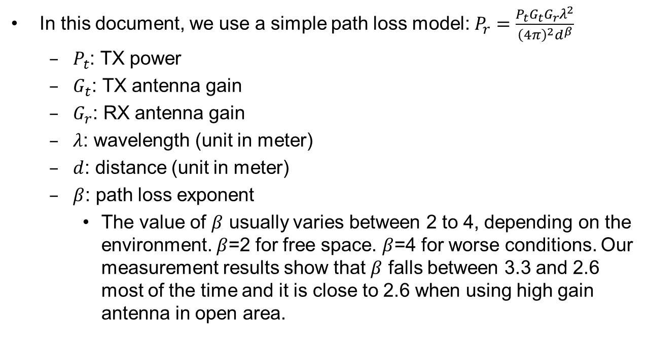
Path Loss Model
In this document, we use a simple path loss model: $P_{r}=\frac{P_{t}G_{t}G_{r}λ^{2}}{{\left(4π\right)}^{2}d^{β}}$
  $P_{t}$: TX power
  $G_{t}$: TX antenna gain
  $G_{r}$: RX antenna gain
  $λ$: wavelength (unit in meter)
  $d$: distance (unit in meter)
  $β$: path loss exponent
    The value of $β$ usually varies between 2 to 4, depending on the environment. $β$=2 for free space. $β$=4 for worse conditions. Our measurement results show that $β$ falls between 3.3 and 2.6 most of the time and it is close to 2.6 when using high gain antenna in open area.

Slide 4
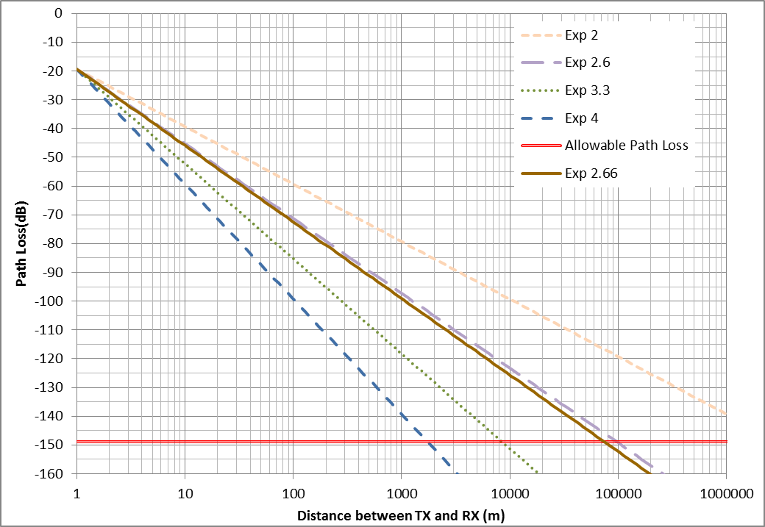
Link Analysis
With the following parameters, a large cell size up to tens of kilometers radius is achievable.
  Carrier frequency: 220 MHz
  TX power: 30 W
  TX antenna gain: 6 dBi
  RX antenna gain: 3 dBi
  RX sensitivity: -105 dBm
    GMSK 9.6Kbps BT=0.3
  Fading margin: 10 dB

