Slide 1
Project: IEEE P802.15 Working Group for Wireless Personal Area Networks(WPANs)
Submission Title: TG4m 4TV Closing Report for September 2013
Date Submitted: 19 September 2013
Source: Sangsung Choi (ETRI), Phil Beecher (Wi-SUN Alliance)
Contact: Sangsung Choi (ETRI)
Voice: +82 42 860 6831, E-Mail: sschoi@etri.re.kr
Re: TG4m Closing Report for September 2013 Interim Meeting
Abstract: Closing Report for TG4m Session in Nanjing
Purpose: TV White Space Amendment to IEEE 802.15.4
Notice: This document has been prepared to assist the IEEE P802.15. It is offered as a basis for discussion and is not binding on the contributing individual(s) or organization(s). The material in this document is subject to change in form and content after further study. The contributor(s) reserve(s) the right to add, amend or withdraw material contained herein.
Release: The contributor acknowledges and accepts that this contribution becomes the property of IEEE and may be made publicly available by P802.15.
Slide 1

Slide 2
Meeting Goal This Week
Resolve all the comments from the Sponsor Ballot.
Hear and discuss the contribution presentations.
Discuss the future efforts and next steps.

Slide 3
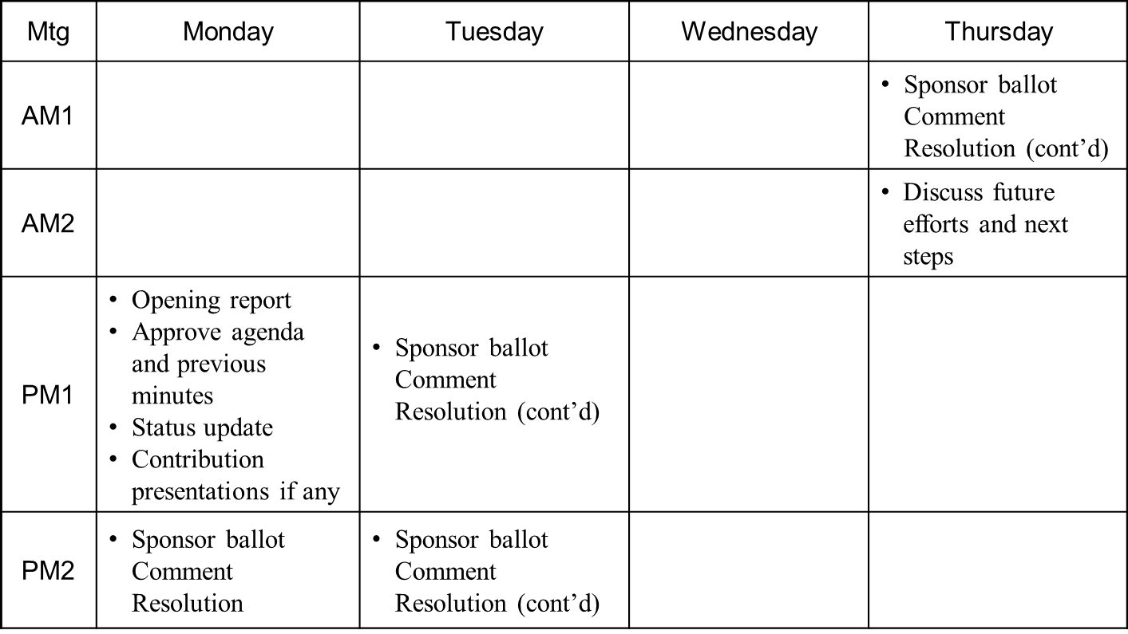
Meeting Slots
Notes:
doc.: IEEE 802.15-<doc#>
<month year>
<author>, <company>
Page 3

Slide 4
TG4m Closing Report
The Sponsor Ballot was closed on September 7, 2013
- 94% of affirmative responses
(yes votes: 103, No votes: 6, Abstain votes: 6)
- Total comments 388
(Editorial 242, General & Technical 146)
The BRC took care of comments in this meeting
- BRC assigned volunteers to resolve all comments , and resolved most of comments in this meeting.

Slide 5
TG4m Closing Report
 | Tech/Gen | Editorial | Overall
Total | 146 | 242 | 388
Total processed | 82 | 242 | 324
Percent processed | 57% | 100% | 84%
Total remaining | 64 | 0 | 64
Percent remaining | 44% | 0% | 16%
- BRC will complete comment resolutions by teleconference in next few weeks
- BRC plans 2 recirculation ballots before November 2013 meeting

Slide 6
Future Plan/Timeline (1)
Form a New Task Group
- Affirm new officers for TG4m September 2011
- Prepare the TGD November, 2011, January 2012 - Finalizing the TGD & Call for Proposal March 2012
Proposal Effort
- Preliminary Proposals & Presentations May 6 2012
- Final Proposals July 9, 2012
- Proposal Presentations July , 2012
- Merge Proposals September 2012
- Adopt Baseline September 2012
Drafting
- Preliminary draft document November 2012
- Final draft (ready for WG Letter Ballot) January 2013
Slide 6
Notes:
6

Slide 7
Future Plan/Timeline (2)
WG Letter Balloting
- Initial Release/Comment Resolution February/March 2013
- Recirculation I Release /Comment Resolution March/April 2013
- Recirculation II Release /Comment Resolution April /May2013
- Recirculation III Release /Comment Resolution May/June 2013
Sponsor Balloting
- Initial Release July 2013
- Comment Resolution September 2013
- SB Recirculation I Release October 2013
- SB Recirculation I Comment Resolution October 2013
- SB Recirculation II Comment Resolution November 2013
- SB Recirculation III Comment Resolution November 2013
RevCom
- EC approval November 2013
- RevCom approval March 2014
Slide 7
Notes:
7

