Slide 1
Project: IEEE P802.15 Working Group for Wireless Personal Area Networks (WPANs)
Submission Title: [Overview of SG SRU]
Date Submitted: [ 16 September, 2013]
Source: [Shoichi Kitazawa] Company [ATR]
Address [2-2-2 Hikaridai Seika Kyoto Japan]
Voice:[+81-774-95-1565], FAX: [], E-Mail:[kitazawa@atr.jp]
Re: [ ]
Abstract: [This document describes SG SRU objectives and past activities]
Purpose: [Information]
Notice: This document has been prepared to assist the IEEE P802.15. It is offered as a basis for discussion and is not binding on the contributing individual(s) or organization(s). The material in this document is subject to change in form and content after further study. The contributor(s) reserve(s) the right to add, amend or withdraw material contained herein.
Release: The contributor acknowledges and accepts that this contribution becomes the property of IEEE and may be made publicly available by P802.15.

Slide 2
Overview of SG SRU
Shoichi Kitazawa

Slide 3
Contents
Background
IG SRU activity
Goal for SG SRU
Use Case Examples

Slide 4
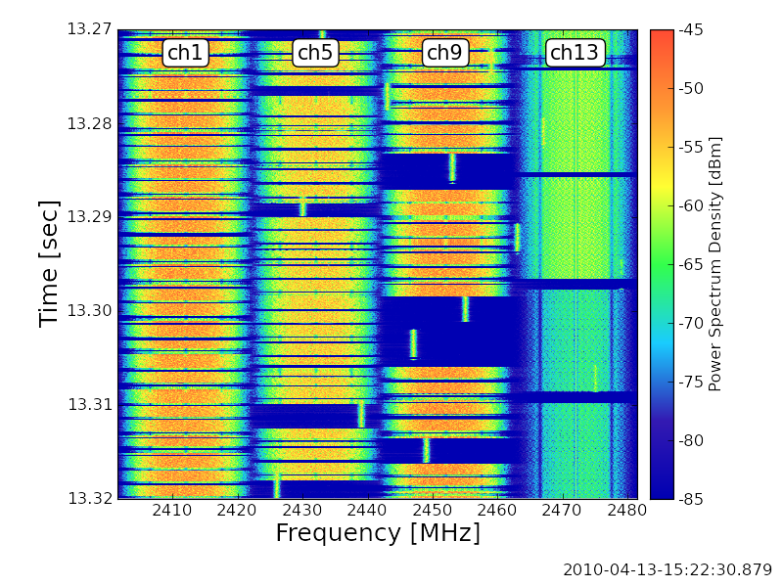
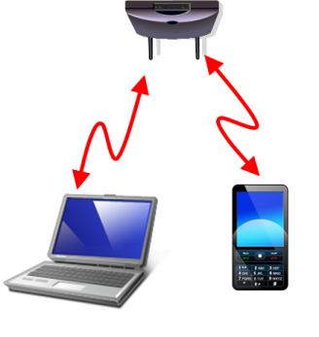
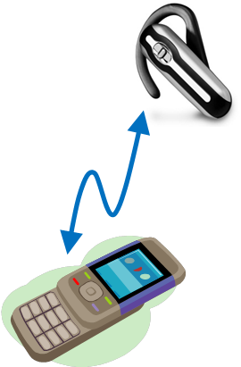
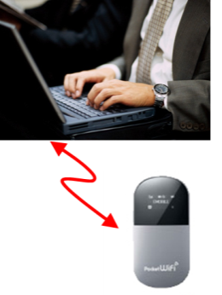
Congestion situation in the ISM band
High traffic-load situation will be caused frequently in the near future in ISM band
  degrades the efficiency of the overall communications due to inter-system interference among co-existing wireless systems

Slide 5
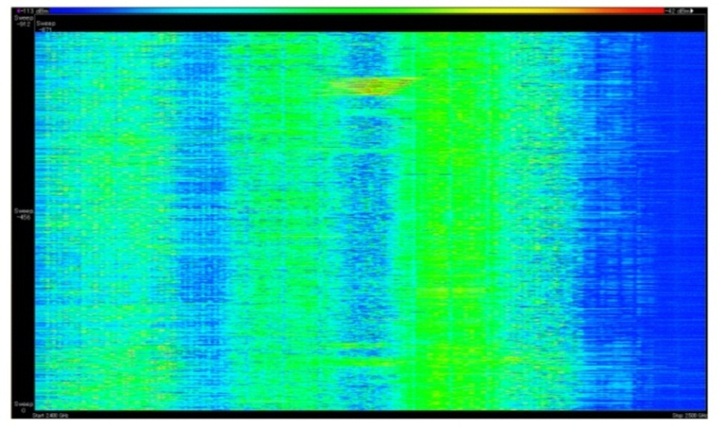
Current situation in 2.4GHz band
To confirm current situation in 2.4GHz ISM band, the following locations were selected and measured.
  Airport
  Railroad station
  Conference room
  Residential area
  Hospital
-114dBm
Signal strength
-34dBm
10:00
Time
10:15
2.4GHz
Frequency
2.5GHz
Spectrogram

Slide 6
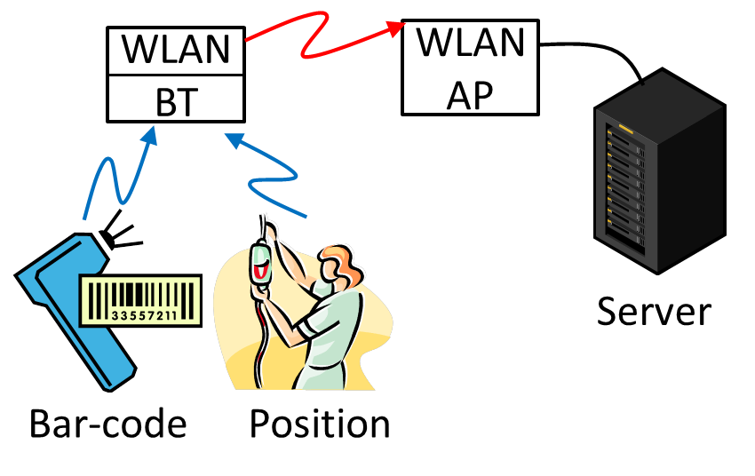
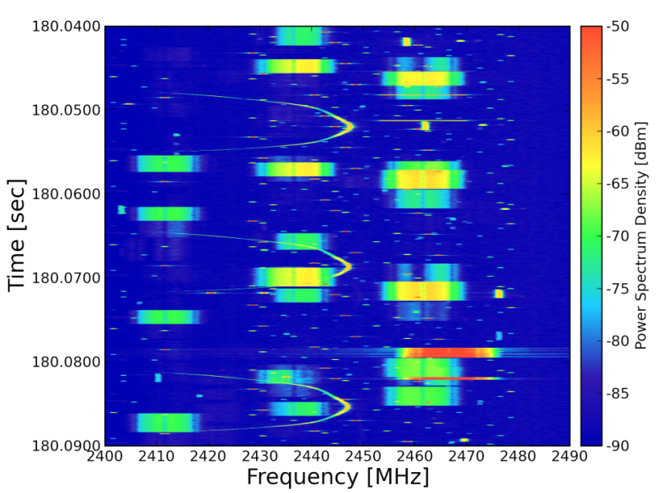
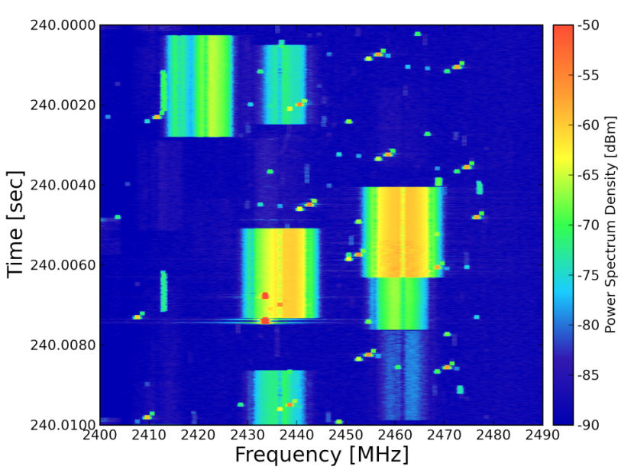
Hospital
Spectrogram

Slide 7
IG SRU activities
The IG SRU (Spectrum Resources Usage in WPANs) started in November 2010.
  “A Proposal Toward Better Use of Spectrum Resources in future WPAN (15-10-0739-01)” was presented WNG in September 2010.
Objectives
  To explore advanced technologies for improving the efficiency of spectrum usage in ISM and unlicensed band.
  To summarize informative ideas to judge and establish SG.
Discussion topics
  Measurements and simulations of congestion situation in 2.4GHz
  System and mechanism proposals
Achievements (deliverables) of IG SRU so far
  IG SRU Technical Document (15-12-184r1) has been released.
  Motion to establishing SG has been passed on July 2013.

Slide 8
Past IG SRU meetings
Held 11 meeting and three teleconference meetings.
  Average number of attendees were 10.
Year | Month | Venue | Agenda | Closing Report | Minutes | Number of participants
2010 | November | Dallas | 15-10-0839-01 | 15-10-0924-01 | 15-10-0934-00 | 10
2011 | March | Singapore | 15-11-0159-01 | 15-11-0298-00 | 15-11-0440-00 | 8
 | July | San Francisco | 15-11-0456-00 | 15-11-0552-00 | 15-11-755-00 | 11
 | November | Atlanta | 15-11-0757-01 | 15-11-0830-00 | 15-12-0106-00 | 13
2012 | March | Waikoloa | 15-12-0107-00 | 15-12-0191-00 | 15-12-0197-00 | 4
 | July | San Diego | 15-12-0326-01 | 15-12-0425-00 | 15-12-0440-00 | 11
 | November | San Antonio | 15-12-0595-01 | 15-12-0628-01 | 15-12-0659-01 | 9
2013 | January | Vancouver | 15-12-0681-02 | 15-13-0078-00 | 15-13-0093-00 | 10
 | March | Orlando | 15-13-105-01 | 15-13-0225-00 | 15-13-0305-00 | 12
 | May | Waikoloa | 15-13-260-01 | 15-13-0318-00 | 15-13-0344-00 | 9
 | July | Geneva | 15-13-0354-01 | 15-13-0469-00 | 15-13-0497-00 | 14

Slide 9
Goal for SG SRU
The focus of the SG SRU is to draft a PAR and 5C for achieving more efficient utilization of spectrum resources through mechanisms of Radio Resource Measurement and Management for WPANs.
Primarily targeting applications using 802.15.4.
  Hospital/Medical/Healthcare
  Industrial Automation
  Infrastructure Monitoring

Slide 10
Use Case Examples
Three major use cases have been in consideration
  Hospital/Medical/Healthcare
  Industrial Automation
  Infrastructure Monitoring

Slide 11
Use case: Hospital
Various wireless systems (WLAN, Bluetooth etc) are deployed in medical environments.
Requirement
  Self-organizing wireless system
  Spectrum sensing of whole band for searching vacant radio resources
  Radio resource assignment and network topology management
A Use Case of Self-Organizing Wireless Network for Medical System(15-13-0306r0)

Slide 12
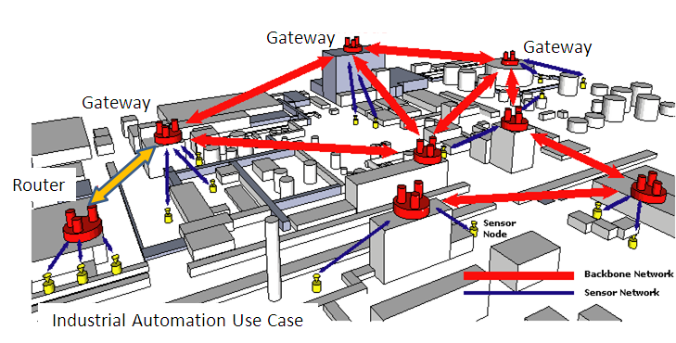
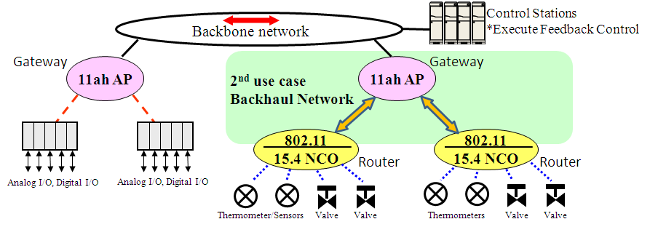
Use case: Industrial Automation

Slide 13
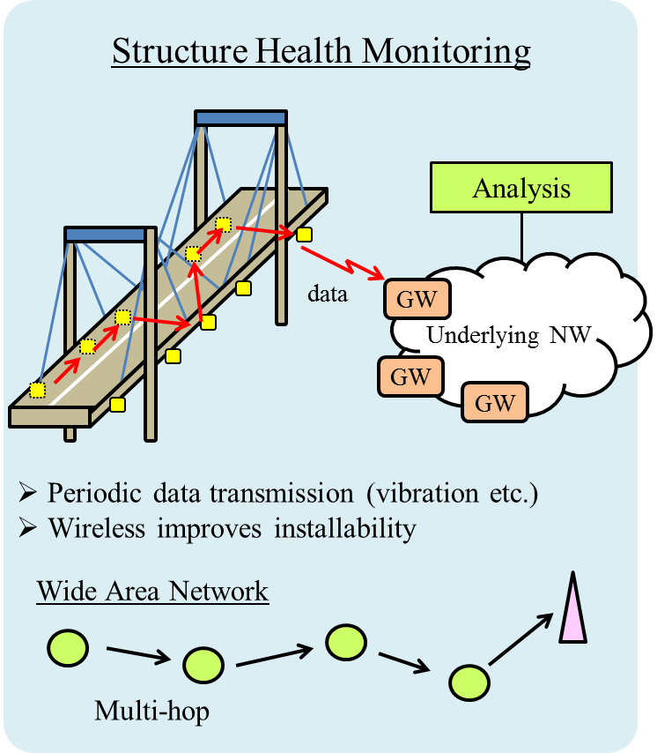
Use case: Infrastructure monitoring
Application Server
Status Management
network condition
(maximum data rate, …)
desired QoS
(data rate, delay, ...)
Radio Resource
Management Entity
Optimization Function
measurement result
(interference, battery, …)
communication parameters
(interval, topology, ...)
Wireless Node
Radio Resource
Measurement
Configuration
Modification
Proposal of radio resource management architecture(15-13-0285r1)

Slide 14
Proposed Timeline
Year |  | 2013 |  |  | 2014 |  |  |  |  |  | 2015
Month |  | 7 | 9 | 11 | 1 | 3 | 5 | 7 | 9 | 11 | 1 | 3 | …
SG Work Items | PAR development
 | Use Cases
 | Title
 | Scope & Purpose
 | 5C analyses
 | Interaction with other TG/WG (to identify relationship )
 | Submission to WG
Standard development phase (TG) |  |  |  |  |  |  | Ad Hoc
Target dates:
  PAR submission to WG in January 2014
  PAR submission to NesCom in March 2014
  SASB approval in June 2014

Slide 15
References
Proposal of radio resource management architecture(15-13-0285r1)
A Use Case of Self-Organizing Wireless Network for Medical System(15-13-306-0)
IG SRU Working Draft RRMM-usecases and 5C(15-13-0294r1)
IG SRU Usecase requirements table(15-13-0293r1)
A Use Case of Self-Organizing Wireless Network for Medical System(15-13-0306r0)
Proposal of radio resource management architecture(15-13-0285r1)
Establishing a Study Group for a Spectrum Resource Utilization (SRU) through Radio Resource Measurement and Management for WPANs (15-13-0404-01)

