Slide 1
Doc: IEEE 802.15-13-0532-00-0led
Project: IEEE 802.15 LED(Light Emitting Diode) Interest Group (IG-LED)
Submission Title: [Smart Device based LED Communication examples]
Date Submitted: [16th Sept, 2013]
Source: [Jaesang Cha]
[Seoul National Univ. of Science & Technology]
Address : [Seoul National University of Science & Technology, Seoul, Korea]
Voice: [82-2-970-6431], FAX: [82-2-970-6123], E-Mail:[chajs@seoultech.ac.kr]
Re: []
Abstract: [Smart Device based LED Communication are introduced in the presentation.]
Purpose: [Contribution to IEEE 802.15 IG-LED]
Notice: This document has been prepared to assist the IEEE 802.15. It is offered as a basis for discussion and is not binding on the contributing individual(s) or organization(s). The material in this document is subject to change in form and content after further study. The contributor(s) reserve(s) the right to add, amend or withdraw material contained herein.
Release: The contributor acknowledges and accepts that this contribution becomes the property of IEEE and may be made publicly available by IEEE 802.15
Slide 1
Notes:
doc.: IEEE 802.15-09-0117-00-0007
<month year>

Slide 2
Contents
Doc: IEEE 802.15-13-0532-00-0led
LED light to receiver(Dedicated terminal)
Smart Device(LED flash) to receiver(PD)
LED light to Smart Device(Camera)
Smart Device(LED flash) to Smart Device(Camera)
Coexistence of RF & LED Communication for Smart Device

Slide 3
Doc: IEEE 802.15-13-0532-00-0led
LED light to receiver(Dedicated terminal) example
LED Lights of LED patch
Information
Tx module: LED light
Rx module: Dedicated receiver using PD

Slide 4
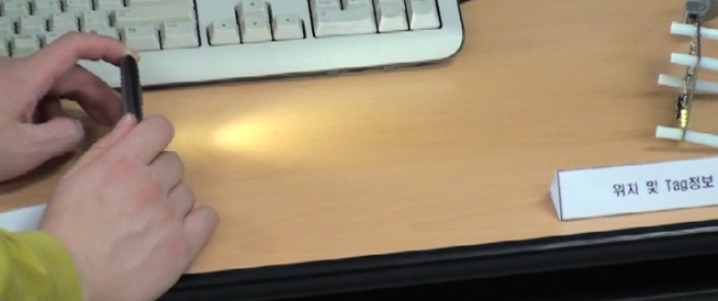
Doc: IEEE 802.15-13-0532-00-0led
Smart Device(LED flash) to receiver(PD) example
LED flash Light Smart phone
Data recovery by PD
Tx module : LED flash light of Smart Devices
Rx module: PD

Slide 5
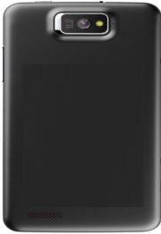
July 2013
Doc: IEEE 802.15-13-0532-00-0led
LED light to Smart Device(Camera) example
Tx module: LED light
Rx module: Smart device Camera
Jaesang Cha, Seoul National Univ. of Science&Tech.

Slide 6
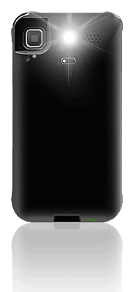
July 2013
Doc: IEEE 802.15-13-0532-00-0led
Smart Device(LED flash) to Smart Device(Camera) structure
Smart Device LED Flash
Smart Device Camera
Tx module: LED flash of Smart Device(Phone/PAD)
Rx module: Camera module of Smart Device(Phone/PAD)
Jaesang Cha, Seoul National Univ. of Science&Tech.

Slide 7
July 2013
Doc: IEEE 802.15-13-0532-00-0led
Coexistence of RF & LED Communication for Smart Device
RF : 3G/LTE, Wi-Fi, Blue-tooth etc.
LED communication
- Tx module: Smart device LED flash
- Rx module: Smart device Camera
RF + LED Com.
Smart Device LED Flash
Smart Device Camera
Hybird Tx: Smart Device LED flash &/or RF (3G/LTE, Wi-Fi, Blue-tooth etc.)
Hybrid Rx : Smart Device Camera &/or RF (3G/LTE, Wi-Fi, Blue-tooth etc.)
Jaesang Cha, Seoul National Univ. of Science&Tech.

Slide 8
Doc: IEEE 802.15-13-0532-00-0led
Conclusion
In this submission, we presented or proposed various Smart Device based LED Communication examples
Especially, Smart device based LED Communication with LED flash light & Smart Device Camera could be a good Smart Device based Solution for LED-ID or LED-IT convergence technologies in future.
Furthermore, Hybrid T/Rx structure example coexisting RF & Camera based LED communication is proposed

