Slide 1
Doc: IEEE 802.15-13-0531-00-0led
Project: IEEE 802.15 LED(Light Emitting Diode) Interest Group (IG-LED)
Submission Title: [Energy Efficient LED light Control using Object based sensor]
Date Submitted: [16th Sept, 2013]
Source: [Jaesang Cha*, Soonho Jung*, HyungO Kim*, Hyung Guen Ryu *, Yeong Min Jang, Byunghoon Lee, EunSoo Kim, Incheol Jeong , Jaekwon Shin,, Jaemoon Kim]
[Seoul National Univ. of Science & Technology*, Kookmin Univ., CUE&WORKS Inc, SamSang Eng. Co., Sungkonghoe Univ., Fivetek Co ., National University of Transportation ]
Address : [Seoul National University of Science & Technology, Seoul, Korea]
Voice: [82-2-970-6431], FAX: [82-2-970-6123], E-Mail:[chajs@seoultech.ac.kr]
Re: []
Abstract: [Energy Efficient LED light Control using Object based sensor are introduced.]
Purpose: [Contribution to IEEE 802.15 IG-LED]
Notice: This document has been prepared to assist the IEEE 802.15. It is offered as a basis for discussion and is not binding on the contributing individual(s) or organization(s). The material in this document is subject to change in form and content after further study. The contributor(s) reserve(s) the right to add, amend or withdraw material contained herein.
Release: The contributor acknowledges and accepts that this contribution becomes the property of IEEE and may be made publicly available by IEEE 802.15
Slide 1
Notes:
doc.: IEEE 802.15-09-0117-00-0007
<month year>

Slide 2
Contents
Doc: IEEE 802.15-13-0531-00-0led
What is a Energy Efficient LED light Control using Object based sensor ?
Requirement of Energy Efficient LED light Control using Object based sensor
Energy Efficient LED light Control using Object based sensor
Energy saving Object Sensor consist of Sensor Units , AC Direct Driver and Standby Power Cutoff Module
Conclusion

Slide 3
Doc: IEEE 802.15-13-0531-00-0led
What is a Energy Efficient LED light Control using Object based sensor?
Energy Efficient LED Control and Object based sensor
Uses conventional technologies associated with LED, various sensors
Improves the convergence works of LED light applications (track
]ing, monitoring, smart lighting, control, etc.)
Key issue in the object based sensor and LED light control
Power consumption monitoring technology
Standby power cutoff technology
Hybrid technologies for the various applications
Proposed schemes have LED energy saving structure using object based sensor connected LED light control

Slide 4
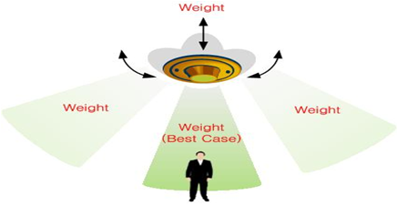
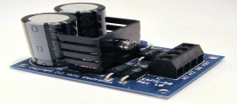
Doc: IEEE 802.15-13-0531-00-0led
Requirement of Energy Efficient LED light Control using Object based sensor
AC power
AC direct LED driver
LED Lights
angle
Wake-Up signal
Cover
Cover
Tracking
DC power
Sensor driver circuit
Object based sensor is able to control LED
Object based services has constraints of FOV : coverage and performance are restricted
There are possible to seamless service and broad-coverage services through object tracking
Energy Efficient LED light control system has the advantages in Low power consumption and smart motion detection

Slide 5
Doc: IEEE 802.15-13-0531-00-0led
Energy Efficient LED light Control using Object based sensor
Advantages
Uses existing infra structure(LED lighting, smart devices)
Taking advantages of existing technology and compensates
Low power consumption.
High securities, resolution (Accurate detection )
Smart motion detection.
Weakness
High Complexity
High Costs (because of additional sensors and devices)
Object based sensor and Energy Efficient LED control system have many advantages.

Slide 6
Doc: IEEE 802.15-13-0531-00-0led
Energy saving Object Sensor consist of
Sensor Units + AC Direct Driver + Standby Power Cutoff Module
Standby Power
Cutoff
AC direct LED driver
LED Lights
AC power
Wake-Up signal
DC power
Sensor Units
Proposed Energy saving object sensor parts mainly consist of Sensor Units plus AC-Direct Driver and Standby Power Cutoff module could be presented
Slide 6

Slide 7
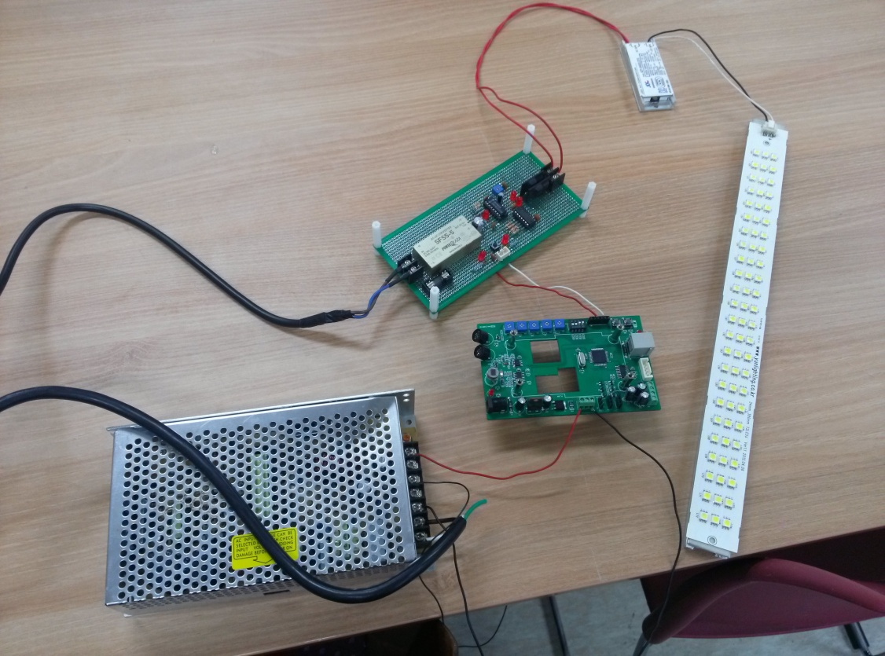
Doc: IEEE 802.15-13-0531-00-0led
Energy saving Object Sensor consist of
Sensor Units + AC Direct Driver + Standby Power Cutoff Module
By basic experimental test using Object sensor & LED light we verified that
LED light connected sensor is operated well
Slide 7

Slide 8
Doc: IEEE 802.15-13-0531-00-0led
Conclusion
Synergy effects by convergence of various technologies is possible (LED light & communication, monitoring, tracking, smart device, sensor)
Especially, Energy Efficient LED light control system has the advantages in Low power consumption and smart motion detection
And, Object based sensor and Energy Efficient LED control system have many advantages.
We proposed one example of Energy saving object sensor structure mainly consist of Sensor Units plus AC-Direct Driver and Standby Power Cutoff module
By basic experimental test using Object sensor & LED light we verified that the operation of proposed structure has no problem

