Slide 1
doc.: IEEE 802.15-13-0530-00-0led
Project: IEEE P802.15 Working Group for Wireless Personal Area Networks (WPANs)
Submission Title: [Development Issues for LED-ID Services Using CamCom]
Date Submitted: [September, 2013]
Source: [Yeong Min Jang, Ratan Kumar Mondal]
[Kookmin University]
Address [Kookmin University, Seoul, Korea]
Voice:[82-2-910-5068], FAX: [82-2-910-5068], E-Mail:[yjang@kookmin.ac.kr]
Re: []
Abstract: [Development Issues for LED-ID Services Using CamCom]
Purpose: [Contribution to IEEE 802.15 IG-LED]
Notice: This document has been prepared to assist the IEEE P802.15. It is offered as a basis for discussion and is not binding on the contributing individual(s) or organization(s). The material in this document is subject to change in form and content after further study. The contributor(s) reserve(s) the right to add, amend or withdraw material contained herein.
Release: The contributor acknowledges and accepts that this contribution becomes the property of IEEE and may be made publicly available by P802.15.
Notes:
doc.: IEEE 802.15-09-0117-00-0007
<month year>

Slide 2
Goals
doc.: IEEE 802.15-13-0530-00-0led
Direction for revision of LED-ID system, where LED-ID system is using CamCom concept
Specify the applications and services those can be supported LED-ID system using CamCom
Study issues of PHY and MAC for deploying LED-ID services using CamCom

Slide 3
Revision directions for active LED-ID standardization
doc.: IEEE 802.15-13-0530-00-0led
Revision of LED-ID services using CamCom
Reader-Tag modification
Deploying CamCom operation in identification services
Use the existing IEEE 802.15.7 MAC and PHY for LED-ID services
Amend the IEEE 802.15.7 MAC and PHY by including identification services

Slide 4
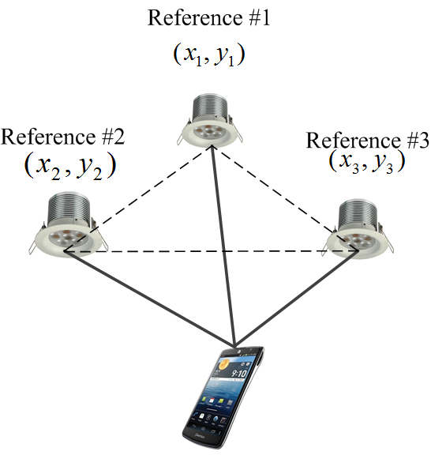
Deployable LED-ID Service Scenario
doc.: IEEE 802.15-13-0530-00-0led
Indoor wireless networking and illumination: home networking through TV, PC monitor and LED lighting
Product information broadcasting, digital signage
Indoor positioning for LBS application
Guiding and authentication services in museum scenario
Streaming
Server
ID Server
IP Network
PLC
Tag # 2
Tag # 1
Tag # N
Tag # 3
Tag # N-1
Reader # N
Reader # 2
Reader # 1
LED-ID based museum scenario
Products information marketing
Localization by reference lighting system for LBS application

Slide 5
Study Issues of MAC for LED-ID services using CamCom
doc.: IEEE 802.15-13-0530-00-0led
Scenario #1: Deploying broadcasting MAC for LED-ID services (in one-way Reader-Tag operation)
Scenario #2:Deploying infrared (IR) based uplink for bi-directional communication in CamCom
Scenario #3: Interworking with another short-range communication technologies for bi-directional MAC protocol in CamCom based LED-ID services
For all the scenarios, following issues need to study further for LED-ID services using CamCom —
Channel scanning
Channel access
Association/Disassociation- specify for the Reader-Tag operation
Synchronization

Slide 6
Study Issues of PHY for LED-ID services using CamCom
doc.: IEEE 802.15-13-0530-00-0led
Modulation Schemes—
Use the existing modulation schemes- OOK, VPPM, and CSK
Deploy novel and compatible modulation scheme for CamCom
Undersampled Frequency Shift OOK (UFSOOK) [1(Intel)]
Generalised Space Shift Keying (GSSK) [3]
Visual Cell OOK [3(Kookmin)]- need to provide dimming support
MIMO operation—
Need to standardized MIMO system for multiple Reader-Tag accessing
Reader-Tag synchronization-
Need to provide simple frame synchronization procedure for CamCom based LED-ID services

Slide 7
Conclusions
doc.: IEEE 802.15-13-0530-00-0led
Need to specify the MAC and PHY operation for LED-ID services using CamCom
Enhancing the multiple Reader-Tag access operation by deploying MIMO concept in CamCom system
Specify the applications and services those can be supported LED-ID system using CamCom

Slide 8
References
doc.: IEEE 802.15-13-0530-00-0led
[1] “VLC system deployment discussion,” R. Roberts, IEEE P802.15.7 working group for wireless personal area networks, March 2013.
[2] Popoola, W.O.; Poves, E.; Haas, H., "Error Performance of Generalised Space Shift Keying for Indoor Visible Light Communications," Communications, IEEE Transactions on , vol.61, no.5, pp.1968,1976, May 2013.
[3] “Visual Cell OOK Modulation for MIMO CamCom” Yeong Min Jang, Ratan Kumar Mondal, Nam Tuan Le, IEEE P802.15.7 working group for wireless personal area networks, July2013.

