Slide 1
doc.: IEEE 802.15-13-0530-00-0led
Project: IEEE P802.15 Working Group for Wireless Personal Area Networks (WPANs)
Submission Title: [Development Issues for LED-ID Services Using CamCom]
Date Submitted: [September, 2013]
Source: [Yeong Min Jang, Ratan Kumar Mondal]
[Kookmin University]
Address [Kookmin University, Seoul, Korea]
Voice:[82-2-910-5068], FAX: [82-2-910-5068], E-Mail:[yjang@kookmin.ac.kr]
Re: []
Abstract: [Development Issues for LED-ID Services Using CamCom]
Purpose: [Contribution to IEEE 802.15 IG-LED]
Notice: This document has been prepared to assist the IEEE P802.15. It is offered as a basis for discussion and is not binding on the contributing individual(s) or organization(s). The material in this document is subject to change in form and content after further study. The contributor(s) reserve(s) the right to add, amend or withdraw material contained herein.
Release: The contributor acknowledges and accepts that this contribution becomes the property of IEEE and may be made publicly available by P802.15.
Notes:
doc.: IEEE 802.15-09-0117-00-0007
<month year>

Slide 2
Goals
doc.: IEEE 802.15-13-0530-00-0led
Direction for revision of LED-ID system, where LED-ID system is using CamCom concept
Specify the applications and services those can be supported LED-ID system using CamCom
Modify MAC and PHY for deploying LED-ID services using CamCom

Slide 3
Revision directions for active LED-ID standardization
doc.: IEEE 802.15-13-0530-00-0led
Revision of LED-ID services using CamCom
  Reader-Tag modification
  Short and simple MAC protocol for LED-ID services
  Deploying CamCom operation in identification services
Need to modify existing IEEE802.15.7 MAC protocol
Need to modify existing IEEE802.15.7 MAC services
Need to existing IEEE802.15.7 PHY layer

Slide 4

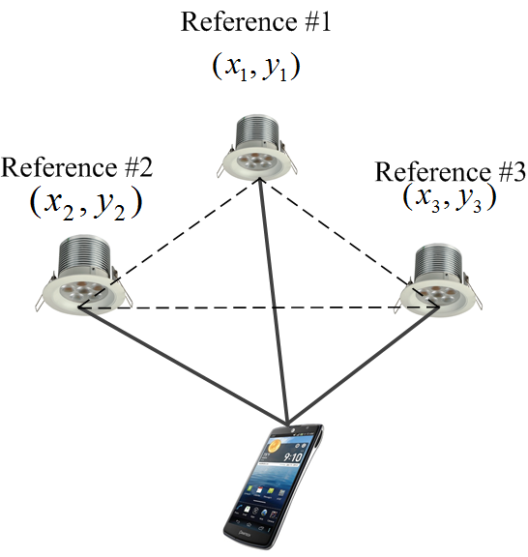
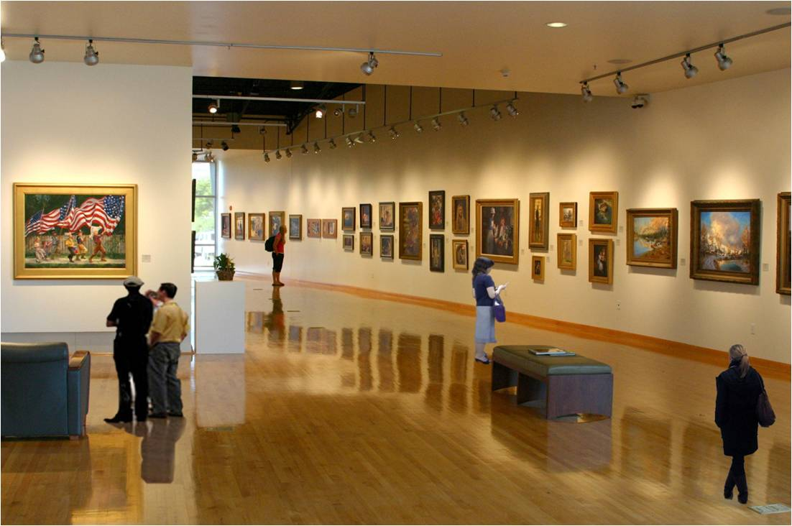

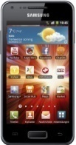
Deployable LED-ID Service Scenario
doc.: IEEE 802.15-13-0530-00-0led
Indoor wireless networking and illumination: home networking through TV, PC monitor and LED lighting
Product information broadcasting, digital signage
Indoor positioning for LBS application
Guiding and authentication services in museum scenario
Streaming
Server
ID Server
IP Network
PLC
Tag # 2
Tag # 1
Tag # N
Tag # 3
Tag # N-1
Reader # N
Reader # 2
Reader # 1
LED-ID based museum scenario
Products information marketing
Localization by reference lighting system for LBS application

Slide 5
Modification of MAC for LED-ID services using CamCom
doc.: IEEE 802.15-13-0530-00-0led
Scenario #1: Need to modify MAC in broadcasting scenario (in one-way Reader-Tag operation)
Scenario #2: Modify MAC for bi-directional communication in CamCom –using IR based uplink
Scenario #3: Interworking with another short-range communication technologies for bi-directional MAC protocol
For all the scenarios, following issues need to develop—
  Channel scanning
  Channel access
  Association/Disassociation
  Synchronization

Slide 6
Modification of PHY for LED-ID services using CamCom
doc.: IEEE 802.15-13-0530-00-0led
Modulation Schemes—
  Use the existing modulation schemes- OOK, VPPM, and CSK
  Deploy novel and compatible modulation scheme for CamCom
    Undersampled Frequency Shift OOK (UFSOOK) [1(Intel)]
    Spatial Modulation [2]
    Generalised Space Shift Keying (GSSK) [3]
    Visual Cell OOK [4(Kookmin)]- need to provide dimming support
MIMO operation—
  Need to standardized MIMO system for multiple Reader-Tag accessing
Reader-Tag synchronization-
  Need to provide simple frame synchronization procedure for LED-ID services
Error –correction—
  Providing pre-coding system for MIMO operation

Slide 7
Conclusions
doc.: IEEE 802.15-13-0530-00-0led
Need to specify the MAC and PHY operation for LED-ID services using CamCom
Enhancing the multiple Reader-Tag access operation by deploying MIMO concept in CamCom system
Specify the applications and services those can be supported LED-ID system using CamCom

Slide 8
References
doc.: IEEE 802.15-13-0530-00-0led
[1] “VLC system deployment discussion,” R. Roberts, IEEE P802.15.7 working group for wireless personal area networks, March 2013.
[2] Mesleh, R.; Haas, H.; Chang Wook Ahn; Sangboh Yun, "Spatial Modulation - A New Low Complexity Spectral Efficiency Enhancing Technique," Communications and Networking in China, 2006. ChinaCom '06. First International Conference on , vol., no., pp.1,5, 25-27 Oct. 2006.
[3] Popoola, W.O.; Poves, E.; Haas, H., "Error Performance of Generalised Space Shift Keying for Indoor Visible Light Communications," Communications, IEEE Transactions on , vol.61, no.5, pp.1968,1976, May 2013.
[4] “Visual Cell OOK Modulation for MIMO CamCom” Yeong Min Jang, Ratan Kumar Mondal, Nam Tuan Le, IEEE P802.15.7 working group for wireless personal area networks, July2013.

