Slide 1
Project: IEEE P802.15 Working Group for Wireless Personal Area Networks (WPANs)
Submission Title: Data Center Traffic Characteristics and 100Gb/s Demand
Date Submitted:
Source: Cai Yunlong, Huawei
Address: Huawei Building, No.3 Xinxi Road, Shangdi, District Haidian, Beijing, 100085, China
E-Mail: <caiyunlong@huawei.com>
Abstract: This contribution will investigate the data center infrastructure and its traffic features. With this contribution, it is considered that the THz(SG 100G) techniques may have a great application in data center.
Purpose: Input for data center scenarios discussion of THz(SG 100G).
Notice: This document has been prepared to assist the IEEE P802.15. It is offered as a basis for discussion and is not binding on the contributing individual(s) or organization(s). The material in this document is subject to change in form and content after further study. The contributor(s) reserve(s) the right to add, amend or withdraw material contained herein.
Release: The contributor acknowledges and accepts that this contribution becomes the property of IEEE and may be made publicly available by P802.15.

Slide 2
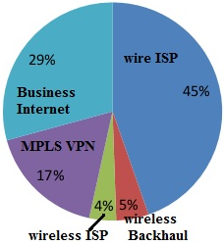
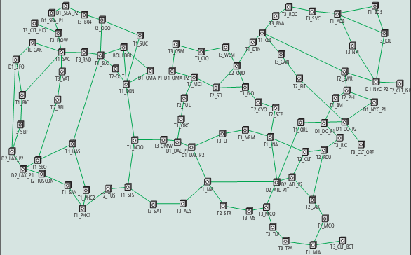
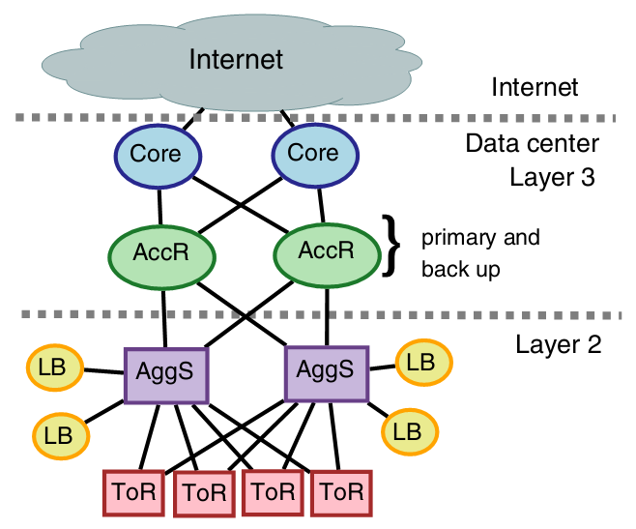
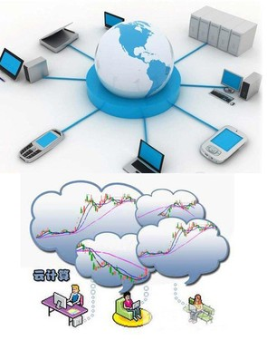
Data Centers, Cornerstones
Topology and location of add-drop nodes for the North American
Composition of IP services
THz?100Gbps
Data center infrastructure
Notes:
“Total Cost of Ownership of WDM and Switching Architectures for Next-Generation 100Gb/s Networks”
“Traffic Types and Growth in Backbone Networks “

Slide 3
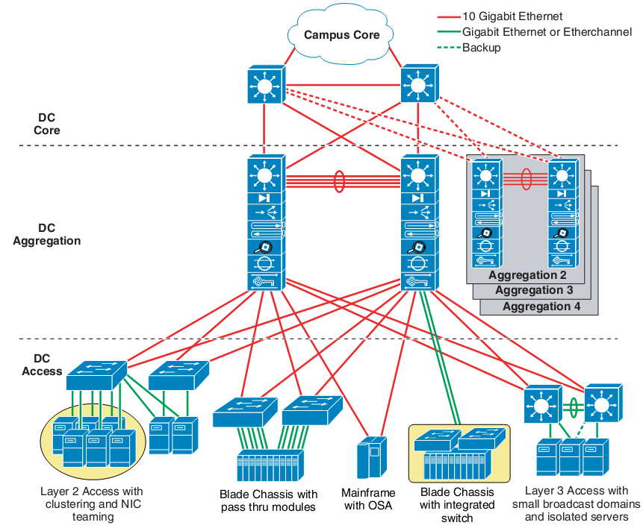
3-Tier Data center Infrastructure
Core Layer
the data center core is a Layer 3 domain built with high-bandwidth links (10 GE or a bunch of 10GE);
Aggregation Layer
supports Layer 2 and Layer 3 functionality; using 10 Gbps links
Access Layer/ToR
A Layer 2 domain
ToR using 1Gbps links
Topology is tradeoffs
  Emerging 40G Ethernet , performance bottlenecks
Source: Enterprise Data Center Wide Area Application Services (WAAS) Design GuideCisco Systems, Inc.
Notes:
Topology is tradeoffs:
Performance, system packaging,
path diversity, and redundancy,
In turn, affect the network’s resilience to faults, average and maximum cable length, and, of course, cost。
Emerging 40G Ethernet , performance bottlenecks
the communication stack that require better hardware-software coordination for efficient communication.

Slide 4
Insights of Traffic -1
Much of the traffic could be by two patterns：
  Work-Seeks-Bandwidth and Scatter-Gather(application determined)
75% of traffic stays within a rack (Clouds)
Half packets are small (< 200B)， Keep alive
At most 25% of core links highly utilized
  Effective routing algorithm to reduce utilization
  Load balance across paths and migrate VMs
Few links experience loss
Core > Edge > Aggregation; Many links are unutilized , Back-up/redundant
Traffic adheres to ON-OFF
Arrival process is lognormal
Source, Theophilus Benson, etc, “Network Traffic Characteristics of Data Centers in the Wild”
Theophilus Benson,etc, “Understanding Data Center Traffic Characteristics”
Notes:
ON-OFF, Human speech consists of talk-spurts and silence gaps, also known as on-off patterns.
Collecting Data-case 1:
Events from each of the 1500 servers
For over two months
Collecting Data-case 2:
Differences in size and architecture
Data for intranet and extranet server farms
Applications: messaging, search, video streaming, email
Data consists of
Packet traces from edge switches in one data center
SNMP MIB of devices in all data centers
Data collected over a span of 10 days
Much of the traffic could be by two patterns：
Work-Seeks-Bandwidth and
Scatter-Gather(application determined)

Slide 5

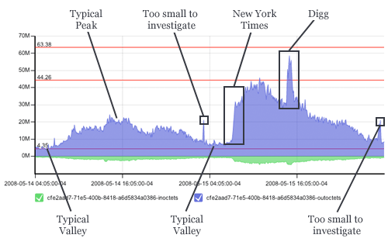
Insights of Traffic -2
Internet traffic becomes highly aggregated
The mean of traffic flows says very little because
  aggregated traffic exhibits highly variable and
  non-Gaussian；
Common classification is bimodal,
  with modes around 200B and 1,400B；
  using the so-called “elephant” and “mice” classes;
  Elephant flows account for less than 1%,
  but more than half the data volume. long lived
  and “bursty”;
  Traffic spikes
  Caused when many virtual machines experience
  a burst at the same time.
  The rate of virtual server growth is far outpacing
  physical servers.
Source: A Guided Tour through Data-center Networking
Notes:
Source:
1), “Will Traffic Spikes Overwhelm Your Data Center Network” http://omniti.com/seeds/dissecting-todays-internet-traffic-spikes
2), “A Guided Tour through Data-center Networking”

Slide 6
Traffic Inter/intra Cluster Feature
Traffic between clusters , typically less time-critical
Inter-cluster traffic is less orchestrated and consists of much larger payloads,
Intra-cluster traffic is often fine-grained with bursty behavior.
Clouds: most traffic stays within a rack (75%)
  Colocation of apps and dependent components

Slide 7
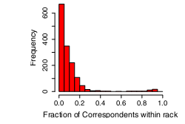
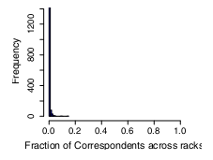
# Correspondents a Server Talks with
Figure : How many other servers does a server correspond with? ( Rack= 20servers, Cluster ∼ 1500servers)
A server either talks to almost all the other servers within the rack (the bump near 1 in figure left) or it talks to fewer than 25 % of servers within the rack.
Further, a server either doesn’t talk to servers outside its rack (the spike at zero in figure right) or it talks to about 1~10% of outside servers.

Slide 8
Internet Inter-Domain Traffic
The majority of inter-domain traffic now flows directly between large content providers, data center / CDNs and consumer networks.
Significant changes in Internet, including a global decline of P2P and a big rise in video traffic.
In the emerging new Internet economy, content providers build their own global backbones
Craig Labovitz, etc, “Internet Inter-Domain Traffic”, SIGCOMM’10,August 30–September 3, 2010, New Delhi, India.

Slide 9
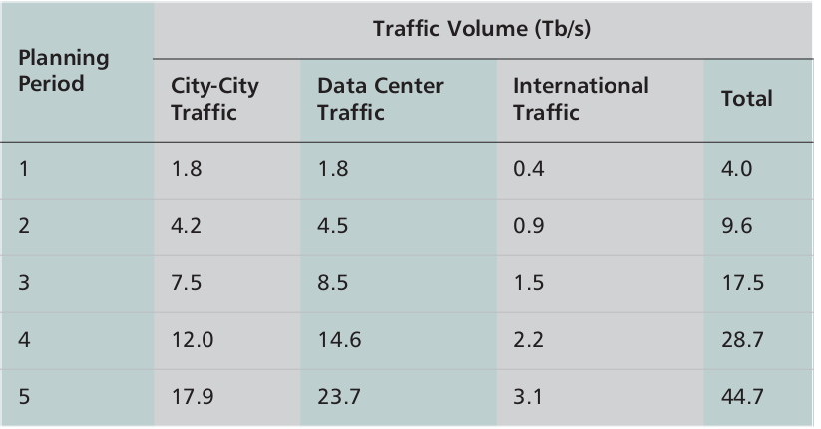
Model of Service Demands and Multiperiod Traffic
Three-tiered model :
  City-to-city demands between all nodes,
  Using a multivariable gravity model
  Data center traffic between data center locations
  Using market research data on Internet traffic flows and sources.
  International traffic from submarine cable landing sites
Source:“Total Cost of Ownership of WDM and Switching Architectures for Next-Generation 100Gb/s Networks”
Notes:
Source:“Total Cost of Ownership of WDM and Switching Architectures for Next-Generation 100Gb/s Networks”

Slide 10
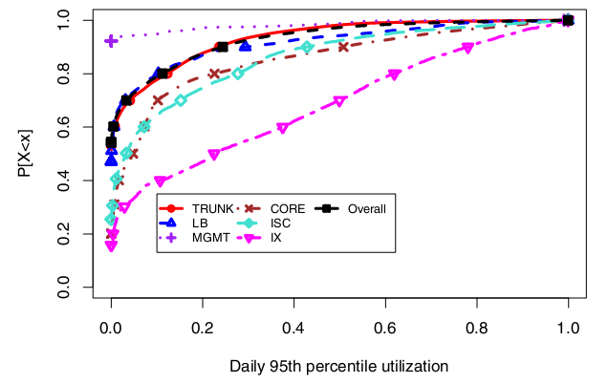
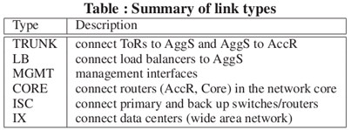
Data Center Workload Characteristics
Figure 2: The daily 95th percentile utilization as computed using five-minute traffic averages (in bytes)
In particular the prevalence of a large volume of short-lived latency-sensitive “mice” flows and
A few long-lived throughput-sensitive “elephant” flows that make up the majority of bytes transferred in the network.
Source: “Understanding Network Failures in Data Centers:Measurement, Analysis, and Implications”,Sigcomm ’11, 2011
Notes:
SIGCOMM11-DCFailure.pdf Understanding Network Failures in Data Centers:Measurement, Analysis, and Implications
TRUNK and LB links which reside lower in the network topology are least utilized with 90% of TRUNK links observing less than 24% utilization. Links higher in
the topology such as CORE links observe higher utilization with 90% of CORE links observing less than 51% utilization.

Slide 11
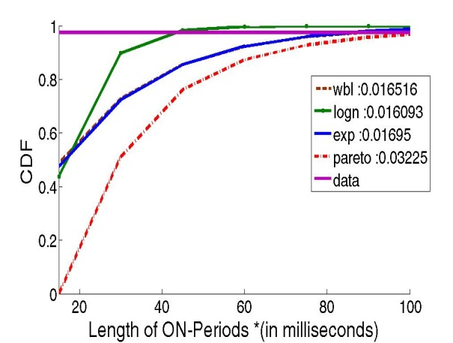
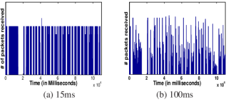
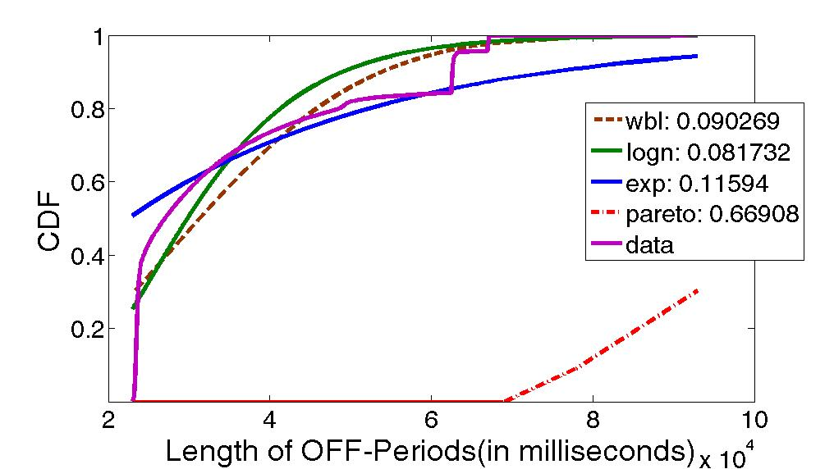
Data Center Traffic Model/Packet-Level
What is the arrival process?
  Heavy-tail for the 3 Distributions
    ON, OFF times, Inter-arrival,
  Lognormal across all data centers
Different from Pareto of WAN
  Need new models
Data Center | Off Period Dist | ON periods Dist | Inter-arrival Dist
Prv2_1 | Lognormal | Lognormal | Lognormal
Prv2_2 | Lognormal | Lognormal | Lognormal
Prv2_3 | Lognormal | Lognormal | Lognormal
Prv2_4 | Lognormal | Lognormal | Lognormal
EDU1 | Lognormal | Weibull | Weibull
EDU2 | Lognormal | Weibull | Weibull
EDU3 | Lognormal | Weibull | Weibull
Source, Theophilus Benson, etc, “Network Traffic Characteristics of Data Centers in the Wild”
Notes:
Using a packet inter-arrival time threshold to identify the ON/OFF periods in the traces
To characterize this ON/OFF traffic pattern, we focus on three aspects: (1)the durations of the ON periods, (2)the durations of the OFF periods, (3)the packet inter-arrival times within ON periods

Slide 12
Facebook/Google’s Traffic
Facebook requires big networks for big data
  A particular HTTP request required 88 cache lookups (648 KB), 35 database lookups (25.6 KB), and 392 backend remote procedure calls (257 KB), and took a total of 3.1 seconds. If HTTP request was 1 KB, then a 930x increase in internal data center traffic. 100 PB of data stored in its data warehouse.
Google dominates internet traffic figures
  Handle a massive 60% average of all internet traffic a day(source:DeepField);Now accounts for nearly 25% on average.
  Last week Google said it had more than doubled the amount of cash spent on building out new data center capacity in Q2 this year, compared to its 2012 results.

Slide 13
High Speed Demand and THz
The data rate, the infrastructure of next generation data center?
Traffic model=>connections bandwidth demand?
The traffic model is not accurate, intra/inter Data center, or city-to-city/international flows.
3G/4G wireless data traffic will more complicated?
The cyber-giants design their own data center, what’s traffic in/out?
THz 100Gbps/40Gbps/10Gbps can be used in ToR, Aggregation layer?

