Slide 1
Project: IEEE P802.15 Working Group for Wireless Personal Area Networks (WPANs)
Submission Title: Performance evaluation for query-based discovery
Date Submitted: September 16th, 2013
Source: Suhwook Kim, Jinyoung Chun, Han Gyu Cho (LG Electronics)
Address: Seocho R&D Campus, 19, Yangjae-daero 11gil, Seocho-gu, Seoul , Korea
Voice: +82-2-6912-6589, E-Mail: suhwook.kim@lge.com
Re: Proposal for PFD
Abstract: Technical proposal of PAC procedure
Purpose: Proposal for discussion
Notice: This document has been prepared to assist the IEEE P802.15. It is offered as a basis for discussion and is not binding on the contributing individual(s) or organization(s). The material in this document is subject to change in form and content after further study. The contributor(s) reserve(s) the right to add, amend or withdraw material contained herein.
Release: The contributor acknowledges and accepts that this contribution becomes the property of IEEE and may be made publicly available by P802.15.

Slide 2
Outline
Recap of previous proposal
Simulation result
  Simulation parameters
  Simulation results
  Analysis
Conclusion

Slide 3
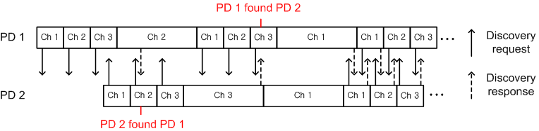
Recap
Discovery in channel hopping system (13-394r0)
  Discovery region
    Fixed length
    PD broadcasts Discovery Request frame
  Communication region
    Random length (Unit: Hopping slot)
    PD waits for Discovery Request frame

Slide 4
Discovery protocol
We adopt query-based discovery by using Discovery Request/Response frame
  Discovery Request frame
    Contents: Device ID, Service type(s), offset of the next discovery region
    Transmitted in broadcast manner (generally)
  Discovery Response frame
    Contents: Device ID, Service type(s), slot timing information, hopping pattern
    Transmitted in unicast manner
    We have two options: Using ACK/Retransmission or not
  We will evaluate and analyze two options in various density environments

Slide 5
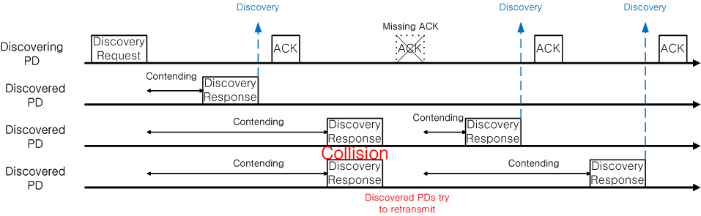
Example of two options
Using ACK/Retransmission for Discovery Response frame
  Discovering PD
    Send Discovery Request frame
    Send ACK right after receiving Discovery Response frame
  Discovered PD
    Send Discovery Response frame when it receives Discovery Request frame
    If there isn’t ACK, re-send Discovery Response frame until receiving ACK

Slide 6
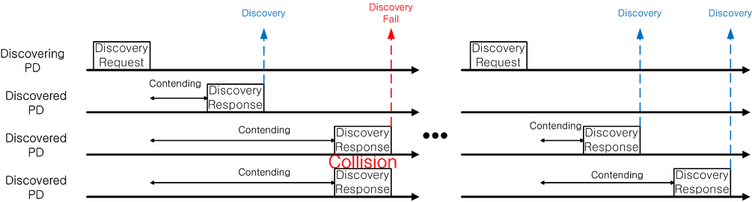
Example of two options
No ACK/Retransmission for Discovery Response frame
  Discovering PD
    Send Discovery Request frame
  Discovered PD
    Send Discovery Response frame when it receives Discovery Request frame

Slide 7
System evaluation
Simulation parameters (same as previous version)
  3 non-overlapped channels
  Hopping slot length: 100 msec
  Discovery slot length: 33 msec (100 msec / 3 channel)
  Communication region: 100, 200, 300 msec (random)
  PD deployment: Uniform random drop
  0~400 msec random turn-on
  CSMA/CA
  Using IEEE 802.11 PHY
    6Mbps transmission rate (BPSK, 1/2 coding rate)
    Discovery frame size: 45 bytes (Including PHY/MAC header)
    Discovery frame transmission time: 45 bytes *8bit / 6Mbps = 60 usec

Slide 8
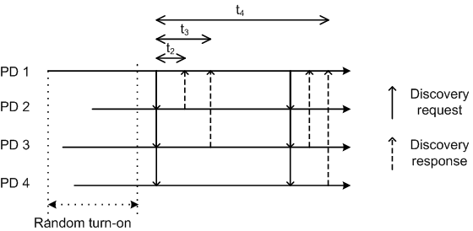
Discovery simulation
Random variables for performance evaluation
  Discovering time: Duration from sending first Discovery request frame to receiving the first Discovery response frame from each neighbor PD
  Discovery complete time: Duration from sending first Discovery request frame to receiving Discovery response frames from whole neighbor PDs
Mathematic definition (of device k)
  Discovering time
    t_{i} (i≠k, i: device index)
  Discovery complete time
    Max (t_{i}) (i≠k, i: device index)

Slide 9
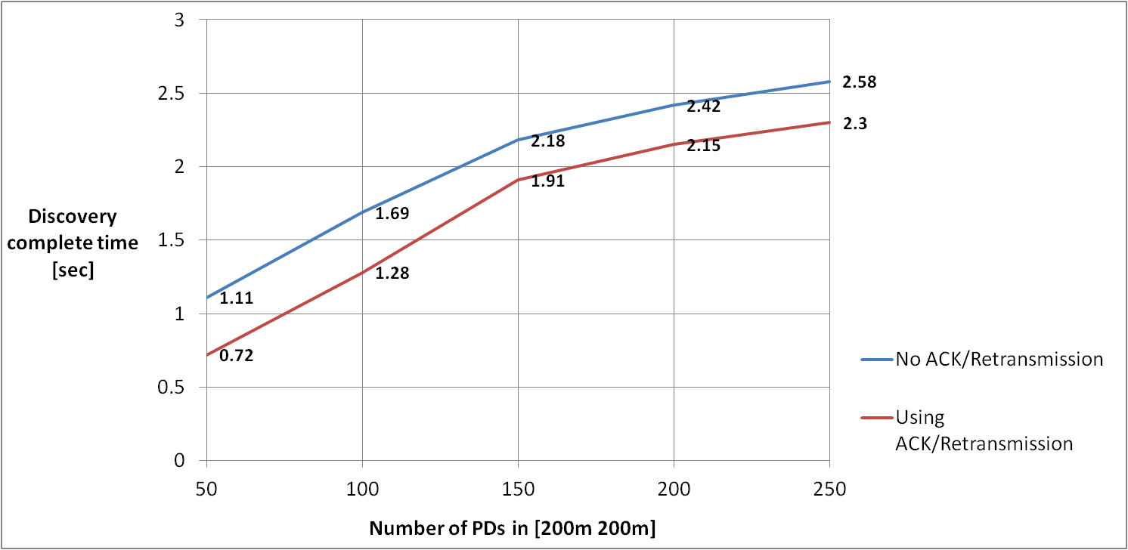
Simulation results
Expectation of Discovery complete time

Slide 10
Simulation results
Histogram of Discovery complete time (100 devices)

Slide 11
Simulation results
Histogram of Discovering time (100 devices)

Slide 12
Analysis & Conclusion
If we use ACK and retransmission for Discovery Response frame, we can achieve lower discovery complete time in every cases
If PAC use query-base discovery protocol, using ACK/Retransmission might be preferable to reducing discovery delay

