Slide 1
Project: IEEE P802.15 Working Group for Wireless Personal Area Networks (WPANs)
Submission Title: Overview of Mesh Networking over IEEE 802.15.4
Date Submitted: 4 September 2013
Source: Pat Kinney Company: Kinney Consulting LLC
Voice:+1.847.960.3715, FAX: +1.630.524.9054, E-mail: pat.kinney@ieee.org
Re: Issue of 802.1 Bridging versus 802.15.4 Mesh Networking
Abstract: Mesh Networking examples
Purpose: Presentation to IEEE 802.1
Notice: This document has been prepared to assist the IEEE P802.15. It is offered as a basis for discussion and is not binding on the contributing individual(s) or organization(s). The material in this document is subject to change in form and content after further study. The contributor(s) reserve(s) the right to add, amend or withdraw material contained herein.
Release: The contributor acknowledges and accepts that this contribution becomes the property of IEEE and may be made publicly available by P802.15.

Slide 2
Mesh Networking – at 802.15.4’s DLL
802.15.4 Overview
Mesh Standards
802.15.5
IETF RPL
Proprietary
Implemented Mesh Networks
Industrial
  IEC 62591(Wireless HART)
  IEC 62601 (WIA-PA)
  IEC 62734 (ISA100.11a)
Smart Utility Networks
  ZigBee Mesh
Conclusion

Slide 3
IEEE 802.15.4 Overview
How significant is 802.15.4?
~5 million 802.15.4 RFICs per month
  ~2 million for consumer devices such as gaming, remote control, cable boxes, third party applications such as Xfinity
  ZigBee Alliance uses such as smart meters, building automation, retail, et al
  Lower volume uses in commercial and industrial applications such as industrial automation
Volumes are now increasing in an exponential fashion due to the installed bases including smart meters

Slide 4
IEEE 802.15.4 Overview
Historical Perspective
Initial publication was 2003, revision in 2006 and 2011
  Next revision is anticipated in 2014
First uses of IEEE 802.15.4 RFICs beyond ZigBee were often not compliant with standard, e.g. using chips for bits
First trend in RFIC industry was to buy MAC firmware companies and then include the MAC with their RFIC

Slide 5
IEEE 802.15.4 Overview
802.15.4 WPAN: a simple, low-cost communication network that allows wireless connectivity in applications with limited power and relaxed throughput requirements. The main objectives of the 802.15.4 WPAN are ease of installation, reliable data transfer, extremely low cost, and a reasonable battery life, while maintaining a simple and flexible protocol.
Addressing: All devices operating on an 802.15.4 WPAN have unique 64-bit MAC addresses, referred to as extended addresses. A device will use either the extended address for direct communication within the WPAN or the 16-bit short address that was allocated by the WPAN coordinator when the device associated

Slide 6
IEEE 802.15.4 Overview
MAC frame size:
  typically <127 octets
  Typical PHY data rates of 20kb/s to 250 kb/s yielding typical packet durations of 4 ms to 51 ms
  Coherence time is the time duration over which the channel impulse response is considered to be not varying. Such channel variation is much more significant in wireless communications due to Doppler and multipath. Typical coherence times run from 2 – 25 ms
Network Components: 1) full-function device (FFD) and
2) reduced-function device (RFD). An FFD is a device that is capable of serving as the WPAN coordinator or a coordinator. An RFD is a device that is not capable of serving as either a PAN coordinator or a coordinator. An RFD is intended for applications that are extremely simple, such as a light switch or a passive infrared sensor; it does not have the need to send large amounts of data and only associates with a single FFD at a time. Consequently, the RFD can be implemented using minimal resources and memory capacity.

Slide 7
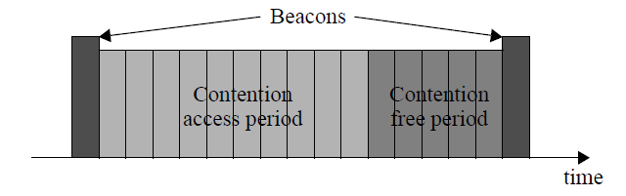
IEEE 802.15.4 Overview
Network types: beacon-enabled, non beacon-enabled
  Beacon-enabled
  Non beacon-enabled
    Each device communicates directly with other devices in its radio communications range. In order to do this effectively, the devices wishing to communicate will need to either receive constantly or synchronize with each other. In the former case, the device can simply transmit its data. In the latter case, other measures need to be taken in order to achieve synchronization. Such measures are beyond the scope of this standard.

Slide 8
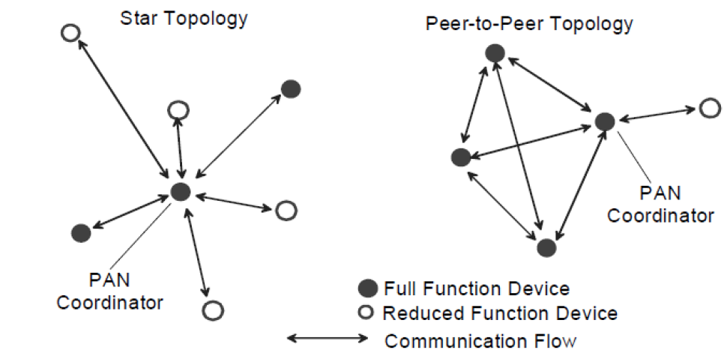
IEEE 802.15.4 Overview
Topologies: star, or peer-peer

Slide 9
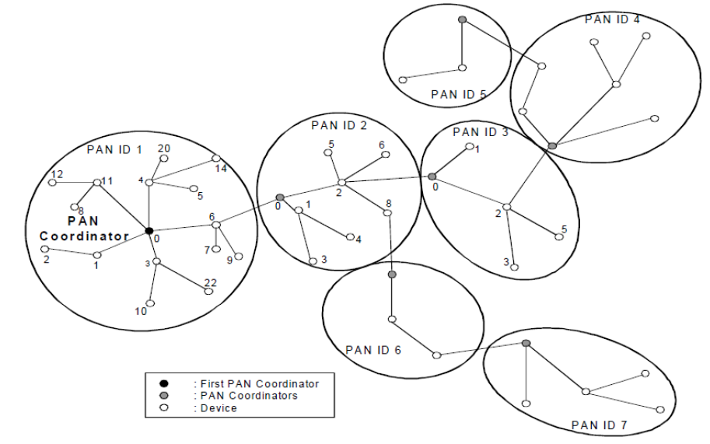
IEEE 802.15.4 Overview:
Cluster Tree as one form of a mesh

Slide 10
Mesh Standards
Presentation focus in on mesh-under, not over
Current mesh-under implementations run above MAC but below network layer
  This is done due to lack of mesh mechanisms in 802.15.4 standard

Slide 11
Mesh Standards:
IEEE 802.15.5 Overview
This recommended practice provides a standard way of doing mesh networking over IEEE Std 802.15.4-2006 within the IEEE standard body
Supported features for LR-WPAN include the following:
  unicast, multicast, and reliable broadcast mesh data forwarding
  synchronous and asynchronous power saving for mesh devices
  trace route function
  portability of end devices

Slide 12
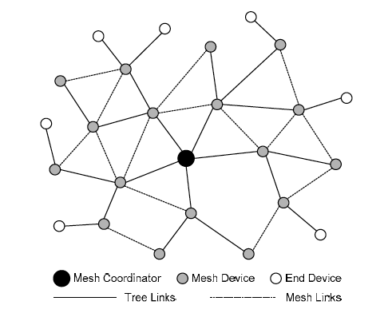
Mesh Standards:
IEEE 802.15.5 Overview

Slide 13
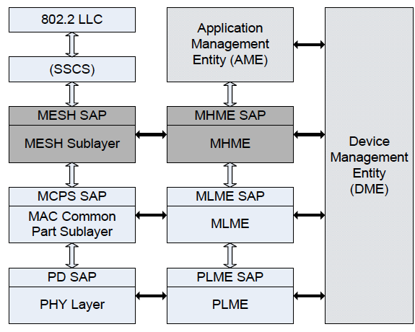
Mesh Standards:
IEEE 802.15.5 Overview

Slide 14
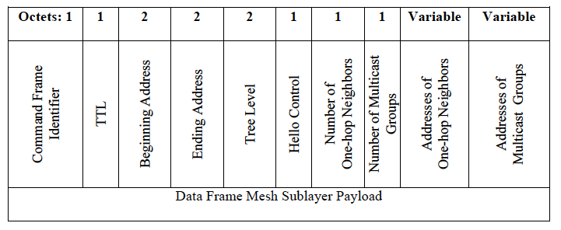
Mesh Standards:
IEEE 802.15.5 Overview
The hello command is used to exchange connectivity information among neighbors and to manage network and multicast group membership.

Slide 15
Mesh Standards:
IETF RPL Overview
RPL: distance vector IPv6 Routing Protocol for a Low power and Lossy Network
  RPL: RFC 6553
  LLN: RFC 6550
RPL constructs a Directed Acyclic Graph (DAG) that attempts to minimize path costs

Slide 16
Mesh Standards:
IETF RPL Overview
RPL defines an IPv6 option, called the RPL Option, to be carried within the IPv6 Hop-by-Hop header
  only for use between RPL routers participating in the same RPL Instance
  provides a mechanism to include routing information with each datagram that a router forwards
  This document also specifies the use of IPv6-in-IPv6 tunneling [RFC2473] when attaching a RPL option to a packet.

Slide 17
Mesh Standards:
Proprietary
Large number of companies that use IEEE 802.15.4 have developed and use their own mesh network
  Such as smart meter companies – e.g. Silver Spring Networks
  Some companies offer mesh networks for inclusion in products – e.g. Synapse
Current trend is for RFIC companies buying mesh network companies reminiscent of the initial trend of buying MAC companies
  ARM purchased Sensinode
  Silicon Labs purchased Ember
  Linear Technology purchased Dust Networks

Slide 18
Industrial Mesh Network Overview
Industrial applications (and some commercial applications) have critical requirements such as low latency, robustness in the harsh industrial RF environment, and determinism that are not adequately addressed by IEEE Std 802.15.4-2006
MAC behaviors added to IEEE 802.15.4 by the IEEE 802.15.4e amendment facilitate industrial applications such as addressed by IEC 62591 (WirelessHART), IEC 62734 (ISA100.11a), and IEC 62601 (WIA-PA), behaviors include:
  TSCH - Time Scheduled Channel Hopping
  DSME - Deterministic and synchronous multi-channel extension
  IE - Information Elements for such items as TSCH Synchronization payload IE, TSCH-Slotframe and Link payload IE,TSCH Timeslot payload IE, and Channel Hopping payload IE
  Secure Acknowledgment

Slide 19
Industrial Mesh Network Overview
TSCH Operation
  All devices in the same network synchronize slotframes
  All timeslots are contained within a slotframe cycle
  Timeslots repeat in time: the slotframe period
  Device-to-device communication within a timeslot includes packet Tx/Rx & ACK Tx/Rx
  Each timeslot uses a different channel, i.e. channel hopping
Industrial Systems typically include a network manager and a system manager

Slide 20
IEC 62591 (Wireless HART) Overview
Command Summary
Core Command Requirements
Backward Compatibility Requirements
Host Conformance Classes
Codes used in Commands
Codes used in commands errors
Common Tables
Command Response Code
Common Practice Command
Block Data Transfer
Monitoring & Control
Notification by exception
Time & Condition based Publishing
Vibration Spectra
Radar-Level Waveforms
Universal Command
Discrete Applications
Device Identification
Process Data & Status
Device Health & Status
Device Revision Information
Pump & Motor control
On/Off Valves
Wireless Devices
Wireless Command
Specific requirements ensure interoperability
Access by all HART tools to all parameters
Only Network Manager can configure network
Network Management
Source and Graph Routing
End-End Security, PDU Encipherment
Continuous network optimization
Joining Process
Route packets across the mesh
Redundant Routes
End-End acknowledgements
Integrated support for Adapters
TDMA Data-Link Layer
2.4GHz DSSS O-QPSK Physical Layer
TDMA + Channel Hopping
Dedicated and Shared Slots
Unicast and Broadcast
Move the message One-Hop
Link-level Acknowledgments

Slide 21
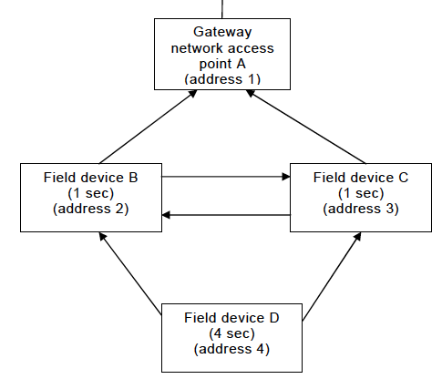
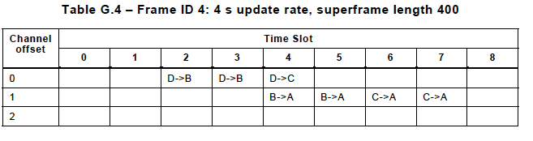
IEC 62591 (Wireless HART) Overview

Slide 22
Industrial Mesh Networks
IEC 62591 (Wireless HART) Overview
Routing function forms the lowest level of the Network layer
All devices are required to support both source and graph routing
  Graph is a collection of directed paths that connect network endpoints, i.e. it indicates the neighbors that can be used as the destination for the next hop.
  Each Graph_ID in the device should have multiple associated neighbors. In a properly configured network, all devices have at least two neighbor devices in the graph

Slide 23
Industrial Mesh Networks
IEC 62601 (WIA-PA) Overview
The IEC62601 system architecture and communication protocol for process automation based on IEEE802.15.4.
IEC62601 communication uses mesh networking to connect clusters of devices using star topologies

Slide 24
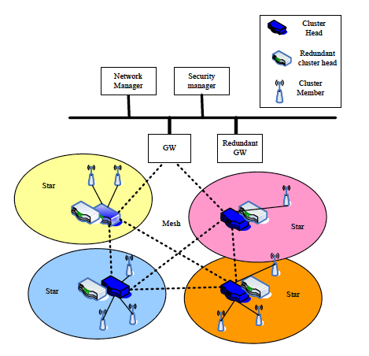
IEC62601 (WIA-PA) Overview
Architecture

Slide 25
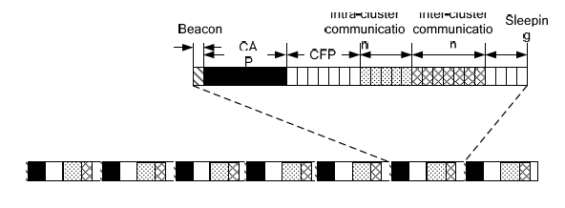
IEC62601 (WIA-PA) Overview
Due to real-time and reliable communication requirements, IEC6260 is based upon the beacon-enabled IEEE 802.15.4 superframe structure. DSME was added to IEEE 802.15.4-2006 to accommodate this standard within the MAC

Slide 26
Industrial Mesh Networks
IEC 62734 (ISA100.11a) Overview
Provides reliable and secure wireless operation for non-critical monitoring, alerting, supervisory control, open loop control, and closed loop control applications. This standard defines the protocol suite, system management, gateway, and security specifications for low-data-rate wireless connectivity with fixed, portable, and moving devices supporting very limited power consumption requirements. The application focus is to address the performance needs of applications such as monitoring and process control where latencies on the order of 100 ms can be tolerated, with optional behavior for shorter latency

Slide 27
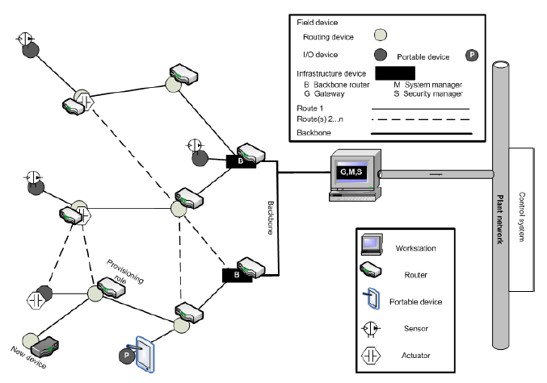
Industrial Mesh Networks
IEC 62734 (ISA100.11a) Architecture

Slide 28
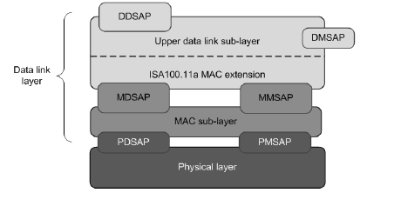
Industrial Mesh Networks
IEC 62734 (ISA100.11a) Overview
The mesh networking is done in the DLL above the IEEE 802.15.4-2006 MAC
This standard supports graph routing as well as source routing.

Slide 29
Industrial Mesh Networks
IEC 62734 (ISA100.11a) Overview
Communications between devices occur in a scheduled manner with each device assigned a timeslot for transmission to other devices.
A timeslot is a single, non-repeating period of time. The timeslot durations in IEC 62734 are configurable to a fixed value such as 10 ms or 12 ms.

Slide 30
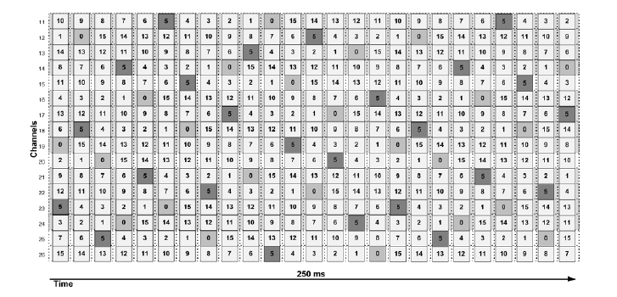
Industrial Mesh Networks
IEC 62734 (ISA100.11a) Overview
Timeslots occupy an RF channel that is changed for each time slot in a manner such as frequency hopping

Slide 31
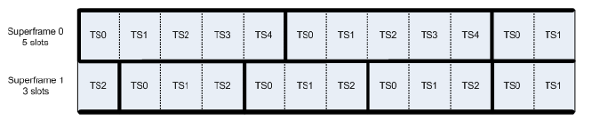
Industrial Mesh Networks
IEC 62734 (ISA100.11a) Overview
A superframe is a collection of timeslots repeating on a cyclic schedule. The number of timeslots in a given superframe determines how frequently each timeslot repeats, thus setting a communication cycle for devices that use the superframe.

Slide 32
Utility Networks
Some of the world's leading utilities, energy service providers, product manufacturers and technology companies are supporting the development of ZigBee Smart Energy
ZigBee Smart Energy SE includes several important features including dynamic pricing enhancements, tunneling of other protocols, prepayment features, over-the-air updates

Slide 33
Utility Networks:
ZigBee Overview
Mesh Network: consists of ZigBee Coordinator, Routers, End nodes, with trust centers,
Mesh network routing permits path formation from any source device to any destination device via a path formed by routing packets through the device’s neighbors:
  Radio Receivers on coordinator and routers must be on at all times
  Table routing employs a simplified version of Ad Hoc On Demand Distance Vector Routing (AODV). This is an Internet Engineering Task Force (IETF) Mobile Ad Hoc Networking (MANET) submission

Slide 34
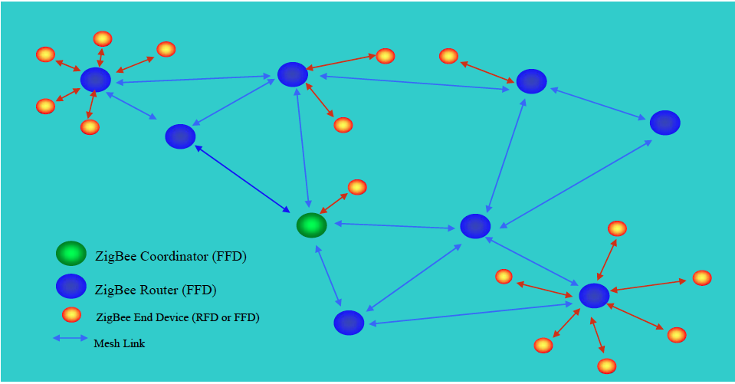
Utility Networks:
ZigBee Overview

Slide 35
Summary
Mesh Networks built on IEEE 802.15.4 exist in every application space
Mesh Networks today exist above the MAC due to the standard not including mesh routing but most use the MAC functions due to timing and other issues
Current trend is to drive some to all mesh functionality into the MAC

Slide 36
Summary
Excerpt from a white paper written by a Smart Grid supplier
Harmonized existing proprietary technologies, including historical utility vendor mesh technologies – such as Silver Spring’s RF mesh – creating an interoperability framework. Incorporating support for existing deployments is a crucial advantage for utilities whose devices have been operating for years before the formal standard was ratified. It also benefits the industry overall, since the standard incorporated mature, proven technology rather than inventing or hypothesizing unproven techniques.

Slide 37
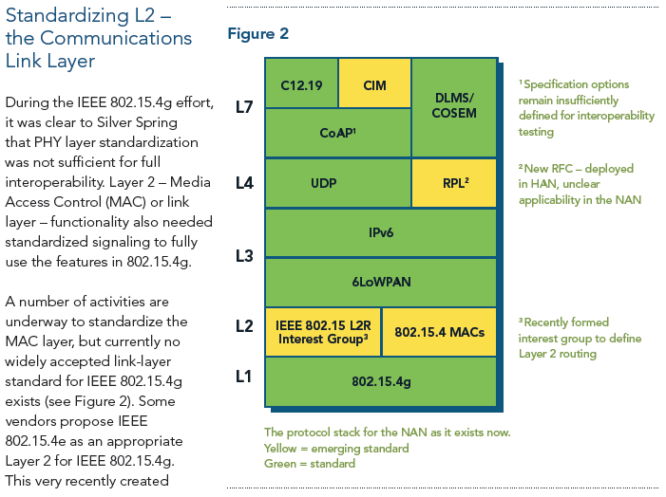
Summary
Excerpt from a white paper written by a Smart Grid supplier

