Slide 1
Project: IEEE P802.15 Working Group for Wireless Personal Area Networks (WPANs)
Submission Title: [Multi-hop multicast simulation result for PAC networks]
Date Submitted: [August 27th, 2013]
Source: [Jeongseok Yu, Woongsoo Na, Hyoungchul Bae, Taejin Kim, Yunseong Lee, Juho Lee, Zeynep Vatandas, Sungrae Cho, and Junbeom Hur]
Company [Chung-Ang University, Korea]
E-Mail:[jsyu@uclab.re.kr, wsna@uclab.re.kr, hcbae@uclab.re.kr, tjkim@uclab.re.kr, yslee@uclab.re.kr, jhlee@uclab.re.kr, zvatandas@uclab.re.kr, srcho@cau.ac.kr, jbhur@cau.ac.kr]
Re: [This is the original document]
Abstract: [This documents include simulation result of multi-hop multicast protocol for IEEE 802.15.8]
Purpose: [To provide materials for discussion in 802.15.8 TG]
Notice: This document has been prepared to assist the IEEE P802.15. It is offered as a basis for discussion and is not binding on the contributing individual(s) or organization(s). The material in this document is subject to change in form and content after further study. The contributor(s) reserve(s) the right to add, amend or withdraw material contained herein.
Release: The contributor acknowledges and accepts that this contribution becomes the property of IEEE and may be made publicly available by P802.15.

Slide 2
What’s difference in Rev. 1
Delete non-realistic scenario(scenario 1) with full-buffered 1-hop multicasting scenario.
Add realistic scenarios(scenario 3, 4, 5) with background traffic and multi-groups.

Slide 3
Performance Evaluation
We proposed reliable multi-hop multicast protocol for PAC. (DCN: 446)
Multicast group creation/management
Routing table management
Selective group ACK and pre ACK based reliable multicast protocol
To evaluate our multicast technique for PAC, we use the OPNET simulator under the one-hop scenario and multi-hop scenario.

Slide 4
MAC Parameters Used in Simulations
Parameter | Value
ACF Size | 32.75 bytes
MPDU | 512 bytes
MGNF Size | 48 bytes
Data Type | Multicast
Number of Groups | 1~8
Topology Size | Scenario 1,3,4 : 50m x 50m Scenario 2, 5: 500m x 500m
PHY | BPSK (1/2)
Number of Channels | 1
General Parameters | TGD Revision 7
# of Nodes | 1~512

Slide 5
MAC Parameters Used in Simulations
Parameter | Value
Data arrival Rate | Scenario 1,2,3: 2 Frames/sec per transmitter Scenario 4, 5: 5 Frames/sec per transmitter
Mobility | Static Mobility
Drop | 2-stage Drop
Data Rate | 10Mbps
Multi-hop | Supported
 | Multicast
RTS/CTS | Disable
NAV | Disable
ACK/NACK | Enable
CSMA/CA | Exponential increase of CW
Carrier Sensing | Enable
CWmin | 2⁴
CWmax | 2¹⁰
Retry Limit | 7

Slide 6
Performance Metrics
Areal sum goodput (Mbps/km²): Total number of packets received by all PDs during 1second, expressed as bits per second per square-kilometer.
Reliability: The number of successful frames divided by the number of frames transmitted excluding retransmissions
Jain’s fairness index: Jain’s index for number of packets received by PDs.

Slide 7
Simulation Scenarios
Scenario 1:
Multiple transmitters
Inter arrival rate: 2 frames/sec (Poisson)
All PDs are located in 1-hop range of transmitters.
Scenario 2:
Multiple transmitters
Inter arrival rate: 2 frames/sec (Poisson)
All PDs uniformly distributed in 500m x 500m (multi-hop operation)

Slide 8
Simulation Scenarios
Scenario 3:
Multiple transmitters
Inter arrival rate: 2 frames/sec (Poisson)
Inter arrival rate of background node: 5 frames/sec (Poisson)
All PDs are located in 1-hop range of transmitters.
Scenario 4:
Multiple transmitters
Inter arrival rate: 5 frames/sec (Poisson)
Number of groups: 2 ~ 8 groups
All PDs are located in 1-hop range of transmitters.
Scenario 5:
Multiple transmitters
Inter arrival rate: 5 frames/sec (Poisson)
Number of groups: 2 ~ 8 groups
All PDs uniformly distributed in 500m x 500m (multi-hop operation)

Slide 9
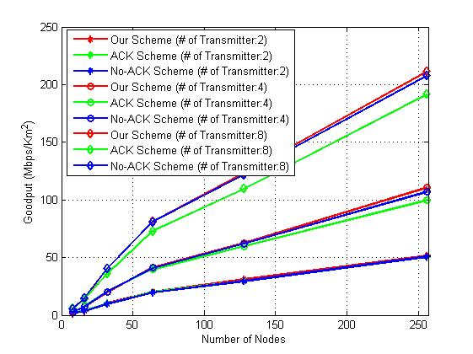
Areal Sum Goodput (Scenario 1)
Proposed scheme achieves the best
performance (reducing ACK transmission)
When a data frame collision occurs,
No ACK based scheme does not
retransmit
ACK frames are frequently collided
in ACK based scheme

Slide 10
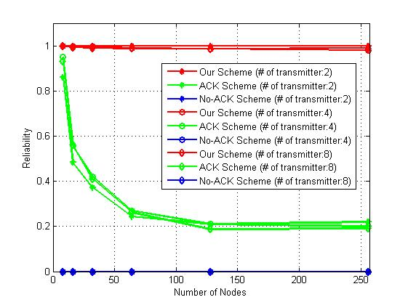
Reliability (Scenario 1)
Our scheme:
Best performance
ACK-based:
When a large number of
nodes located, reliability
get worse due to ACK
Collision
No ACK-based:
No reliability support

Slide 11
Fairness (Scenario 1)
Jain’s fairness index is close to 1
All PDs have equal opportunity to send multicast data. (All transmitters have same inter arrival rate : 2 frames/sec)

Slide 12
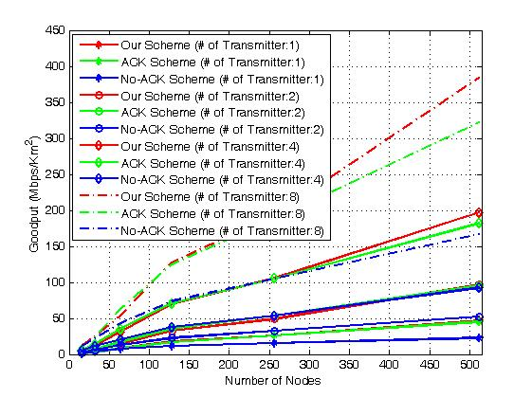
Areal Sum Goodput (Scenario 2)
Our protocol achieves the best
performance.
In multi-hop scenario, there are
forwarding nodes. If they do
not receive the frame successfully,
they do not forward frame
No-ACK based scheme’s
performance is the worst.

Slide 13
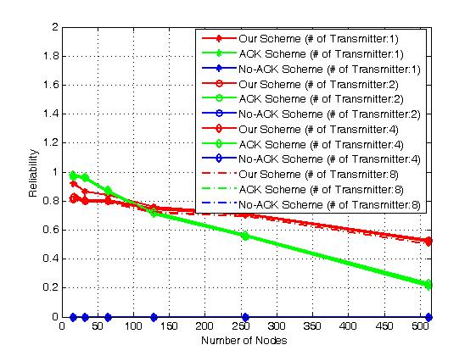
Reliability (Scenario 2)
Proposed scheme achieves
the best performance in
a large number of nodes.
When a small number of
nodes are located, the
efficiency of pre ACK
gets worse.
Due to pre ACK, proposed scheme’s
reliability is lower than ACK-based scheme

Slide 14
Fairness (Scenario 2)
Jain’s fairness index is close to 1
All PDs have equal opportunity to send multicast data. (All transmitters have same inter arrival rate : 2 frames/sec).

Slide 15
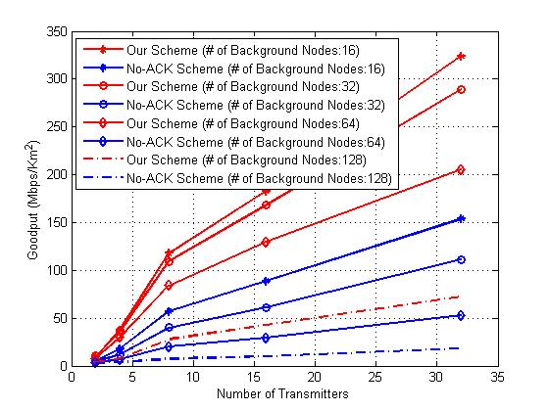
Areal Sum Goodput (Scenario 3)
Our protocol achieves the best
performance.
No-ACK based-Scheme is lower than ours.
This is because our protocol performs retransmission due to collision.

Slide 16
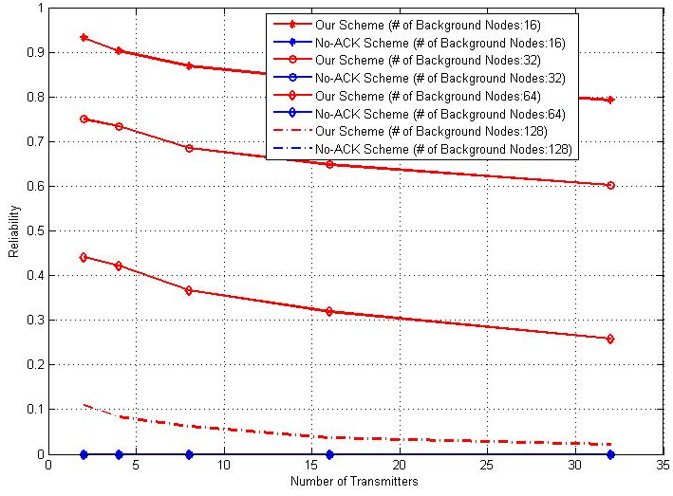
Reliability (Scenario 3)
Our protocol provides reliable transmission although collisions occur with background traffics.
However, if the background traffics are very heavy loaded (the background nodes = 128, background nodes generates 10Mbps traffics), ACK collision is occurred often.

Slide 17
Fairness (Scenario 3)
Jain’s fairness index is close to 1
All PDs have equal opportunity to send multicast data. (All transmitters have same inter arrival rate : 2 frames/sec).

Slide 18
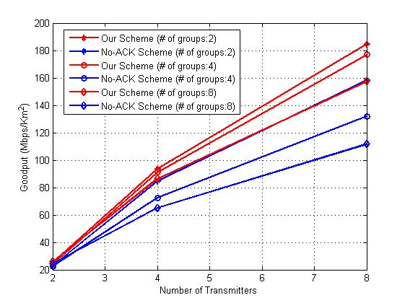
Areal Sum Goodput (Scenario 4)
The goodput of scenario 4 is measured by only 1 groups.
Our protocol achieves the best
performance.
No-ACK based scheme is lower than ours.
This is because our protocol performs retransmission due to collision.

Slide 19
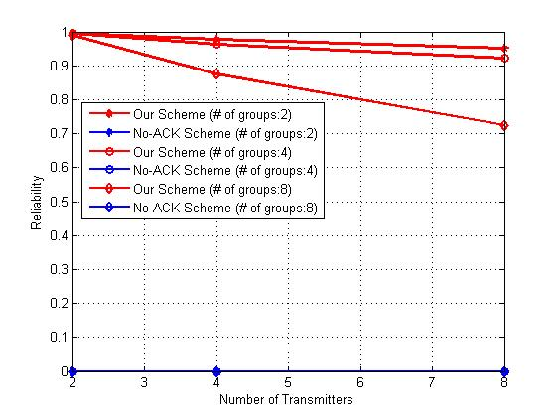
Reliability (Scenario 4)
Our protocol provides reliable transmission although collisions occur with other group’s traffic.

Slide 20
Fairness (Scenario 4)
Jain’s fairness index is close to 1
All PDs have equal opportunity to send multicast data. (All transmitters have same inter arrival rate : 5 frames/sec).

Slide 21
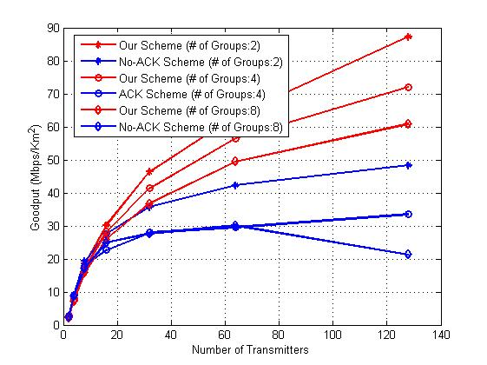
Areal Sum Goodput (Scenario 5)
The goodput of scenario 5 is measured by only 1 groups.
Our protocol achieves the best
performance.
No-ACK based scheme is lower than ours.
This is because our protocol performs retransmission due to collision.

Slide 22
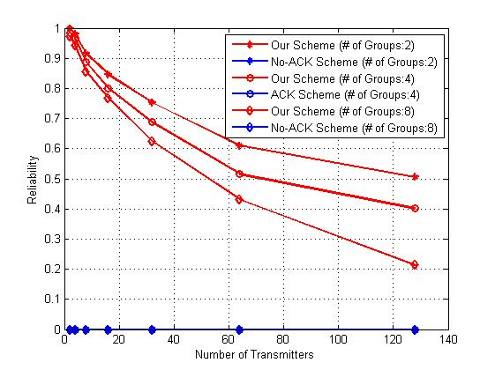
Reliability (Scenario 5)
Our protocol provides reliable transmission although collisions occur with other group’s traffic.
However, if the background traffics (in this scenario, other group’s traffic is treated as background traffics) are very heavy loaded (the background nodes = 128, background nodes generates 10Mbps traffics), ACK collision is occurred often.

Slide 23
Fairness (Scenario 5)
Jain’s fairness index is close to 1
All PDs have equal opportunity to send multicast data. (All transmitters have same inter arrival rate : 5 frames/sec).

Slide 24
Conclusion
The proposed multi-hop multicast protocol provides the best goodput and reliability compared with ACK-based (scenarios 1 and 2) and No ACK based (all scenarios) schemes.
When a small number of nodes are located, proposed scheme’s efficiency is lower due to pre ACK overhead (pre ACK is mandatory).
All of PDs have same opportunity to send multicast data. (i.e., the fairness index is close to 1)

