Slide 1
Project: IEEE P802.15 Working Group for Wireless Personal Area Networks (WPANs)
Submission Title: [Multi-hop multicast simulation result for PAC networks]
Date Submitted: [August 27th, 2013]
Source: [Jeongseok Yu, Woongsoo Na, Hyoungchul Bae, Taejin Kim, Yunseong Lee, Juho Lee, Zeynep Vatandas, Sungrae Cho, and Junbeom Hur]
Company [Chung-Ang University, Korea]
E-Mail:[jsyu@uclab.re.kr, wsna@uclab.re.kr, hcbae@uclab.re.kr, tjkim@uclab.re.kr, yslee@uclab.re.kr, jhlee@uclab.re.kr, zvatandas@uclab.re.kr, srcho@cau.ac.kr, jbhur@cau.ac.kr]
Re: [This is the original document]
Abstract: [This documents include simulation result of multi-hop multicast protocol for IEEE 802.15.8]
Purpose: [To provide materials for discussion in 802.15.8 TG]
Notice: This document has been prepared to assist the IEEE P802.15. It is offered as a basis for discussion and is not binding on the contributing individual(s) or organization(s). The material in this document is subject to change in form and content after further study. The contributor(s) reserve(s) the right to add, amend or withdraw material contained herein.
Release: The contributor acknowledges and accepts that this contribution becomes the property of IEEE and may be made publicly available by P802.15.

Slide 2
Performance Evaluation
We proposed reliable multi-hop multicast protocol for PAC. (DCN: 446)
Multicast group creation/management
Routing table management
Selective group ACK and pre ACK based reliable multicast protocol
To evaluate our multicast technique for PAC, we use the OPNET simulator under the one-hop scenario and multi-hop scenario.

Slide 3
MAC Parameters Used in Simulations
Parameter | Value
ACF Size | 32.75 bytes
MPDU | 512 bytes
MGNF Size | 48 bytes
Data Type | Multicast
Number of Groups | 1
Topology Size | Scenario 1,2 : 50m x 50m Scenario 3: 500m x 500m
PHY | BPSK (1/2)
Number of Channels | 1
General Parameters | TGD Revision 7
# of Nodes | 1~512

Slide 4
MAC Parameters Used in Simulations
Parameter | Value
Data arrival Rate | Scenario 1: Full Buffer Scenario 2, 3: 2 Frames/sec per transmitter
Mobility | Static Mobility
Drop | 2-stage Drop
Data Rate | 10Mbps
Multi-hop | Supported
 | Multicast
RTS/CTS | Disable
NAV | Disable
ACK/NACK | Enable
CSMA/CA | Exponential increase of CW
Carrier Sensing | Enable
CWmin | 2⁴
CWmax | 2¹⁰
Retry Limit | 7

Slide 5
Performance Metrics
Areal sum goodput (Mbps/km²): Total number of packets received by all PDs during 1second, expressed as bits per second per square-kilometer.
Reliability: The number of successful frames divided by the number of frames transmitted excluding retransmissions
Jain’s fairness index: Jain’s index for number of packets received by PDs.

Slide 6
Simulation Scenarios
Scenario 1:
1 transmitter (it generates multicast data)
Full-buffer
All PDs are located in 1-hop range of transmitter.
Scenario 2:
Multiple transmitter
Inter arrival rate: 2 frames/sec (Poisson)
All PDs are located in 1-hop range of transmitters.
Scenario 3:
Multiple transmitter
Inter arrival rate: 2 frames/sec (Poisson)
All PDs uniformly distributed in 500m x 500m (multi-hop operation)

Slide 7
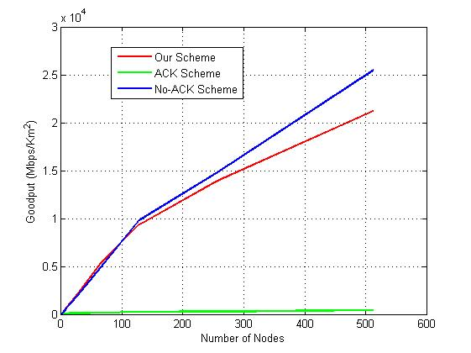
Area Sum Goodput (Scenario 1)
No-ACK based scheme
achieves the best
performance.
(There is no collision in
this scenario)
In the proposed scheme,
ACK frame collision is
reduced.
Due to frequent ACK collision
The performance is worst .

Slide 8
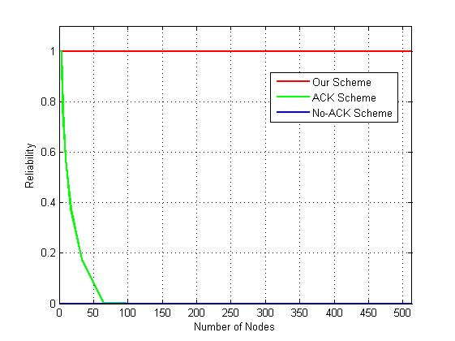
Reliability (Scenario 1)
In the proposed scheme,
ACK frame collision is
reduced. →
Reliability is improved.
Most of the ACK frames
are collided in ACK based scheme
→ Reliability get worse

Slide 9
Fairness (Scenario 1)
Jain’s fairness index is always 1
Since, the number of transmitters is 1.

Slide 10
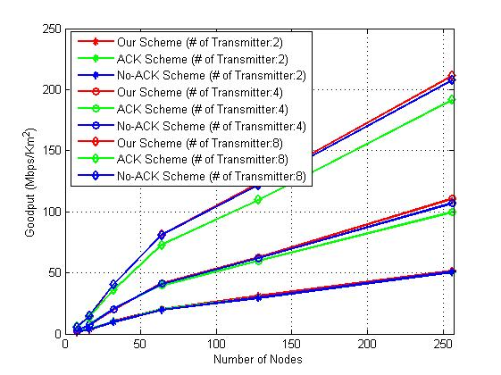
Area Sum Goodput (Scenario 2)
Proposed scheme achieve the best
performance (reduce ACK transmission)
When a data frame collision occurs,
No ACK based scheme does not
retransmit
ACK frames are frequently collided
in ACK based scheme

Slide 11
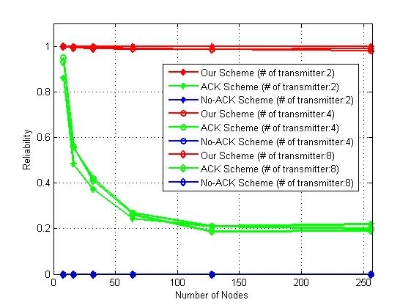
Reliability (Scenario 2)
Our scheme:
Best performance
ACK-based:
When a large number of
nodes located, reliability
get worse due to ACK
Collision
No ACK-based:
No reliability support

Slide 12
Fairness (Scenario 2)
Jain’s fairness index is close to 1
All PDs have equal opportunity to send multicast data. (All transmitters have same inter arrival rate : 2 frames/sec)

Slide 13
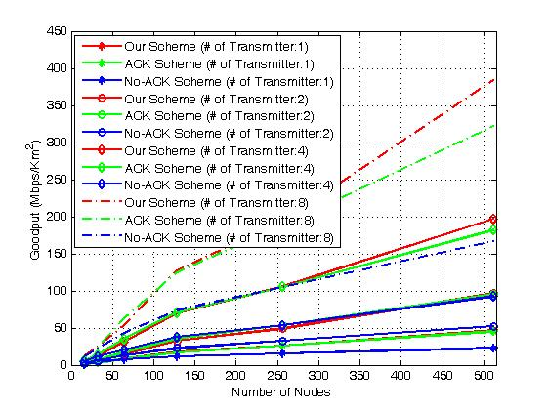
Area Sum Goodput (Scenario 3)
Our protocol achieve the best
performance.
In multi-hop scenario, there are
forwarding nodes. If they do
not receive the frame successfully,
they do not forward frame
No-ACK based scheme’s
performance are lowest

Slide 14
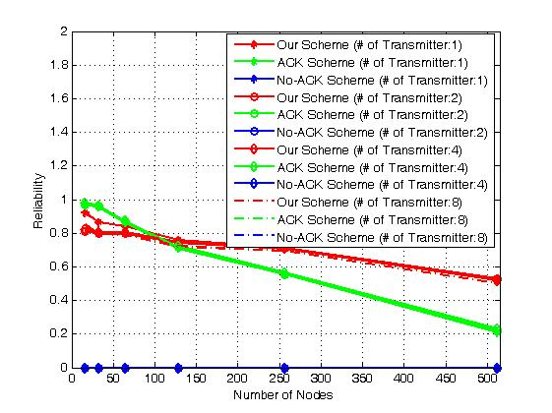
Reliability (Scenario 3)
Proposed scheme achieve
the best performance in
a large number of nodes.
When a small number of
nodes are located, the
efficiency of pre ACK
is worse.
Due to pre ACK, proposed scheme’s
reliability is lower than ACK-based scheme

Slide 15
Fairness (Scenario 3)
Jain’s fairness index is close to 1
All PDs have equal opportunity to send multicast data. (All transmitters have same inter arrival rate : 2 frames/sec).

Slide 16
Conclusion
The proposed multi-hop multicast protocol provides the best goodput and reliability compared with ACK-based and No ACK based schemes.
When a small number of nodes are located, proposed scheme’s efficiency is lower due to pre ACK overhead.
All of PDs have same opportunity to send multicast data. (i.e., the fairness index is close to 1)

