Slide 1
Project: IEEE P802.15 Working Group for Wireless Personal Area Networks (WPANs)
Submission Title: Application Scenarios
Date Submitted: August 2013
Source: Frederik Beer¹, Jörg Robert¹;
¹Friedrich-Alexander-Universität Erlangen-Nürnberg, Information Technology
Phone: +4991318525123, Fax: +4991318525102
E-Mail: frederik.beer@fau.de
Abstract: Some application scenarios for an ULP standard
Purpose:
Notice: This document has been prepared to assist the IEEE P802.15. It is offered as a basis for discussion and is not binding on the contributing individual(s) or organization(s). The material in this document is subject to change in form and content after further study. The contributor(s) reserve(s) the right to add, amend or withdraw material contained herein.
Release: The contributor acknowledges and accepts that this contribution becomes the property of IEEE and may be made publicly available by P802.15.
Frederik Beer, Jörg Robert

Slide 2
Application Scenarios

Slide 3
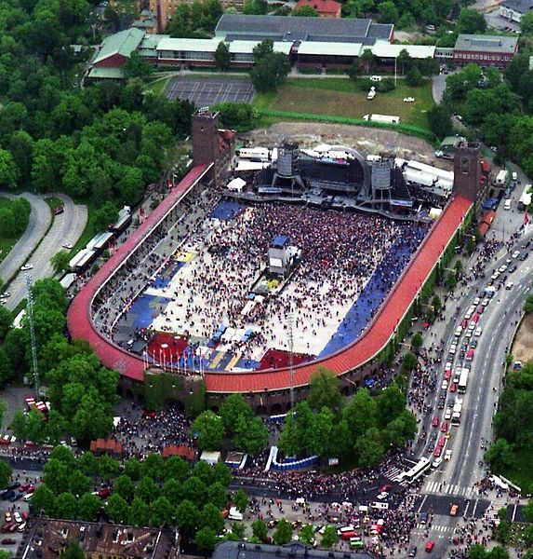
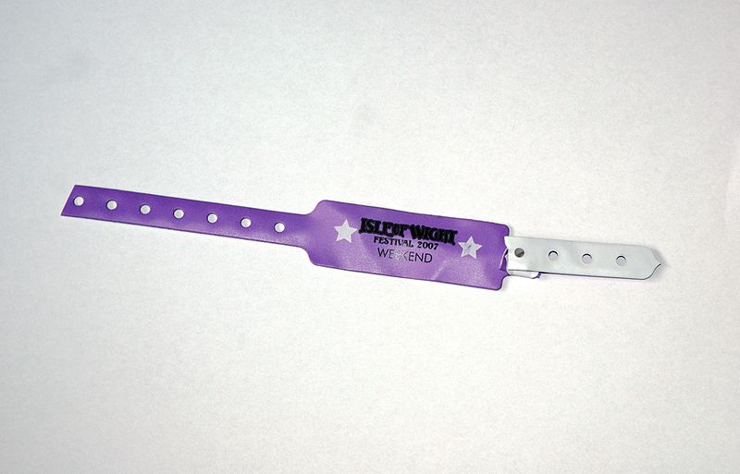
Crowd Management (1)

Slide 4
Crowd Management (2)
Enhance festival wristbands with very low cost and low energy transmitters
  Can be used for simplified access control to the event area
  Instant information about the number of attendees in the event area
  Detection of certain motion patterns for early detection of a mass panic
Key technical features:
  Very limited energy source, should last a few days to a week
  Very large amount of transmitters (up to 100,000)
  Positioning features necessary

Slide 5

Smart Labels (1)

Slide 6
Smart Labels (2)
Price management
Permanent inventory
Surveillance of cold chain e.g. for meat products
Key technical features:
  Very large amount of transmitters (up to 100,000)
  Very low cost transmitters

Slide 7





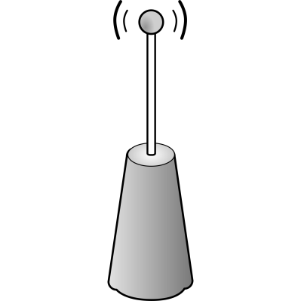


Animal Tracking (1)

Slide 8
Animal Tracking (2)
Tracking of small animals for biological research or private use
Transmission of ID and possibly health status
Location of animals (e.g. lost cats)
Key technical features:
  Very small and light (<5g) transmitter needed, thus only small energy sources feasible, still long lifetime needed
  Long distances possible (up to 1 km)
  Positioning features necessary

Slide 9
Conclusion
Range: Typically well below 1 km
Data Rate: Necessary data rate per transmitter actually quite low, however higher data rates might be necessary to limit channel occupation
Transmit Power: Extremely limited transmit power available in some cases
Chan availability: Some scenarios do not require co-located networks
Interoperability: Maybe usage of some hopping techniques for certain environments; dynamic parameter changes not necessary
Operational bands: Due to antenna size very low frequencies are not feasible, 433 MHz or 868/915 MHz are preferred

