Slide 1
doc.: IEEE 15-13-0457-00-0led
Project: IEEE 802.15 LED(Light Emitting Diode) Interest Group (IG-LED)
Submission Title: [Location information transmission solutions with LED lights]
Date Submitted: [17th July, 2013]
Source: [Jaesang Cha*, Seonhee Lee*, Yeong Min Jang, Kye San Lee, Jin Young Kim, Sangkook Han, Byunghoon Lee, Jaekwon Shin, JongHo Baek and SangWoon Lee]
[Seoul National Univ. of Science & Technology*, Kookmin Univ., Kyunghee Univ., Kwangwoon Univ., Yonsei Univ., CUE&WORKS Inc, Fivetek Co., Ltd, Seoul Women’s Univ. and Namseoul Univ.]
Address : [Seoul National University of Science & Technology, Seoul, Korea]
Voice: [82-2-970-6431], FAX: [82-2-970-6123], E-Mail:[chajs@seoultech.ac.kr]
Re: []
Abstract: [LED-based hybrid/switching techniques are introduced in the presentation.]
Purpose: [Contribution to IEEE 802.15 IG-LED]
Notice: This document has been prepared to assist the IEEE 802.15. It is offered as a basis for discussion and is not binding on the contributing individual(s) or organization(s). The material in this document is subject to change in form and content after further study. The contributor(s) reserve(s) the right to add, amend or withdraw material contained herein.
Release: The contributor acknowledges and accepts that this contribution becomes the property of IEEE and may be made publicly available by IEEE 802.15
Slide 1
Notes:
doc.: IEEE 802.15-09-0117-00-0007
<month year>

Slide 2
Contents
LED-based Location information transmission
using Data hybrid technology
LED-based location information transmission
for QR Code & Smart device

Slide 3
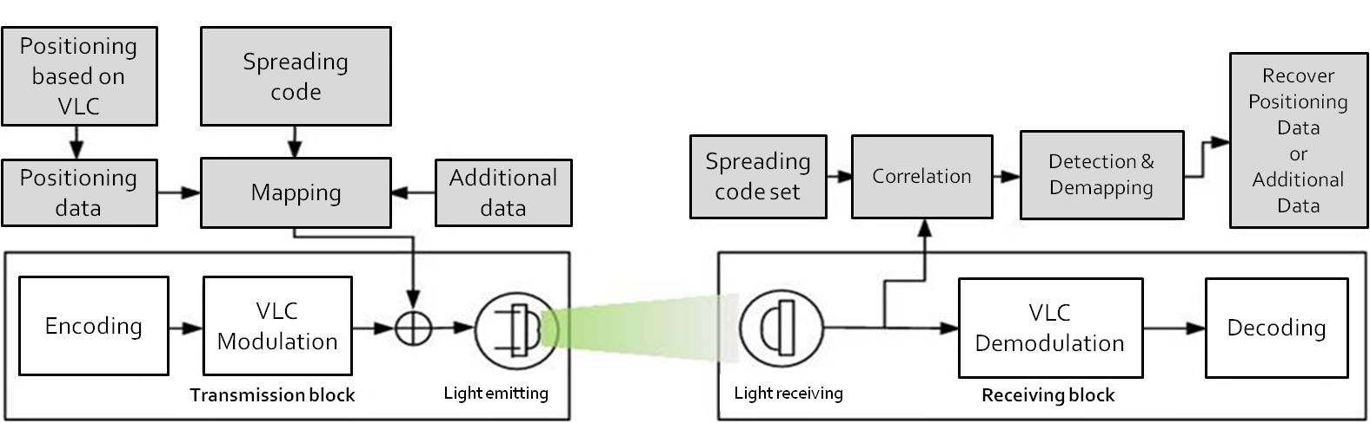
LED-based location information transmission using Data hybrid technology
Modulation based on OOK (On-Off Keying)
Additional data are dispersed by direct spread spectrum(SS).
Additional data(location data) has been demodulated using correlation peak value and detection tools.
Additional positioning data can be transmitted by Data hybrid technology
by SS watermarking and addition solutions

Slide 4
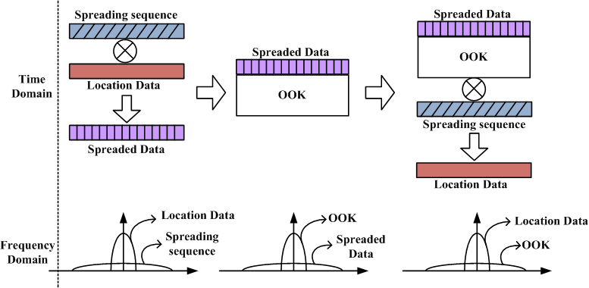
LED-based location information transmission using Data hybrid technology
Tx: (Low power) SS signals with location information are added to
original payload VLC signal(e.g. : OOK)
Rx : Location data can be detectected and recovered by Despreading of
In put signal including (SS watermarking signal + original payload signal)

Slide 5
LED-based location information transmission using Data hybrid technology ~ simulation examples
By using BER & DER simulations, we certified the availability of proposed schemes,
where
- BER : Performance of original payload data
- DER : : Detection Performance of watermarking SS signal with location information

Slide 6
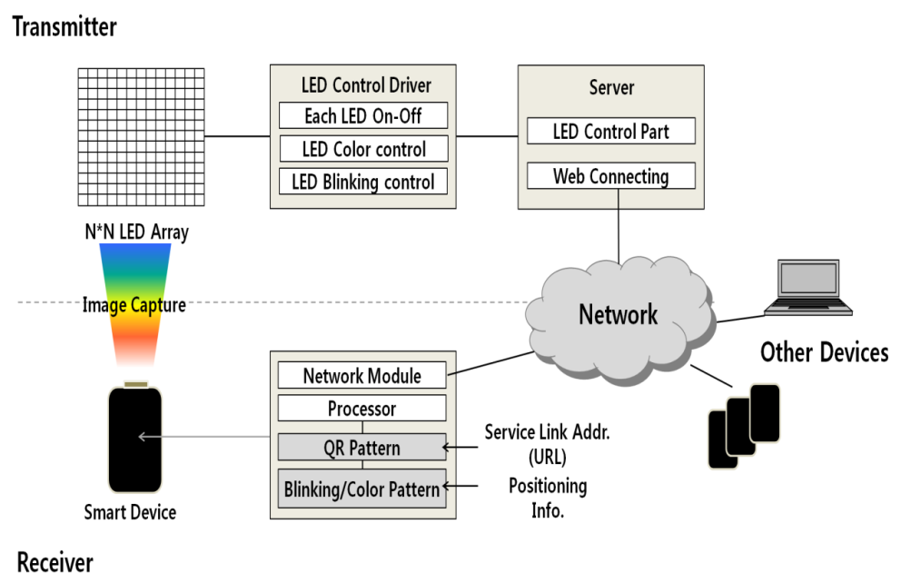
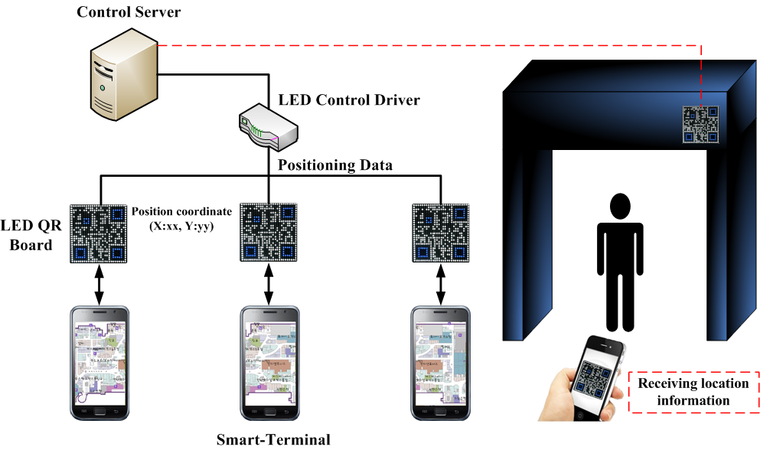
LED-based location information transmission for QR Code & Smart device
All location information are embedded in QR-code
QR-code could be represented by LED-QR board optionally
Smart devices take location information by simple QR Scanning
Location information transmission solutions is implemented using
LED flash lights of Smart device

Slide 7
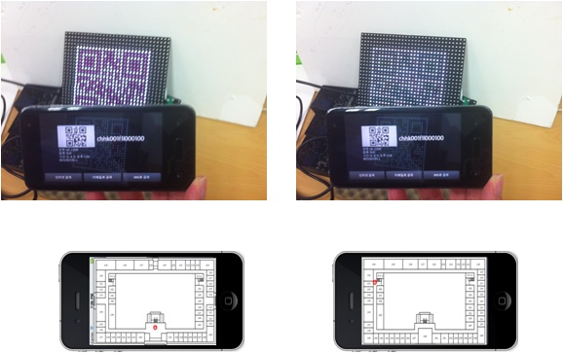
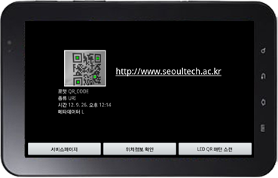
LED-based location information transmission for QR Code & Smart Phone ~scanning
QR pattern express using LED arrangement
Check location data using smart device

Slide 8
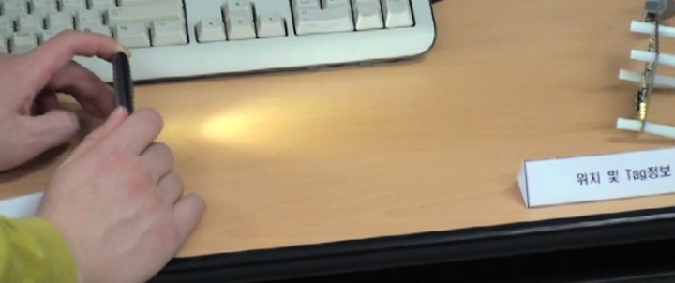
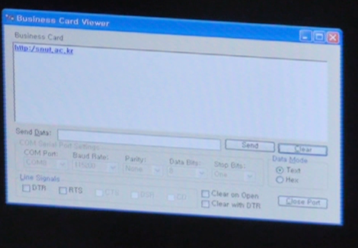
LED-based location information transmission for QR Code & Smart device ~ by LED flash light
Recovered Location information
LED flash Light Smart phone
Location Data recovery
Tx : Location information are transmitted by LED flash light of Smart Devices
  Rx : Location data is demodulated and displayed

Slide 9
Conclusion
We are considering various LED-based location information transmission solutions
In this submission, we introduced some solution & applications such as
Data hybrid technology and LED flash light transmission technology of Smart device

