Slide 1
Project: IEEE P802.15 Working Group for Wireless Personal Area Networks (WPANs)
Submission Title: [Technical Proposal for IEEE 802.15.8]
Date Submitted: [May 6th, 2013]
Source: [Jeongseok Yu, Woongsoo Na, Hyoungchul Bae, Taejin Kim, Yunseong Lee, Juho Lee, Zeynep Vatandas, Sungrae Cho, and Junbeom Hur]
Company [Chung-Ang University, Korea]
E-Mail:[jsyu@uclab.re.kr, wsna@uclab.re.kr, hcbae@uclab.re.kr, tjkim@uclab.re.kr, yslee@uclab.re.kr, jhlee@uclab.re.kr, zvatandas@uclab.re.kr, srcho@cau.ac.kr, jbhur@cau.ac.kr]
Re: [This is the original document]
Abstract: [Technical Proposal for IEEE 802.15.8]
Purpose: []
Notice: This document has been prepared to assist the IEEE P802.15. It is offered as a basis for discussion and is not binding on the contributing individual(s) or organization(s). The material in this document is subject to change in form and content after further study. The contributor(s) reserve(s) the right to add, amend or withdraw material contained herein.
Release: The contributor acknowledges and accepts that this contribution becomes the property of IEEE and may be made publicly available by P802.15.

Slide 2
Technical Proposal for IEEE 802.15.8
Jeongseok Yu, Woongsoo Na, Hyoungchul Bae, Taejin Kim, Yunseong Lee, Juho Lee, Zeynep Vatandas, Sungrae Cho, and Junbeom Hur
Chung-Ang University

Slide 3
Contributions of the Proposal
Multicast/Broadcast Protocol for PAC
Multicast Group Management Technique
Reliable Multicast Protocol
Directional Antenna based Multicast Protocol
Multi-hop Operation for PAC
Multi-hop Unicast Transmission without Heavy Loaded Routing Table.
Security Mechanism for PAC
Infrastructure based Security Mechanism
Infrastructureless based Security Mechanism

Slide 4
Why Multi-hop/Multicast/Security Mechanism?
FlashLinQ
PAC
GPS/Base-station is required for synchronization.
It does not support Multi-hop
GPS /Base-station is not necessary for synchronization
It supports Multi-hop
Bluetooth
1-to-1 Data Communication
Communication Range is limited 10m
It does not support Multi-hop
Multicast/broadcast technique can be available
1:1, 1:N, N:N communication.
Multi-hop transmission can extend transmission range
Wi-Fi
Direct
Group Owner (AP) and Client (Terminal) make
a group.
Multiple clients is associated per one group
owner (1:N).
1-to-1 data communication (Group owner and
client)
The data communication between clients is
impossible.
Communication Range is limited 100m.
It does not support Multi-hop.
Fully Distributed (There is no role for AP or terminal)
Data communication among PDs is available
Low energy consumption
Multi-hop transmission can extend transmission range
Compare with FlashLinQ, Bluetooth, and Wi-Fi Direct, PAC has a several merits including multi-hop support.

Slide 5
In the Pre-Proposal
We proposed
Multicast Group Management (Finding/Joining/Leaving Multicast Group)
Multi-hop Transmission Technique (Routing Table Management/Multi-hop Unicast Transmission)
Reliable Multicast Data Transmission (Implicit ACK based Transmission)
Due to time constraints, we briefly summarize our pre proposal and new features for this presentation in more detail.
Full version final proposal refer to DCN 387 r1.

Slide 6
Summary of the Pre-proposal (1/3)
Finding/Joining/Leaving Multicast Group
By using ACF/ARCF, each PD can find the group and join the multicast group.
After join the group, PD creates the device group ID for multicast.
If a PD wants to leave the group, it updates its routing table and multicasts MGNF to its group members.
Multicast Group Notification Frame
It used for 1) Limiting duplicate ARCF, 2) Management of routing table, 3) Notifying leaving multicast group, 4) Device group ID creation, 5) Request for unicast routing, 6) Reply for unicast routing, 7) Mobility support, 8) Local repair, and 9) Notification of removed routing entry
In order to limit a larger number of MGNF transmission, United Multicast Address is used which unifies multiple different groups into a single one.

Slide 7
Summary of the Pre-proposal (2/3)
Routing Table Management
Whenever a PD receives ACF or ARCF, a routing entry is created in its routing table.
Also, routing table is updated by receiving MGNF.
It is used for multicast data transmission and multi-hop data transmission.
If the link is broken, a PD finds another route by using ACF/ARCF mechanism.
Multicast Data Transmission
If a PD received multicast data, it checks routing table and determines forward or not the data.
If there is entry to forward, it forward the data frame.
Unicast Data Transmission
If a PD has routing information of destination in its routing table, it can transmits to next hop.
Otherwise, it request a destination path using MGNF (type = 4).

Slide 8
Summary of the Pre-proposal (3/3)
Reliable Multicast
We proposed bitmap based implicit ACK mechanism for reliable multicast.
In order to satisfy the full reliability, each PD has a bitmap which is included in a routing table.
The bitmap indicates whether a PD received an ACK from a particular one-hop PD.
Also, to avoid ACK implosion, transmitters send the ACK at random time.
Directional Antenna Support
We use an additional routing table field which describes its beam number forwarding to destination in order to transmit frame.

Slide 9
New Features for Multi-hop Multicasting
Distributive routing table for reducing # of routing entries
Classification of MGNF types into two (response with ACK and no response with ACK) to limit the # of control messages
Selective Group ACK technique for reliable multicast
Pre ACK technique for reducing # of multicast data forwardings

Slide 10
Reducing # of Routing Entries (1/6)
When a PD is full of routing entries due to memory constraints, it chooses to remove an entry with the lowest hop count from it in its routing table.
Then, it transmits a MGNF (Notification type : 8) to the chosen PD (the removed entry) and sets timer.
When the chosen PD receives the MGNF (Notification type : 8), it deletes the entry of the sender PD from its routing table, and tries to connect another member of the multicast group by sending an ACF.
If a PD receives the ACF, it replies with ARCF and creates a new link.

Slide 11
Reducing # of Routing Entries (2/6)
When S wants to break the link to B (due to routing entry full), S transmits MGNF (Notification type : 8) to B and sets a timer.
A
B
S
D
S’s Routing Table
A’s Routing Table
B’s Routing Table
C
Destination address | …
A | …
B
C
D
Destination address | …
S | …
Destination address | …
S | …
: MGNF (Type 8)
: ACF
: ARCF

Slide 12
Reducing # of Routing Entries (3/6)
When B receives the MGNF (Notification type : 8), it breaks the link.
A
B
S
D
S’s Routing Table
A’s Routing Table
B’s Routing Table
C
Destination address | …
A | …
B
C
D
Destination address | …
S | …
Destination address | …
S | …
: MGNF (Type 8)
: ACF
: ARCF

Slide 13
Reducing # of Routing Entries (4/6)
Then, B transmits ACF.
S ignores B’s ACF because of PD S’s timer is not expired.
A
B
S
D
S’s Routing Table
A’s Routing Table
B’s Routing Table
C
Destination address | …
A | …
C
D
Destination address | …
S | …
Destination address | …
: MGNF (Type 8)
: ACF
: ARCF

Slide 14
Reducing # of Routing Entries (5/6)
A receives the ACF and transmits MGNF (type 0) and ARCF to B.
A
B
S
D
S’s Routing Table
A’s Routing Table
B’s Routing Table
C
Destination address | …
A | …
C
D
Destination address | …
S | …
Destination address | …
: MGNF (Type 8)
: ACF
: ARCF

Slide 15
Reducing # of Routing Entries (6/6)
Then, A and B create a new link.
A
B
S
D
S’s Routing Table
A’s Routing Table
B’s Routing Table
C
Destination address | …
A | …
C
D
Destination address | …
S | …
B
Destination address | …
A | …
: MGNF (Type 8)
: ACF
: ARCF

Slide 16
Classification of MGNF types
Duplicate response to the MGNF may cause traffic implosion, so we divided nodes into two types
ACK-enabled MGNF transmission (Notification type = 2, 3, 4, 5, 8)
A source node transmitting a MGNF has to receive ACK frame.
ACK-disabled MGNF transmission (Notification type = 0, 1, 6, 7)
ACK frame is not required since MGNF with type 0, 1, 6, 7 does not need to be reliably transmitted.
Without those, multicast group management can still work OK.

Slide 17
Selective Group ACK technique for reliable multicast (1/12)
In the pre-proposal
We proposed bitmap based implicit ACK mechanism for reliable multicast.
If we use the implicit ACK mechanism, the transmitted frame becomes larger due to bitmap size (considering significant # of one-hop neighbours).
We propose a new reliable broadcast technique in order to resolve the above scenario.
In the final proposal
We propose a selective group ACK technique for reliable multicast to know whether the nodes receive multicast data frame fully or not.
When sender PD sends a multicast data frame, it chooses the groups to acknowledge the frame in the multicast group.

Slide 18
Selective Group ACK technique for reliable multicast (2/12)
To avoid the feedback implosion problem, a sender forms groups of nodes in its routing table.
Then, the sender transmits multicast data frame including the information of the group which sends their Block ACK.
When the nodes in the group receive all multicast data frames successfully, they transmit Block ACK to the sender by notifying that they received all frames successfully.
If they did not receive any data frame or they did not receive it, they do not transmit Block ACK to the sender.

Slide 19
Selective Group ACK technique for reliable multicast (3/12)
Sender S chooses the groups.
In this example, the number of nodes in a group is 3.
A,B,C are in group1, D,E,F are in group2 and G,H,I are in group3.
S transmits multicast data frame F1 notifying that group1 is responsible for the acknowledgement.
I
A
B
H
S
C
G
D
F
E
: Multicast Data Frame
: Timer Based Block ACK
*The order of frames to be transmitted is F1, F2, and F3.

Slide 20
Selective Group ACK technique for reliable multicast (4/12)
A, B, and C transmit Block ACK (actually a single ACK in this case) to S for F1 because these nodes are in group 1.
I
A
B
H
S
C
G
D
F
E
: Multicast Data Frame
: Timer Based Block ACK

Slide 21
Selective Group ACK technique for reliable multicast (5/12)
S transmits multicast data frame F2 notifying group 2 needs to send the Block ACK.
I
A
B
H
S
C
G
D
F
E
: Multicast Data Frame
: Timer Based Block ACK

Slide 22
Selective Group ACK technique for reliable multicast (6/12)
D, E, and F transmit Block ACK for F1, F2 (Frame1, Frame2) to S.
I
A
B
H
S
C
G
D
F
E
: Multicast Data Frame
: Timer Based Block ACK

Slide 23
Selective Group ACK technique for reliable multicast (7/12)
S transmits multicast data frame F3 notifying group 3 needs to send the Block ACK.
I
A
B
H
S
C
G
D
F
E
: Multicast Data Frame
: Timer Based Block ACK

Slide 24
Selective Group ACK technique for reliable multicast (8/12)
G, H, and I transmit Block ACK for F1, F2, F3 to S.
I
A
B
H
S
C
G
D
F
E
: Multicast Data Frame
: Timer Based Block ACK

Slide 25
Selective Group ACK technique for reliable multicast (9/12)
Since all groups are acknowledged, S checks any unacknowledged groups and frames.
S did not receive ACK for F2 and F3 from A,B, and C and ACK for F3 from D, E, and F.
If the timer is expired, S sends Request ACK to the groups in order to check the reliability for group 1 and 2.
I
A
B
H
S
C
G
D
F
E
: Multicast Data Frame
: Timer Based Block ACK
: Request Block ACK

Slide 26
Selective Group ACK technique for reliable multicast (10/12)
If A, B, and C receive the Request ACK, they transmit the Block ACK (for frames F2 and F3) to S.
I
A
B
H
S
C
G
D
F
E
: Multicast Data Frame
: Timer Based Block ACK
: Request Block ACK

Slide 27
Selective Group ACK technique for reliable multicast (11/12)
Similarly sender S transmit the Request Block ACK to PD F, E, and D.
I
A
B
H
S
C
G
D
F
E
: Multicast Data Frame
: Timer Based Block ACK
: Request Block ACK

Slide 28
Selective Group ACK technique for reliable multicast (12/12)
If D, E, and F receive the Request ACK, they transmit the Block ACK (for frame F3) to S.
I
A
B
H
S
C
G
D
F
E
: Multicast Data Frame
: Timer Based Block ACK
: Request Block ACK

Slide 29
Flow Chart – Block ACK Mechanism
Block ACK Group1
Block ACK Group2
PD 1
PD 2
PD 3
PD 4
PD 5
Send Multicast Data #1
Send ACK
Send ACK
Send Multicast Data #2
Send ACK
Send ACK
Retransmit Multicast Data #1
Send ACK

Slide 30
Pre-ACK (1/6)
In order to satisfy full reliability, each PD has to receive ACK frame from all nodes in its routing table.
Suppose S has entry for A, A has entry for B, B has entry for C, C has entry for D, and D has entry for E.
Although A, B, C, D, and E is in one-hop range from S, total transmissions is 5
It will take a long time and cause
traffic congestion.
A
B
S
E
C
D
: Multicast Data Frame
: ACK

Slide 31
Pre-ACK (2/6)
Pre-ACK
If a PD overhearing a data sent by sender does not have the sender in its routing table, the PD sends pre-ACK to the PDs in the routing table.
Pre-ACK includes
Originator Address of Data
Sequence Number of Data
Address of Receiver
If a PD receives pre-ACK, it creates an ACK table.
If all receivers in the ACK table are acknowledged, the PD doesn’t forward the data.

Slide 32
Pre-ACK (3/6)
Assume that the topology.
S multicasts data frame.
It needs ACK of A for reliability.
And B, C, D overhear the data then they create an ACK table for overheard data and set timer for forwarding.
S | O
B | X
A | X
C | X
A
B
A | X
D | X
S
E
C
B | X
D | X
C | X
E | X
D
: Multicast Data Frame

Slide 33
Pre-ACK (4/6)
A sends ACK to S because it has routing entry of S.
B, C, D send pre-ACK to PDs in its routing table.
When a PD receives pre- ACK, it checks the sender in ACK table.
If all PDs of routing
entry successfully receive
the frame, it does not forward a frame.
S | O
B | O
A | O
C | X
A
B
A | O
D | O
S
E
C
B | O
D | O
C | O
E | X
D
: ACK
: Pre-ACK

Slide 34
Pre-ACK (5/6)
If some entries are left to forward frame,
it forwards the frame in order to satisfy reliability
(Retransmission Concept)
In this example, B and E forward the data because their ACK table are not fully checked.
S | O
B | O
A | O
C | X
A
B
A | O
D | O
S
E
C
B | O
D | O
C | O
E | X
D
: Multicast Data Frame

Slide 35
Pre-ACK (6/6)
When a PD receives the forwarded data, it sends ACK to the sender.
If whole ACK table is checked, reliable multicast of the data is finished.
S | O
B | O
A | O
C | O
A
B
A | O
D | O
S
E
C
B | O
D | O
C | O
E | O
D
: ACK

Slide 36
Performance Evaluation
To evaluate our multicast technique for PAC, we use the OPNET simulator under the one-hop scenario and multi-hop scenario.
Each scenario includes background unicast data transmissions for realistic scenario.
With i7 quad core CPU and 32G memory, each simulation scenario took more than about 10-hour time.

Slide 37
MAC Parameters Used in Simulations
Parameter | Value
ACF Frame Size | 32.75 bytes
MPDU | 512 bytes
MGNF Size | 48.5 bytes
Data Type | Multicast/Unicast
Number of Groups | 1~5
Topology Size | 500m x 500m, depends on max hops
PHY | BPSK (1/2)
Simulation Time | 100 seconds
Number of Channels | 1
Tx Power | DCN-0568
Communication Range | DCN-0568
# of Nodes | 100

Slide 38
MAC Parameters Used in Simulations
Parameter | Value
Data arrival Rate | Full Buffer, 512Bytes/sec, 256Bytes/sec, 1024Bytes/sec, 5120Bytes/sec
Mobility | Static Mobility
Drop | 2-stage Drop
Data Rate | 10Mbps
Multi-hop | Supported
 | Multicast | Unicast
RTS/CTS | Disable | Enable
NAV | Disable | Enable
ACK/NACK | Enable | Enable
CSMA/CA | Exponential increase of CW | Exponential increase of CW
Carrier Sensing | Enable | Enable
CWmin | 2⁴ | 2⁴
CWmax | 2¹⁰ | 2¹⁰
Retry Limit | 7 | 7

Slide 39
Performance Metric
Areal sum goodput (bps/km²): Total number of packets received by all PDs during 1second, expressed as bits per second per square-meter.
Jain’s fairness index: Jain’s index for number of packets received by PDs.
Average group joining time: The time duration between ACF transmission time and ARCF reception time for one PD.

Slide 40
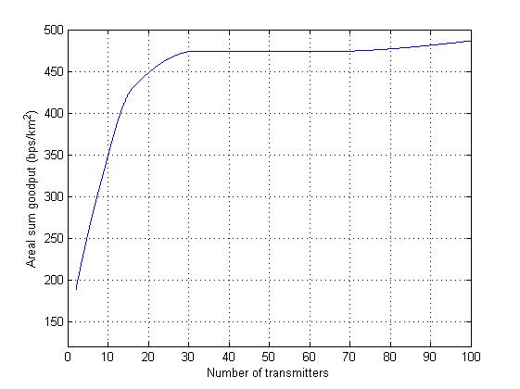
1-Hop Scenario (100PDs, Full buffer, 1Group, Multicast)
Areal sum goodput
Maximum saturated goodput point (470 bps/km²)
Goodput increases as the
number of transmitters increases
(since they generate more traffic)
When the number of transmitters
is 32, goodput reaches is saturated

Slide 41
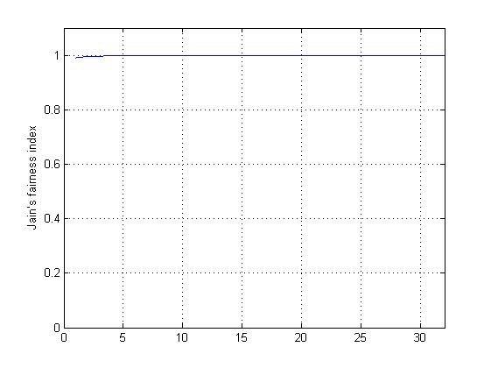
1-Hop Scenario (100PDs, Full buffer, 1Group, Multicast)
Jain’s fairness index
All of transmitters have almost same chance to transmit
Since all of PDs in a one-hop
range of transmitters, all nodes have same opportunity of send data.

Slide 42
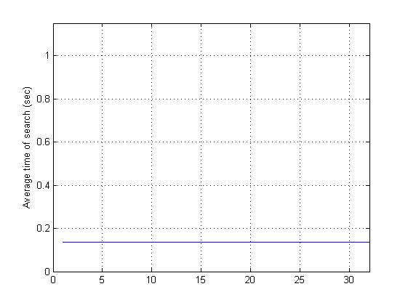
1-Hop Scenario (100PDs, Full buffer, 1Group, Multicast)
Average Group Joining Time
A PD finds a group and join within 0.2 seconds
Since all of PDs within one-hop coverage, group joining delay is relatively small.

Slide 43
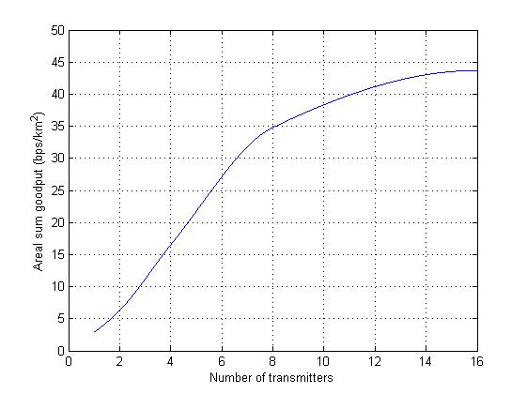
Multi-Hop Scenario (100PDs, 512Bytes/sec, 1Group, Multicast)
Areal sum goodput
Goodput increases as the
number of transmitters increases
(since they generate more traffic)

Slide 44
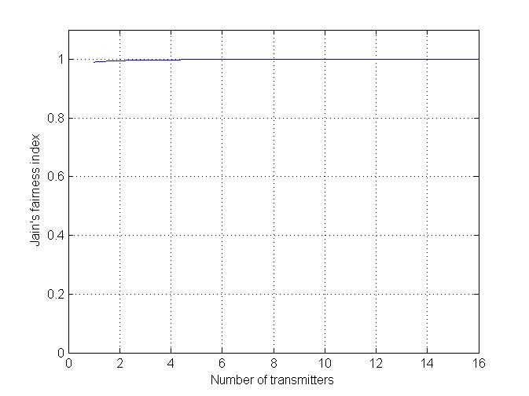
Multi-Hop Scenario (100PDs, 512Bytes/sec, 1Group, Multicast)
Jain’s fairness index
All of transmitters have almost same chance to transmit

Slide 45
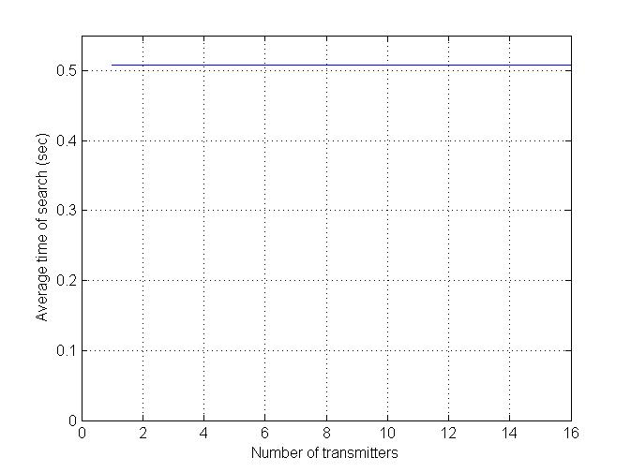
Multi-Hop Scenario (100PDs, 512Bytes/sec, 1Group, Multicast)
Average Group Joining Time
Since PDs distributed within multi-hop coverage, it makes some delay in order to group joining.

Slide 46
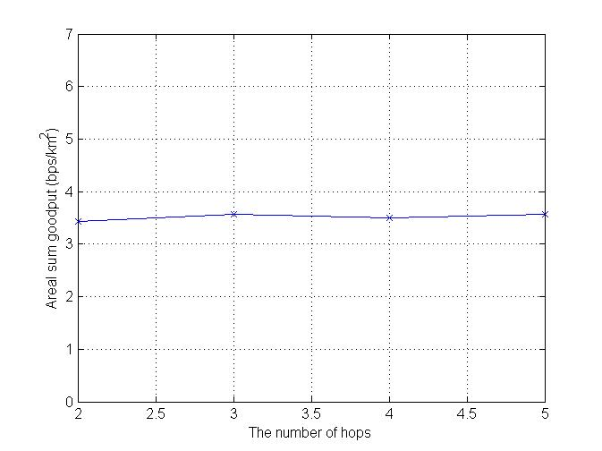
Multi-Hop Scenario (100PDs, 512Bytes/sec, 1Group, Multicast)
Areal sum goodput (X-axis: The number of Hops)
The goodput is independs on the number of hops.

Slide 47
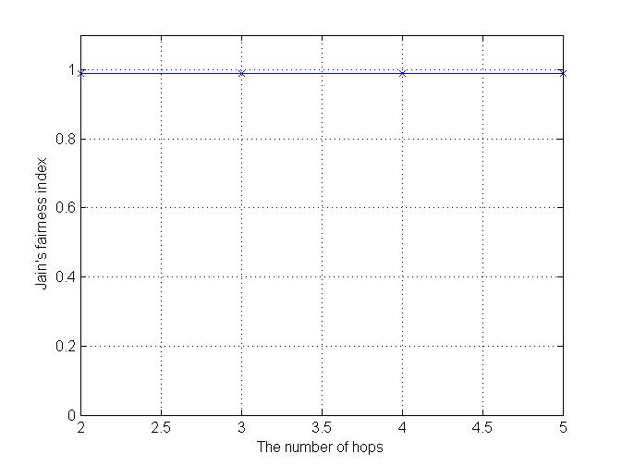
Multi-Hop Scenario (100PDs, 512Bytes/sec, 1Group, Multicast)
Jain’s fairness index (X-axis: The number of Hops)
The result is similar with previous scenario.
All of PDs have same chance to transmit a data frame.

Slide 48
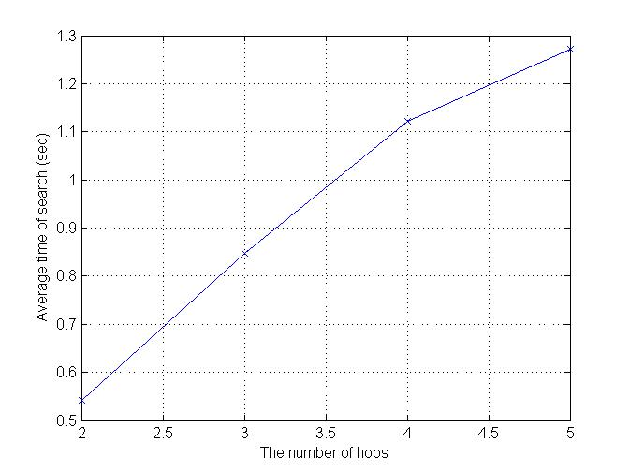
Multi-Hop Scenario (100PDs, 512Bytes/sec, 1Group, Multicast)
Average Group Joining Time (X-axis: The number of Hops)
The average group joining time increases as the number of hops increases due to forward delay.
Most of PDs finds a group with in a 1.5 seconds even if a PD is far away from group member.

Slide 49
Realistic Scenario
Realistic Scenario
Number of PDs: 100
Traffic Generation: 512Bytes/sec
Transmitter: 2~8 (half of them generate multicast data and others generate unicast data)
The number of Groups per PD: 3

Slide 50
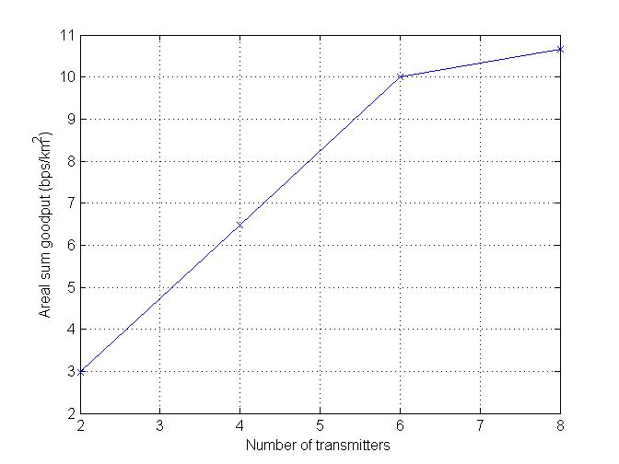
Realistic Scenario - Goodput
In the realistic scenario, result is similar to previous scenario. goodput increases as the
number of transmitters increases
(since they generate more traffic)
<Single-Hop Scenario>

Slide 51
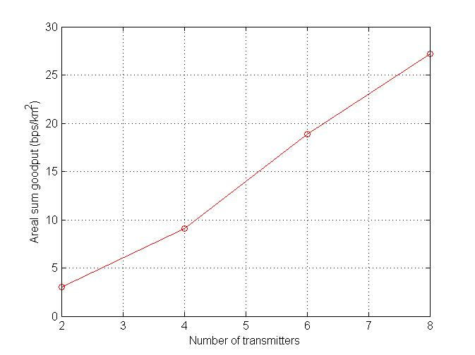
Realistic Scenario - Goodput
In the multi-hop scenario, the result also similar with previous simulation result.
<Multi-Hop Scenario>

Slide 52
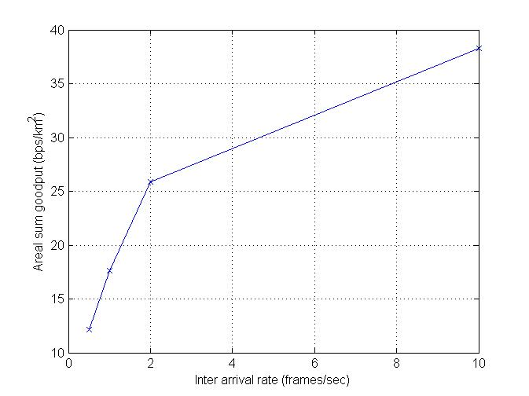
Realistic Scenario – Goodput (x-axis: inter arrival rate)
# of Transmitters: 8
As we expected the goodput increases
as the inter arrival rate increases.
→ Since high inter arrival rate generates more traffic loads.
<Single-Hop Scenario>

Slide 53
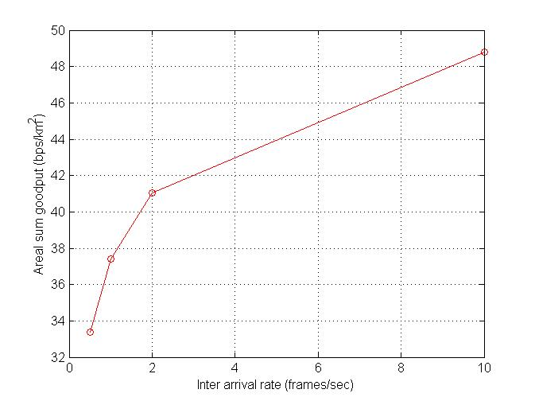
Realistic Scenario – Goodput (x-axis: inter arrival rate)
# of Transmitters: 8
→ Similar to single-hop scenario, the goodput increases with the inter arrival rate.
<Multi-Hop Scenario>

Slide 54
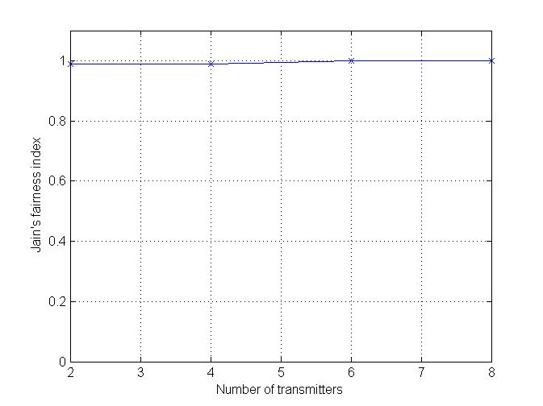
Realistic Scenario – Jain’s Fairness Index
→ Fairness also similar to previous scenario.
<Single-Hop Scenario>

Slide 55
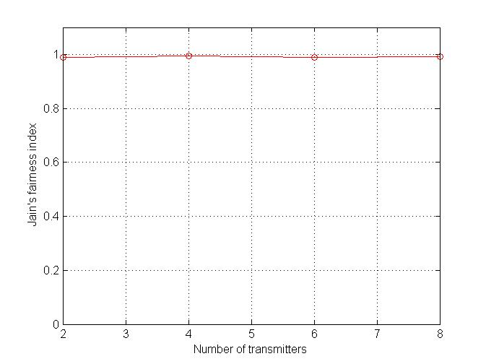
Realistic Scenario – Jain’s Fairness Index
→ Fairness also similar to previous scenario.
<Multi-Hop Scenario>

Slide 56
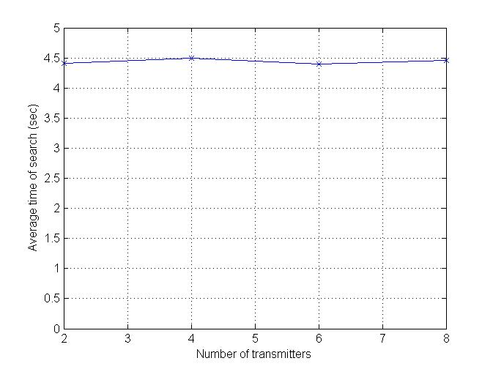
Realistic Scenario – Average Group Joining Time
→ The group joining time is 4.5 seconds,
<Single-Hop Scenario>

Slide 57
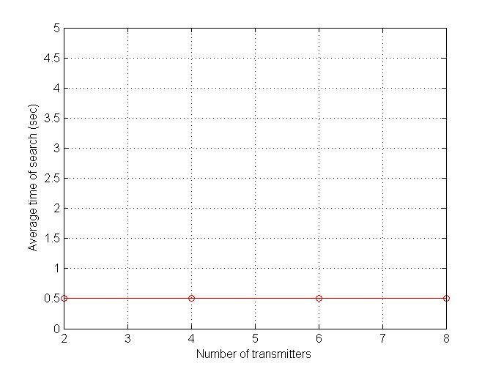
Realistic Scenario – Average Group Joining Time
<Multi-Hop Scenario>

Slide 58
Security Mechanism for PAC

Slide 59
Security Mechanism Summary (1/2)
Three security modes
Non-security mode
Service level enforced security mode
Optional authentication, authorization, encryption
Link level enforced security mode
Mandatory authentication, authorization, encryption
Notes:
For the security part of our proposal, since it does not require the simulation result, the proposed details are almost the same as the pre-proposal we proposed in May at Hawaii.
So now we will present the summary of the security proposal due to the time limitation.
For the security mode, we propose three different level of security on the basis of the security requirement of each communication.
Mode 1 is non-security mode, which means that the communication does not require any security mechanism.
Mode 2 is service level enforced security mode, which means that the security mechanism such as authentication, authorization and encryption is different for each service or communications. So, each communication or service can dynamically choose their own security level.
Mode 3 is link level enforced security mode, which means that all the security mechanisms are mandatory. So, every security mechanism such as authentication, authorization, and encryption should be done for a secure communications or secure services before the communication.

Slide 60
Security Mechanism Summary (2/2)
Authentication and Authorization
Infrastructureless architecture
Using PIN (symmetric), or certificate (asymmetric) issued by the trusted third party
Infrastructure architecture
Using master key (symmetric) issued by the AAA server, or certificate issued by the AAA server
EAP(extensible authentication protocol)
Key derivation and authentication protocols with security parameters
Refer to the pre-proposal
Notes:
Authentication and authorization may be done during the peering process on the basis of the security mode or security requirement of each service.
For authentication and authorization mechanisms, we proposed two different protocols for infrastructureless architecture and infrastructure architecture.
For infrastructureless architecture, each device authenticates each other with symmetric PIN information or certificate, since there is no security architecture, for example, authentication server.
For infrastructure architecture, where there are existing authentication server, each device authenticates each other through the dynamic coordinator, which can have connection with the authentication server. In this environment, the authentication procedure may adopt EAP, that is extensible authentication protocol, after the association procedure.
After authentication process, each device may share secret information, that is secret authentication key. Then, the encryption for a secure unicast or group encryption key for a secure group communication may be derived from the shared secret authentication key. The concrete key derivation and authentication protocols with security parameters are the same as the pre-proposal. So, we omit the presentation of them due to the time limitation.

