Slide 1
Project: IEEE P802.15 Working Group for Wireless Personal Area Networks (WPANs)
Submission Title: Rx Performance Simulation for GFSK Modulation
Date Submitted: July 15, 2013
Source: Lin Zhang, Ning Li, Zhongliang Deng BUPT; Liang Li, Vinno;
Arthur Astrin, Astrin Radio;
Suite 202, Building D, No.2 Xinxi Lu, Beijing, China,
Voice: 1-949-813-7909, FAX: 1-949-813-7909,
E-Mail: liangli@vinnotech.com
Abstract: Tech Proposal for TG4n(MBAN) Task Group
Purpose: Outline accomplishments from the March 2012 meeting and planned tasks for this meeting.
Notice: This document has been prepared to assist the IEEE P802.15. It is offered as a basis for discussion and is not binding on the contributing individual(s) or organization(s). The material in this document is subject to change in form and content after further study. The contributor(s) reserve(s) the right to add, amend or withdraw material contained herein.
Release: The contributor acknowledges and accepts that this contribution becomes the property of IEEE and may be made publicly available by P802.15.

Slide 2
GFSK proposal presentation
Band(MHz) | Modulation | Data Rate(kbps) | Modulation Index | Channel Bandwidth(kHz)
174-216 407-425 608-630 | 2-FFSK (common) | 50 | 1.0 | 500
 | 2-FFSK (optional) | 100 | 0.5 and 1.0 | 500
 |  | 200

Slide 3
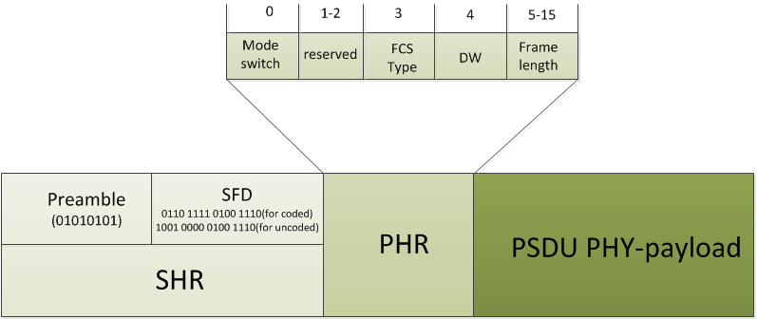
PHY-frame Format
Frame structure

Slide 4
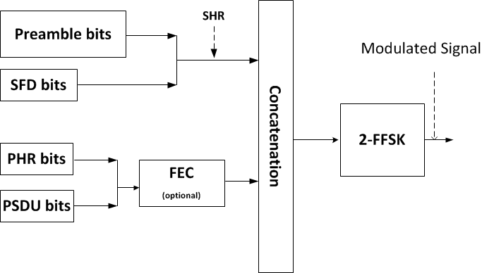
PHY-frame Generate Diagram (GFSK)

Slide 5
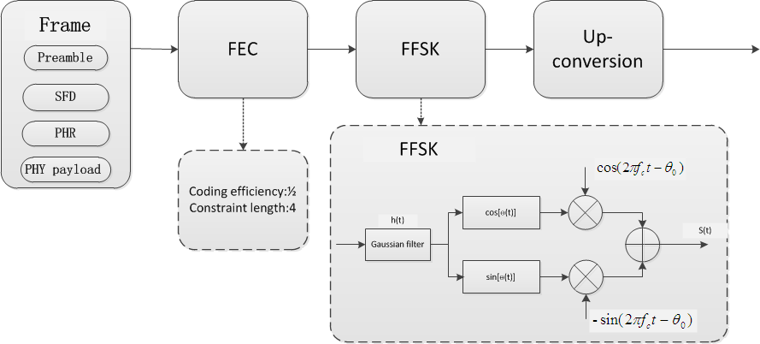
TX Block Description (GFSK)

Slide 6
Receiver Design
Receiver Sensitivity:$S=(S_{0}+10log [\frac{R}{R_{0}}])dBm$
$S_{0}$：-91(without FEC)； -97(with FEC)
$R_{0}$：50kb/s
R ：bit rate in kb/s (common:50kb/s)
common: <-91dBm for the uncoded system and
<-97dBm for the coded system.
(PSDU length = 20 octets, PER < 1%)
Receiver Block

Slide 7
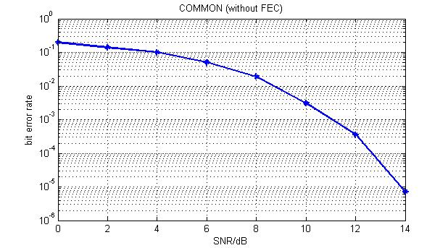
Simulation in Gaussian Noise Environment
Common situation without FEC
modulation index=0.5
BT=1.0
data rate: 50kbps

Slide 8
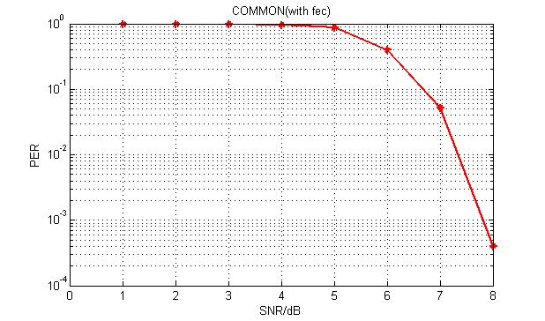
Simulation in Gaussian Noise Environment
Common situation with FEC
modulation index=0.5
BT=1.0
data rate: 50kbps

