Slide 1
Project: IEEE P802.15 Working Group for Wireless Personal Area Networks (WPANs)
Submission Title: [Evaluation of Impact of Spectrum Sensing Duration]
Date Submitted: [15 July, 2013]
Source: [Shoichi Kitazawa] Company [ATR]
Address [2-2-2, Hikaridai, Seika, Kyoto, JAPAN]
Voice:[+81-774-95-1565], FAX: [], E-Mail:[kitazawa@atr.jp]
Re: []
Abstract: [This contribution shows the evaluation of sensing time and sensing performance.]
Purpose: [For discussion.]
Notice: This document has been prepared to assist the IEEE P802.15. It is offered as a basis for discussion and is not binding on the contributing individual(s) or organization(s). The material in this document is subject to change in form and content after further study. The contributor(s) reserve(s) the right to add, amend or withdraw material contained herein.
Release: The contributor acknowledges and accepts that this contribution becomes the property of IEEE and may be made publicly available by P802.15.

Slide 2
Impact of Spectrum Sensing Duration

Slide 3
Authors

Slide 4
Background
RRMM is a key issue for efficient use of spectrum.
The impact of spectrum sensing duration on the sensing performance were evaluated.

Slide 5
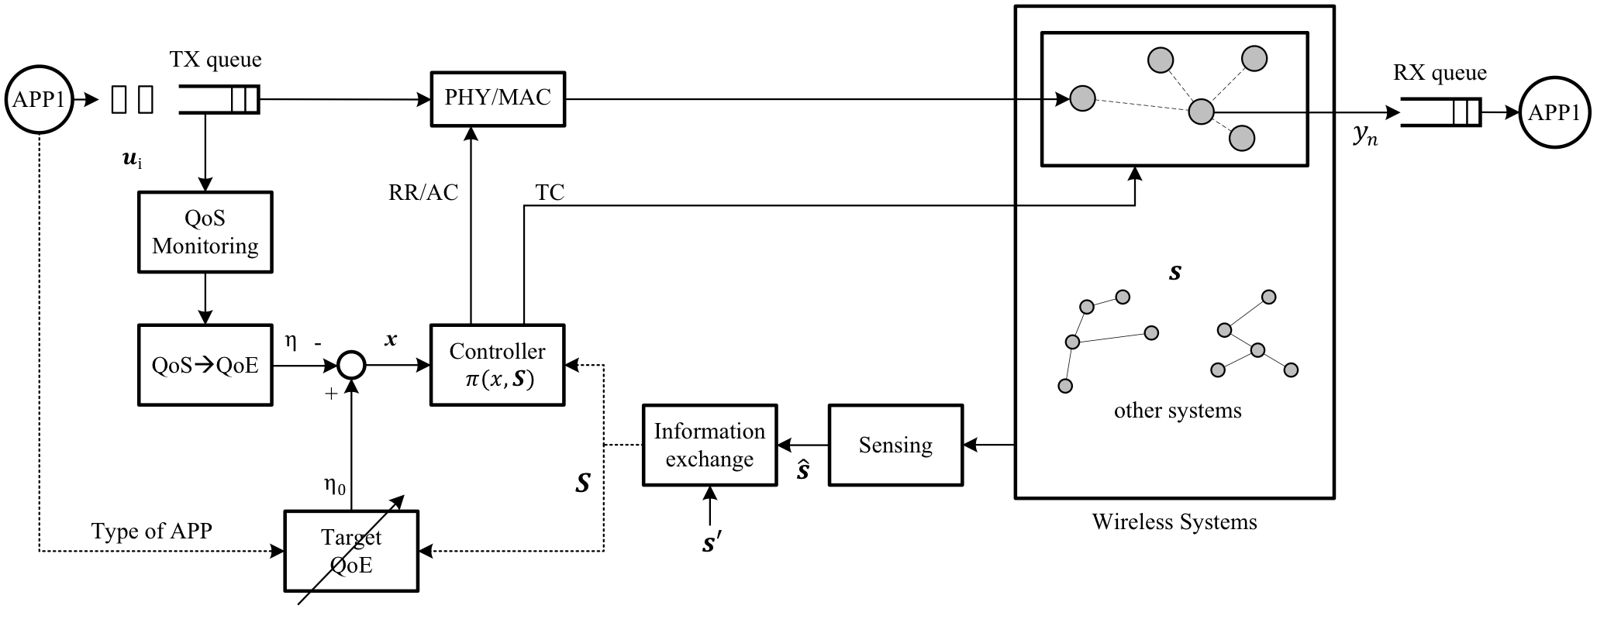
Proposed Architecture
Measuring QoE from TX buffer
Wireless Communication environment
TX
RX
TX Control
Difference of 2 QoEs
Topology Control
Radio resource information
estimated QoE
Target QoE
Estimating QoS from
Spectrum Sensing
QoE bases control
RR: Radio resource assignment, AC: Access control, TC: Topology control

Slide 6
PHY tasks for 802.15.4
Energy detection (ED) within the current channel
Link quality indicator (LQI) for received packets
Clear channel assessment (CCA) for carrier sense multiple access with collision avoidance (CSMA-CA)

Slide 7


Sensing
AP2
Data
WLAN2
AP1
Data
Sensing node
WLAN1

Slide 8


Channel occupancy ratio
represents the ‘true’ channel occupancy ratio obtained by continuous spectrum sensing (No any Tx duration).

Slide 9
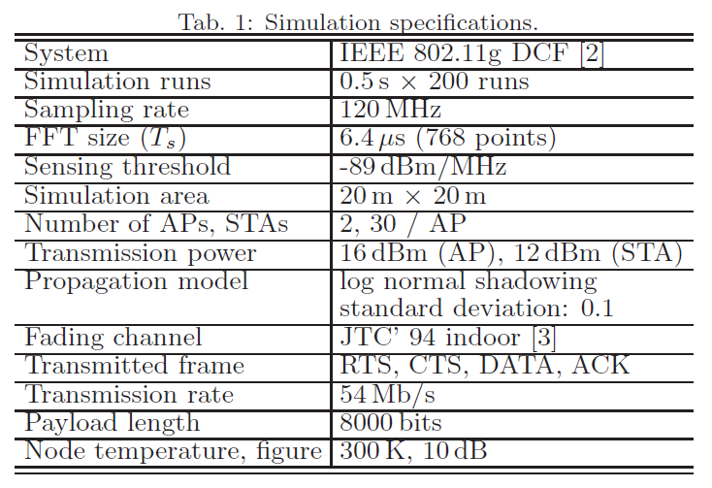
Simulation parameters

Slide 10
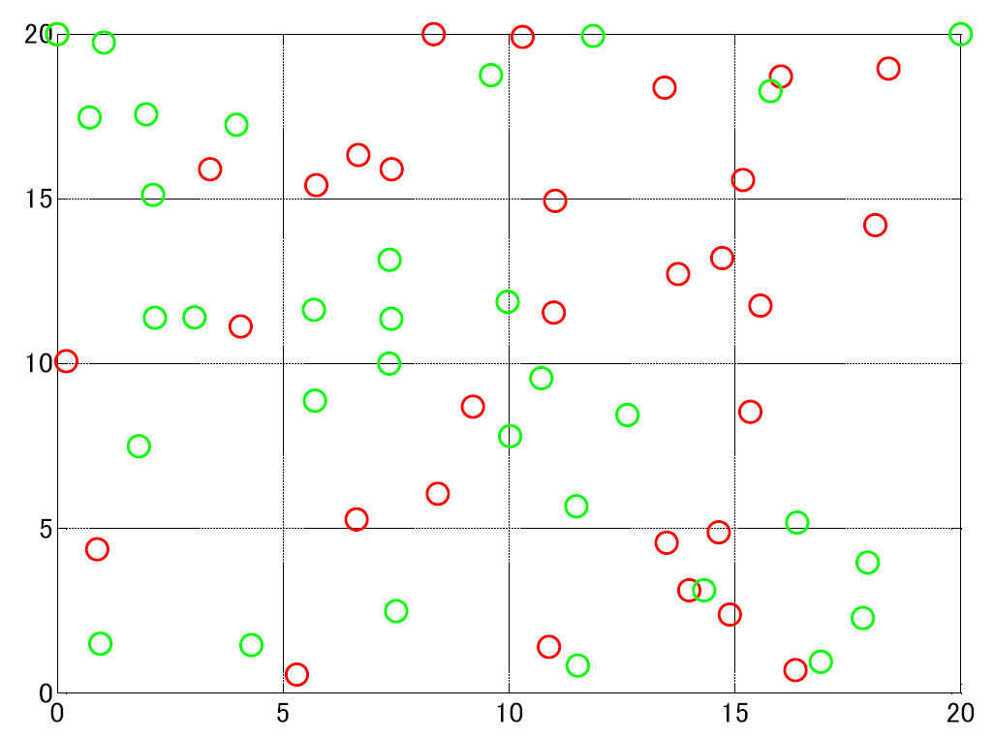
Simulated topologies
AP of WLAN2 (CH12)
AP of WLAN1 (CH7)
Sensing node
STAs of WALN2
STAs of WALN1

Slide 11
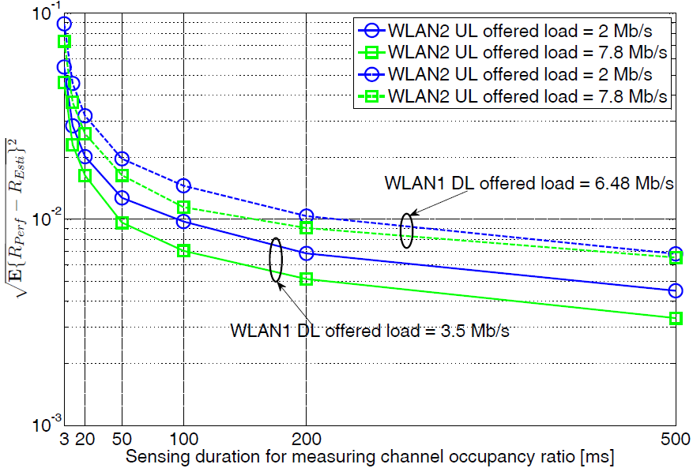
Simulated results

Slide 12
Conclusion
Longer spectrum sensing duration gives smaller RMS error owing to the averaging effect.
RMS error is less than 1% when the sensing duration is longer than 200ms.
This work is supported by the Ministry of Internal Affairs and Communications under a grant entitled "Research and development of dynamic and reconfigurable M2M wireless network technology."

