Slide 1
doc.: IEEE 15-13-0435-00-0led
Project: IEEE P802.15 Working Group for Wireless Personal Area Networks (WPANs)
Submission Title: [Modulation scheme analysis for Visible Light Communication by LED-ID]
Date Submitted: [July, 2013]
Source: [Kye San Lee, Jae Sang Cha, Jin Young Kim, Yeong Min Jang]
[Kyunghee University, Seoul National University of Science and Technology, Kwangwoon University, Kookmin University]
Address [Kyunghee University, Seoul, Korea]
Voice:[82-31-201-2032], FAX: [], E-Mail:[kyesan@khu.ac.kr]
Re: []
Abstract: [In optical systems, the modulation scheme affects the illumination and BER. Therefore, it is necessary to analyze the performance of the modulation schemes applied in the LED-ID system. We compared 4 different modulation schemes, such as OOK, Pulse Position Modulation (PPM), Overlapping PPM (OPPM), and Inverted PPM (I-PPM). Simulations results show that OPPM is a powerful candidate modulation scheme for LED-ID systems]
Purpose: [Contribution to IEEE 802.15 IG-LED]
Notice: This document has been prepared to assist the IEEE P802.15. It is offered as a basis for discussion and is not binding on the contributing individual(s) or organization(s). The material in this document is subject to change in form and content after further study. The contributor(s) reserve(s) the right to add, amend or withdraw material contained herein.
Release: The contributor acknowledges and accepts that this contribution becomes the property of IEEE and may be made publicly available by P802.15.
Kye San Lee, Kyunghee University
Notes:
doc.: IEEE 802.15-09-0117-00-0007
<month year>

Slide 2
Contents
doc.: IEEE 15-13-0435-00-0led
Motivation
Proposed Modulation scheme for LED-ID
Simulation Results
Conclusions
Kye San Lee, Kyunghee University

Slide 3
Motivation
doc.: IEEE 15-13-0435-00-0led
Modulation
  Visible Light Communication (VLC) is used in Wireless communication systems due to its high transmission speed. The advantage of the VLC system is that Light Emitting Diodes (LED) is utilized for illumination and communication at the same time. However, it also carries some limitations for VLC systems
  In optical communication systems, the modulation schemes with good performance in Radio Frequency (RF) systems are not suitable for VLC systems
  The flickering and dimming problem have already been considered, and several modulation schemes have already been proposed, such as I-PPM, subcarrier inverted pulse position modulation (SC-I-PPM), pulse width modulation (PWM), variable pulse position modulation (VPM), and OPPM
Kye San Lee, Kyunghee University

Slide 4
What is the LED-ID System
doc.: IEEE 15-13-0435-00-0led
Definition of LED-ID
Light Emitting Diode Identification (LED-ID) system typically uses line of sight (LOS) channels to achieve high data rate and bright illumination. This technology that uses light waves to contactless exchange voice/video/data among one Photo Detector (PD) or other Reader (or Tag)
Components of LED-ID
  LED(Transmitter)
  Photo Detector(Receiver)
  Each Reader and Tag of LED-ID
Kye San Lee, Kyunghee University

Slide 5
Characteristics of LED-ID
doc.: IEEE 15-13-0435-00-0led
No interference with RF
Wide bandwidth (385 THz ~ 789 THz)
High speed communication networks
Security
No harmful to human
Light waves are worldwide unregulated by any law
Kye San Lee, Kyunghee University

Slide 6
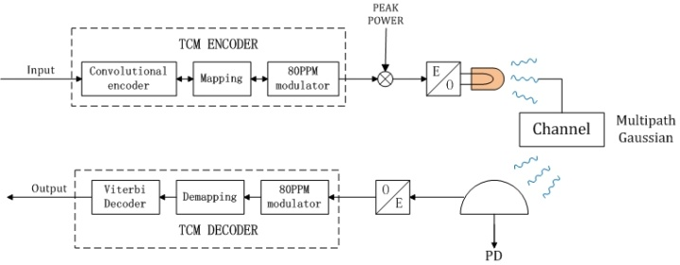
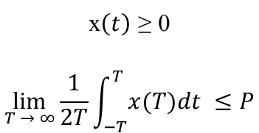

Proposed Modulation scheme for LED-ID
doc.: IEEE 15-13-0435-00-0led
Block diagram of the proposed LED-ID system
Kye San Lee, Kyunghee University

Slide 7
Proposed Modulation scheme for LED-ID
doc.: IEEE 15-13-0435-00-0led
Dimming control
 | OOK | VPN | OPPM
Min | 0% | 0% | 0%
Max | 50% | 100% | 1/Q
Basic Dimming Range
Q is defined as the alphabet size of the OPPM signal set with no overlap
proposed by the IEEE 802.15 VLC task group lies in the range from 0% to 100%
Kye San Lee, Kyunghee University

Slide 8
Proposed Modulation scheme for LED-ID
doc.: IEEE 15-13-0435-00-0led
Long-term flicker severity vs. duty cycle
Dimming level changing 90% to 10% which means the duty cycle changes form 10% to 90%
Kye San Lee, Kyunghee University

Slide 9
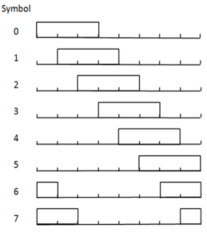
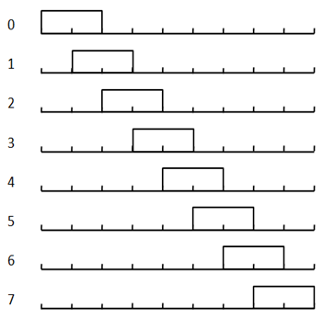
Proposed Modulation scheme for LED-ID
doc.: IEEE 15-13-0435-00-0led
Original (9, 2) 8OPPM signal → (8, 3) OPPM signal
In the 8OPPM scheme from (9, 2) to (8, 3) to improve the brightness range. With the modified scheme, we increased the brightness range by 12.5% compared to that of PPM
Dimming range increases from 22.2% to 37.5%
Kye San Lee, Kyunghee University

Slide 10
Parameters
doc.: IEEE 15-13-0435-00-0led
Optical modulation | IM/DD
Primary modulation | 4PPM, 8OPPM, IPPM, 8TCM-OPPM
data rate | 100-400[M bits/s]
O/E conversion efficiencies blue | 0.4[A/W]
O/E conversion efficiencies green | 0.48[A/W]
O/E conversion efficiencies red | 0.52[A/W]
Optical Channel model | Multipath
Noise model | AWGN
background light noise | 1e-3
Photodetector responsivity | 0.53A/W
Simulation dimming range | 37.5% 62.5% 75%
Kye San Lee, Kyunghee University

Slide 11
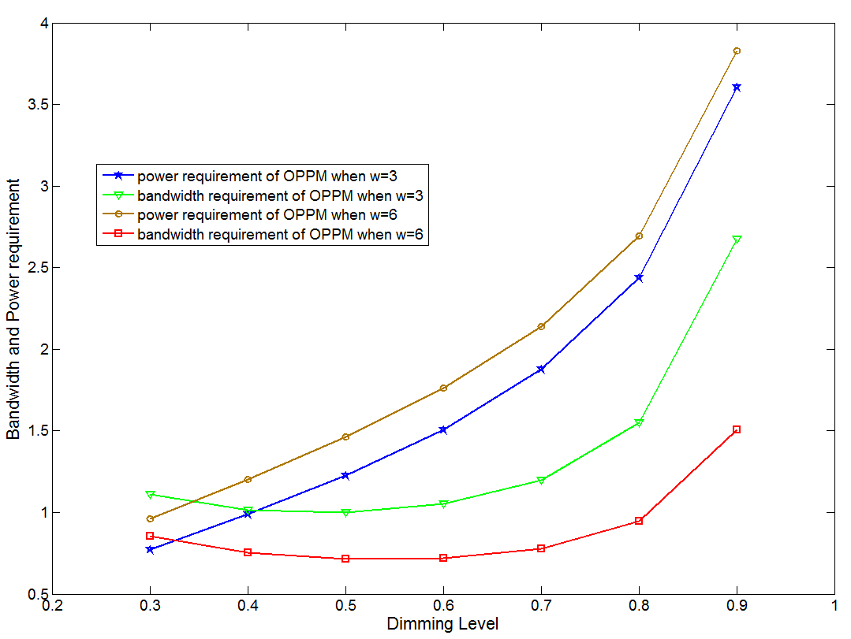
Simulation Results
doc.: IEEE 15-13-0435-00-0led
Bandwidth and power requirement VS Dimming level
The bandwidth doesn’t vary much for a dimming level range that lies in the interval (0.3, 0.7). As the value of w increases, the bandwidth decreases. The power requirement increases dramatically as the dimming level increases. In addition, with the increasing of w, the power also increases.
Kye San Lee, Kyunghee University

Slide 12
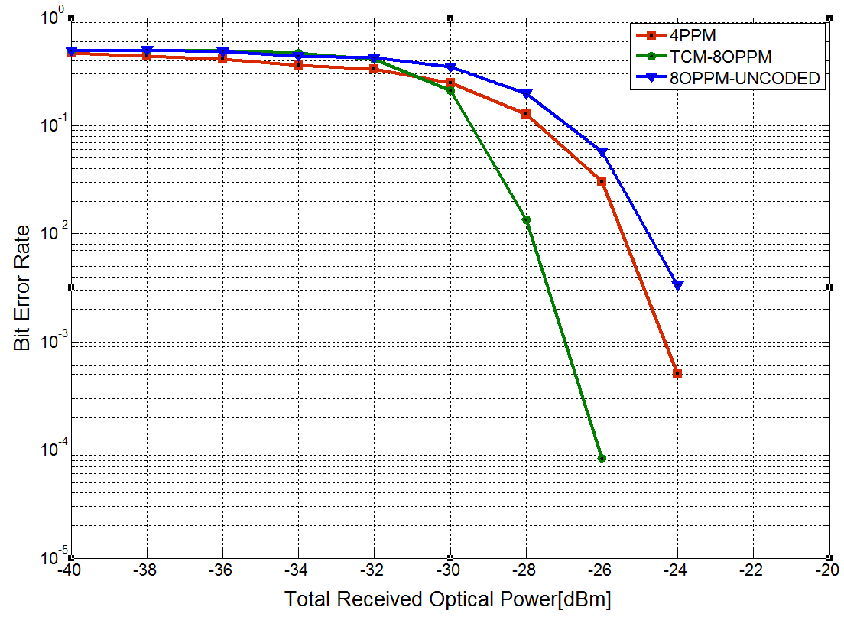
Simulation Results
doc.: IEEE 15-13-0435-00-0led
BER of LED-ID system with 3 modulation schemes
We can see that TCM-8OPPM has the best BER performance compared to those of other systems. On the contrary, un-coded 8OPPM has the worst BER performance
Kye San Lee, Kyunghee University

Slide 13
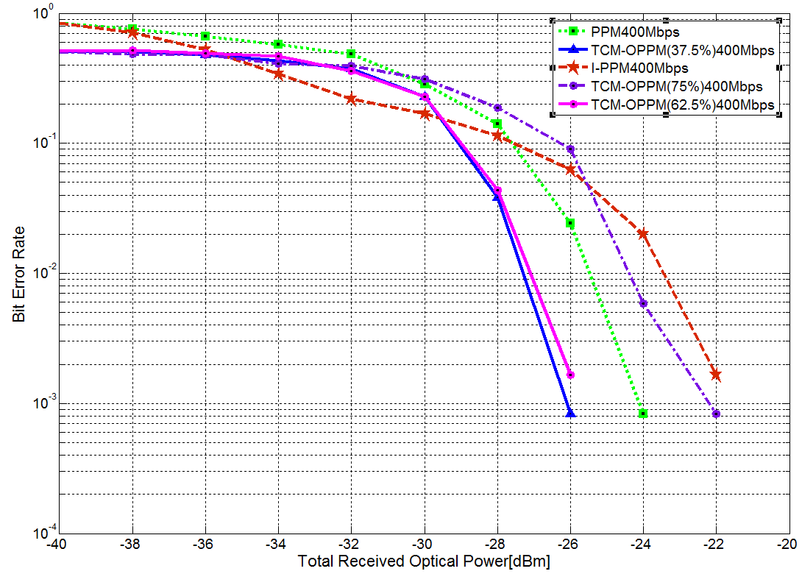
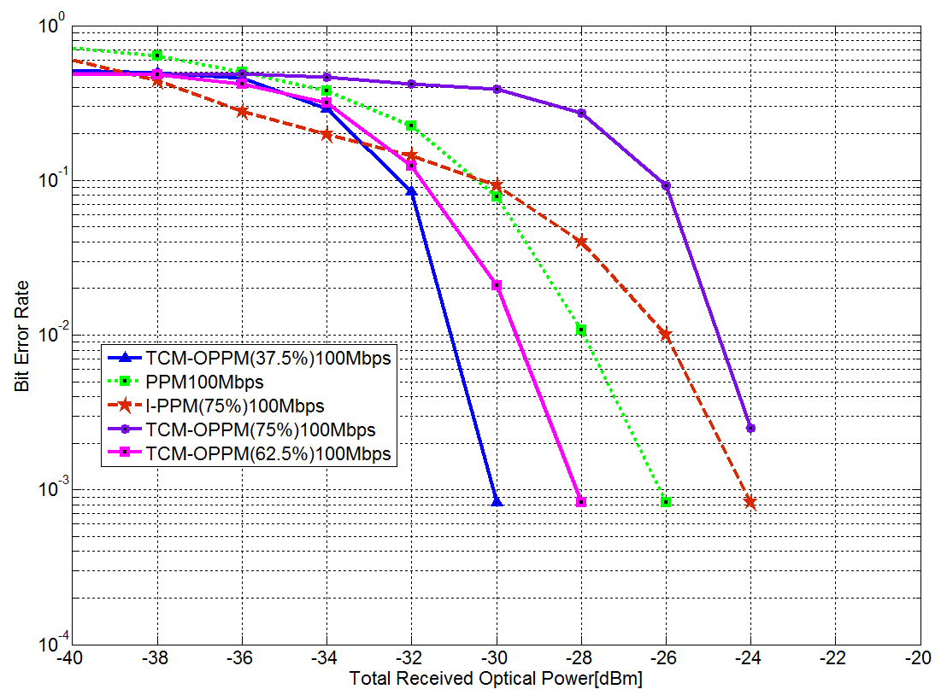
Simulation Results
doc.: IEEE 15-13-0435-00-0led
BER of LED-ID system with PPM, I-PPM, TCM-8OPPM on dimming range (37.5%, 62.5%, 75%)
(a) data rate = 400Mbps
(b) data rate = 100Mbps
We can see that as dimming level lies in the interval of (37.5%, 62.5%), the TCM-8OPPM scheme can get a good BER performance.
Kye San Lee, Kyunghee University

Slide 14
Conclusions
doc.: IEEE 15-13-0435-00-0led
Propose the several modulation schemes applied in LED-ID systems
  OPPM cannot achieve the BER performance as well as illumination performance. Therefore, we enjoyed TCM technology combined with the OPPM scheme in VCL in order to improve BER performance.
  TCM-8OPPM scheme has better performance compared to those of other schemes with dimming levels that lie in the interval of (37.5%, 62.5%).
Kye San Lee, Kyunghee University

