Slide 1
Project: IEEE P802.15 Working Group for Wireless Personal Area Networks (WPANs)
Submission Title: Benefits of using FEC
Date Submitted: July 2013
Source: Frederik Beer¹, Jörg Robert¹;
¹Friedrich-Alexander-Universität Erlangen-Nürnberg, Information Technology
Phone: +4991318525123, Fax: +4991318525102
E-Mail: frederik.beer@fau.de
Abstract: Some basic considerations about benefits from using FEC
Purpose:
Notice: This document has been prepared to assist the IEEE P802.15. It is offered as a basis for discussion and is not binding on the contributing individual(s) or organization(s). The material in this document is subject to change in form and content after further study. The contributor(s) reserve(s) the right to add, amend or withdraw material contained herein.
Release: The contributor acknowledges and accepts that this contribution becomes the property of IEEE and may be made publicly available by P802.15.
Frederik Beer, Jörg Robert

Slide 2
Benefits of using FEC

Slide 3
Objective
Show possible improvements by using FEC
Calculation of necessary bit error rate (BER) for certain packet error rate (PER)
Show performance of uncoded modulation types
Show possible coding gain
Show how the coding gain can be translated into different parameter optimisations
Efficiency
Peak power consumption
Range
PER

Slide 4
BER Calculation
In order to achieve a certain PER we can calculate the necessary BER at a given packet length of n bits
$BER≤1−\sqrt[n]{1−PER}$
20 octet packets:
To achieve a PER of 1%: $BER≤6.3∙{10}^{−5}$
To achieve a PER of ${10}^{−4}$: $BER≤6.3∙{10}^{−7}$

Slide 5
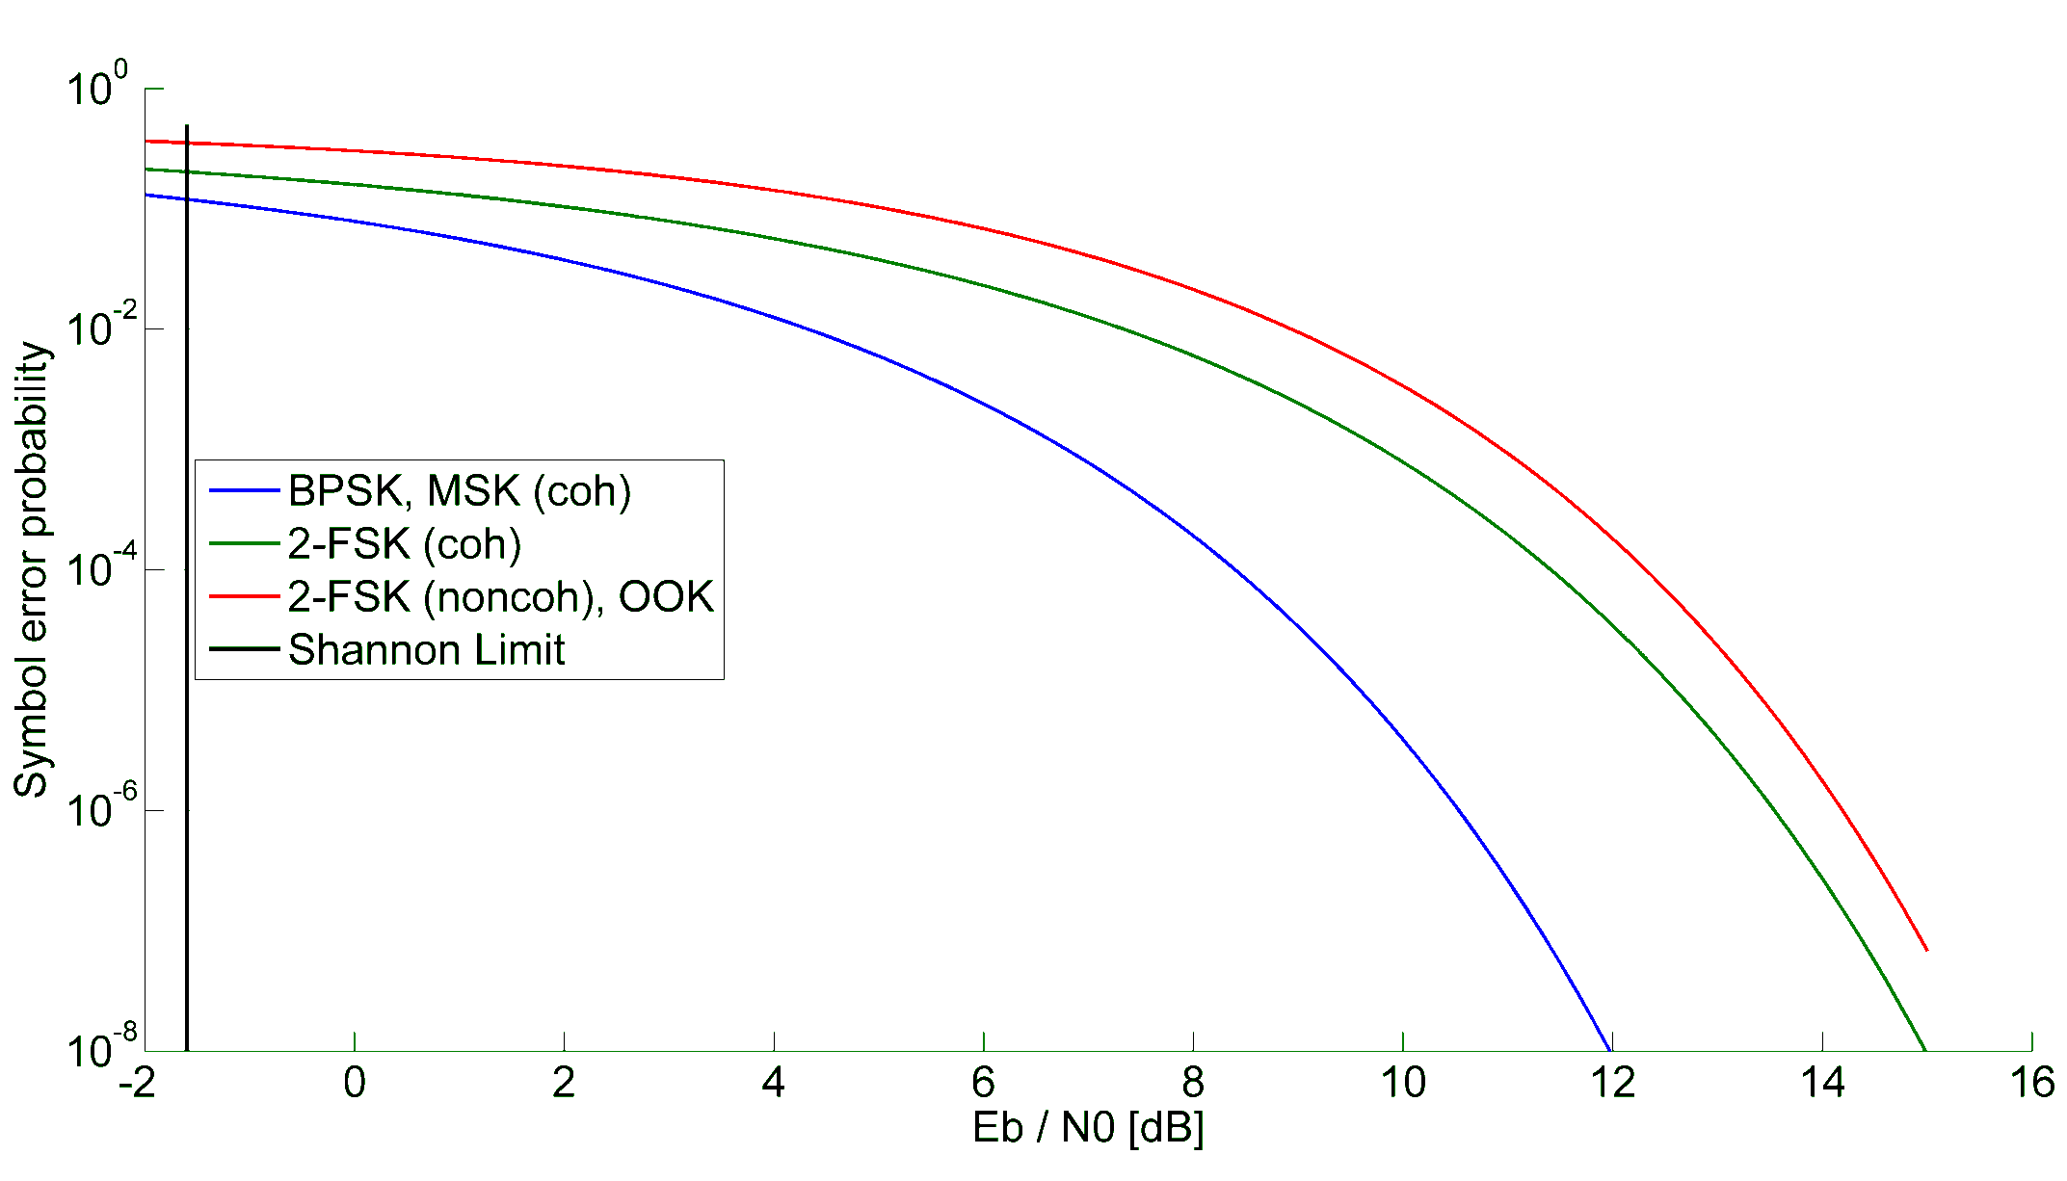
BER Curves

Slide 6
Coding Gain
Gap between non coherent FSK and the Shannon Limit at
$BER=6.3∙{10}^{−5}$ is approx. 14.1 dB
$BER=6.3∙{10}^{−7}$ is approx. 16 dB
This gap can be dramatically minimized by usage of FEC schemes
According to [DOL98] the necessary Eb/N0 can be reduced to about 4.8 dB by usage of convolutional codes (R=1/2, k=7)
This results in a coding gain of at least 9.3 dB

Slide 7
Benefits (1)
This lower necessary Eb/N0 can be traded for a variety of benefits
Faster transmission at constant trasmit power
8.5 times higher datarates possible
Higher datarates increase overall efficieny of transmission
Reduced transmit power at constant datarate
12% of the transmit power necessary
Reduced peak power consumption

Slide 8
Benefits (2)
This lower necessary Eb/N0 can be traded for a variety of benefits
Higher range at constant transmit power and datarate
Depending on the environment range can be extended by factor 2.9 - 1.5
Lower packet error rates at constant transmit power, datarate and range

Slide 9
Conclusion
Usage of FEC schemes open up a variety of possibilities
System can be optimised according to its intended use
In order to achieve maximum degree of freedom we suggest to include an optional systematic FEC scheme in 4q

Slide 10
References
[DOL98] S. Dolinar, D. Divsalar, and F. Pollara. “Code Performance as a Function of Block Size.” TMO Progress Report 42-133 (January-March 1998).

