Slide 1
Project: IEEE P802.15 Working Group for Wireless Personal Area Networks (WPANs)
Submission Title: System Considerations for ULP Communications
Date Submitted: July 16, 2013
Source: Jinesh P Nair¹, Kiran Bynam¹, Youngsoo Kim¹;
¹Samsung Electronics
Phone: +918041819999-464, Fax: +918041819999
E-Mail: jinesh.p@samsung.com
Abstract: System Considerations for ULP Communications
Purpose: Reference on channel models for fair comparison of proposals and system evaluation
Notice: This document has been prepared to assist the IEEE P802.15. It is offered as a basis for discussion and is not binding on the contributing individual(s) or organization(s). The material in this document is subject to change in form and content after further study. The contributor(s) reserve(s) the right to add, amend or withdraw material contained herein.
Release: The contributor acknowledges and accepts that this contribution becomes the property of IEEE and may be made publicly available by P802.15.
Jinesh P Nair, Kiran Bynam and Youngsoo Kim

Slide 2
Objective
To discuss the importance of parameters like Transmitter Power, Receiver Power and the Complexity of Transceiver for ULP Physical Layer amendment

Slide 3
Outline
Power Consumption Model
  Active Mode, Sleep Mode, Transient Mode
Transmit Signal and Transceiver Power Comparisons
Dependence of Transmitter Power on Modulation Schemes
  Impact of Duty Cycle
  Start-up Time
Applications Requiring Low Receiver Power
Summary

Slide 4
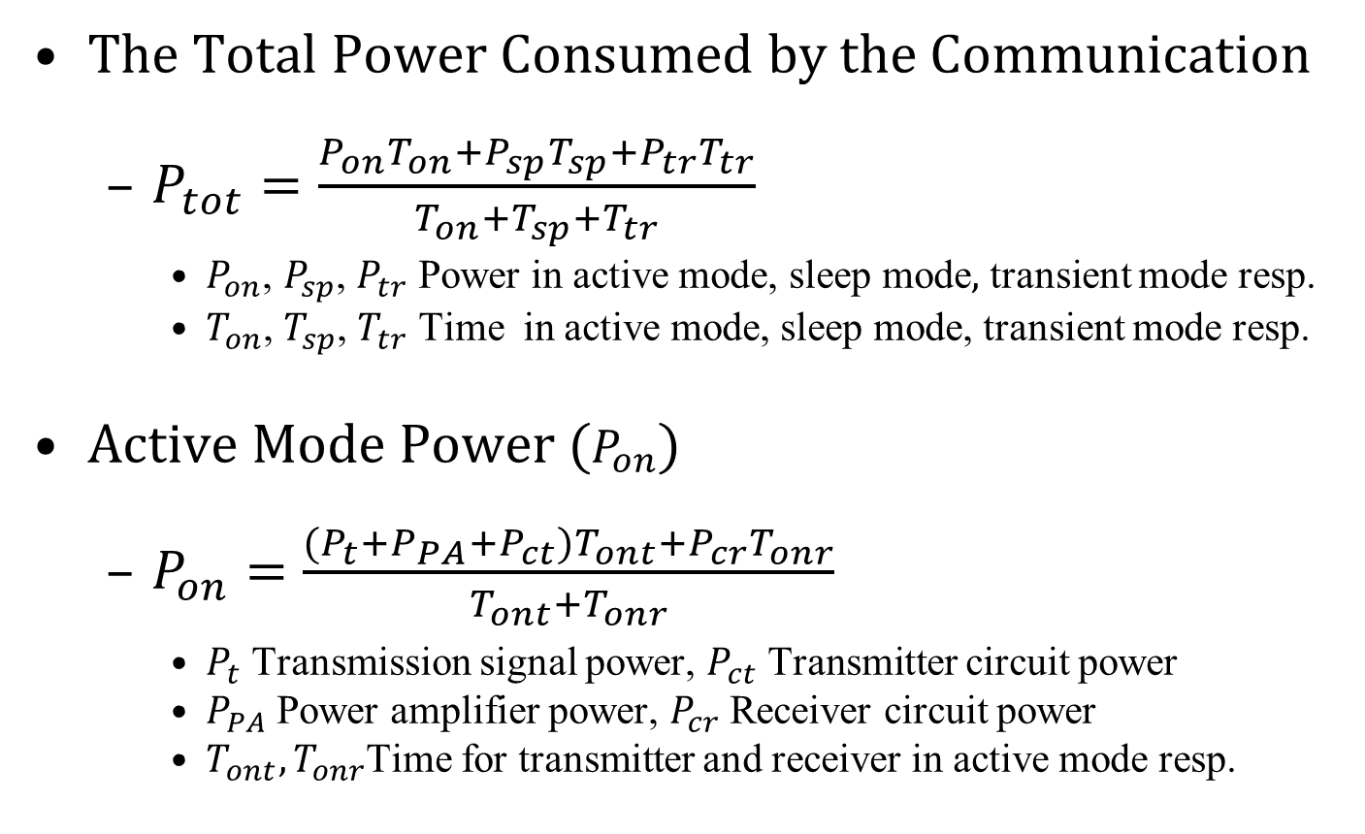
Power Consumption Model
The Total Power Consumed by the Communication
  $P_{tot}=\frac{P_{on}T_{on}+P_{sp}T_{sp}+P_{tr}T_{tr}}{T_{on}+T_{sp}+T_{tr}}$
    $P_{on}$, $P_{sp}$, $P_{tr}$ Power in active mode, $\text{sleep} \text{mode},$ transient mode resp.
    $T_{on}$, $T_{sp}$, $T_{tr}$ Time in active mode, sleep mode, transient mode resp.
Active Mode Power ($P_{on}$)
  $P_{on}=\frac{{(P}_{t}+P_{PA}+P_{ct})T_{ont}+P_{cr}T_{onr}}{T_{ont}+T_{onr}}$
    $P_{t}$ Transmission signal power, $P_{ct}$ Transmitter circuit power
    $P_{PA}$ Power amplifier power, $P_{cr}$ Receiver circuit power
    $T_{ont},T_{onr}$Time for transmitter and receiver in active mode resp.

Slide 5
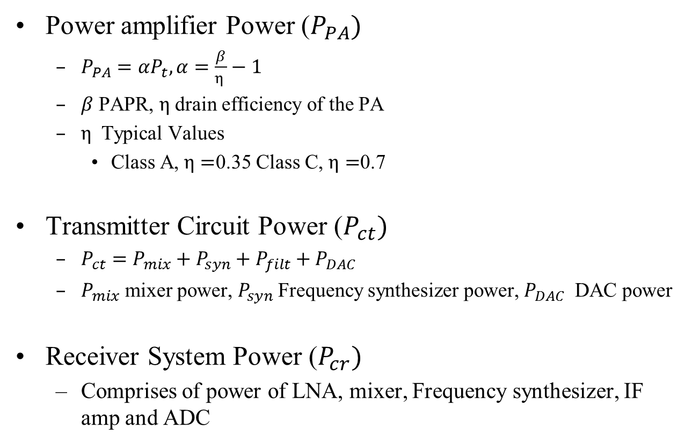
Active Mode Power Components
July 2013
Power amplifier Power ($P_{PA})$
  $P_{PA}=αP_{t}, α=\frac{β}{η }−1$
  $β$ PAPR, $η$ drain efficiency of the PA
  $η$ Typical Values
    Class A, $η=$0.35 Class C, $η=$0.7
Transmitter Circuit Power ($P_{ct})$
  $P_{ct}=P_{mix}+P_{syn}+P_{filt}+P_{DAC}$
  $P_{mix}$ mixer power, $P_{syn}$Frequency synthesizer power, $P_{DAC}$ DAC power
Receiver System Power ($P_{cr})$
  Comprises of power of LNA, mixer, Frequency synthesizer, IF amp and ADC

Slide 6
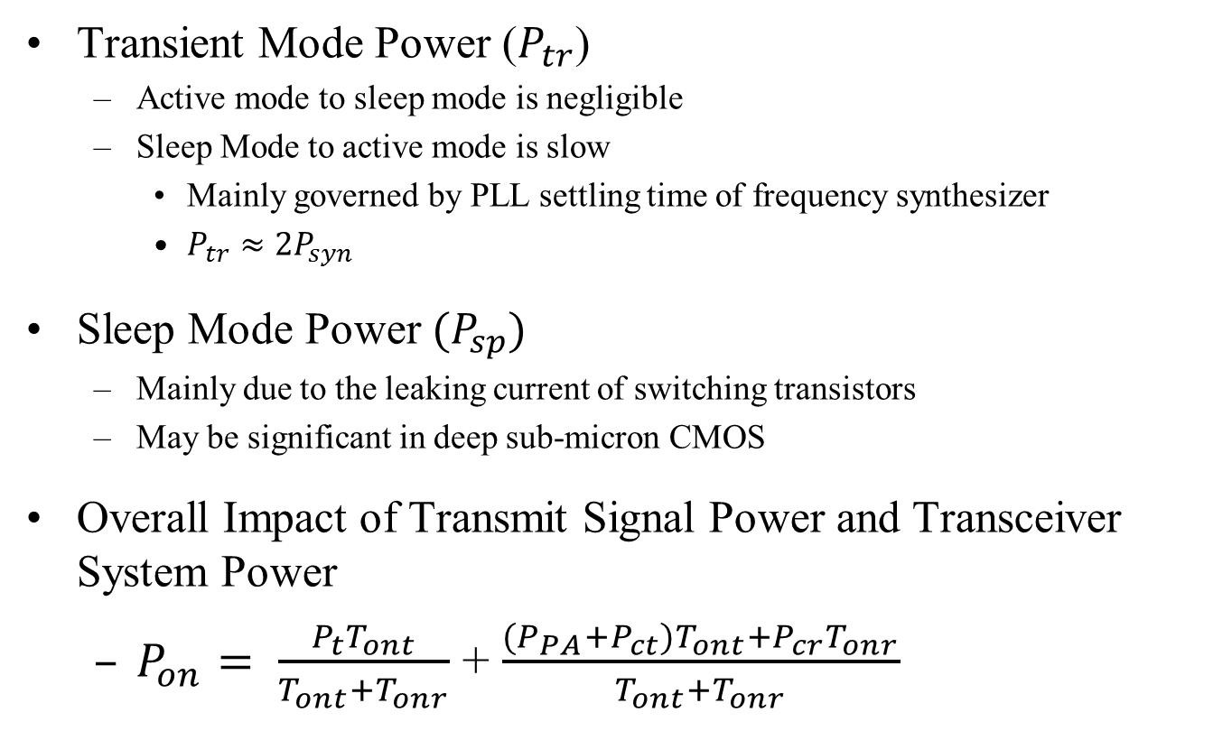
Other Modes
Transient Mode Power ($P_{tr}$)
  Active mode to sleep mode is negligible
  Sleep Mode to active mode is slow
    Mainly governed by PLL settling time of frequency synthesizer
    $P_{tr}≈2P_{syn}$
Sleep Mode Power ${(P}_{sp})$
  Mainly due to the leaking current of switching transistors
  May be significant in deep sub-micron CMOS
Overall Impact of Transmit Signal Power and Transceiver System Power
  $P_{on}= \frac{P_{t}T_{ont}}{T_{ont}+T_{onr}}$ + $\frac{(P_{PA}+P_{ct})T_{ont}+P_{cr}T_{onr}}{T_{ont}+T_{onr}}$
Transmit Signal Power Comp
Transceiver System Power Comp

Slide 7
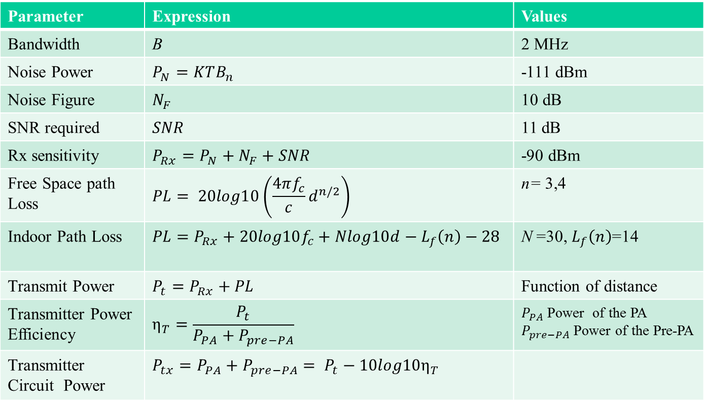

Calculation of Reqd. $P_{t}$ at a distance
Parameter | Expression | Values
Bandwidth | B | 2 MHz
Noise Power | $$P_{N}=KTB_{n}$$ | -111 dBm
Noise Figure | $$N_{F}$$ | 10 dB
SNR required | $$SNR$$ | 11 dB
Rx sensitivity | $$P_{Rx}=P_{N}+N_{F}+SNR$$ | -90 dBm
Free Space path Loss | $$PL= 20log10\left(\frac{4πf_{c}}{c}d^{n/2}\right)$$ | n= 3,4
Indoor Path Loss | $$PL=P_{Rx}+20log10f_{c}+Nlog10d−L_{f}\left(n\right)−28$$ | N =30, $L_{f}\left(n\right)$=14
Transmit Power | $$P_{t}=P_{Rx}+PL$$ | Function of distance
Transmitter Power Efficiency | $$η_{T}=\frac{P_{t}}{P_{PA}+P_{pre−PA}}$$ | $P_{PA}$ Power of the PA $P_{pre−PA}$ Power of the Pre-PA
Transmitter Circuit Power | $$P_{tx}={P_{PA}+P_{pre−PA}= P}_{t}−{10log10η}_{T}$$
We plot $P_{t}$ and $P_{tx}$ required as a function of distance

Slide 8
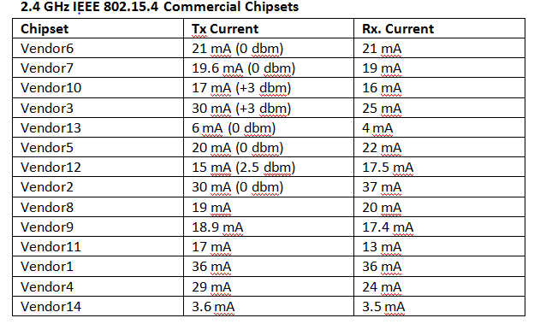
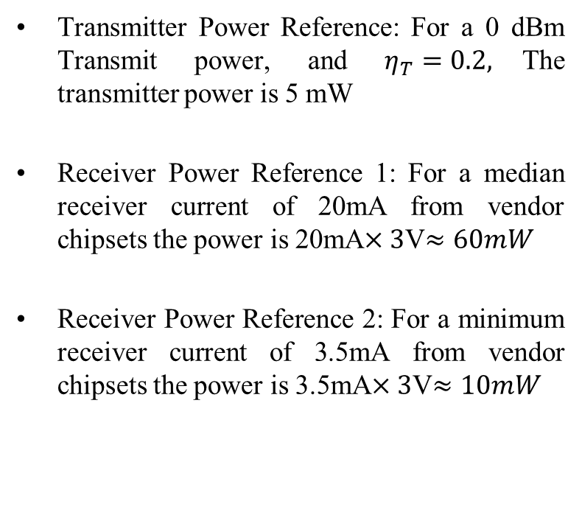
Reference Powers for Transmitter and Receiver Circuits
Transmitter Power Reference: For a 0 dBm Transmit power, and $η_{T}=0.2,$The transmitter power is 5 mW
Receiver Power Reference 1: For a median receiver current of 20mA from vendor chipsets the power is 20mA$×3$V$≈60mW$
Receiver Power Reference 2: For a minimum receiver current of 3.5mA from vendor chipsets the power is 3.5mA$×3$V$≈10mW$
Ref [4]: IEEE902.15-12-0383-0000-4q “A Limitation of Coin Cell Batteries” Shahriar Emami

Slide 9
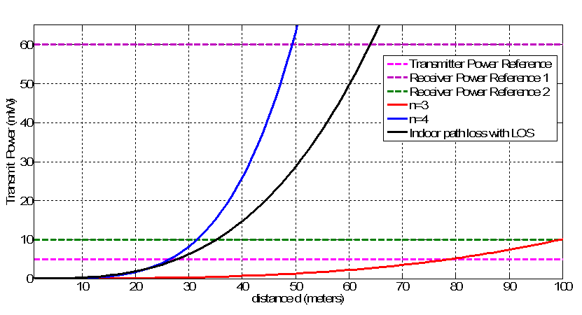
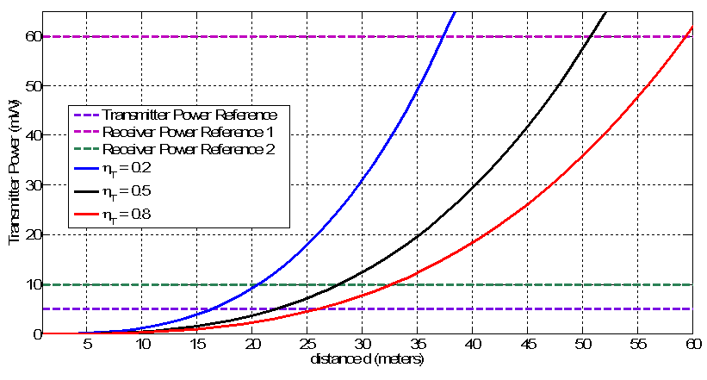
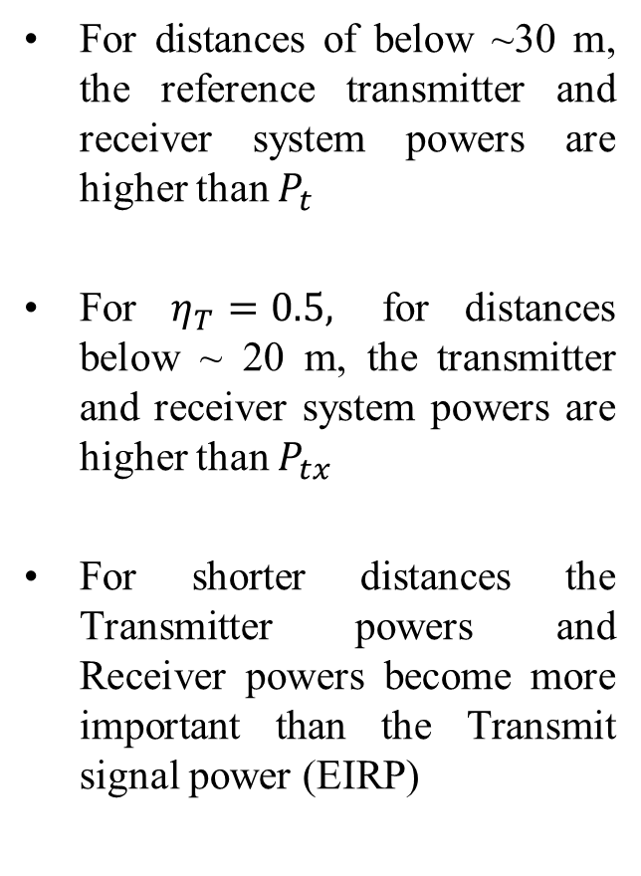

Results
For distances of below ~30 m, the reference transmitter and receiver system powers are higher than $P_{t}$
For $η_{T}=0.5,$ for distances below ~ 20 m, the transmitter and receiver system powers are higher than $P_{tx}$
For shorter distances the Transmitter powers and Receiver powers become more important than the Transmit signal power (EIRP)
Transmit Power Required $P_{t}$ for various distances in Indoor LOS,
and with Free space path loss model with n=3 and n=4
Corresp Transmitter Power $P_{tx}$ for various distances in Indoor LOS

Slide 10
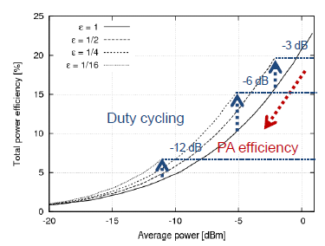

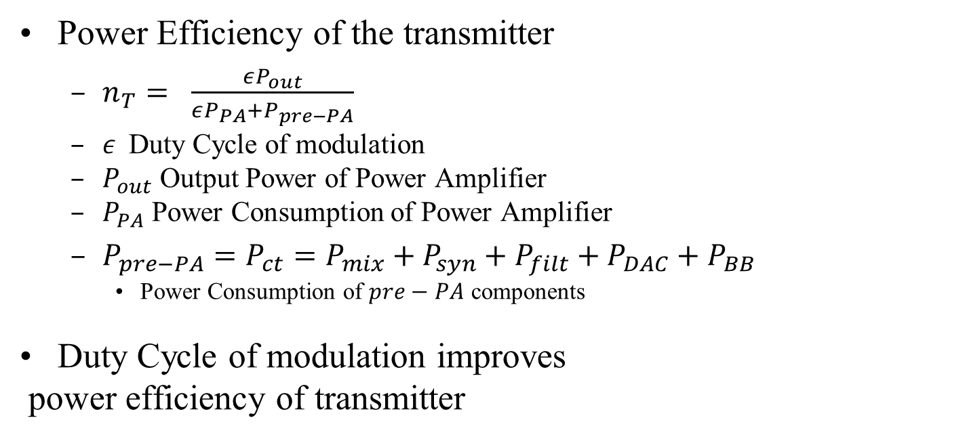

Impact of Modulation on PA
Power Efficiency of the transmitter
  $n_{T}= \frac{εP_{out}}{εP_{PA}+P_{pre−PA}}$
  $ε$Duty Cycle of modulation
  $P_{out}$ Output Power of Power Amplifier
  $P_{PA}$ Power Consumption of Power Amplifier
  $P_{pre−PA}=P_{ct}=P_{mix}+P_{syn}+P_{filt}+P_{DAC}+P_{BB}$
    Power Consumption of $pre−PA$ components
Duty Cycle of modulation improves
power efficiency of transmitter
$$P_{out}$$
$${εP}_{out}$$
On
Off
Off
On
Duty Cycle

Slide 11
Impact of Modulation on PA
Duty cycled transmissions like OOK and PPM will have greater net efficiency
  50% lesser “on-time” than continuous modulations like FSK
  Non-constant envelope
  Class AB type, Class C if Link Margin is Good
FSK/O-QPSK are constant envelope modulations
  Less stringent requirements on power amplifier linearity
  Class C PA may be used
  No duty cycling advantage
Scheme that reduces the overall power for the target application under the underlying trade-off
  Duty Cycling and Constant Envelope Modulations

Slide 12
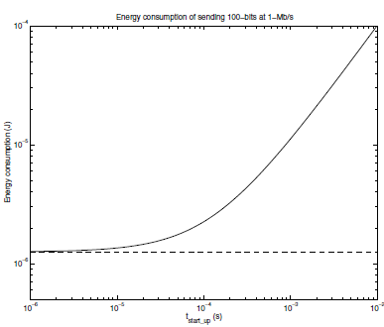
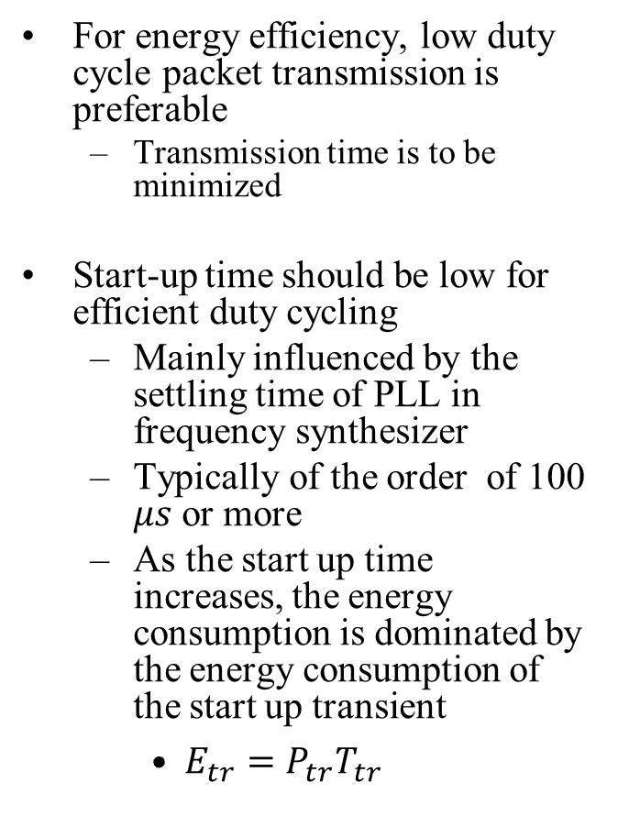
Start-Up Time
For energy efficiency, low duty cycle packet transmission is preferable
  Transmission time is to be minimized
Start-up time should be low for efficient duty cycling
  Mainly influenced by the settling time of PLL in frequency synthesizer
  Typically of the order of 100 $μs$ or more
  As the start up time increases, the energy consumption is dominated by the energy consumption of the start up transient
    $E_{tr}=P_{tr}T_{tr}$
Effect of Start-Up Transient
Ref: [5]

Slide 13
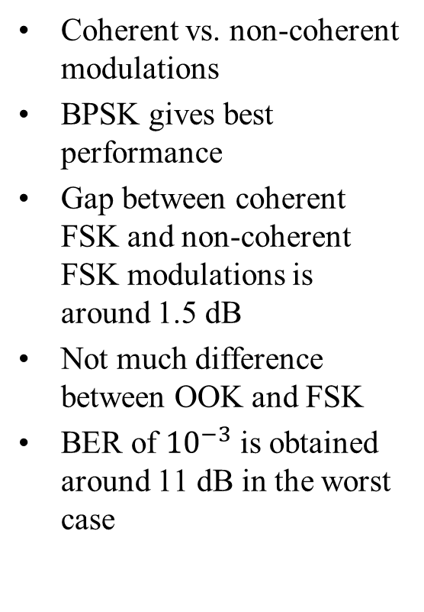
BER Performance of Modulation Schemes
Coherent vs. non-coherent modulations
BPSK gives best performance
Gap between coherent FSK and non-coherent FSK modulations is around 1.5 dB
Not much difference between OOK and FSK
BER of ${10}^{−3}$ is obtained around 11 dB in the worst case

Slide 14
Applications with Low Rx Power Requirement
  Master nodes are becoming energy constrained
    Smartphones acting as master nodes of the WSN
    Body Area Networks / Wearable Computing Devices
  Collaborating sensor nodes
    Multi-hop networks
    Information exchange among neighboring sensor nodes
  Sensors in some applications need continuous sensing
  Power Consumed by the Receiver is also important

Slide 15

Energy Constrained Master Nodes
  Smart Phones
    Acts as a master for variety of short range applications
  Health and Wellness Applications
    Access to the Healthcare network through the smartphone
EEG
ECG
Cellular
Network
WLAN
Healthcare
Network
EMG
Smartphones
Or PDA
Other

Slide 16
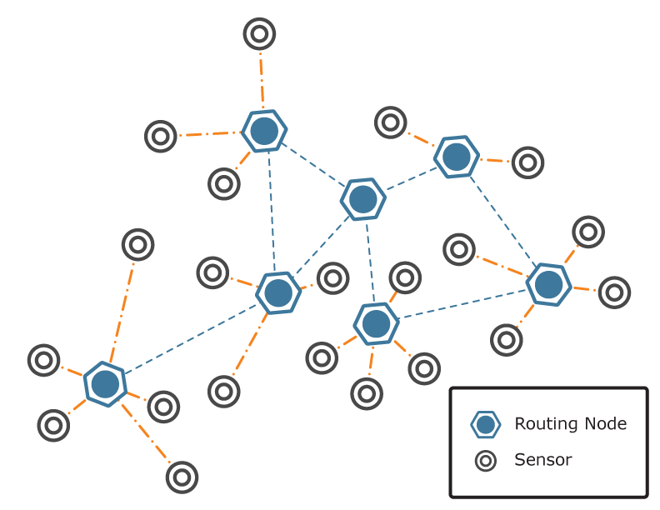
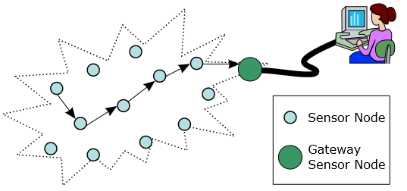
  Collaborating sensor nodes
    Multi-hop networks
      Receive data and forward to neighboring nodes
    Information exchange among neighboring sensor nodes

Slide 17
Receive Power of ICs
 | RFM TR1000 | Chipcon CC1000 | Chipcon CC2420
Modulation | OOK/ASK | FSK | DSSS-OQPSK
Data Rate (Kbps) | 115.2 | 76.8 | 250
Rx. Power (mA) | 3.8 | 9.6 | 19.7
Turn-on time (ms) | 0.02 | 2 | 0.58
Receive Powers for OOK/PPM are lesser than FSK and other systems
The turn on time for OOK is significantly lesser than FSK
  Requirements on the frequency synthesizers are less stringent

Slide 18
Summary
Discussed significance of the Transmit Power/ Receive Power in view of
  Short distances
  Applications
  Comparable Eb/No figures for different modulations
We request the proposers to include the following in the proposal
  Transmitter complexity
  Transmitter Power Efficiency as a function of EIRP
  Receiver Complexity
  Receiver Power consumption

Slide 19
References
Shuguang Cui; Goldsmith, A.J.; Bahai, A., "Energy-constrained modulation optimization," Wireless Communications, IEEE Transactions on , vol.4, no.5, pp.2349,2360, Sept. 2005
Rosas, F.; Oberli, C., "Modulation and SNR Optimization for Achieving Energy-Efficient Communications over Short-Range Fading Channels," Wireless Communications, IEEE Transactions on , vol.11, no.12, pp.4286,4295, December 2012
J.P. Nair, K. Bynam, Youngsoo Kim, “Channel Models for IEEE 802.15.4q,” IEEE P802.15 Working Group for Wireless Personal Area Networks (WPANs), May 2013
S. Emami, “A limitation of coin cell batteries,” ,” IEEE P802.15 Working Group for Wireless Personal Area Networks (WPANs), July 2012
Wan A, Sodini C, Chandrakasan, “Energy efficient modulation and MAC for asymmetric RF microsensor systems,” Proceeding ISLPED '01 Proceedings of the 2001 international symposium on Low power electronics and design, pp. 106-111, 2001
T. Wang, W. Heinzelman, A. Seyedi, “Link energy minimization for wireless networks,” Elsevier Adhoc Networks Journal, pp. 569-585, vol. 10, Oct. 2012
Chandrakasan, A.; Amirtharajah, R.; SeongHwan Cho; Goodman, J.; Konduri, G.; Kulik, J.; Rabiner, W.; Wang, A., "Design considerations for distributed microsensor systems," Custom Integrated Circuits, Proceedings of the IEEE , vol., no., pp.279,286, 1999
Chunhui (Allan) Zhu , Betty Zhao, Hou-Cheng Tang “Applications of ULP Wireless Sensors” IEEE P802.15 Working Group for Wireless Personal Area Networks (WPANs), May 2012
Polastre, J.; Szewczyk, R.; Culler, D., "Telos: enabling ultra-low power wireless research," Information Processing in Sensor Networks, 2005. IPSN 2005. Fourth International Symposium on , vol., no., pp.364,369, 15 April 2005
M. Holland, T. Wang, A. Seyedi, W. heinzelman, “Optimizing physical layer parameters for wireless sensor networks , ” ACM Transactions on Sensor Networks, vol. 4, no. 7, Feb. 2011

